Slide 1
Avoiding Road Traffic Congestion using Incremental Traffic Assignment Approach.
24th September, 2017

Slide 2

Guided By: Mrs. Deepti Nirwal.
Submitted By: Adil Hussain, Ajay Rajpurohit, Mohammad Moheed Inamdar.

Slide 3
Overview
The Focus
is on how to achieve optimal Road Traffic Management using decentralized/independent controllers.
The Idea
is to use incremental changes to propagate modifications in dynamic traffic conditions.

Slide 4
Problem Statement

Slide 5
Provide a Decentralized Solution to Road Traffic Congestion Problems.

Slide 6
Literature Review
2

Slide 7
Sr. No. | Title | Author | Year and Journal | Purpose | Remarks
1 | An Integrated and Scalable Platform for Proactive Event-Driven Traffic Management. | Alain Kibangou, et. al. | Arxiv.org, 8th March 2017. | Example of Congestion Control System.
2 | Self-Organizing Traffic Lights. | Carlos Gershenso. | Arxiv.org, 5th Feb 2008. | Example of Decentralized Traffic Control System.
3 | A dynamic traffic assignment model for highly congested urban networks. | Moshe E. Ben-Akiva, et. al. | Elsevier, 6th Feb 2012. | Example of Incremental Traffic Assignment.
Table 1: Literature Review

Slide 8
Architectural Diagram
3

Slide 9
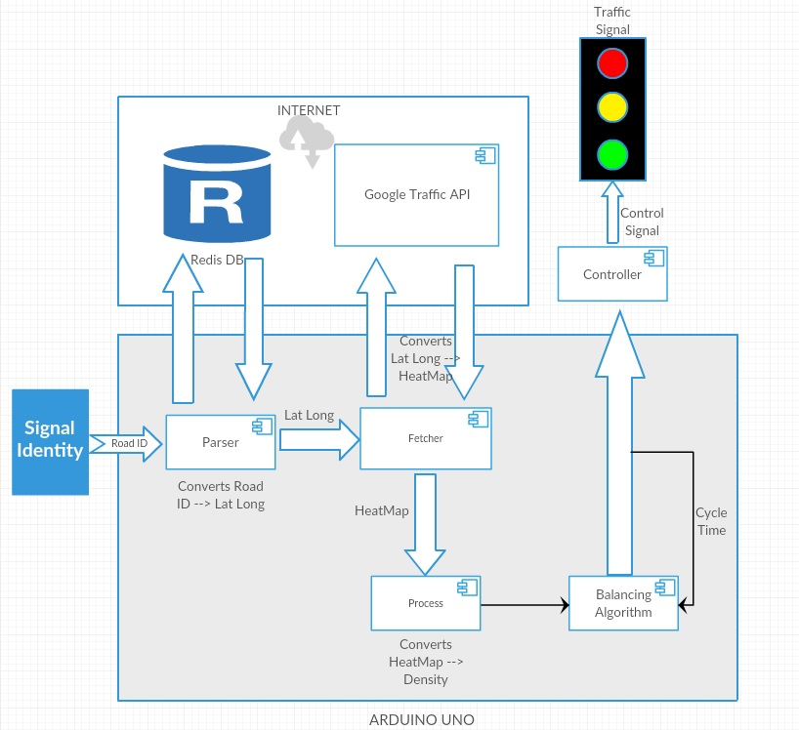
THIS IS A SLIDE TITLE
Fig 1: Architectural Block Diagram

Slide 10
Data Sets
Size
Format
Attributes
Big Data: Velocity
HeatMaps
Weighted averages

Slide 11
Results

Slide 12
References
[1] Alain Kibangou, et. al., “An Integrated and Scalable Platform for Proactive Event-Driven Traffic Management,” Arxiv.org, 8th March 2017.
[2] Carlos Gershenso, “Self-Organizing Traffic Lights,” Arxiv.org, 5th Feb 2008.
[3] Moshe E. Ben-Akiva, et. al., “A dynamic traffic assignment model for highly congested urban networks,” Elsevier, 6th Feb 2012.
[4] Pu Wang, et. al., “Understanding Road Usage Patterns in Urban Area,” SCIENTIFIC REPORTS, vol 2, no. 1001, 20 December 2012.
[5] Nasrin Taherkhani and Samuel Pierre, “Centralized and Localized Data Congestion Control Strategy for Vehicular Ad Hoc Networks Using a Machine Learning Clustering Algorithm,” IEEE TRANSACTIONS ON INTELLIGENT TRANSPORTATION SYSTEMS, March 20, 2016.

