Slide 1


Metaverse Financial Risk Assessment

Slide 2
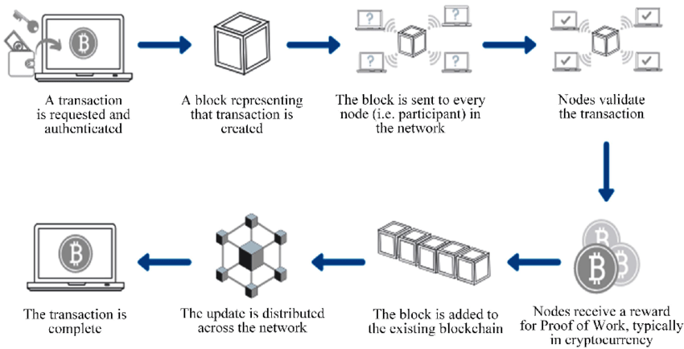
Blockchain: The Foundation
Users send transactions, specifying recipient, amount, and details.
Nodes verify transaction authenticity and compliance with network rules.
Valid transactions are bundled into blocks by miners.
Miners solve puzzles to append blocks to the blockchain.
Network achieves consensus on block validity.
Valid blocks are added to the blockchain ledger.
Transactions become immutable within the distributed ledger system.

Slide 3
Dataset Overview
This dataset provides blockchain financial transactions within the Open Metaverse, aiming to provide a rich, diverse, and realistic set of data for developing and testing anomaly detection models, fraud analysis, and predictive analytics in virtual environments. With a focus on applicability, this dataset captures various transaction types, user behaviors, and risk profiles across a global network.
Transactions were extracted using a sophisticated model that incorporates distributions, behavioral patterns, and risk assessments. The model ensures a diverse representation of activities, from typical transactions to potential fraudulent activities, across different user groups and global regions.
Acknowledgments: This dataset is shared by the Open Metaverse, a collaborative initiative dedicated to the advancement and democratization of virtual worlds. For more information, visit https://www.openmv.org/.
Reference : Simone Casale-Brunet, Marco Mattavelli, Leonardo Chiariglione | Exploring blockchain-based metaverses: Data collection and valuation of virtual lands using machine learning techniques,
Digital Business | Volume 3, Issue 2 | 2023 |100068 | ISSN 2666-9544 |
https://doi.org/10.1016/j.digbus.2023.100068

Slide 4
Dataset Overview
Timestamp: Date and time of the transaction.
Hour of Day: Hour part of the transaction timestamp.
Sending Address: Blockchain address of the sender.
Receiving Address: Blockchain address of the receiver.
Amount: Transaction amount in a simulated currency.
Transaction Type: Categorization of the transaction (e.g., transfer, sale, scam, phishing).
Location Region: Simulated geographical region of the transaction.
IP Prefix: Simulated IP address prefix for the transaction.
Login Frequency: Frequency of login sessions by the user, varying by age group.
Session Duration: Duration of activity sessions in minutes.
Purchase Pattern: Behavioral pattern of purchases (e.g., focused, random, high-value).
Age Group: Categorization of users into new, established, and veteran.
Risk Score: A calculated risk score based on transaction characteristics and user behavior.
Anomaly: Risk level assessment (e.g., high_risk, moderate_risk, low_risk).

Slide 5
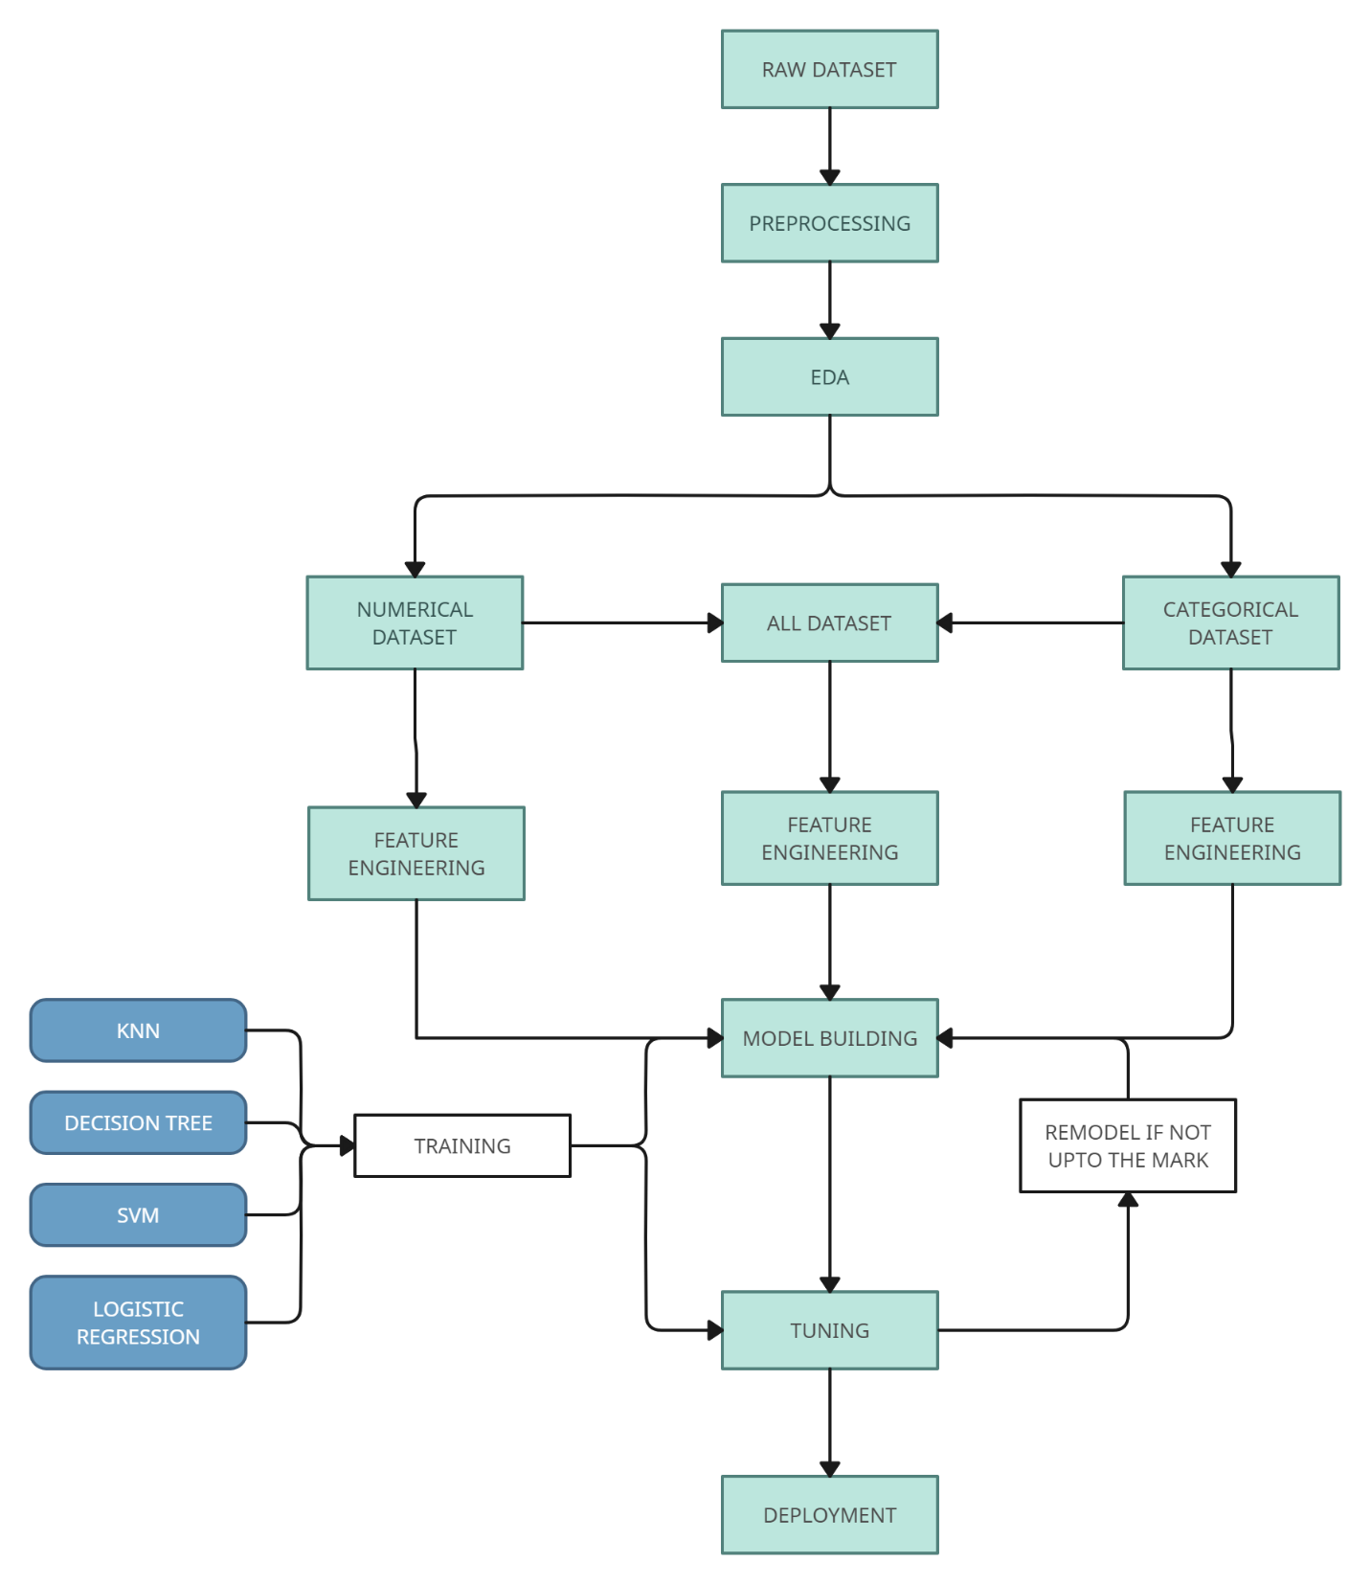
Working Methods

Slide 6
Data Cleaning
Identified columns with low variability as potential categorical variables.
Examined missing values and devised strategies for handling them.
Converted 'timestamp' column to DateTime format for temporal analysis.
Checked for duplicate rows within the dataset to ensure data integrity.
Assessed the number of unique values in each column to gauge data variability.
Conducted preliminary examination of the dataset by displaying the first few rows.
Determined the dataset's dimensions to comprehend the extent of the available data.
Ensured data reliability by scrutinizing potential categorical variables for inconsistencies or data quality issues.

Slide 7
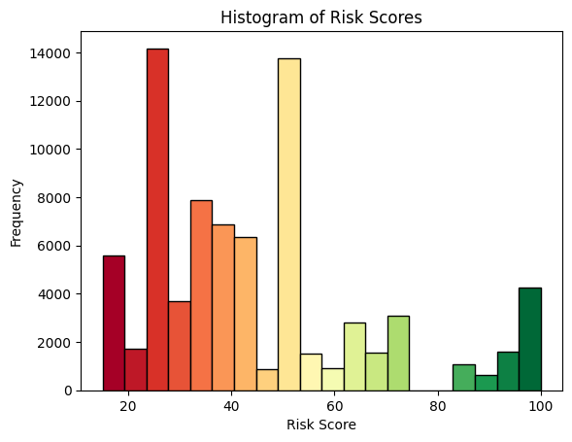
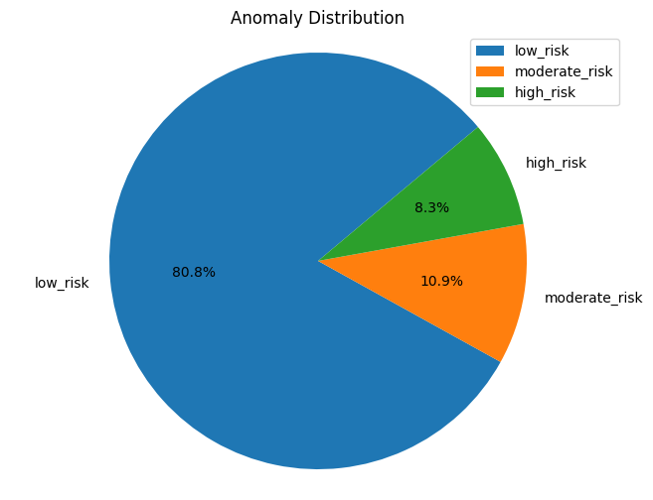
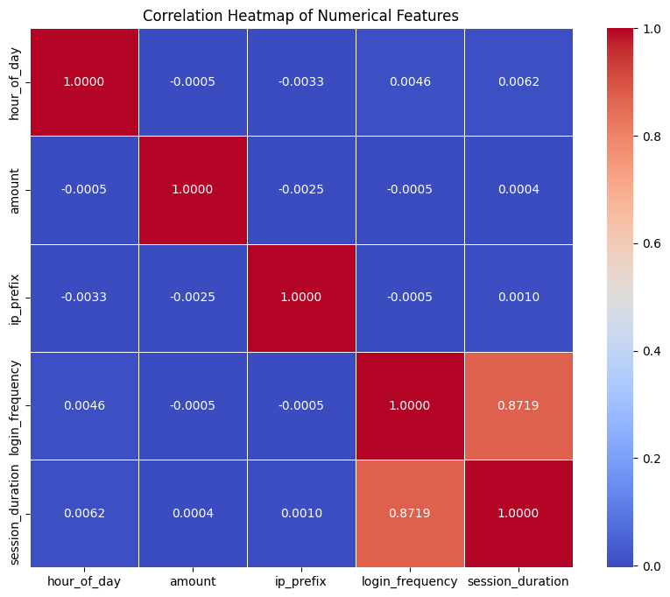
Exploratory Data Analysis

Slide 8
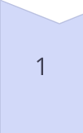
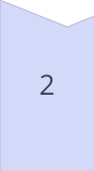
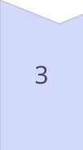


Feature Engineering
Data Preprocessing
The initial stage involves data cleaning, handling missing values, and converting data types to ensure consistency and compatibility with machine learning algorithms.
Categorical Encoding
Categorical features, such as transaction types and user age groups, are encoded using techniques like one-hot encoding, enabling their integration into numerical models.
Numerical Scaling
Numerical features, including transaction amounts and session durations, undergo scaling processes like standardization or normalization to ensure consistent feature ranges and improve model convergence.
Feature Selection
Relevant features are identified and selected based on their potential impact on risk assessment, leveraging techniques like correlation analysis, recursive feature elimination, and domain expertise.
Feature Combination
Engineered features are combined with existing features to create a comprehensive feature matrix, capturing diverse aspects of the data and enhancing the model's predictive capabilities.

Slide 9




Classification Algorithms
Decision Trees
Logistic Regression
Support Vector Machines
K-Nearest Neighbors
Decision tree algorithms recursively partition the data based on feature values, creating a tree-like model that can effectively classify transactions into risk categories.
Logistic regression models estimate the probability of a transaction belonging to a specific risk class, enabling accurate classification and risk assessment.
SVM algorithms construct hyperplanes in high-dimensional spaces, effectively separating transactions into distinct risk classes while maximizing the margin between classes.
KNN classifiers assign risk levels based on the majority class of the nearest neighboring transactions, leveraging similarity measures to identify potential risks.

Slide 10
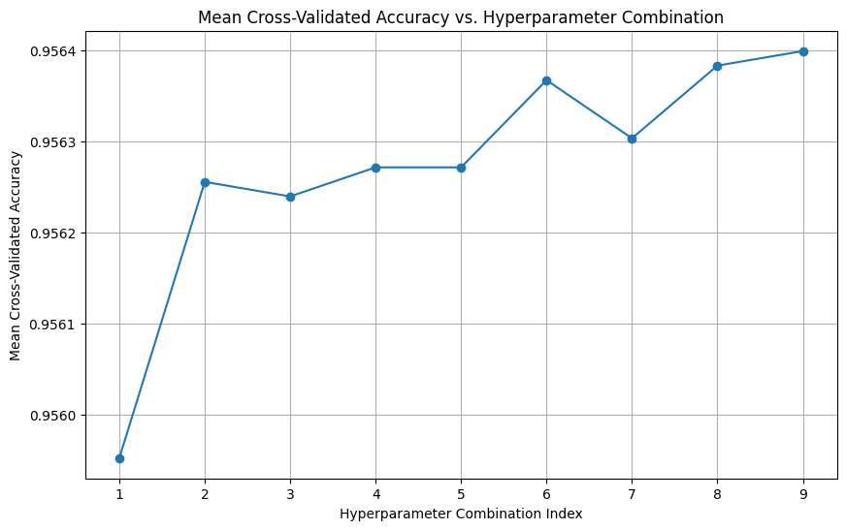
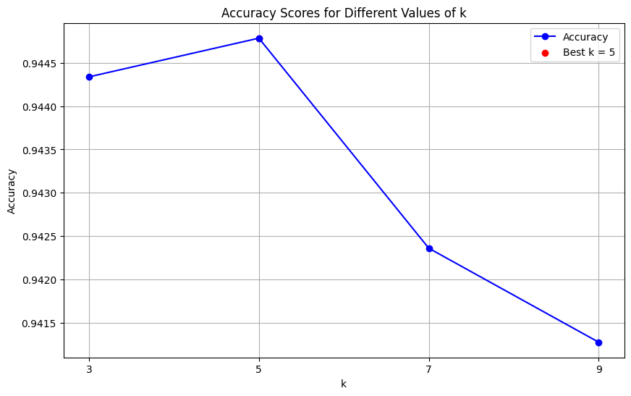
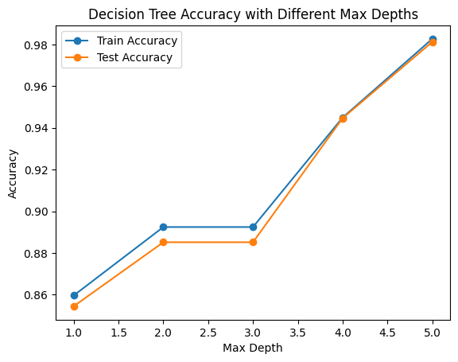
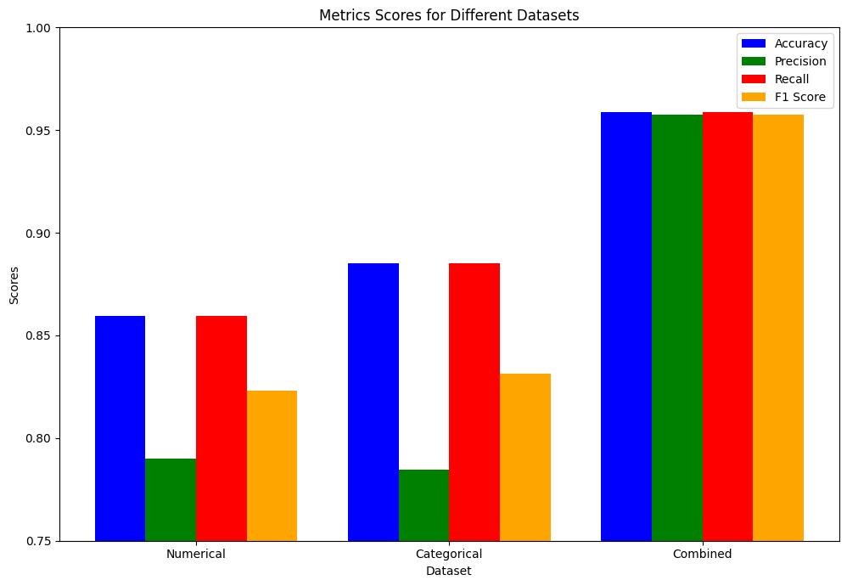

Slide 11
Model Evaluation and Optimization
Model
Accuracy
Precision
Recall
F1-Score
Logistic Regression
95.37%
95.25%
95.37%
95.29%
K-Nearest Neighbors
94.48%
94.45%
94.48%
94.46%
Decision Tree
94.47%
94.19%
94.47%
94.33%
Support Vector Machines
95.87%
95.73%
95.87%
95.77%
Rigorous model evaluation is conducted using various metrics, including accuracy, precision, recall, and F1-score, to assess the performance of each classification algorithm. Techniques such as cross-validation and hyperparameter tuning are employed to optimize model performance and mitigate overfitting. Ensemble methods, which combine multiple models, may also be explored to leverage the strengths of different algorithms and enhance overall predictive power.

Slide 12
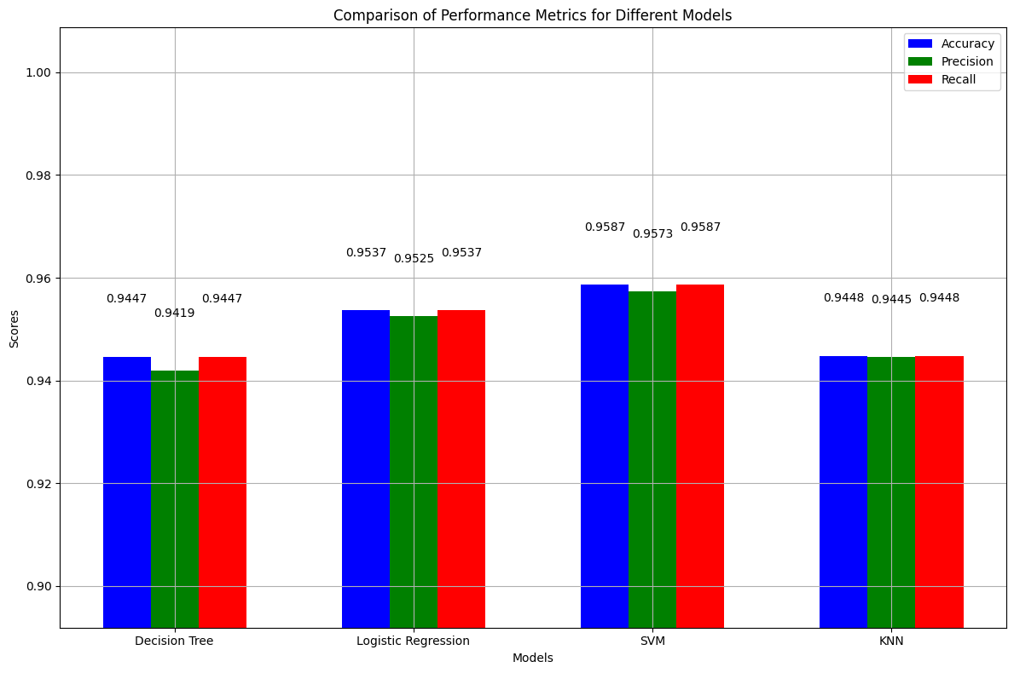
Conclusion
In summary, while all models showcased commendable performances, SVM emerged as the most suitable choice for this classification task within the Open Metaverse dataset. Its high accuracy, precision, and recall scores highlight its effectiveness in accurately categorizing financial transactions and assessing associated risk levels. These findings underscore the importance of leveraging machine learning techniques to enhance fraud detection, risk assessment, and security management within virtual ecosystems, ultimately fostering a safer and more trustworthy financial landscape within the Open Metaverse.

