Slide 1
SQL Learning Assistant
Transforming Natural Language into Optimized SQL
Using RAG and LLMs
Project Overview & Architecture

Slide 2
Problem Statement & Solution
The Challenge: SQL is difficult for beginners due to complex syntax, lack of feedback, and translation difficulties.
Current Limitations: Existing tools (ChatGPT, StackOverflow) often lack domain-specific context or interactive explanations.
The Solution: An intelligent chatbot combining four core techniques:
1. Retrieval-Augmented Generation (RAG) for similar examples.
2. Fine-Tuned LLM (TinyLlama) for domain generation.
3. Prompt Engineering for context management.
4. Gemini Enhancement for explanations.

Slide 3
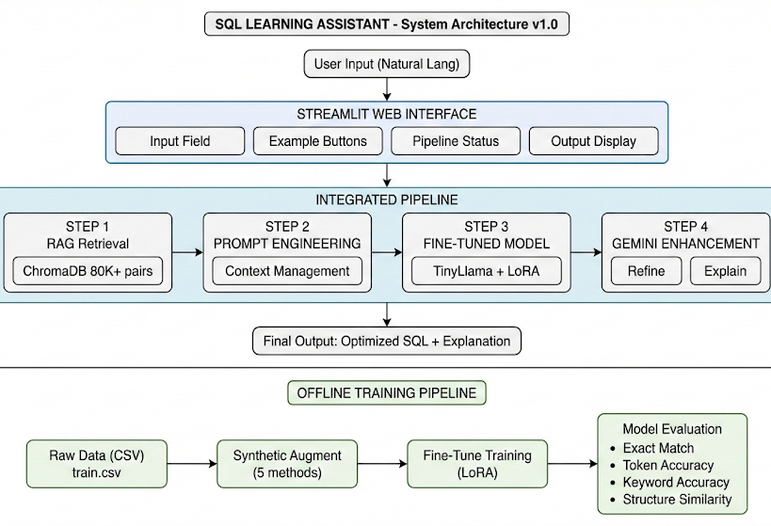

Slide 4
Integrated Pipeline Flow
The system processes queries in four sequential steps:
Step 1: RAG Retrieval - Fetches top 3-5 similar SQL pairs from ChromaDB (80k+ records).
Step 2: Prompt Engineering - Analyzes intent and handles edge cases.
Step 3: Fine-Tuned Inference - TinyLlama + LoRA generates the initial SQL.
Step 4: Gemini Enhancement - Refines syntax and generates a natural language explanation.
(Refer to System Architecture Diagram in Documentation Section 2.1)

Slide 5
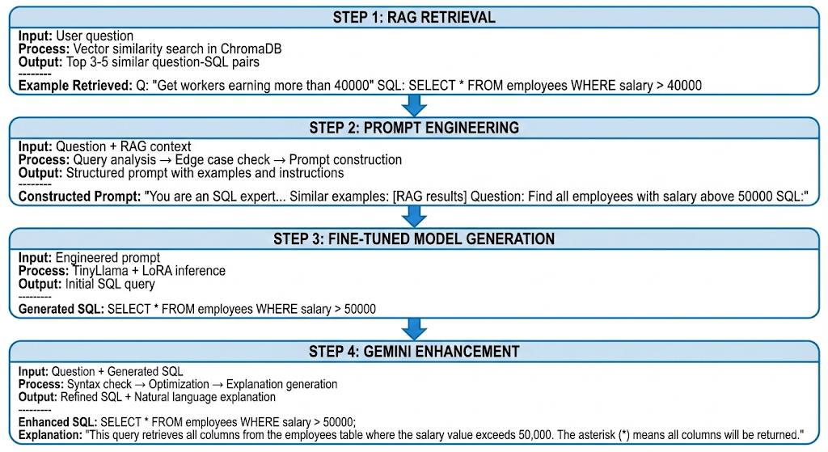

Slide 6
Technology Stack
Frontend: Streamlit (Interactive Web Interface).
Base Model: TinyLlama-1.1B-Chat (Optimized with LoRA).
Vector Database: ChromaDB with 'all-MiniLM-L6-v2' embeddings.
Enhancement: Google Gemini 2.5-flash API.
RAG Strategy: 4 chunking methods (Clause, Complexity, Keyword, Size).

Slide 7
Data Augmentation & Training
Training Pipeline: Offline pipeline for synthetic augmentation and fine-tuning.
Synthetic Augmentation: Applied 5 methods (Synonym, Insertion, Swap, Structure, Case).
Dataset Expansion: Increased data by 2.72x (52k to 142k samples).
Diversity: Maintained an average diversity score of 0.283 to ensure variation.

Slide 8
Performance Evaluation
Metrics assessed on held-out test set:
• Keyword Accuracy: 91.33% (Correctly identifies SQL operations).
• Structure Similarity: 91.07% (High alignment with expected query structure).
• Token Accuracy: 47.21% (Reflects variations in column naming).
• Exact Match: 0.00% (Expected for small models due to strict string matching).

Slide 9
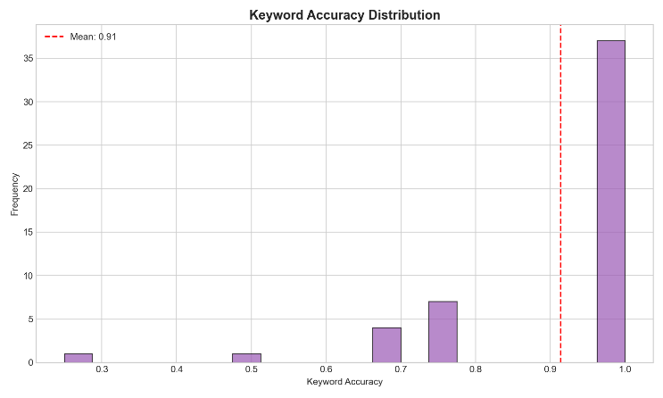
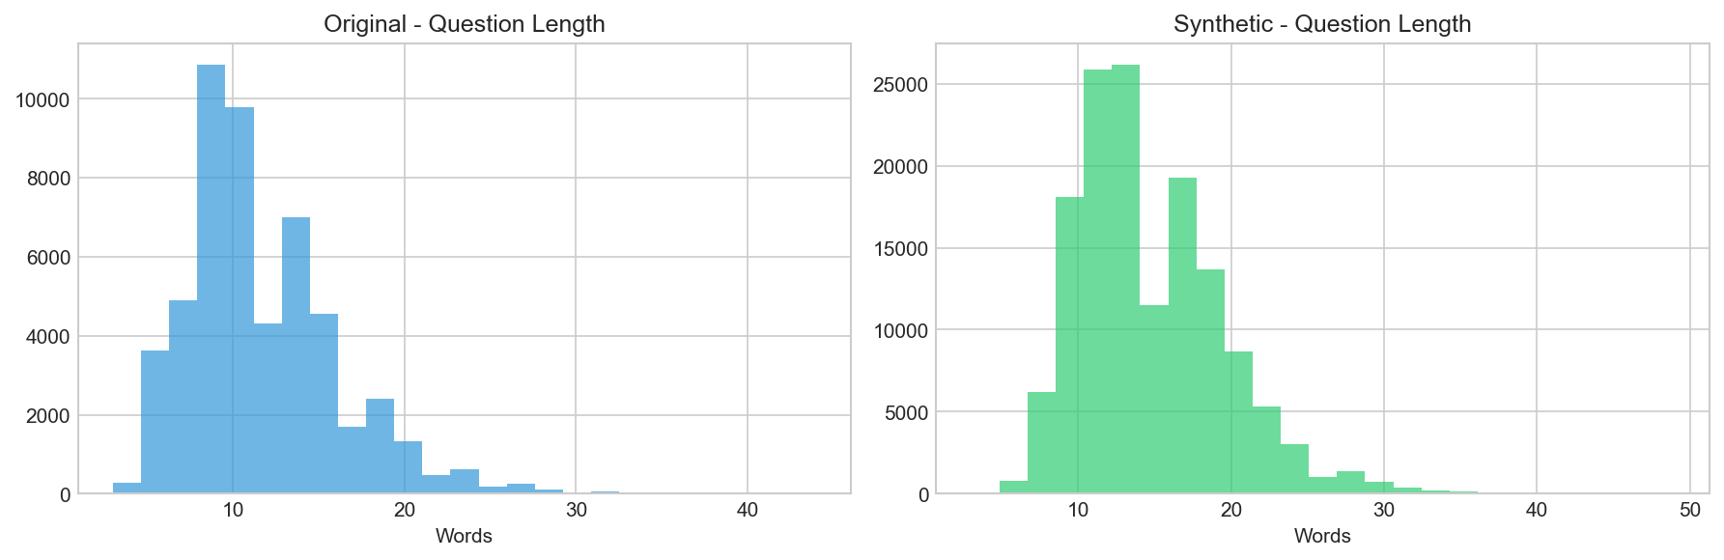
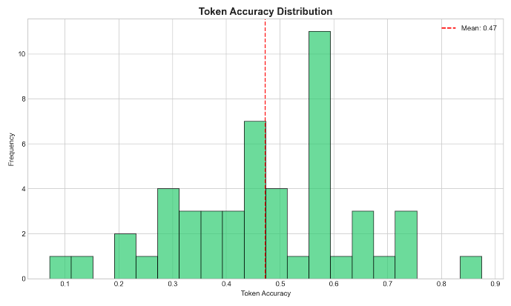
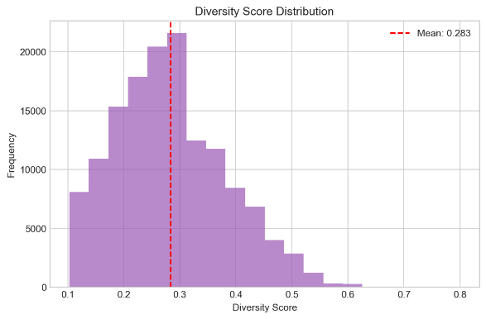
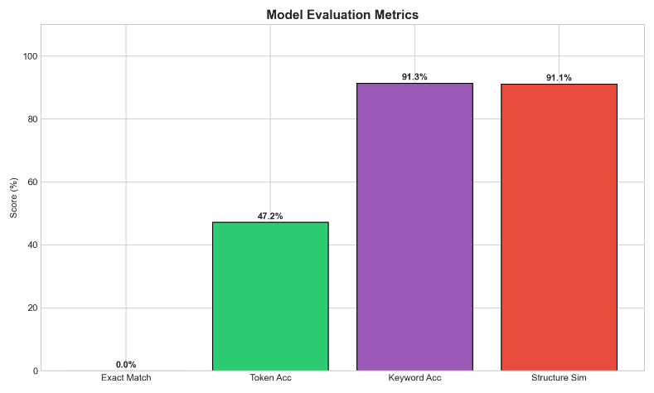

Slide 10
Future Improvements & Ethics
Privacy: Sensitive data (Email, Phone, SSN) is anonymized during training.
Safety: Edge case detection prevents dangerous operations (DROP, TRUNCATE).
Future Improvements:
• Support for specific SQL dialects (PostgreSQL, MySQL).
• Integration of a visual query builder.
• Direct database connection for execution.

Slide 11
Live Demo and Code
Resource | URL
Web Application | https://huggingface.co/spaces/moheesh/sql-learning-assistant
Project Page | https://moheesh.github.io/Prompt_to_SQL_using_RAG_LLM
GitHub Repository | https://github.com/moheesh/Prompt_to_SQL_using_RAG_LLM

