Slide 1
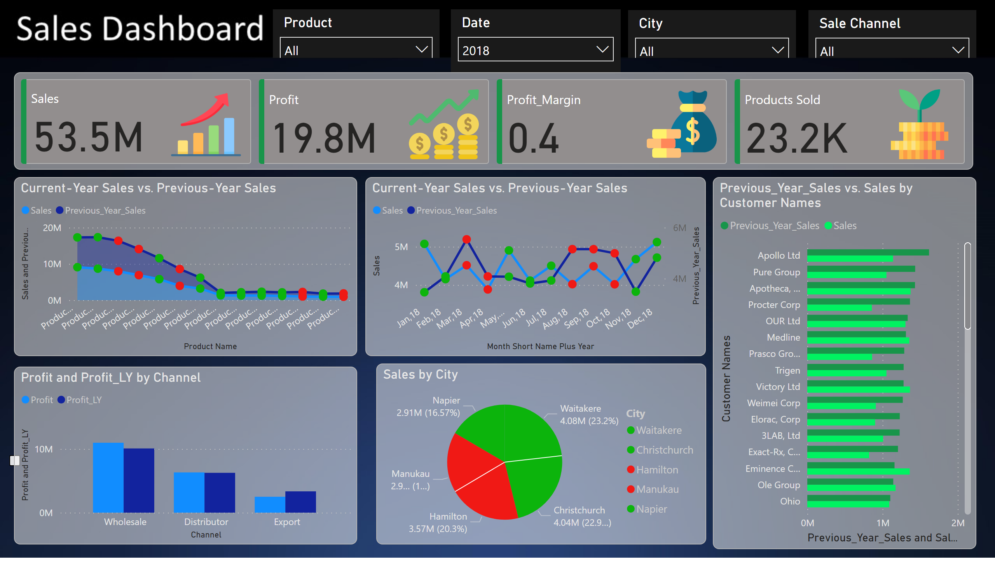
Sales Dashborad
Notes:
slicer
No alt text provided
slicer
No alt text provided
slicer
No alt text provided
slicer
No alt text provided
pivotTable
No alt text provided
Current-Year Sales vs. Previous-Year Sales
No alt text provided
Current-Year Sales vs. Previous-Year Sales
No alt text provided
pieChart
No alt text provided
clusteredColumnChart
No alt text provided
Previous_Year_Sales vs. Sales by Customer Names
No alt text provided
cardVisual
No alt text provided

