Slide 1
Transparent, Scrutable and Explainable User Models for Personalized Recommendation (PR) - Krisztian Balog, Filip Radlinski and Shushan Arakelyan
A Paper Breakdown
By Mohinish Chatterjee
UIN : 329006958

Slide 2
Motivation
All PR models combine explicit and implicit user feedbacks into complex user models.
The problem? Limited scrutability and transparency.
Example: What if my interests change? How long does the model take to learn my new interests? Can models explain my interests?
Bottom-line: Humans preferences are complex and not easy to model.

Slide 3



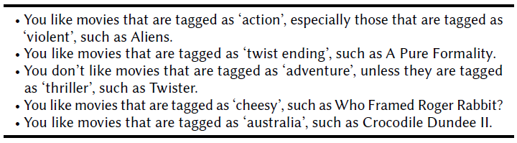
Motivation (Contd.)
What does this paper suggest we do?
Why not allow users to see what model thinks of their interest. Allow them to make minor improvements if they like ☺
Bottom-line: Learn user interests, but let them cross-check!
Something like…

Slide 4


Contribution
In the past, some PR models have tried explaining users why a certain item was recommended.
What’s new then?
Authors suggest instead provide a textual description that summarizes the system’s understanding of the user’s preferences.
You liked “Alien Vs Predator”
We think,
You might also like “Prometheus”
You like movies that are tagged as “Extraterrestrial” especially those tagged as “violent”, such as “Aliens”.

Slide 5
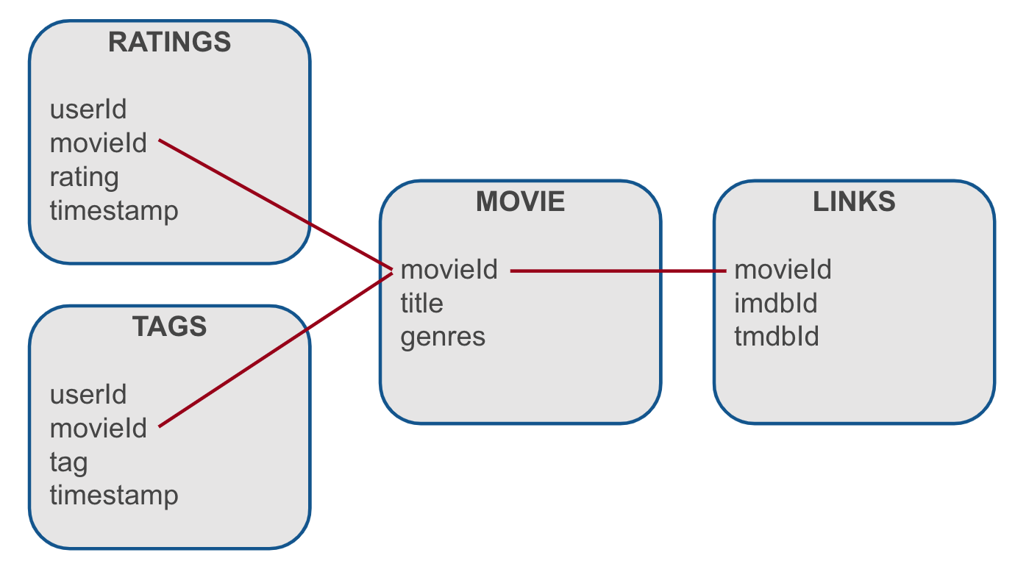
Contribution (Contd.)
Set-based Model:
Idea: Score items by matching the item tags against the tag preferences of the user.
Ex: Each movie can have multiple associated tags. And each user can
prefer a number of tagged movies.
The Movie Lens Dataset.

Slide 6
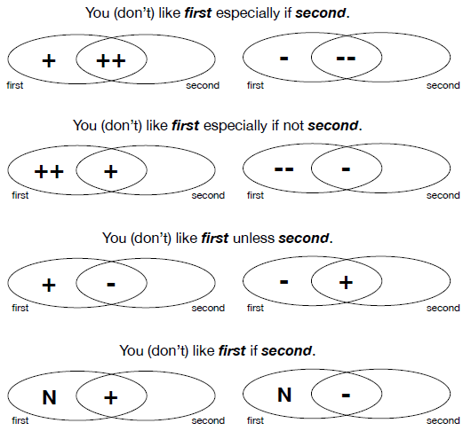
Contribution (Contd.)
Modelling pair-wise Interaction:
Idea: Represent user preferences by interaction between pair of tags.
Ex:- The user does not like science fiction movies, but does like them if they are about space exploration.

Slide 7
Contribution (Contd.)
Prepare Candidate Statements using template.
Calculate utility of each statement by it’s coverage and significance.
Select statements that showcase top-k user preferences.
Presenting/Generating Textual Representations (Most noteworthy part of the paper)
Idea:
Authors show some interesting mathematical modelling to capture coverage and significance of statements ! (P.S.: Complex equations alert)

Slide 8
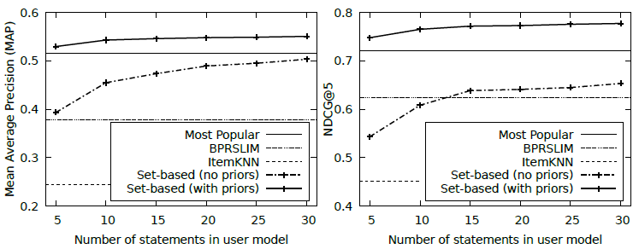
Experimental Findings
Effect of Transparency: Authors study the effect of transparency by varying the length of user summary.
Verdict: As more statements are presented to users, recommendation quality improves. Notice Set-based approach below.

Slide 9
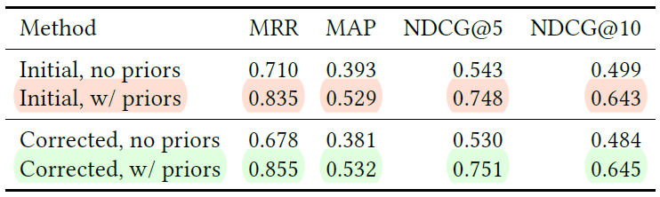
Experimental Findings (Contd.)
Effect of Scrutability: Given, user feedback on generated summary, authors study the impact on recommendations.
Verdict: Only about 34% (with multiple tag statements) and 57%(with single stag statements) of users agree with entire statements.
Bottom-line: Lot of potential for users to improve their inferred user model in tag-based approaches.
(Notice improvement after user scrutiny…)

Slide 10
My Thoughts…
Transparency
Scrutability
Performance
Performs only comparable to traditional collaborative filtering, but allows user interactions to improve recommendation. Not bad.
Loved the idea of presenting model’s understanding to users !
Interesting idea. But it’s just another feedback in addition to ratings. Many might just skip the task, just like they skip rating movies :p

Slide 11



Thoughts… (Contd.)
Limitations:
The Kingsman: Tagged as both “Action” and “Comedy”. However, It’s more of an action film than comedy. Authors assumed equal tag weightage.
Problem: Tag weighted approach is needed !
Number of users who rate movies are only a handful.
Problem: Majority of users, can’t be presented with preference summaries, in absence of their ratings !
(Movie watchers)
(Movie raters)

Slide 12
Thoughts… (Contd.)
Possible next steps:
Problem: Users watch movies, but don’t rate them.
Instead track kind of movies they often watch and come close to finishing it?
Problem: Can’t generalize rigorously. Users want variations too.
Analyze occasional shift in movie preferences to formulate better recommendation?
Problem: What if users skip summary scrutinization?
Look for similar users and see how they scrutinized?

Slide 13

That’s all folks !
Check out the paper here
https://dl.acm.org/doi/10.1145/3331184.3331211
Thanks !

