Slide 1
University of Glasgow Visualising important sensitivity classification features September 2021 until April 2022

Slide 2


User Stories
As Tom,
I want to know a document’s sensitivity,
So that I can quickly label the document.
As Alice,
I want to understand why a classifier made its prediction,
so that I can trust the classifier’s decision.
As Bob,
I want to see multiple predictions on a given document,
so that I can be more confident in the document’s sensitivity.
As Jennifer,
I want to be able to use the website online,
so that I can use it from anywhere in the world.

Slide 3


User Stories
As Tom,
I want to know a document’s sensitivity,
So that I can quickly label the document.
As Alice,
I want to understand why a classifier made its prediction,
so that I can trust the classifier’s decision.
As Bob,
I want to see multiple predictions on a given document,
so that I can be more confident in the document’s sensitivity.
As Jennifer,
I want to be able to use the website online,
so that I can use it from anywhere in the world.

Slide 4
User Stories
As Tom,
I want to know a document’s sensitivity,
so that I can quickly label the document.
As Alice,
I want to understand why a classifier made its prediction,
so that I can trust the classifier’s decision.
As Bob,
I want to see multiple predictions on a given document,
so that I can be more confident in the document’s sensitivity.
As Jennifer,
I want to be able to use the website online,
so that I can use it from anywhere in the world.

Slide 5
User Stories
As Tom,
I want to know a document’s sensitivity,
so that I can quickly label the document.
As Alice,
I want to understand why a classifier made its prediction,
so that I can trust the classifier’s decision.
As Bob,
I want to see multiple predictions on a given document,
so that I can be more confident in the document’s sensitivity.
As Jennifer,
I want to be able to use the website online,
so that I can use it from anywhere in the world.

Slide 6
User Stories
As Tom,
I want to know a document’s sensitivity,
so that I can quickly label the document.
As Alice,
I want to understand why a classifier made its prediction,
so that I can trust the classifier’s decision.
As Bob,
I want to see multiple predictions on a given document,
so that I can be more confident in the document’s sensitivity.
As Jennifer,
I want to be able to use the website online,
so that I can use it from anywhere in the world.

Slide 7
Requirements Gathering
Mo
S
Co
W
Must Have
Should Have
Could Have
Won’t Have
- Classifier predicting document sensitivity
- Explanation for classifier predictions
- User-friendly end to end website
- Multiple classifiers predicting documents
- Multiple explanations for each classifier
- Low latency
- General stats on the collection level
- Receive feedback and reweight term feature importance value
- Deployed website
- Classifier based on the Transformer architecture

Slide 8
Requirements Gathering
Mo
S
Co
W
Must Have
Should Have
Could Have
Won’t Have
- Classifier predicting document sensitivity
- Explanation for classifier predictions
- User-friendly end to end website
- Multiple classifiers predicting documents
- Multiple explanations for each classifier
- Low latency
- General stats on the collection level
- Receive feedback and reweight term feature importance value
- Deployed website
- Classifier based on the Transformer architecture

Slide 9
Requirements Gathering
Mo
S
Co
W
Must Have
Should Have
Could Have
Won’t Have
- Classifier predicting document sensitivity
- Explanation for classifier predictions
- User-friendly end to end website
- Multiple classifiers predicting documents
- Multiple explanations for each classifier
- Low latency
- General stats on the collection level
- Receive feedback and reweight term feature importance value
- Deployed website
- Classifier based on the Transformer architecture

Slide 10
Requirements Gathering
Mo
S
Co
W
Must Have
Should Have
Could Have
Won’t Have
- Classifier predicting document sensitivity
- Explanation for classifier predictions
- User-friendly end to end website
- Multiple classifiers predicting documents
- Multiple explanations for each classifier
- Low latency
- General stats on the collection level
- Receive feedback and reweight term feature importance value
- Deployed website
- Classifier based on the Transformer architecture

Slide 11
Requirements Gathering
Mo
S
Co
W
Must Have
Should Have
Could Have
Won’t Have
- Classifier predicting document sensitivity
- Explanation for classifier predictions
- User-friendly end to end website
- Multiple classifiers predicting documents
- Multiple explanations for each classifier
- Low latency
- General stats on the collection level
- Receive feedback and reweight term feature importance value
- Deployed website
- Classifier based on the Transformer architecture

Slide 12
Design

Slide 13
Live demonstration of the website

Slide 14
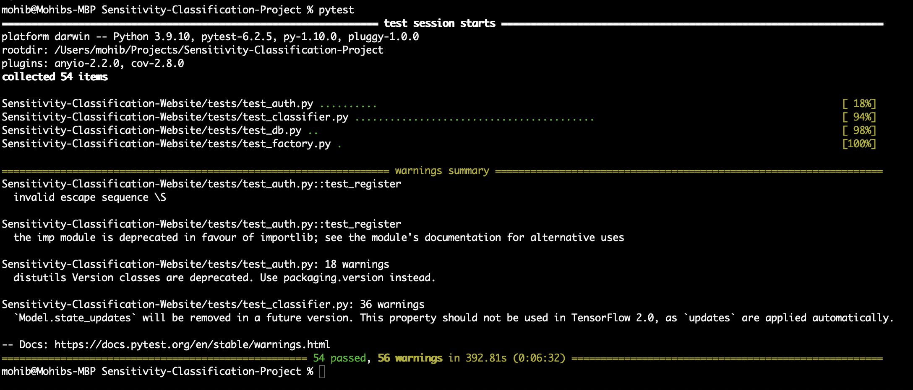
Testing

Slide 15
Results

Slide 16
Results

Slide 17
Results

Slide 18
Thank you for your attention

