Slide 1

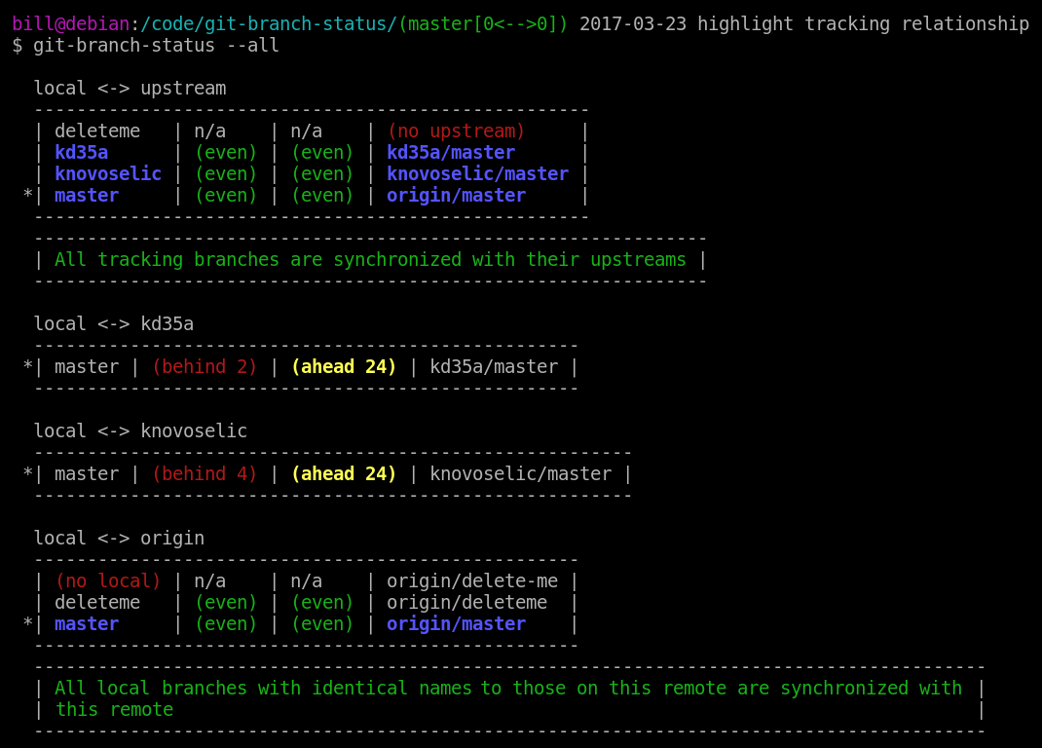

Introduction to version control using git
IMDEA hands-on workshop series

Slide 2
Version Control Systems (VCs)
Tracking changes to our files and folders (Projects)
Maintain a history of the changes (Logs)
Facilitate collaboration

Slide 3
<git>
De facto standard for version control Free and open source

Slide 4
Misconceptions about VCs and git
Only for managing source code
Not useful for individual users
Git and GitHub are the same thing

Slide 5

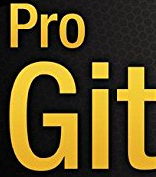

Resources & Credits
Pro Git
git-scm.com/book/en/v2
Missing-Semester
missing.csail.mit.edu
Web Access
Local Access
bit.ly/Imdea
common_folder/Hands-on workshop/git

Slide 6
CONTENTS
/01
Git Vocabulary & Working
/02
Making & Recording Changes
/03
How to view and undo changes
/04
Branching and Merging
/05
Working with Remotes

Slide 7

Lets git going !

Slide 8
What kind of files should I commit?
Do’s
Don'ts
Text files
Source code
Latex source files
Text based CAD files (.DXF)
Datasets
Object Code (binary files)
Passwords
Notebooks (OneNote, Evernote, …)

Slide 9

THANKS!
DO YOU HAVE ANY QUESTIONS?
mohibmustafa@gmail.com
@Mohib_Mustafa

