Slide 1
Population genetics problem set
Practice problems and answer key are posted with lecture. I strongly urge you to try these before you take the quiz.

Slide 2
Evolutionary processes Evolution is understood today in terms of _________

Slide 3
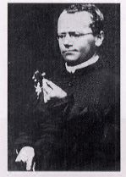
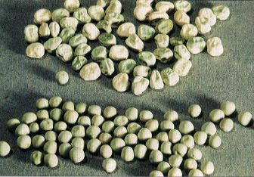
The Founder of Genetics
Round and wrinkled peas
Gregor Mendel

Slide 4
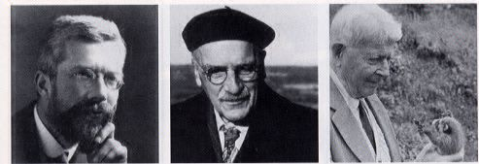
The Founders of Population Genetics
R.A. Fisher
JBS Haldane
S. Wright
The fusion of genetics and Darwinian evolution is referred to as the Modern ____________

Slide 5
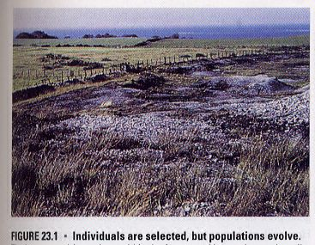
Natural selection acts on individuals, but _____________ evolve.
population = a group of individuals of the same _______________ that occupy the same environment

Slide 6
Individuals have a genotype: Populations have ___________ structure
allele frequency
genotype frequency
all the genes at all the loci in a population is the gene pool.

Slide 7
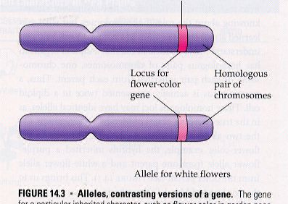
Alleles are different ________
of the same gene.
-diploid individuals have 2
alleles of each gene.
Homozygote = individual with
the same two alleles.
Heterozygote = individual with
two different alleles
-Populations can contain
____________ alleles.

Slide 8
Table 20.1 The ABO blood system.
PHENOTYPE | GENOTYPE
A | AA or AO
B | BB or BO
AB | AB
O | OO
Three alleles in a population (A, B, and O), only 2 per individual organism

Slide 9
Where does variation come from?
Mostly from ______________!
In diploid organisms, by sexual recombination as well

Slide 10
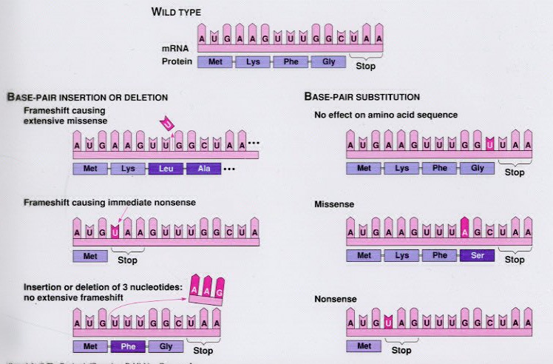
Mutations create new ___________:
1. Point mutations (single nucleotide polymorphisms = SNPs)
Insertions or deletions cause frameshifts. Substitutions cause missense or nonsense
mutations or may have no effect at all. The kind of mutation can have profound effects
on the phenotype.

Slide 11
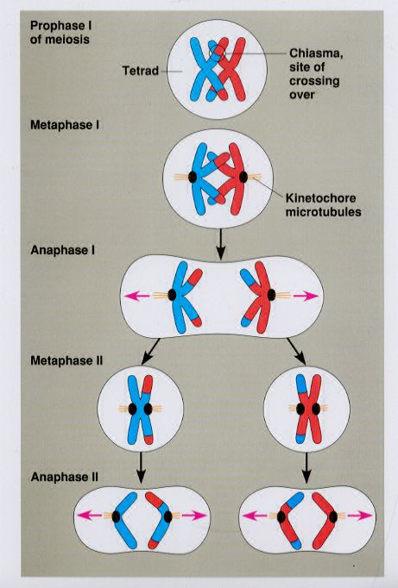
Sexual recombination is a source of
genetic variation.
-new ______________ of alleles
are created.

Slide 12
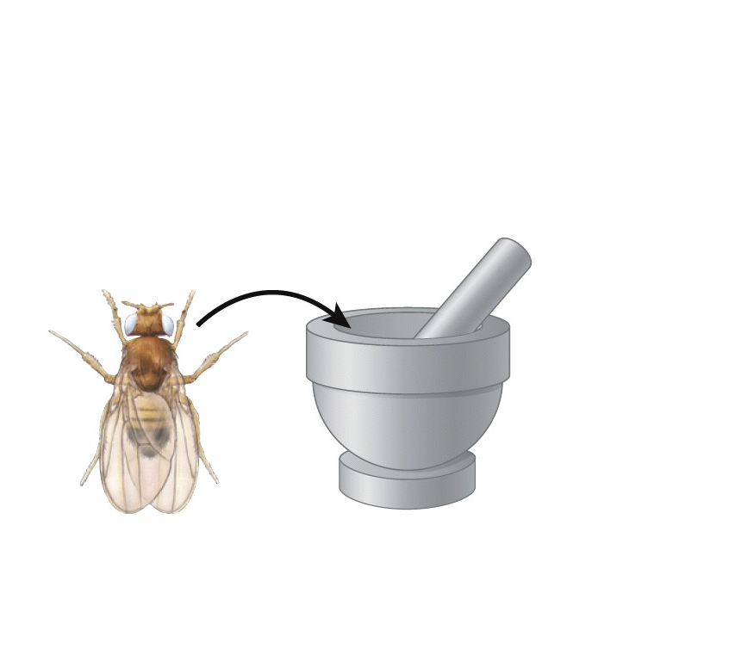
Measuring variation
Test material may include blood samples or ground up samples of organisms.
Drosophila
The body of the fly is ground up.
Can measure traits visually, or biochemically

Slide 13
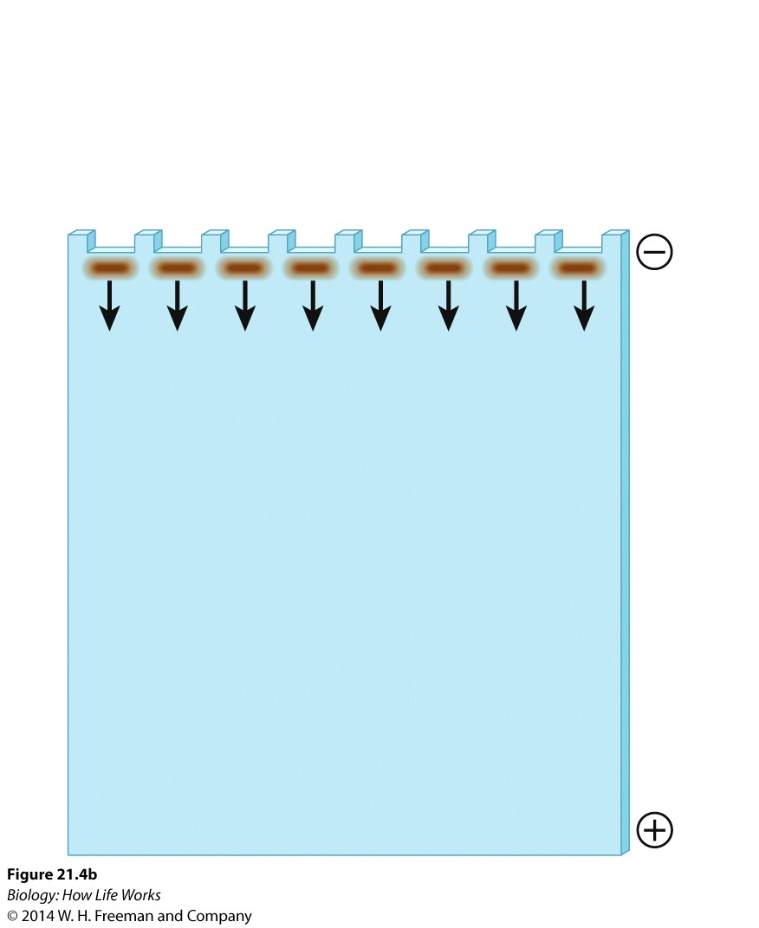
The samples are loaded into separate wells on the gel, and the proteins in each sample migrate toward the positive electrode according to their charge and size.

Slide 14
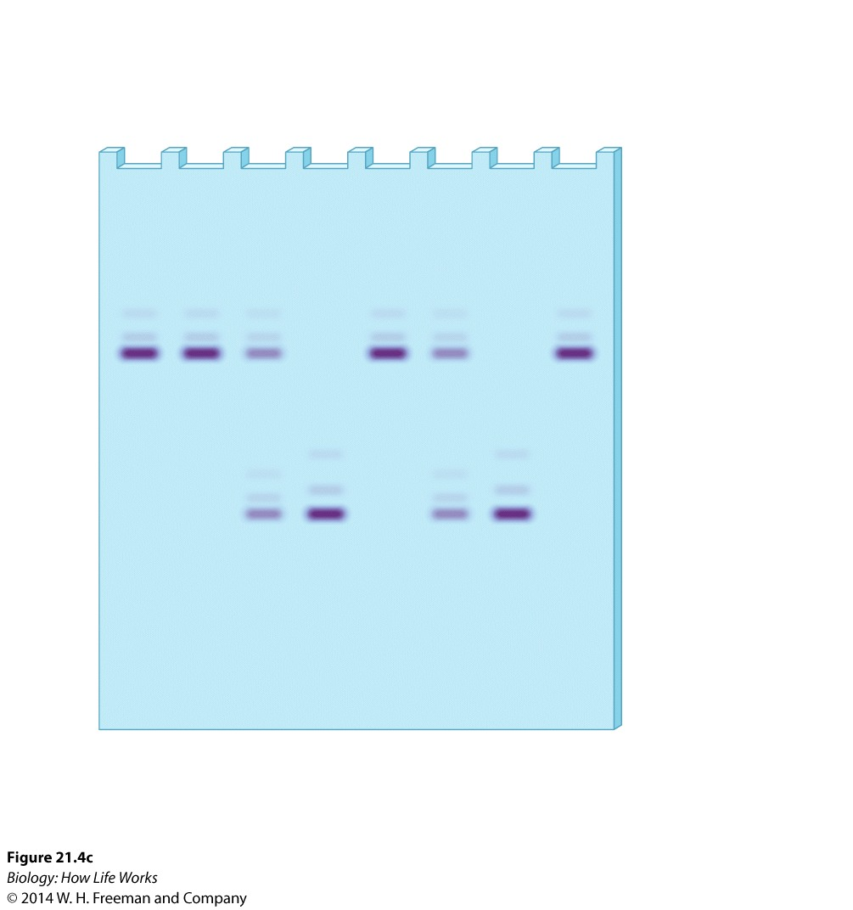
The gel is stained with a biochemical agent to see how far the proteins have migrated.
What are the genotype frequencies in this population?
What are the allele frequencies in this population?
Heterozygote
Homozygote for allele 1
Homozygote for allele 2

Slide 15
Mechanisms of Evolutionary Change
Evolution is defined as a change in allele and genotype ___________ over time. We will measure this later in the lecture. This is also sometimes called microevolution to note the short time scale involved
Specific different forces cause allele and genotype frequencies to change

Slide 16
Mechanisms of Evolutionary Change
Mechanisms that change allele and genotype frequencies in populations:
Natural selection
Mutation
Gene flow
Genetic drift
Non-random mating (inbreeding and sexual selection)
Natural selection is the only mechanism that results in adaptation and leads to increased ___________.

Slide 17
Break time !

Slide 18
Analyzing Allele Frequency Change: The Hardy-Weinberg Model
Analyzes what happens to the frequencies of two alleles at a single locus when the five evolutionary forces are not acting on a population.
If allele and genotype frequencies are the same between a parental and offspring generation, then no evolution is occurring. If they change, then evolution is occurring by definition.
Assumes that there is no mutation, migration, genetic drift, selection, or nonrandom mating in the population. If these conditions are met, the populations are said to be in Hardy-Weinberg equilibrium.
If we want to know if evolution is occurring, we have to __________ the genetic structure of a population over at least one generation.

Slide 19
Calculations like what I will present today are in your book on pages 469-470 (sections 19.1 and 19.2)

Slide 20
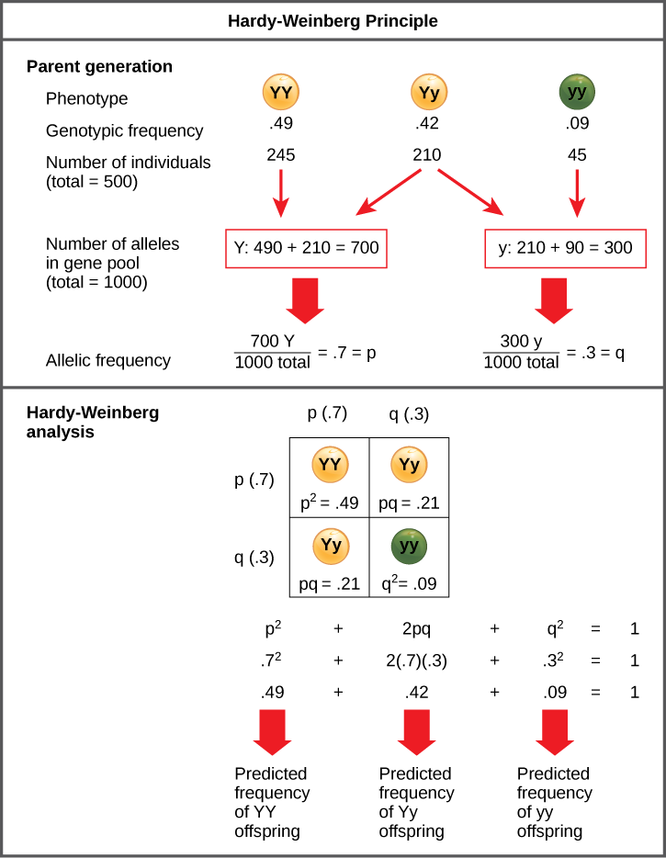
Figure 19.2 Hardy-Weinberg
When populations are in the Hardy-Weinberg equilibrium, the allelic frequency is stable from generation to generation and the distribution of alleles can be determined from the Hardy-Weinberg equation. If the allelic frequency measured in the field differs from the predicted value, scientists can make inferences about what evolutionary forces are at play.

Slide 21
Basic equations and items to know:
p = frequency of allele 1
q = frequency of allele 2
p² = frequency of the p homozygotes.
2pq = frequency of heterozygotes
q² = frequency of the q homozygotes.
Calculations
Allele frequencies:
p + q = 1 (Realize that if you know one allele frequency, you can calculate the other directly if there are only two alleles).
If you know all the genotype frequencies, you can calculate the allele frequencies quickly:
p= p²+(1/2)2pq
q= q²+(1/2)2pq
Genototype frequencies:
p²+ 2pq + q² = 1
These values can be measured from populations in nature (to get observed values) or calculated (to get expected values)

Slide 22
Be sure you understand what allele frequencies are and what genotype frequencies are.
Understand which equations go with which.
Be sure you can move from equation to the next given limited data.

Slide 23
The point of all this is to have a ____________ against which we can detect allele frequency changes, and thus infer that evolution is happening.
Certain patterns of allele changes are characteristic of certain kinds of evolution.

Slide 24
Typical examples:
How to determine if a population is in Hardy-Weinberg equilibrium or not. If not, why not?
How to calculate allele and genotype frequencies from data on people displaying a recessive phenotype (and how to calculate the frequency of “carriers”).
You should be able to go back and forth from each equation to the next.

Slide 25
Fun with population data
AA Aa aa
a. 36 48 16
b. 5 90 5
Which population is in HW equilibrium?
Compare observed data (above) to expected
frequencies that you derive from those data.
Compute the observed genotype frequencies
Compute the observed allele frequencies
Compute the expected genotype frequencies based on the observed allele frequencies
Compare the observed genotype frequencies to the expected genotype frequencies.

Slide 29
Genetic counseling questions:
1/10,000 people are born with PKU.
What is the frequency of the defective PKU allele?
What is the frequency of “carriers” (i.e., heterozygotes)?
This is a common calculation made by genetic counselors. You have to assume the population is in HW equilibrium to do this calculation. Don’t do that unless I tell you that it’s OK!

Slide 31
Problem sets like these are posted with the notes for practice. An answer key is also provided. If you cannot do these problems, ask for help!!

Slide 32
Remember: Mechanisms of Evolutionary Change
Mechanisms that change allele and genotype frequencies in populations:
Natural selection
Mutation
Gene flow
Genetic drift
Non-random mating
Natural selection is the only mechanism that results in adaptation and leads to increased fitness.

