Slide 1
Chapter 1
Preliminaries

Slide 2
Just so you know...
Original (copyrighted) slides have often been modified somewhat by Dr Jackson
Technically, this is a violation of copyright, but I'm pretty sure no one will mind.
Still, this is being performed by a professional driver on a closed course; don't try this at home.

Slide 3
Chapter 1 Topics
Reasons for Studying Concepts of Programming Languages
Programming Domains
Language Evaluation Criteria
Influences on Language Design
Language Categories
Language Design Trade-Offs
Implementation Methods
Programming Environments

Slide 4
Reasons for Studying Concepts of Programming Languages
Increased ability to express ideas
Improved background for choosing appropriate languages
Increased ability to learn new languages
Better use of languages that are already known (e.g., using language as it was designed to be used)
Overall advancement of computing: the "most popular" languages are not always best and can actually set our field back!

Slide 5
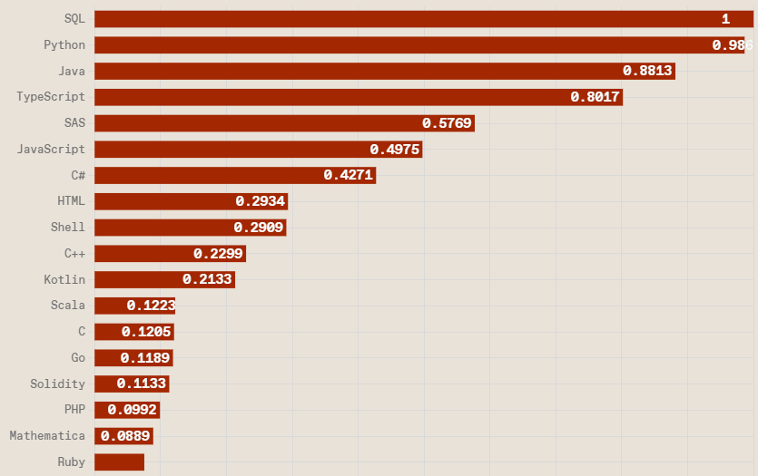
Speaking of most popular languages...
From IEEE Spectrum. Top languages by jobs:

Slide 6
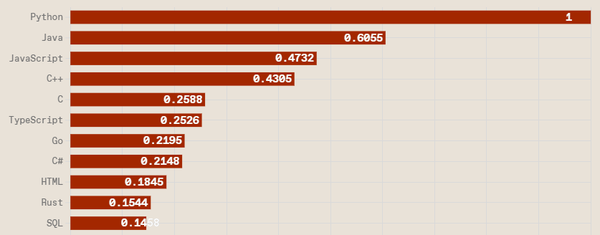
Speaking of most popular languages...
Trending languages (largely measured by StackOverflow posts):

Slide 7
Some Programming Domains
Scientific applications
Large numbers of floating point computations; use of arrays
Fortran was once popular, Python is dominant now.
Business applications
Produce reports, use decimal numbers and characters
COBOL was an early popular language for these apps, still in use!
Artificial intelligence
Early AI was largely symbolic processing, LISP was the original major symbolic language. Scheme is very LISP-like.
Python popular for machine learning.
Systems programming
Need efficiency because of continuous use
C remains popular for systems prog'g and embedded apps; Rust is a newer alternative.

Slide 8
Some Programming Domains
Web development
Frontend (browser UI) language: JavaScript/TypeScript
Backend (server) languages: many, including Java, Python, C#, Ruby, PHP
Mobile applications
Android: originally Java, newer Kotlin
IOS: originally Objective C, newer Swift
Cross-platform: JavaScript (React Native), Dart (Flutter)

Slide 9
Language Evaluation Criteria
Readability: the ease with which programs can be read and understood
Writability: the ease with which a language can be used to create programs
Reliability: how easy/hard is it to introduce/detect/handle bugs?
Cost: how much does it cost (total) to develop and maintain a program using language A vs. language B? (Includes training costs, software tool costs, etc.)

Slide 10
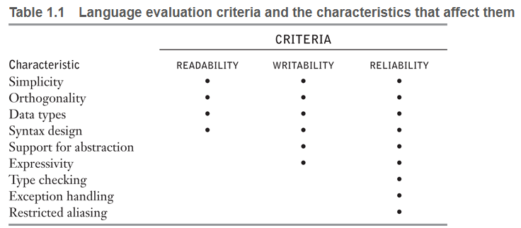

Slide 11
Evaluation Criteria: Readability
Overall simplicity
Minimal feature multiplicity (multiple ways to do task)
Negative Java example: four ways to increment a variable
Minimal operator overloading (+ is overloaded in Java)
System.out.println("Sum is " + 2 + 3);
Orthogonality
A relatively small set of primitive constructs can be combined in every possible way to build the language's control and data structures
Example: In functional languages, every operator is a function
(if (eq? b '())
(list (list a b))
(cons (list a b)
(allappends
(append a (list (car b)))
(cdr b))))

Slide 12
Evaluation Criteria: Readability
Overall simplicity
Minimal feature multiplicity (multiple ways to do task)
Negative Java example: four ways to increment a variable
Minimal operator overloading (+ is overloaded in Java)
System.out.println("Sum is " + 2 + 3);
Orthogonality
A relatively small set of primitive constructs can be combined in every possible way to build the language's control and data structures
Example: In functional languages such as Scheme, every operator is a function
(if (eq? b '())
(list (list a b))
(cons (list a b)
(allappends
(append a (list (car b)))
(cdr b))))
functions

Slide 13
Orthogonality
Another example of orthogonality
Java: i = (j<0 ? -1 : 1);
Java needs a special operator to represent a conditional expression; "if" is not orthogonal.
Ruby: i = if j<0 -1 else 1 end
Ruby's if "statement" is actually an expression, so there is no need for a special conditional operator.

Slide 14
Evaluation Criteria: Readability
Data types: Should be adequate (counterexample: no Boolean in C)
Syntax considerations
Identifiers
Bad example: ANSI Minimal BASIC (1978) requires one-letter (possibly followed by one digit) identifiers!
Choice of special words (e.g., if, while)
Methods of forming compound statements
{ } in C and C-like languages (Java, C++, C#, JavaScript)
if ... end if in some languages, such as Ada and Ruby
if ... elif ... else ... fi in bash scripting
Form and meaning: Ideally, constructs are self-descriptive, keywords are meaningful; meaning (semantics) should follow from form (syntax).
Counterexample: static keyword in C means very different things depending on context (either restricts scope to file if variable is global or specifies non-dynamic memory allocation if variable is local)

Slide 15
Evaluation Criteria: Writability
Simplicity and orthogonality
Large number of features can lead to errors due to misunderstanding some features or accidentally using a feature.
Using = when you meant == and there's no error...
Support for abstraction
The ability to easily define and use complex structures or operations in ways that allow details to be ignored
Expressivity
A set of relatively convenient ways of specifying computations (e.g., +=, for over elements of a collection)
Can also refer to "strength" of operators, ability to perform a great deal of computing with little coding (e.g., list slices in Python a[3:5])
Number of language operators/predefined functions

Slide 16
Evaluation Criteria: Reliability
Type checking
Testing for data type errors, e.g., assign text string to an int
Exception handling
Intercept run-time errors and take corrective measures
Aliasing
Presence of two or more distinct referencing methods for the same memory location (restricting can increase reliability)
Java: Complex a = new Complex(1.0,2.0); Complex b = a;
Readability and writability
A language that does not support “natural” or "simple" ways of expressing an algorithm will require the use of “unnatural” or "complex" approaches, and hence reduce reliability (e.g., having to write i = i+1 rather than i+=1, lack of for each construct)

Slide 17
Evaluation Criteria: Cost
Time to train programmers to use the language
Time required to write programs (suitability to particular applications)
Compilation/Execution time (time developers spend waiting for results)
Financial cost of development tools
Financial costs related to reliability: poor reliability can lead to extremely high costs (lawsuits etc.)
Cost of maintaining project software following initial development
Maintenance can cost ~2-4x development

Slide 18
Evaluation Criteria: Others
Portability
The ease with which programs written in a language can be moved from one implementation of the language to another
Major selling point (not quite true) for Java: "write once, run everywhere"
Generality
The applicability to a wide range of applications
Prolog would be a negative example
Well-definedness
The completeness and precision of the language’s official definition
Ruby existed for many years without a standard definition

Slide 19
Language Design Trade-Offs
Reliability vs. cost of execution
Example: Java demands all references to array elements be checked for proper indexing, which leads to increased execution costs
Readability vs. writability
Example: APL provides many powerful operators (and a large number of new symbols), allowing complex computations to be written in a compact program but at the cost of poor readability
Writability (flexibility) vs. reliability
Example: C/C++ pointers are powerful and very flexible but can lead to hard-to-find bugs (lower reliability)

Slide 20
Language Categories
Imperative
Central features are variables, assignment statements, and iteration
Includes languages that support object-oriented programming
Includes scripting languages
Includes visual languages
Examples: C, Java, Python, JavaScript, Ruby, C#, C++
Functional
Main means of making computations is by applying functions to given parameters
Recursion is naturally functional and tends to be used more than iterative loop constructs
Examples: LISP, Scheme
Logic
Rule-based (rules are specified in no particular order)
Example: Prolog

Slide 21
Influences on Language Design
Computer Architecture
Most languages are developed around the prevalent computer architecture, known as the von Neumann architecture
Programming Methodologies
New software development methodologies (e.g., object-oriented software development) led to new programming paradigms and by extension, new programming languages

Slide 22
Programming Methodologies Influences
1950s and early 1960s: Simple applications; efficient use of compute time and memory a major concern
Late 1960s: People efficiency became major concern: readability, writability more important
structured programming
top-down design and step-wise refinement
Late 1970s: Process-oriented to data-oriented
Increasing importance of data abstraction
Middle 1980s: Object-oriented programming
Data abstraction + inheritance + polymorphism

Slide 23
Computer Architecture Influence
Well-known computer architecture: Von Neumann
Data and programs stored in memory
Memory is separate from CPU
Instructions and data are piped from memory to CPU

Slide 24
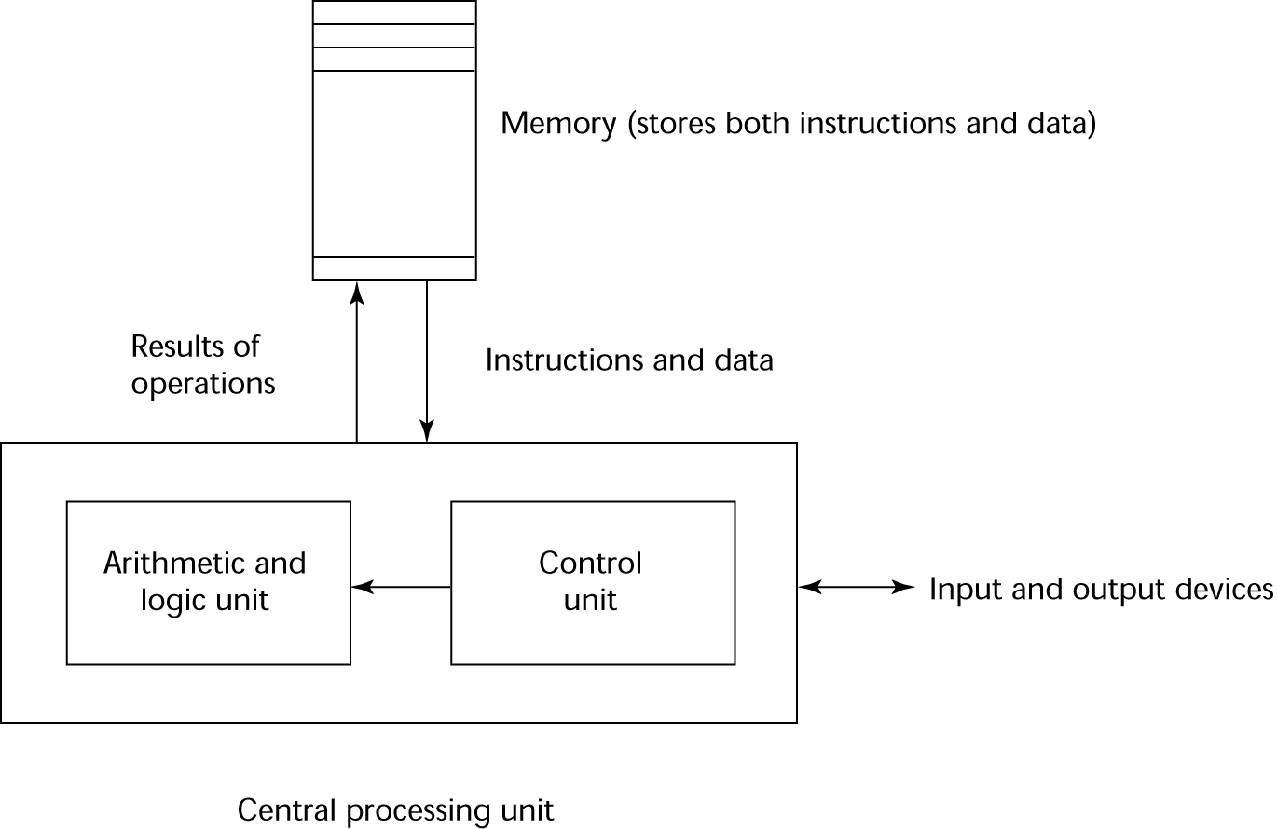
The von Neumann Architecture

Slide 25
The von Neumann Architecture
Fetch-execute cycle (on a von Neumann architecture computer)
initialize the program counter
repeat forever
fetch the instruction pointed at by the counter
increment the counter
decode the instruction
execute the instruction (might change counter)
end repeat

Slide 26
Computer Architecture Influence
Imperative languages are dominant at least in part because of the use of von Neumann computers
Variables model memory cells
Assignment statements model storing data in memory cells
Iteration fits the fetch-execute cycle more naturally than recursion

Slide 27
Language Implementation Methods
Compilation
Programs are translated into machine language; includes Just-in-Time (JIT) systems
Use: Lage commercial applications
Pure Interpretation
Programs are executed line-by-line by another program known as an interpreter
Use: Small programs or when efficiency is not an issue
Hybrid Implementation Systems
A compromise between compilers and pure interpreters
Use: Small and medium systems when efficiency is not the first concern

Slide 28
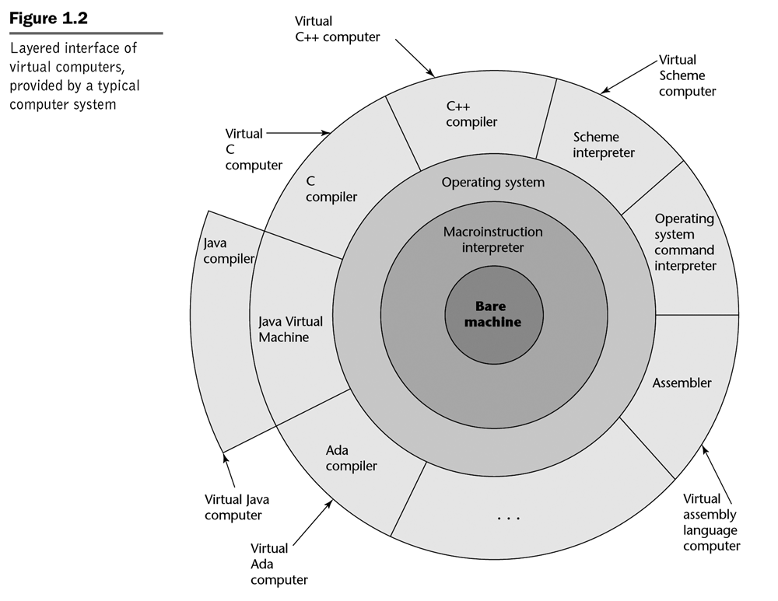
Layered View of Computer
The operating system and language implementation are layered over machine interface of a computer

Slide 29
Compilation
Translate high-level program (source language) into another (object) language (bytecode or machine code)
Slow translation, fast execution
Compilation process has several phases:
lexical analysis: converts characters in the source program into lexical units (e.g., == is a single lexical unit)
syntax analysis: transforms lexical units into parse trees which represent the syntactic structure of program (e.g., 2*3+4 becomes tree with + at root)
semantic analysis: perform semantic checks (e.g., type checking), generate intermediate code
code generation: optimization may be performed, object code is generated

Slide 30
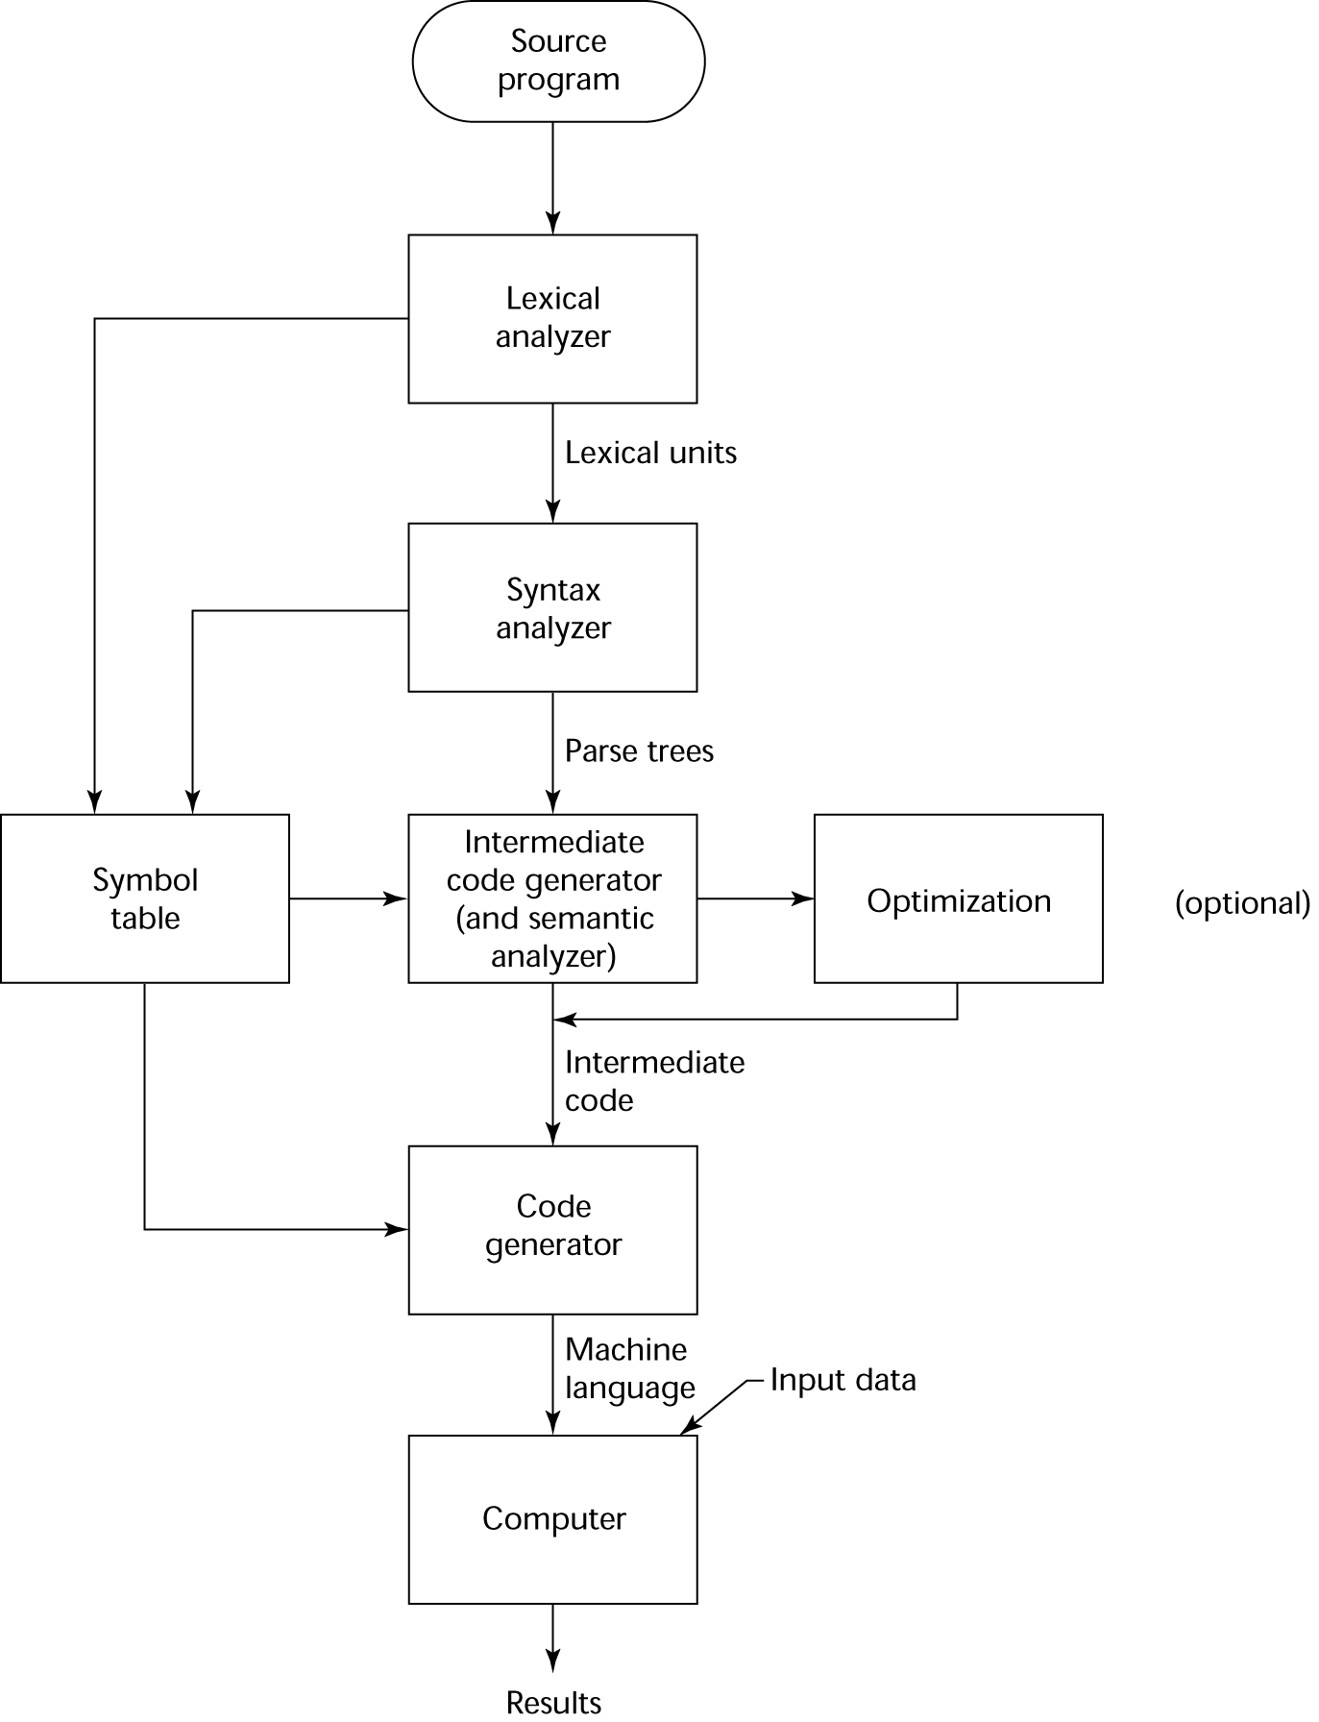
The Compilation Process

Slide 31
Additional Compilation Terminologies
Load module (executable image): all user and system code together
Linking: the process of creating a load module
Often in C/C++ must specify which libraries to link: gcc test.c –o test -lm # m is math library
Loading: the operating system process of copying a load module into memory, possibly modifying addresses

Slide 32
Von Neumann Bottleneck
Connection speed between a computer’s memory and its processor determines the speed of a computer
Program instructions often can be executed much faster than the speed of the connection; the connection speed thus results in a bottleneck
Known as the von Neumann bottleneck; it is the primary limiting factor in the speed of computers

Slide 33
Pure Interpretation
No translation
Easier implementation of programs (run-time errors can easily and immediately be displayed)
Slower execution (10 to 100 times slower than compiled programs)
Often requires more space
Now rare for traditional high-level languages
In the early Web years, was a significant drawback with some Web scripting languages (e.g., JavaScript, PHP)

Slide 34
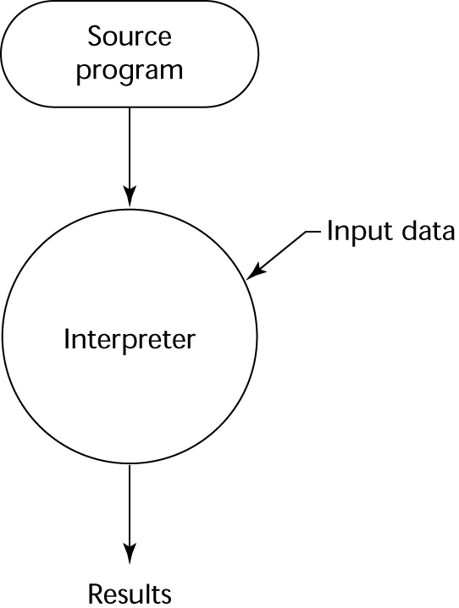
Pure Interpretation Process

Slide 35
Hybrid Implementation Systems
A compromise between compilers and pure interpreters
A high-level language program is translated to an intermediate language that allows easy interpretation
Faster than pure interpretation
Examples
Perl programs are partially compiled to detect errors before interpretation
Many implementations of Java were hybrid; the intermediate form, byte code, provides portability to any machine that has a byte code interpreter and a run-time system (together, these are called Java Virtual Machine)

Slide 36
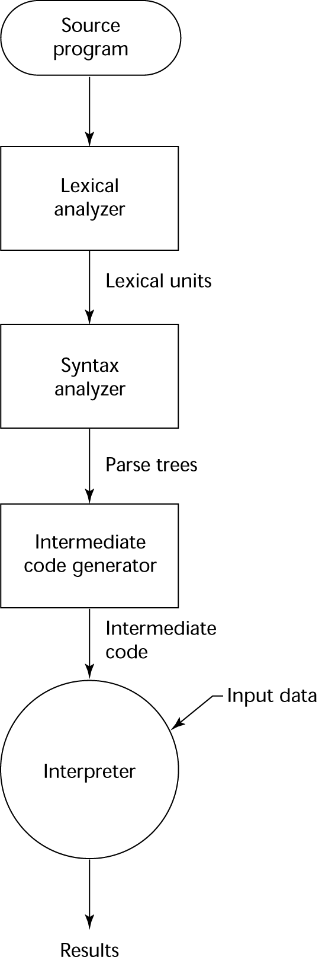
Hybrid Implementation Process

Slide 37
Just-in-Time (JIT) Implementation Systems
Typically, an implementation using JIT initially translates a program to bytecode (Ahead-of-Time compilation) like a hybrid implementation
Then, as the program is executing (via a bytecode interpreter), the implementation might run a JIT compiler to convert portions of the bytecode into machine code to improve execution speed
Machine code is cached for subsequent use
JIT systems are widely used for Java programs
.NET languages are implemented with a JIT system
In essence, JIT systems are delayed compilers

Slide 38
Preprocessors
Preprocessor modifies a program before it is compiled
Example: #include "myFile.h" in C is replaced with contents of file myFile.h
Macros are templates that are replaced with code; can be done by preprocessor
Example:
#define max(A, B) ((A) > (B) ? (A) : (B))
// ...
x = max(2 * y, z / 1.73); // becomes...
x = ((2 * y) > (z / 1.73) ?
(2 * y) : (z / 1.73);

Slide 39
Programming Environments
A collection of tools used in software development
UNIX/Linux command line (CLI)
simple editor for writing code
enter commands to compile and run program
write "makefile" for telling the "linker" what object and library files to use to create an "executable"
Integrated development environments (IDEs)
Typically perform syntax analysis as code is entered and immediately identify syntax (compile) errors
Simplify the compilation/execution process; often a single Run button

Slide 40
Summary
The study of programming languages is valuable for a number of reasons:
Increase our capacity to use different constructs
Enable us to choose languages more intelligently
Makes learning new languages easier
Most important criteria for evaluating programming languages include:
Readability, writability, reliability, cost
Major influences on language design have been machine architecture and software development methodologies
The major methods of implementing programming languages are: compilation, pure interpretation, and hybrid implementation

