Slide 1




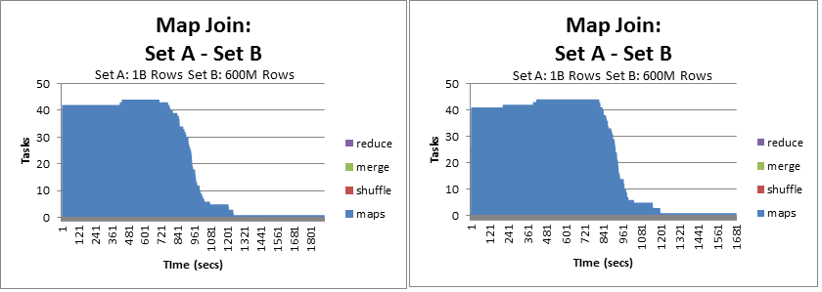
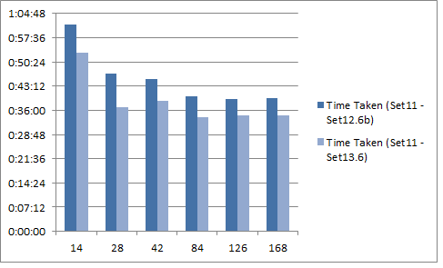
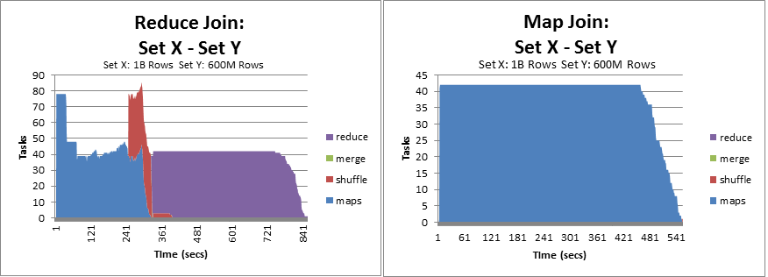

Relational Joins in Hadoop:
A module for Cloud9lib MapReduce library.
Mohamed Mohideen Abdul Rasheed
Deliverables
Working Relational Join Module
Availble for download at https://github.com/mohideen/cloud9
Experimentation Report & Documentation
Available at http://mohideen.github.com/Cloud9/
Big Data
Data is Everywhere: Information is accumulated at a staggering rate everywhere from small startups to massive corporations.
More Data = Better Insights: Research provides evidence that simple algorithms running on large data outperforms sophisticated algorithms running on smaller data set.
Business Intelligence: It is a widely accepted fact that these accumulated data (such as user logs) has the key to identify crucial business opportunities and will guide the companies make right decisions.
Hadoop
Hadoop is an open source implementation of the MapReduce – a framework for tackling data-intensive applications.
Widely adopted Big Data tool.
(Facebook, Amazon, Microsoft,…)
Active community for getting support
Less Investment
Open Source
Runs on commodity hardware
Great Data Capabilities
Can handle data in the PB scale
Support for unstructured and semi-structured data sets.
Performance Tuning
Hadoop job configuration can be tuned to set internal sort properties appropriate to application characterstics to gain perfomance.
Relational Joins
“Relational Joins combine different data structures together and gain meaningful information from them.”
Relational Joins are essential for any data warehousing application.
Hadoop Relational Join Techniques:
Reduce-Side Joins
Map-side Joins
Memory Backed Joins
Memcached Joins
GOALS
    Learn Map-Reduce programming
    Understand Hadoop Framework
    Contribute meaningfully to a project
Chart showing time taken before (left) and after (right) perfomance tuning.
To deliver a relational join module for UMD's Cloud9lib, an open source Hadoop library, developed by Dr. Jimmy Lin.
Map Join vs Reduce Join
Set X: 1 Billion Rows (2 Integer & 3 String Fields) Uniform Distribution
Set Y: 600 Million Rows (3 Integer Fields) Uniform Distribution
Chart showing job durations for joins on same dataset pairs with increasing the number of tasks.
Time Taken vs
Num. Tasks
Techniques Implemented
Reduce-Side Joins – Caters applications with unorganized data. Less efficient. Suitable for Ad-hoc necessities.
Map-side Joins – Efficient technique but requires sorted-partitioned input data.
Experimentation on the cluster
Bespin: A 13-node UMIACS Hadoop Cluster with 78 Map Slots and 52 Reduce Slots.
Test Data:
Size ranging from 10 Milllon to 1 Billion rows.
Uniform and Zipf distributions
Num Tasks

