Slide 1
Low Bandwidth GFS
Aadi Swadipto Mondal Mohil Patel Rahul Chakwate
(Group 3-15)

Slide 2
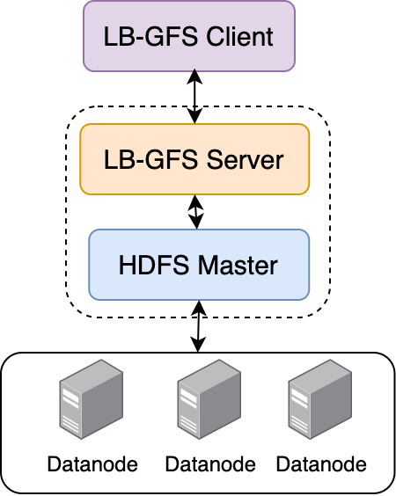
Key Points
Developed a wrapper on top of HDFS to optimize for low bandwidth conditions
Use chunk hashes to identify same chunks in server & client thus save BW
Chunks are immutable. They are garbage collected at regular intervals
Each chunk is stored as a separate file in HDFS

Slide 3
Application Programming Interface (API)
CreateFile(filepath): Create a new file in the system
DeleteFile(filepath): Delete the file from the system
ReadFile(filepath, offset, length): Read file data
TentativeAppend(filepath, data): Collects data locally for appending
CommitAppend(filepath): Push all tentative appends to the server

Slide 4
System Design
Server Design
Server works as a wrapper on top of HDFS managing files inside it
Server communicates with HDFS master and create separate files for each chunk
Stores & manage file to chunk id mappings
Stores the chunk reference count
Client Design
Client caches the chunks locally
Maintains cache’s chunk hash last access timestamp to identify already existing blocks
Communicates with server if new chunk needs to be fetched
For tentative appends client manages local temp files

Slide 5
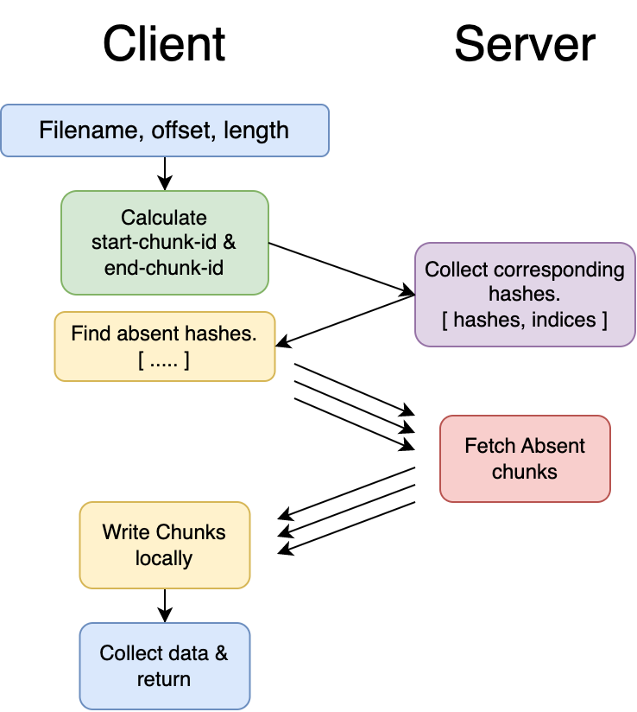
Read Protocol
Based on offset and length, we calculate the corresponding chunk-ids.
Server returns the hashes corresponding to these chunk ids.
If hash is present on client, we read from cache, if not, then that block is fetched from the server.
Extract data from chunks corresponding to offset and length; return to client.

Slide 6
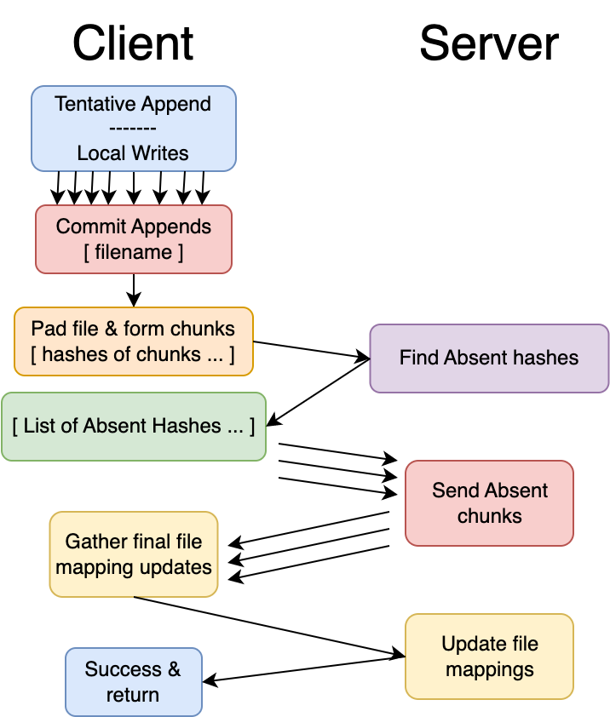
Append Protocol
Tentative Appends locally write data in a temporary file.
Commit pads the data till chunk boundary and form chunks.
Send server chunk hashes to identify chunks absent on server.
Send absent chunks to the server.
Once server has all the new data, client sends a final update file mapping request, to append the data.

Slide 7
Reconstructing File in Server
Update File -> Chunk Mappings: receives chunk hashes of newly appended data chunks.
Server reads the last chunk (if incomplete).
Reads data from the new chunks and forms a temporary file with the last incomplete chunk and the newly appended data chunks.
Form fresh chunks from the temporary file and update chunk to reference count map.
Update file-mapping with chunk-ids of newly appended chunks.
Update file size (this is crucial to track the last chunk size (if incomplete)).
Acknowledge the client.

Slide 8
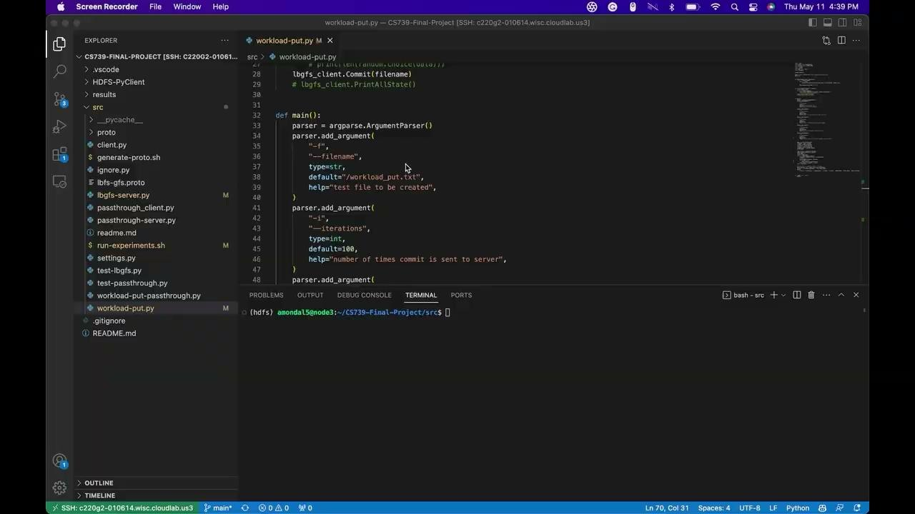
Demo Video

Slide 9
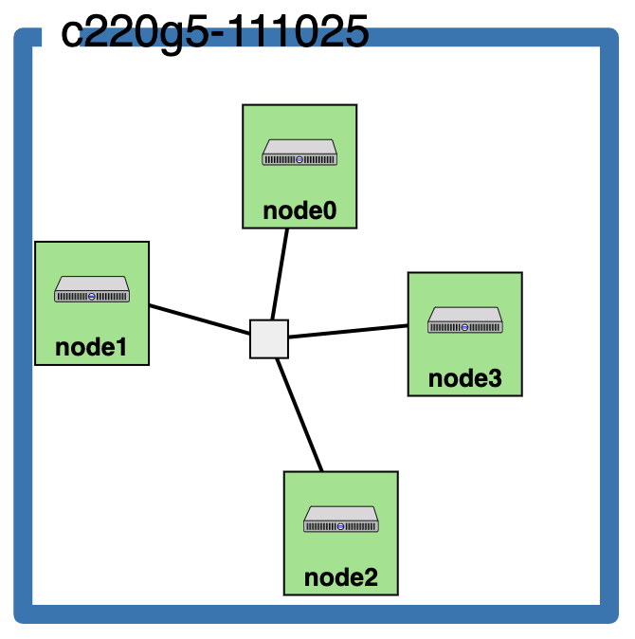
Experimental Setup
4 Node cluster with internode network speed of 100Mbps
Workload Parameters:
Block size - HDFS chunk size
# distinct keys - total number of distinct events in workload
Key size - size of each individual event
While running workload we randomly append distinct events repeatedly
Server + HDFS
HDFS
Client
HDFS

Slide 10
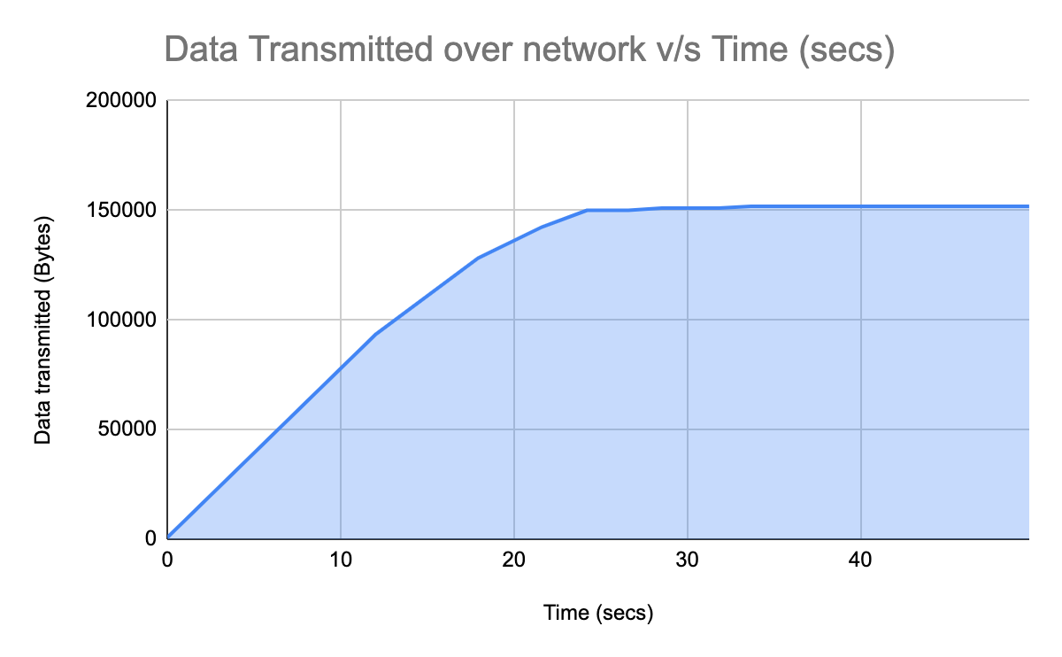
Time axis Data Received Plot
Block Size: 1024 bytes # Distinct Key: 4
Key Size: 256 bytes

Slide 11
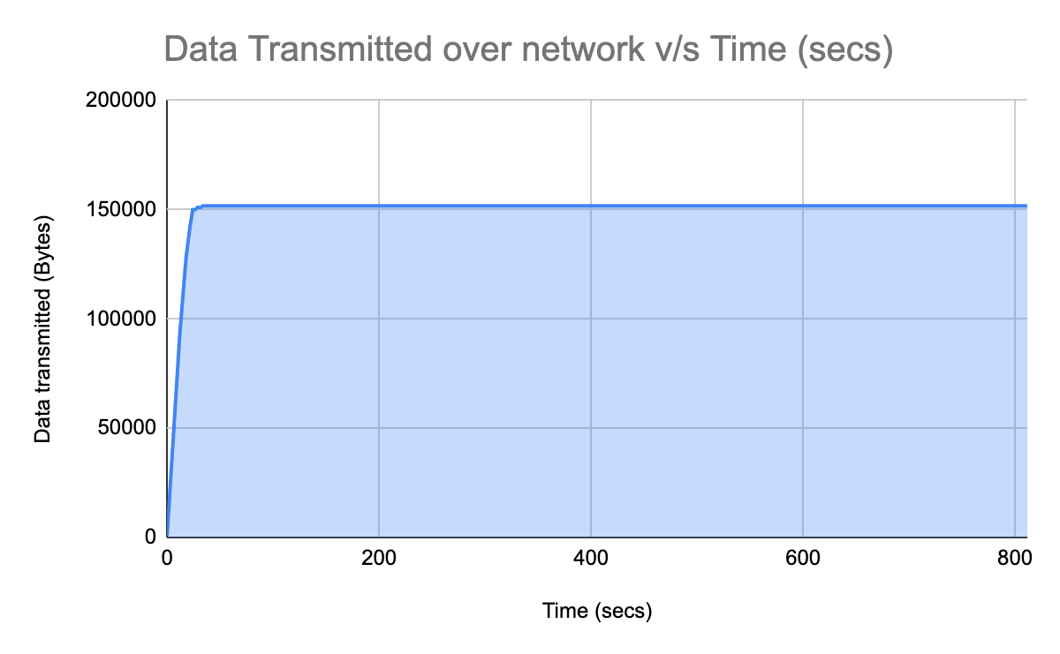
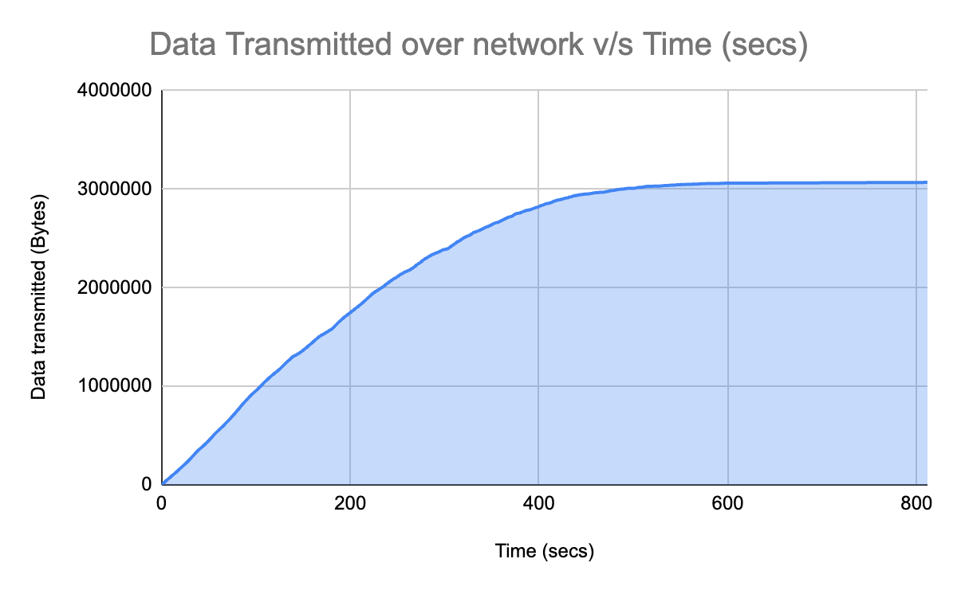
Time axis Data Received Plot
Block Size: 1024 bytes
Block Size: 1536 bytes

Slide 12
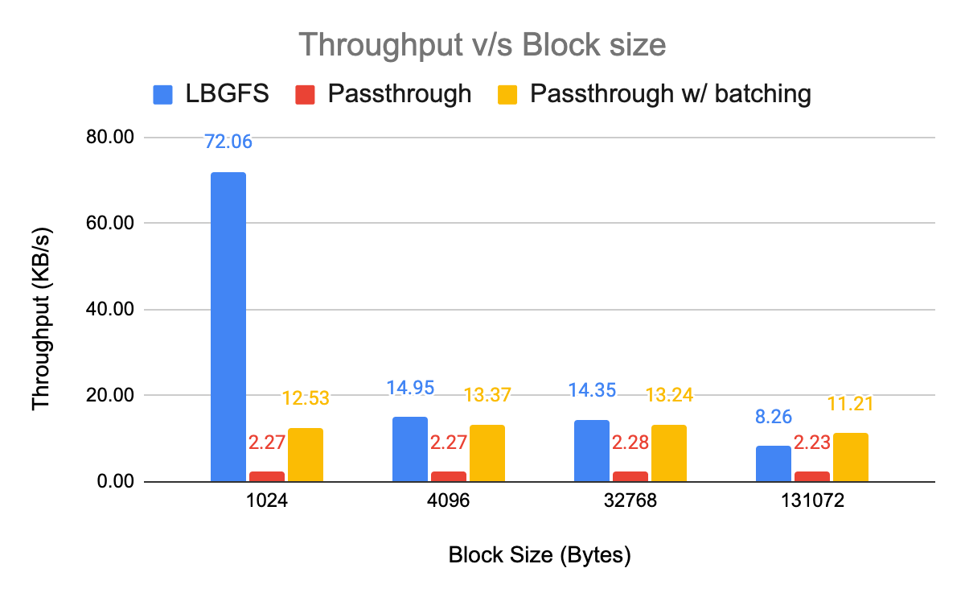
Block Size (Throughput)

Slide 13
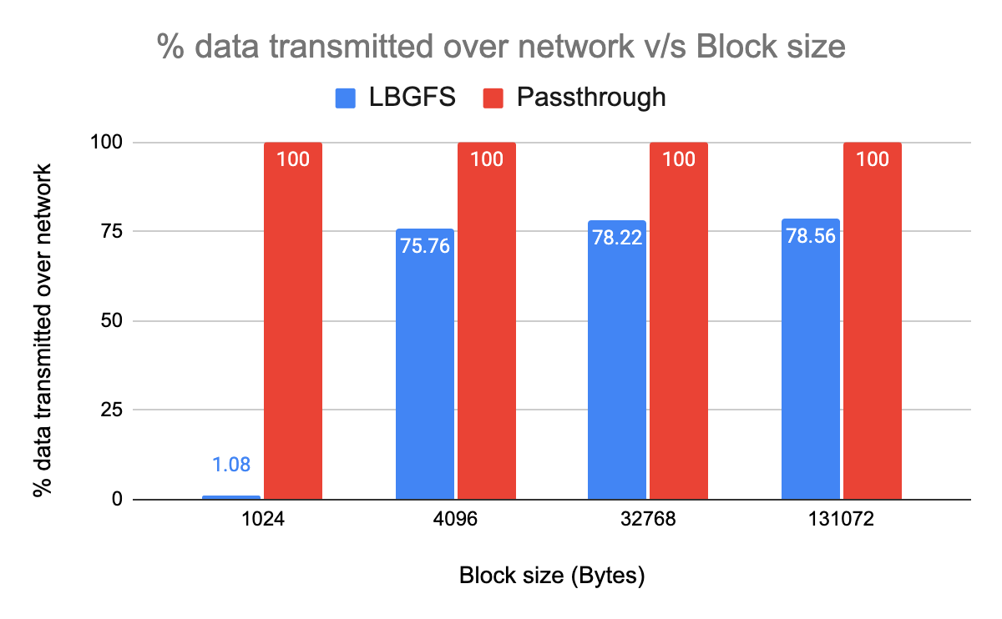
Block Size (% data transmitted over network)

Slide 14
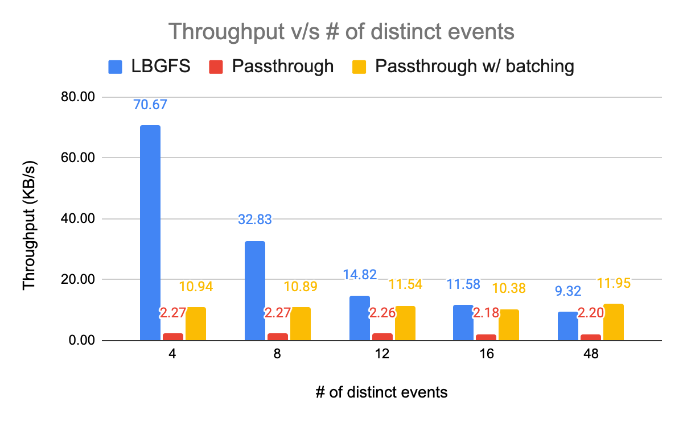
# Distinct Events (Throughput)

Slide 15
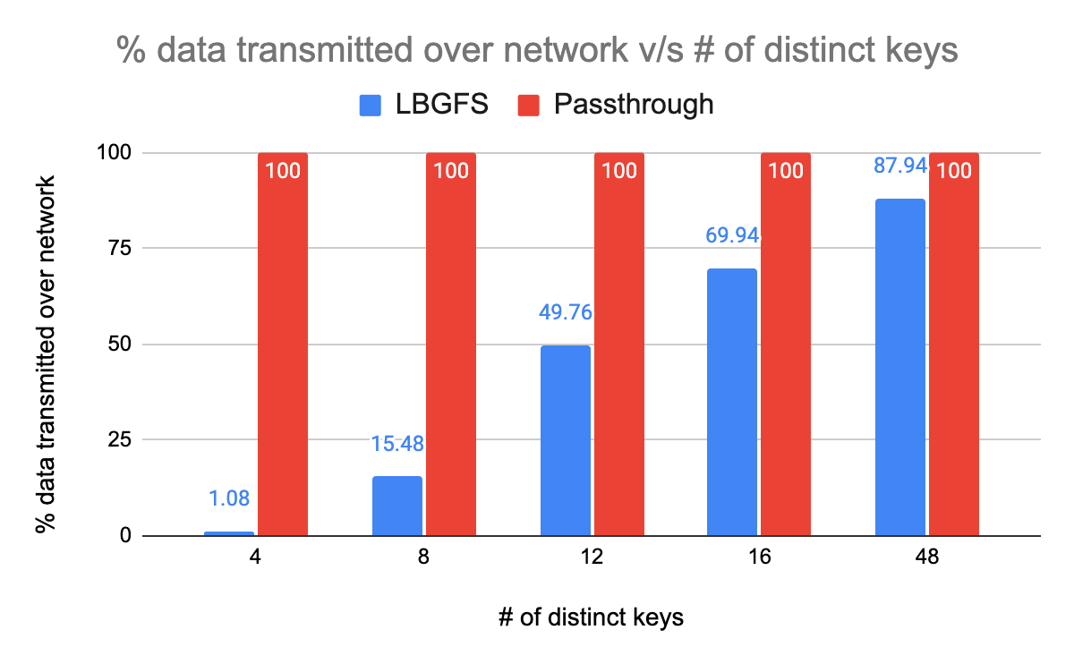
# Distinct Events (% data transmitted over network)

Slide 16
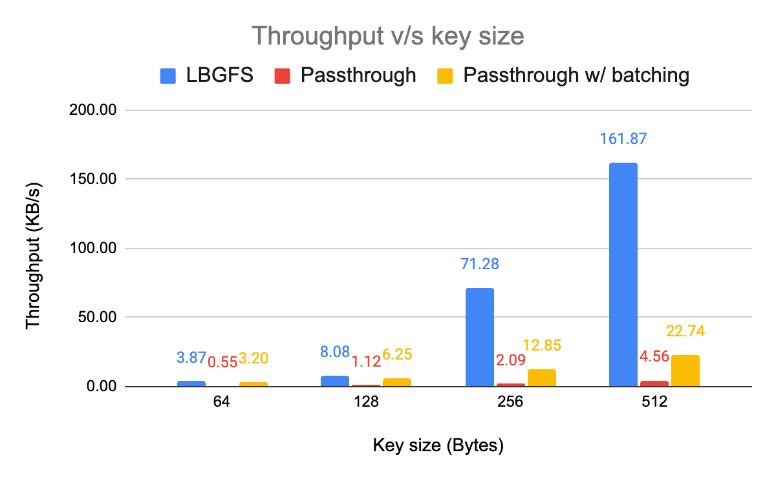
Key Size (Throughput)

Slide 17
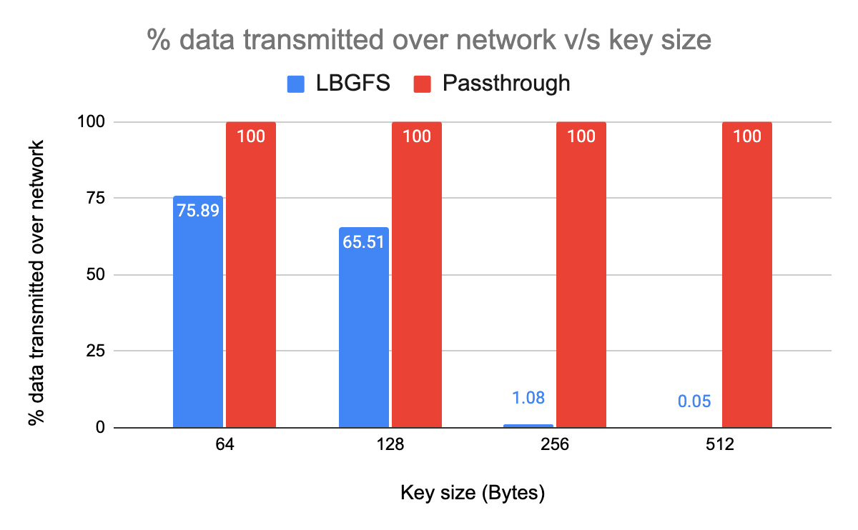
Key Size (% data transmitted over network)

Slide 18
Conclusion
Low Bandwidth optimizations show bandwidth and storage saving improvement on top of base HDFS.
Results show that depending on the workload characteristics benefits of low bandwidth varies.
Number of possible distinct blocks in a workload dictates system warmup time.
New blocks can be created both by client (data transmission) and server (file reconstruction), this speeds up warmup time

