Slide 1
wiscAFS
(Project Group 1/8)
Aadi Swadipto Mondal | Mohil Patel | Rahul Uday Chakwate

Slide 2
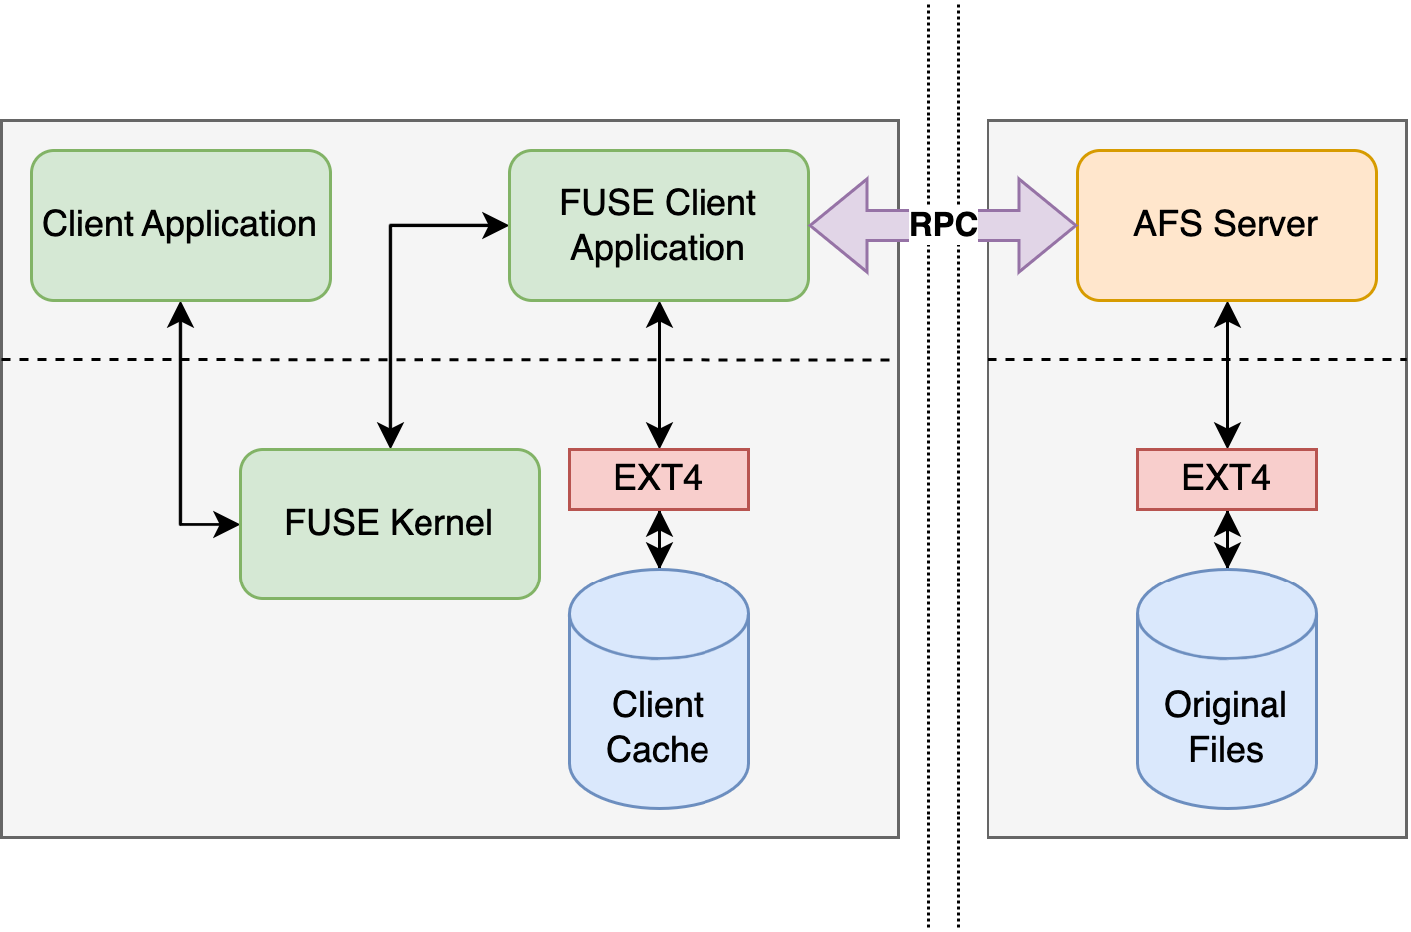
Key Design Principles
Server is stateless.
Synchronized over server timestamp.
Three client cache states for files:
Not present in client cache.
File is currently opened (.tmp present)
File is currently closed (.per present)
Client stores last modified time of file in server in filename.
Client tracks open and unlinked open files.

Slide 3
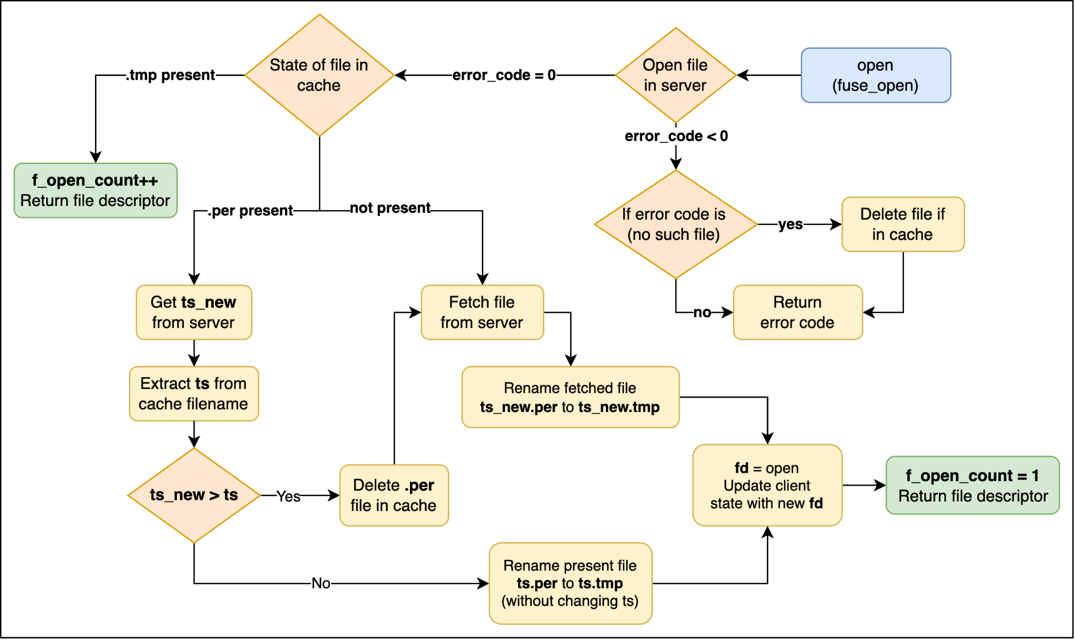
Open Protocol

Slide 4
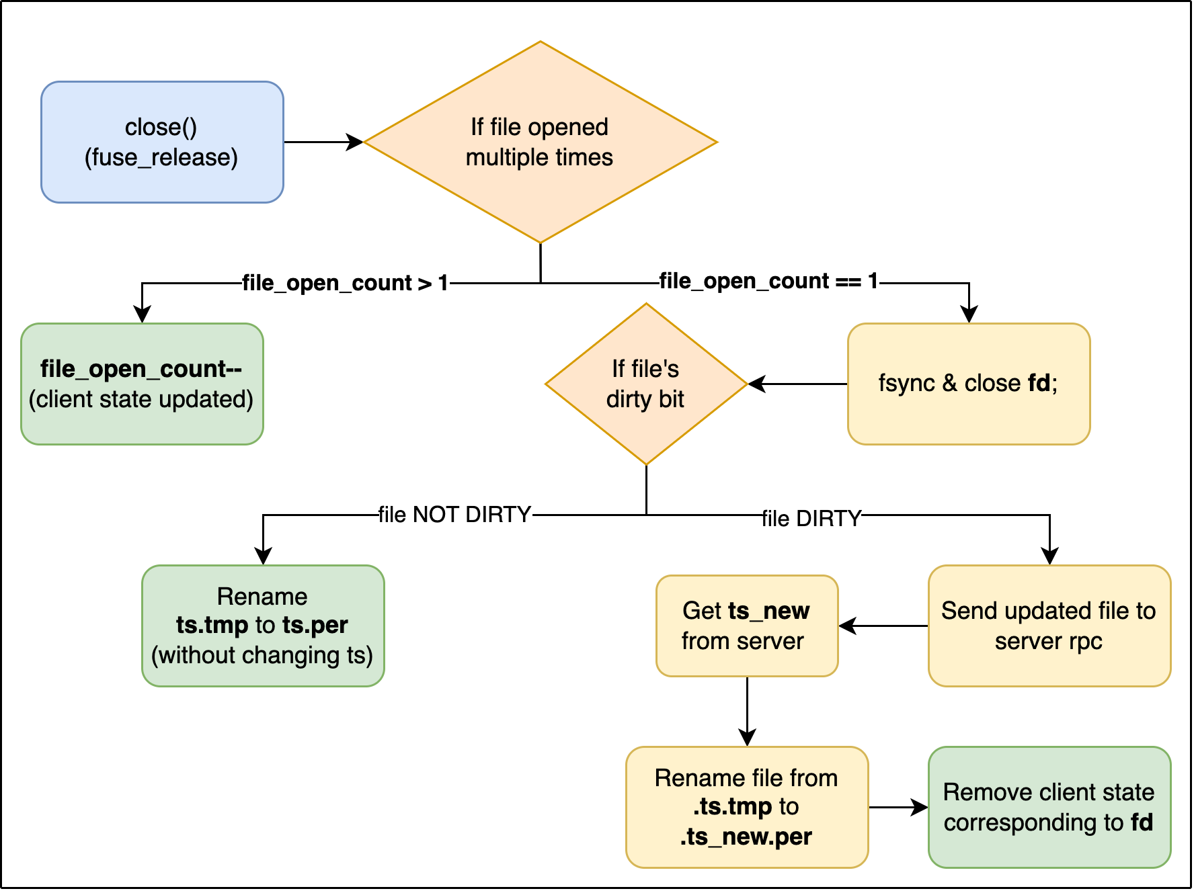
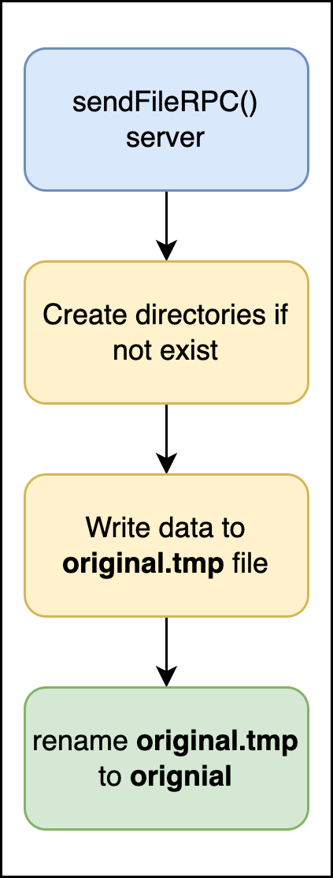
Close Protocol

Slide 5
Crash Consistency
Client
Client tracks open file descriptors. Upon crash, it is safe to lose file descriptors.
Opened files are marked temporary (via rename). Upon crash, client restarts and deletes temporary files.
Cached opened files lost due to crash can be lazily fetched on subsequent opens.
Cached closed files are marked permanent (via rename); preserved in cache after restart.
Server
Server is inherently stateless. Upon crash, server can restart to serve files to clients.
While receiving file from client, a temporary file is created to write the data. Rename (assumed atomic) operation is performed after whole file is received from client.
Temporary files are deleted upon server restart. This ensures original server files are not corrupted.

Slide 6
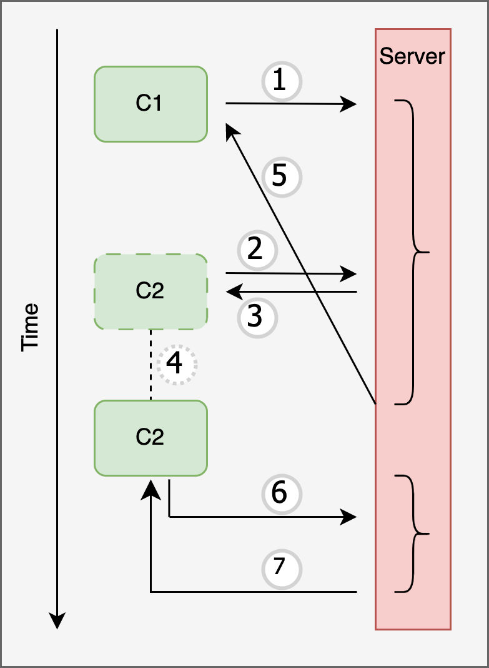
Last Writer Wins
C1 sends close file “f1.txt”.
C2 sends close file “f1.txt” while C1’s data copy RPC is still in progress.
Server sends C2 wait request (C1 has not finished writing data).
C2 sleeps for sometime.
C1’s close finishes on the server and returns.
C2 re-requests for close file “f1.txt” after waking up.
Server updates “f1.txt” with data sent from C2.
Last writer C2 wins!!
Notes:
›

Slide 7
Miscellaneous Protocols
Unlink: Unlink forwards call to server (deletes from cache if successful); track files that were deleted while file was open. To comply with posix semantics, such files are ignored upon close.
Utimens: Two major challenges: a) We depend on monotonic increase of last modified time for server files. b) We cannot allow client time to overwrite server time (happens when files are moved from outside mount point directory).
Getattr: File writes (directed to client cache copy) may change file size. Fetches all information from server via RPC, except file size which is overwritten to client cache file size.
Permissions: Files are always created with all permissions (777). This is to handle complex permission issues like write only for the first time, read only thereafter. chown and chmod are NO-OP operations.
Directories: All directory related operations are forwarded to the server. Directories in cache are created on file open and deleted when empty directories are left after file unlink (or File Not Found error codes).

Slide 8
Filebench
wiscAFS
filemicro_createfiles
Create, write & close many files sequentially. Each time creating a new file of 1k size.
Closefile and createfile shows significantly worse latency in wiscAFS compared to unreliableFS results. This might be due to open and close network activity and complexity in wiscAFS.
Writefile also shows poor performance in wiscAFS, but we suspect this is due small write file size. For write heavy workloads we see similar results (slides ahead)
 | Thrput (mb/s) | Lat (ms/op)
closefile | 0 | 4.294
writefile | 0.047 | 1.796
createfile | 0 | 14.639
unreliableFS
 | Thrput (mb/s) | Lat (ms/op)
closefile | 0 | 0.031
writefile | 0.489 | 0.063
createfile | 0 | 0.112

Slide 9
Filebench
filemicro_createrand
Open a file once, does 10 write calls, fsync and repeats.
The fsync latency is identical for wiscAFS and unreliableFS. This is because fsync is a client cache function and does not require server interaction.
For the appendfile performance, wiscAFS performance is nearby unreliableFS. This happens because write operations only applies on client cache.
The potential performance degradation in wiscAFS could be last close call.
wiscAFS
 | Thrput (mb/s) | Lat (ms/op)
sync | 0 | 14.183
appendfile | 76.194 | 5.057
unreliableFS
 | Thrput (mb/s) | Lat (ms/op)
sync | 0 | 14.449
appendfile | 101.441 | 3.41

Slide 10
Filebench
filemicro_seqread
Preallocated a large file, opens it and do a sequential read on the file
Results between wiscAFS and unreliableFS are almost identical. This is because during preallocation wiscAFS gets the copy of file in the client cache
Thus subsequent experiment only needs to open cached file and read, which does not require any server interaction. So both are equally fast
wiscAFS
 | Thrput (mb/s) | Lat (ms/op)
seqread-file | 5459.415 | 0.181
unreliableFS
 | Thrput (mb/s) | Lat (ms/op)
seqread-file | 5420.266 | 0.183

Slide 11
Filebench
filemicro_statfile
Preallocated large number of files and randomly calls stat on all those files
wiscAFS latency is very bad compared to unreliableFS for stat calls.
This happens because in wiscAFS we are always going to server to get stat info for the file. This increases latency significantly.
wiscAFS
 | Thrput (mb/s) | Lat (ms/op)
statfile | 0 | 66.022
unreliableFS
 | Thrput (mb/s) | Lat (ms/op)
statfile | 0 | 0.026

Slide 12
Filebench
filemicro_deletefile
Preallocates a huge number of files and during experiment deletes them randomly
Similar to stat call, wiscAFS performs significantly bad in deletefile operation compared to unreliableFS.
wiscAFS delete needs to remove the file from the server, which requires a RPC. It has removes files from the client and additionally check if directory structure needs to be removed too. This complexity adds to the latency in wiscAFS.
wiscAFS
 | Thrput (mb/s) | Lat (ms/op)
deletefile | 0 | 78.713
unreliableFS
 | Thrput (mb/s) | Lat (ms/op)
deletefile | 0 | 1.328

Slide 13
Filebench
mongo.f benchmark
wiscAFS
unreliableFS
 | Thrput (mb/s) | Lat (ms/op)
deletefile1 | 0 | 6.153
closefile2 | 0 | 0.037
readfile1 | 0.703 | 0.112
openfile2 | 0 | 8.861
closefile1 | 0 | 0.042
appendfilerand1 | 0.333 | 1.637
openfile1 | 0 | 5.28
 | Thrput (mb/s) | Lat (ms/op)
deletefile1 | 0 | 0.135
closefile2 | 0 | 0.016
readfile1 | 39.061 | 0.049
openfile2 | 0 | 0.033
closefile1 | 0 | 0.016
appendfilerand1 | 19.826 | 0.068
openfile1 | 0 | 0.035

Slide 14
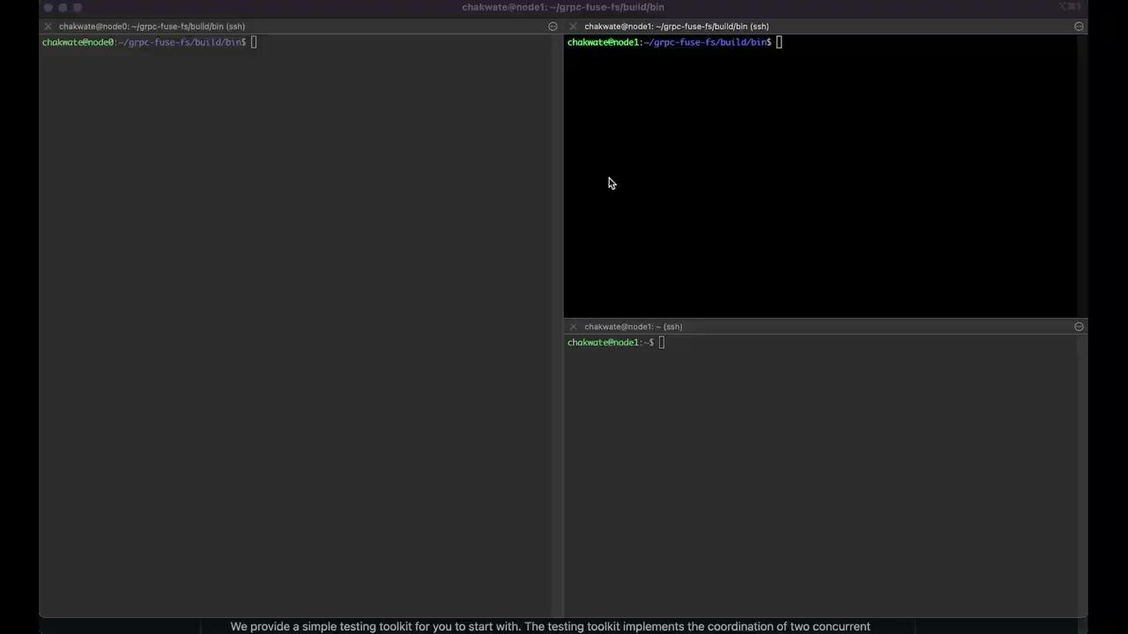
Demos - Qemu

Slide 15

Demos - Parallel Build

Slide 16
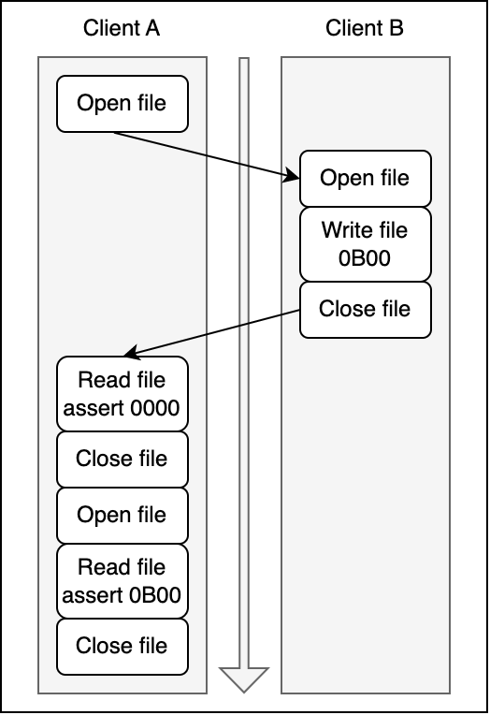
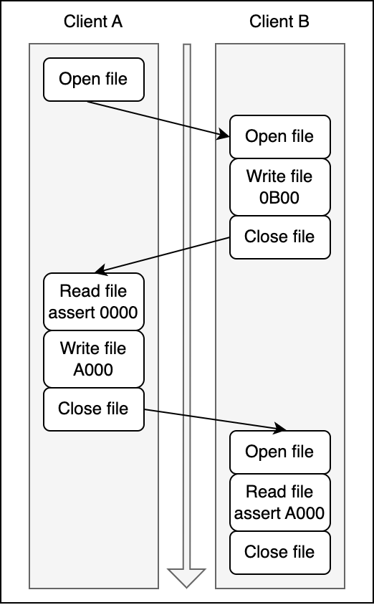
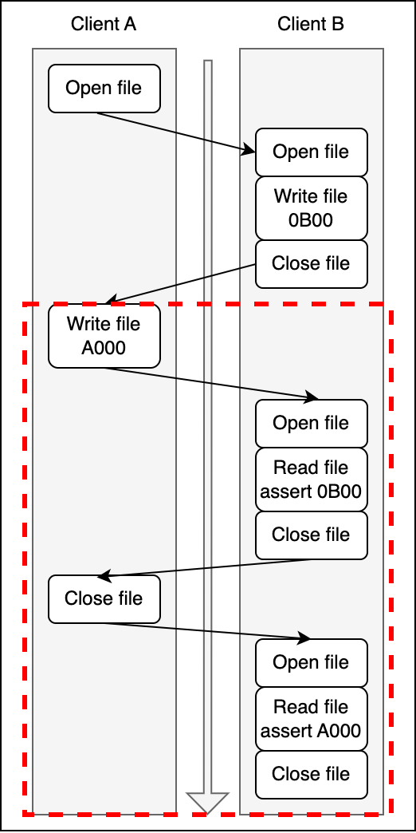
Basic Cache Consistency
Test 1
Test 2
Test 3

Slide 17

Basic Cache Consistency

Slide 18
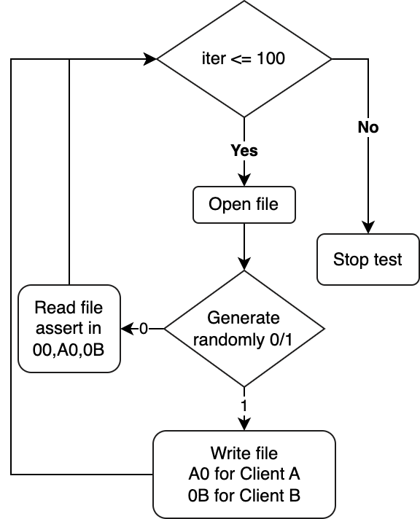
Advanced Cache Consistency
Test 4

Slide 19
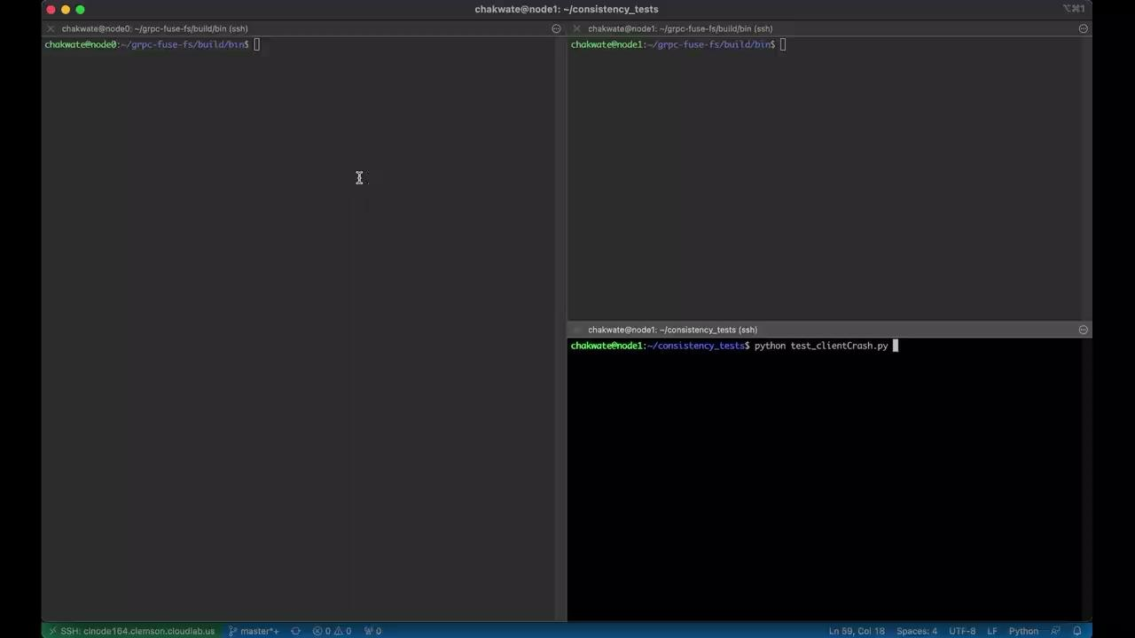
Crash Consistency

Slide 20
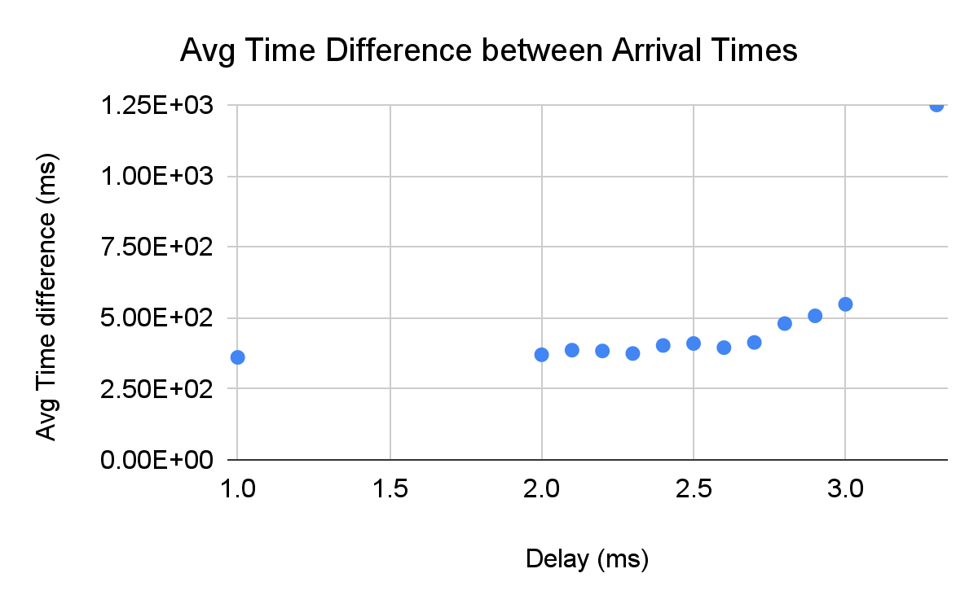
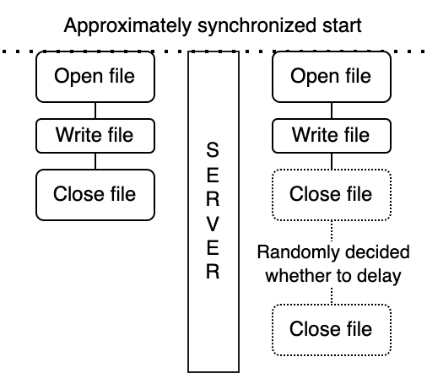
Impact of network randomness of WiscAFS
10¹
10^{1.5}
10²
10^{2.5}
10³

Slide 21
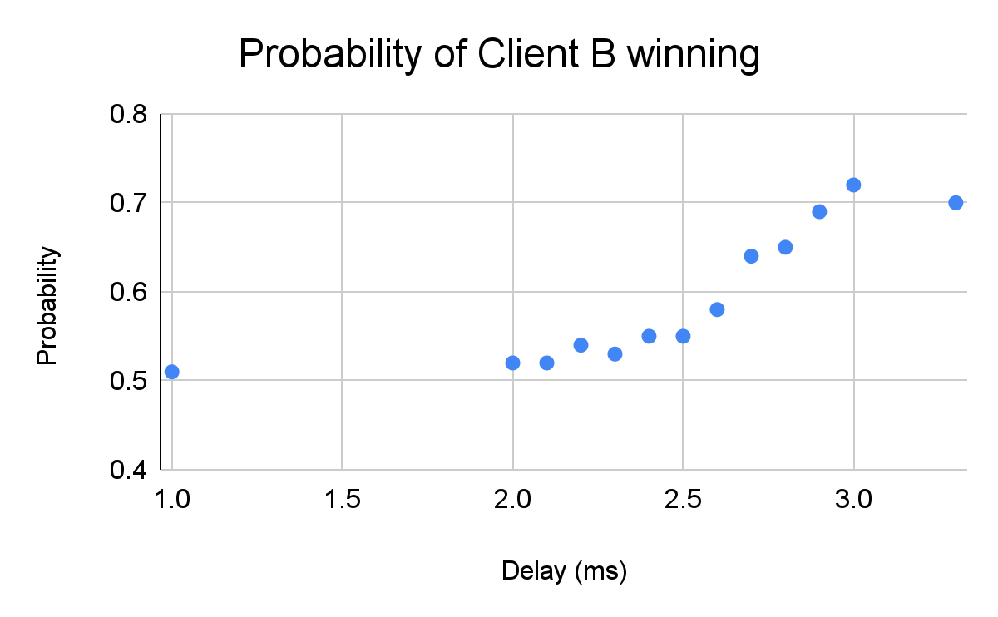
Impact of network randomness of WiscAFS
Fixed delay >> Slowdown delay
p(B winning)
= 0.5 (Since randomly any client be winner)
Slowdown delay >> Fixed delay
p(B winning)
= p(delay in A)*p(B winning) + p(no delay in A)*p(B winning)
= 0.5 * 1 + 0.5 * 0.5 = 0.75
10¹
10^{1.5}
10²
10^{2.5}
10³

Slide 22
Durability: New Error Types
errnj_alice_delay:
When the error is injected the operation is added to a queue and the system call returns success without executing the call.
The operation is executed when the next system call happens before executing the next call.
Added asynchronous delay of 1 system call duration.
errnj_alice_reorder:
Similar to delay when error is injected the operation is added to a queue and system call returns success without executing the call.
The operation is executed after executing the next system call.
Reorders the operation to run after executing the next system call.

Slide 23
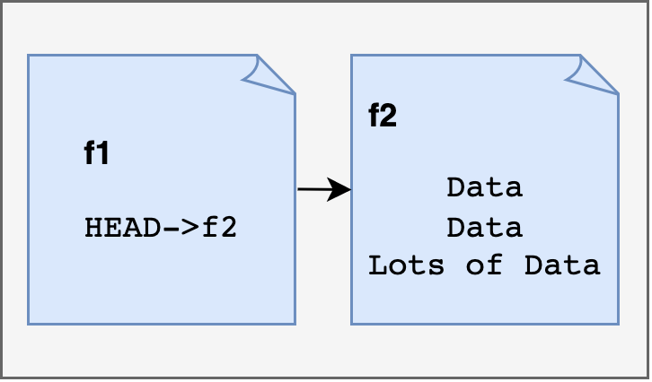
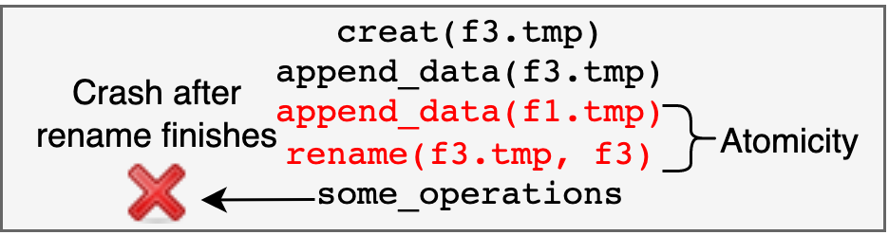
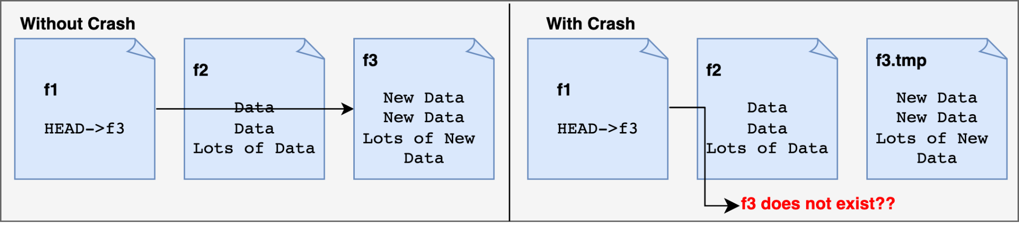
Durability: Workload
Initial State:
In this workload we are adding err_inj_alice_delay in the rename operation.
Application see rename as success but because of the delay there can be inconsistency if crash afterwards
Workload:
Final States:

Slide 24
Durability: Video of Test Case

Slide 25
Takeaways
Filesystems are complicated and POSIX semantics can be confusing!!!
close() (fuse_release operation) seems to execute lazily and ignores return code.
You can unlink an open file. This can mess with AFS semantics.
In mv command, utimens sets last modified time to past, violates monotonic increase in time. Is problematic for systems relying on monotonic increase in time.
Permissions are not just ‘rwx’, there is a lot more inside !!
create() can make a read-only file, but can write on it for the first time (depending on flags).
Consistency
Even with hard-bound “Last Writer Wins” semantics, network latency can change the winner. Sadly you don’t have control :’(.
Durability
Applications assume file-system persistence properties which maybe violated by FS for optimizations leading to application data corruption.
Integrating libraries from C and C++ together is hard.

