Slide 1
Ensembling & Data Augmentation for QA
Agam Dwivedi Mohil Patel Rahul Chakwate
(Team-4)

Slide 2
Introduction
The field of Question Answering (QA) has wide-ranging applications such as in Chatbots, ChatGPT, and machine comprehension.
Recent research has shown that ensemble techniques can improve the performance of QA models.
Data augmentation such as word replacement, oversampling, and data perturbation is commonly used to enhance performance.
Question Generation is a frequently used technique for generating synthetic data.
Notes:
QA has been widely used in various applications such as Chatbots, ChatGPT, etc.
QA is also used in form of machine comprehension where humans answer the questions based on the context.
Recent research showed the improvement in the QA tasks using ensemble techniques. QA models such as BERT, RoBERT, BiDAF and others have been widely used together with different ensemble techniques.
Data augmentation is the common approach to improve the performance of the QA tasks. Techniques such as word replacement, context expansion, oversampling, and data perturbation have been used in recent works.
Question Generation is also a frequently used technique to generate synthetic data. There has been many approaches to generate questions using context and answer.
But there are no comparative studies analysis all these techniques together

Slide 3
Motivation
Ensembling, oversampling and question generation have been widely used in machine learning to improve model performance.
In our work we plan to adapt these techniques specifically for QA task using SQuAD dataset.
We also want to utilize modern LLMs to generate questions and see their impact on QA task.
Our study involves analyzing and comparing different data augmentation techniques and ensemble models.

Slide 4
Retrieval-based QA Task
Problem Formulation:
Given Question (Q) and Context (C), task is to find the answer (A) within the given context.
A = f(Q, C)
Question:
"Where did Super Bowl 50 take place?"
Context:
“Super Bowl 50 was an American foot-
ball game to determine the champion of the Na-
tional Football League (NFL) for the 2015 season.
The American Football Conference (AFC) cham-
pion Denver Broncos defeated the National Foot-
ball Conference (NFC) champion Carolina Pan-
thers 24–10 to earn their third Super Bowl title.
The game was played on February 7, 2016, at
Levi’s Stadium in the San Francisco Bay Area at
Santa Clara, California.”
Answer:
"Levi’s Stadium in the San Francisco Bay Area at
Santa Clara, California."

Slide 5
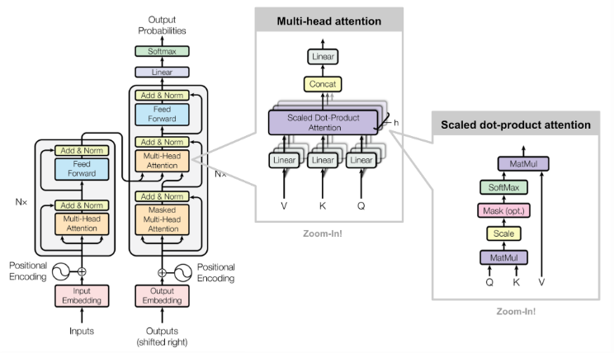
Retrieval-based QA Task
Problem Formulation:
Given Question (Q) and Context (C), task is to find the answer (A) within the given context.
A = f(Q, C)
The model (f) used is a transformer model which extracts meaning from the given input by tracking relationships in the input with the help of self-attention techniques.

Slide 6
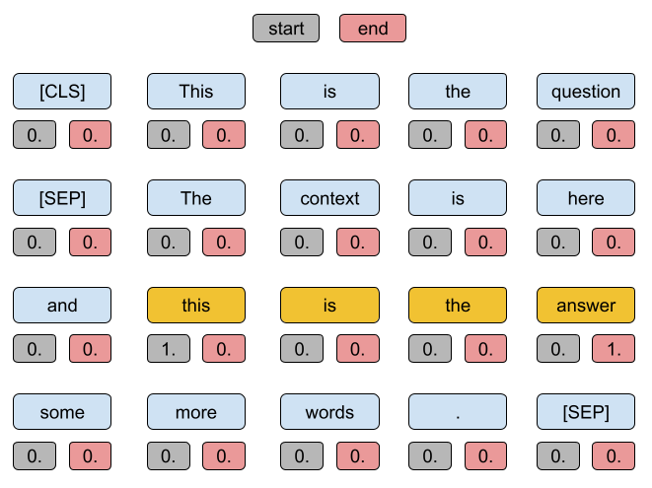
Retrieval-based QA Task
Problem Formulation:
Given Question (Q) and Context (C), task is to find the answer (A) within the given context.
A = f(Q, C)
The model (f) used is a transformer model which extracts meaning from the given input by tracking relationships in the input with the help of self-attention techniques.
Retrieval-based QA differs from generative QA as the model predicts the start and end location of the answer as opposed to generating the answer using sequence models.
We only need encoder part of the transformer architecture as the model must output the probabilities of a word being start token and end token.

Slide 7
Dataset: SQuAD
SQuAD is a Retrieval-based QA dataset widely used in many QA model evaluation.
SQuAD provides (Context, Question, Answer) tuples with the property that answers strings are part of the context itself.
In this way the QA models trained on SQuAD dataset generally predicts the output as start and end tokens in context as the answer.
This unique property of SQuAD allows model to just focus on understanding the context rather than focusing on predicting next word.
In this sense models trained on SQuAD are not generative models.
Dataset cardinality:
Training samples: 87599
Validation samples: 10570

Slide 8
Ensemble Techniques: Models Used
BERT:
BERT is the Encoder stack of transformer architecture containing 12 layers
BERT base has 768 hidden units, 12 attention heads, and contains around 110M parameters.

Slide 9
Ensemble Techniques: Models Used
BERT:
BERT is the Encoder stack of transformer architecture containing 12 layers
BERT base has 768 hidden units, 12 attention heads, and contains around 110M parameters.
RoBERTa:
RoBERTa uses dynamic masking instead of static masking.
RoBERT is Facebook’s Robustly optimized BERT which includes training the model for longer time with larger mini-batches on a larger dataset.
The training dataset size was increased to 160GB of uncompressed text.

Slide 10
Ensemble Techniques: Models Used
ALBERT:
ALBERT is a lite variant of BERT with approx 90% less parameters than the original BERT
This reduction is achieved using matrix factorization of embedding matrix
Cross-layer parameter sharing improves efficiency and decreases redundancy

Slide 11
Ensemble Techniques: Models Used
ALBERT:
ALBERT is a lite variant of BERT with approx 90% less parameters than the original BERT
This reduction is achieved using matrix factorization of embedding matrix
Cross-layer parameter sharing improves efficiency and decreases redundancy
DistillBERT:
A distilled version of BERT
Idea is to using the distillation technique in which a large network is trained and its full output distribution is approximated by a smaller network.
Optimized using KL divergence similar to posterior approximation.
Retains 95% performance with only half the parameters (half the layers of original BERT)

Slide 12
Ensemble Techniques: Approach
Each model gives us the confidence score for each predicted answer, we use this confidence score to create ensemble.
Specifically, we choose predictions of that model whose confidence is highest.
This technique is based on the intuition that model will predict correct answers with high confidence and will be unsure in case of uncertain answers.
We use this technique specifically for SQuAD dataset because simple averaging will not work in case of predicting start or end tokens.
Our intuition is that in case of SQuAD, best prediction should come from only one model as aggregating or voting from multiple models may result in unreasonable answer spans.

Slide 13
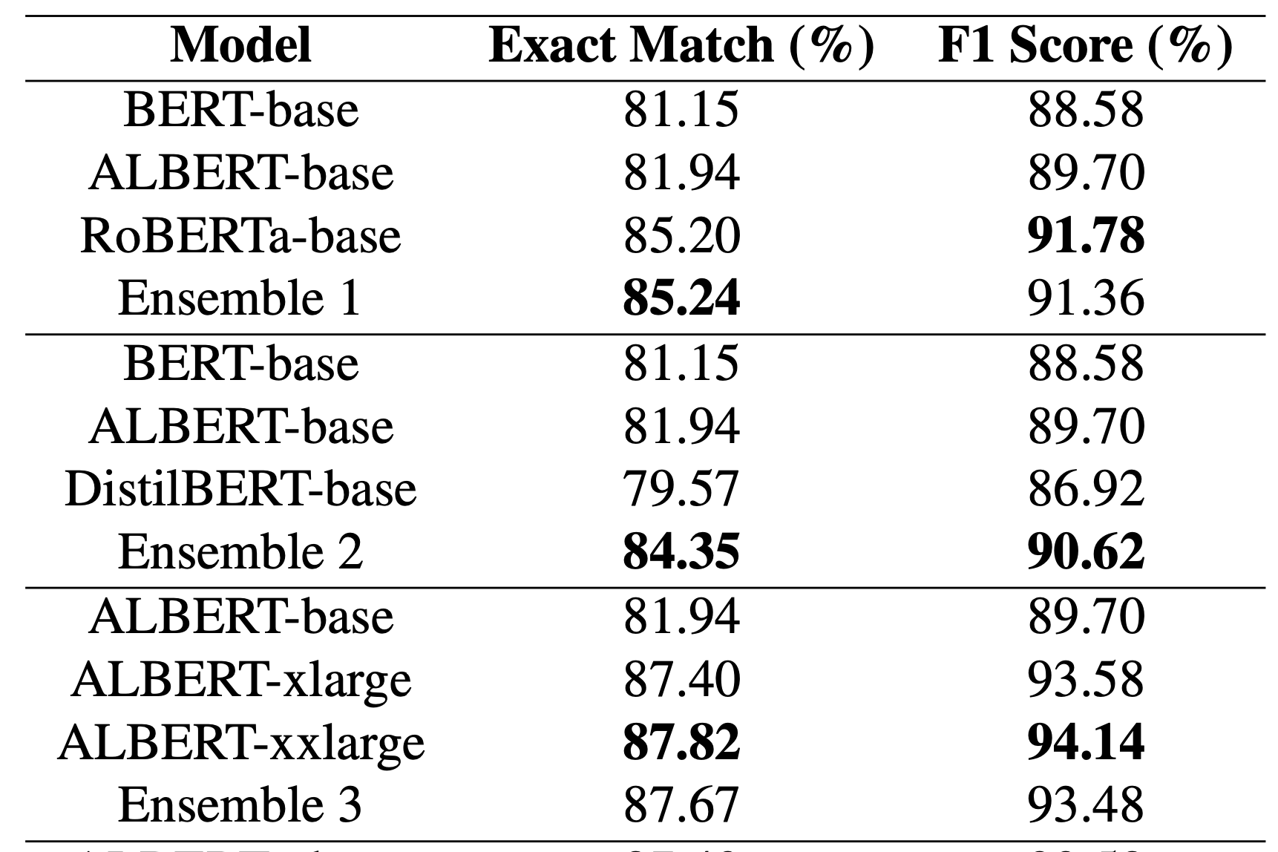
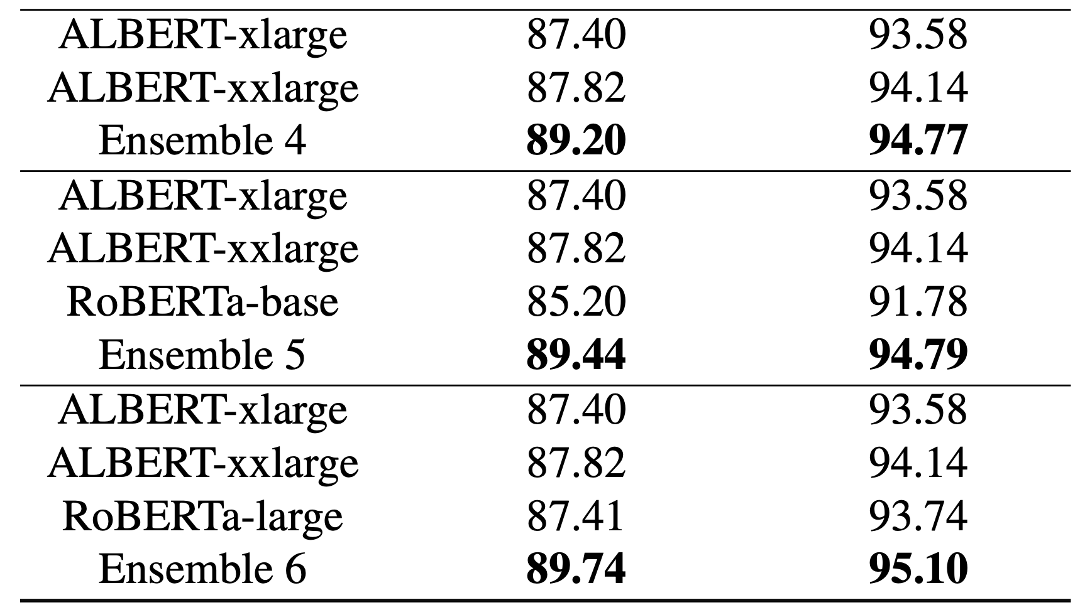
Results (Plots and Tables)

Slide 14
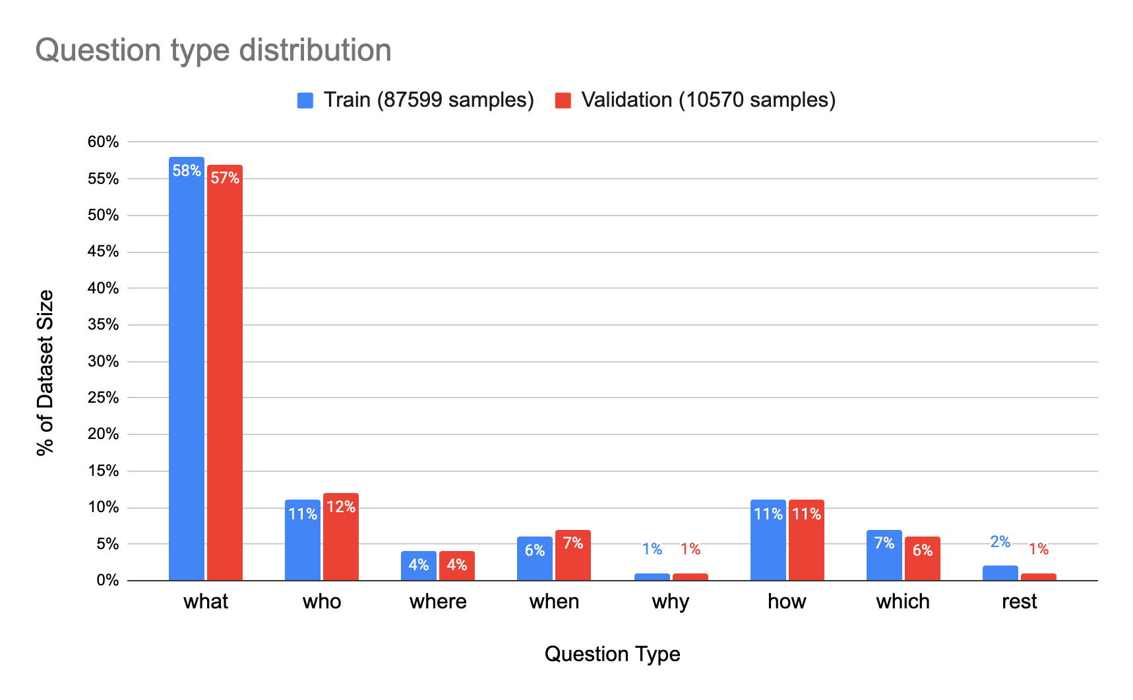
Oversampling: Preliminary Analysis

Slide 15
Oversampling: Approach
As shown in the analysis on the previous slide there is a huge imbalance between what type of question and rest of the questions.
By oversampling the dataset we increased the number of underrepresented question type to balance the dataset.

Slide 16
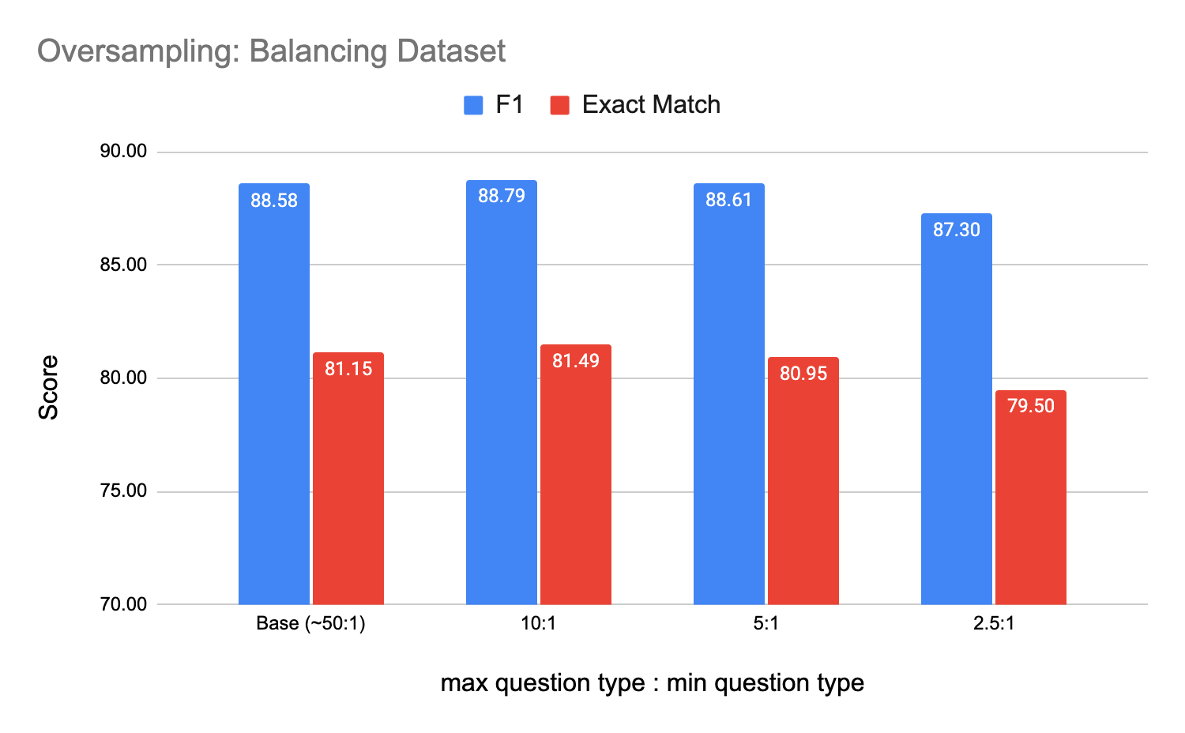
Oversampling: Results

Slide 17
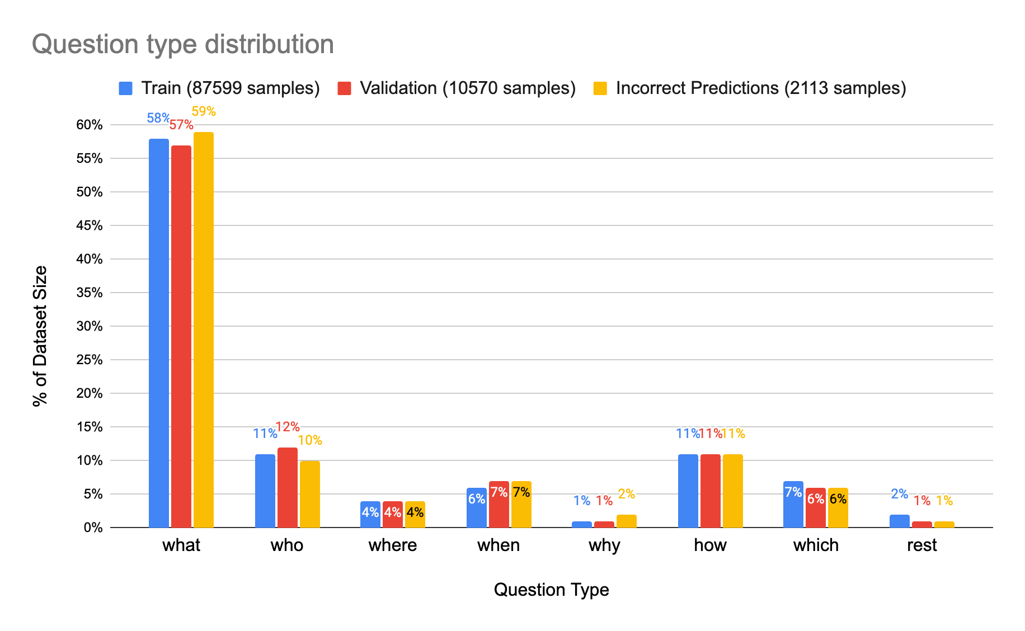
Oversampling: Why no improvement?
To understand the reason we analyzed distribution on incorrect prediction for BERT-Base (without oversampling)
Distribution of incorrect prediction is similar to train and validation, which means the BASE model is learning each question equally well
Thus we do not see improvement

Slide 18
Question Generation
Many existing approaches generate new questions by modeling C, A → Q.
They train LLMs to generate new questions based on given Context and Answer.
Using this approach for SQuAD provides a unique challenge for generating A.
In SQuAD A must be part of the context.
This means we cannot use generative LLMs to generate A because the generated answer might not be part of the context.
We used two different approaches here.

Slide 19
Question Generation: Approach
Approach-1 (using same A as SQuAD):
Used T5 based fine tuned Question Generation model.
It is a generative model which generates question using context and answers as input: C, A → Q.
In approach-1 for A we used the SQuAD’s answers for that context as input.
Approach-2 (training a model to generate A):
To generate new A from context (C), we trained a BERT model which output start and end token for A (p(a|c; θ_{A}))
Generated output A were not of good quality so we decided not to use them.
Future challenge: Generate C→ A model for SQuAD. Here generated A must be part of context.
Notes:
Output of the BERT model is passed through MLP layers to generate start and end tokens.

Slide 20
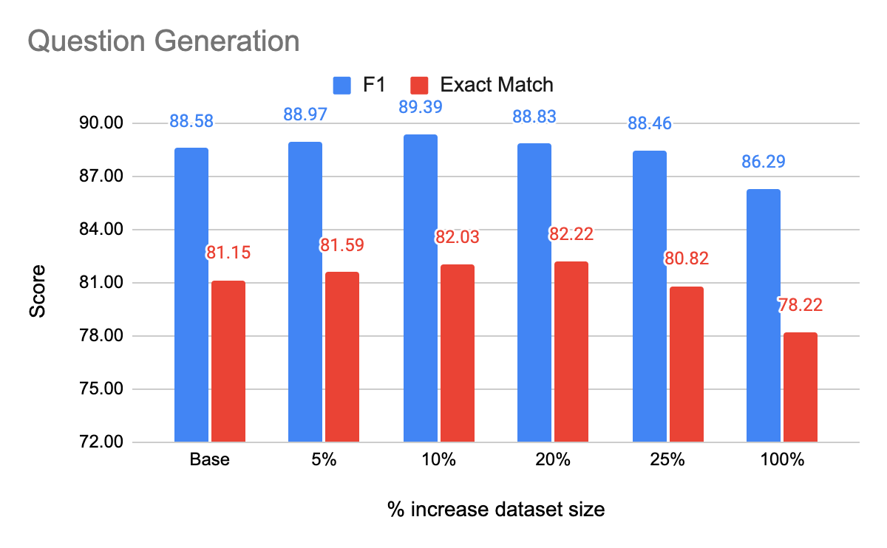
Question Generation: Results

Slide 21
Takeaways
Question Generation can lead to improvement. Modern LLMs (C, A→ Q) can be used to generate synthetic dataset for better performance.
For SQuAD specifically training C→ A can be improved by using techniques like syntactic parsing. This can help generate better synthetic dataset.
For SQuAD dataset using confidence metric for ensembling can lead to performance improvement.

Slide 22
Questions?
(our QA model can answer them, given answer is part of the context!)

