Slide 1
Improving Performance in LSM-Tree based Key-Value Stores using NVMe
CS 736 Advanced Operating Systems
Satoshi Iwata Mohil Patel Partho Sarthi John Shawger

Slide 2

RocksDB
LSM-Tree based key-value store
Good write performance
Initially developed by Facebook based on LevelDB
Adapted to multiple systems
A number of backend systems at Facebook
Database storage engine
MySQL, MongoDB

Slide 3
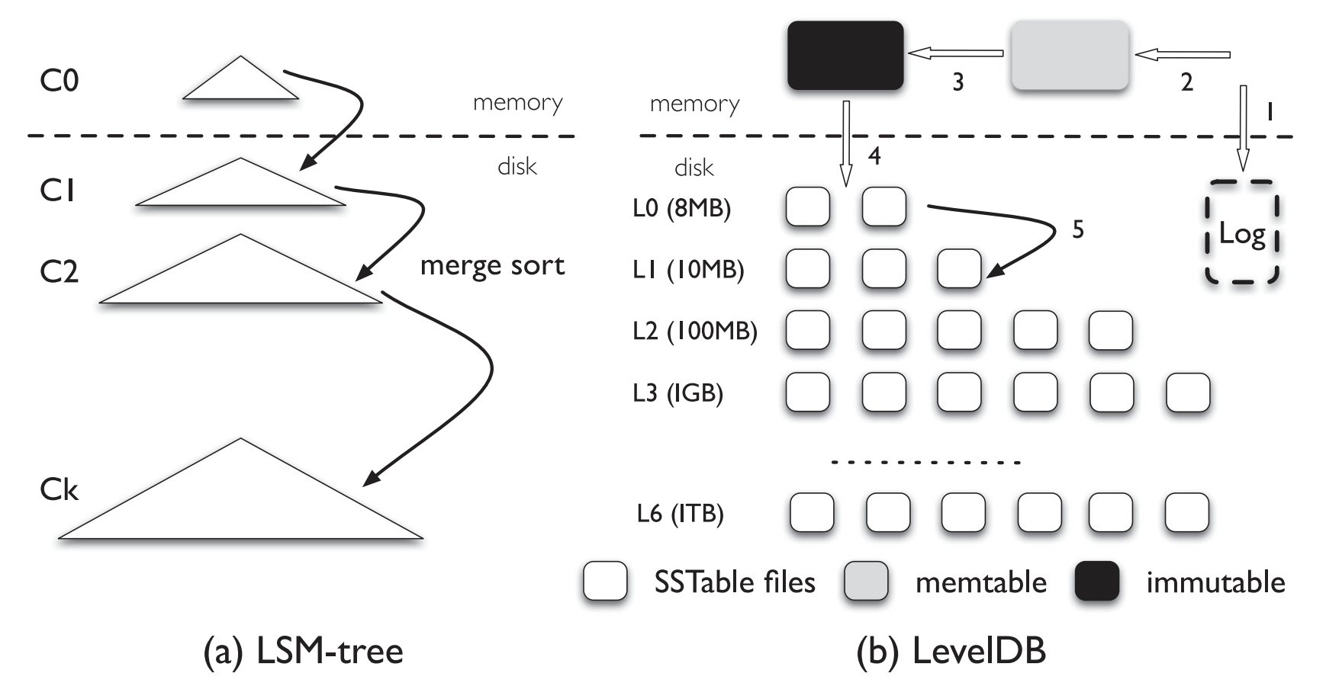
RocksDB Write Path
L0 can have duplicates
Compaction pushes data to higher levels (write amplification)
WAL (Write Ahead Logging) used for persistence
Figure 1: “WiscKey: Separating Keys from Values in SSD-Conscious Storage” [Lu, Lanyue, et al. ACM TOS 17]

Slide 4
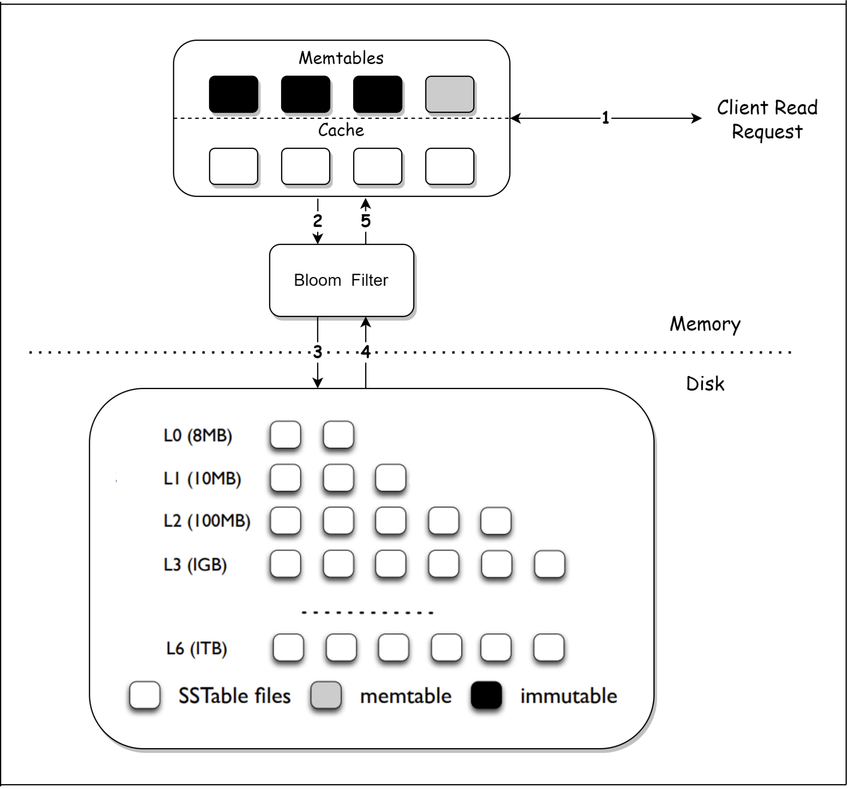
RocksDB Read Path
Need to read L0 sequentially because of duplicate (& stale) entries
Reads slow down due to read amplification
To speed up reads use bloom filters and in-memory caching of SSTables

Slide 5
RocksDB
Performance gap:
For example, on a SATA SSD, 20GB of data written with random keys has a throughput from the client’s perspective of 91.8 MB/sec
In the background, compaction has written 73.61GB at 337.89 MB/sec on average.

Slide 6
SATA, NVMe, SPDK
SATA is an interface developed for HDD
Maximum of 600 MB/s
NVMe is an interface developed for SSD
Maximum of 16,000 MB/s with Gen 4, x8 lanes
SPDK is a library which provides high-speed storage access
User-mode storage access to avoid context switches
Polling-based completion check to avoid interrupt overhead
Notes:
At the initial appearance of SSD, SATA, which was already available, compatible interface was selected. To utilize the maximum speed of SSD, NVMe, which is a new interface based on PCIe is proposed and became available. SPDK is proposed to utilize full speed of NVMe SSDs.

Slide 7
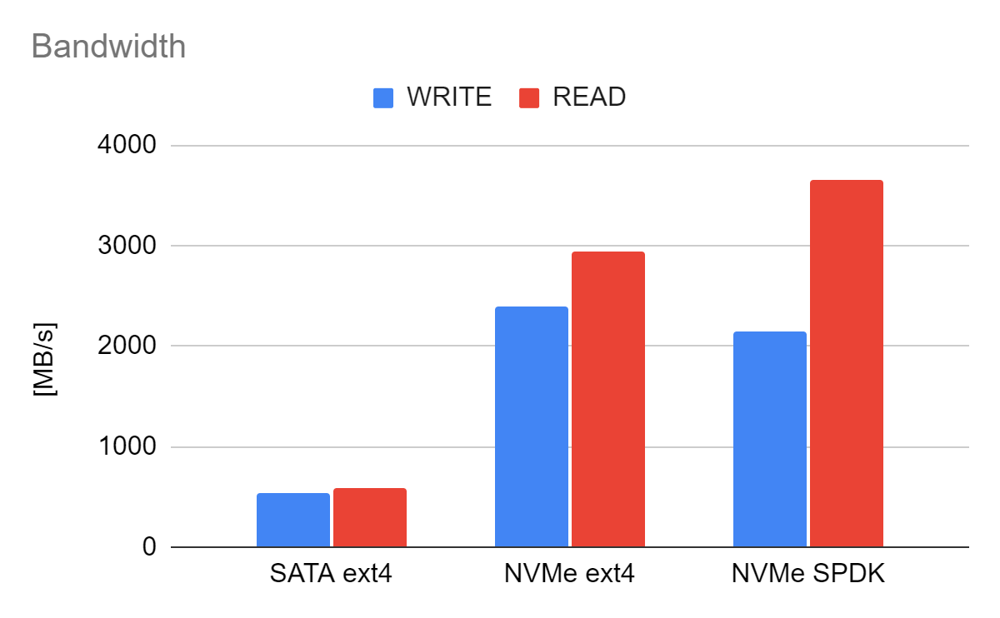
Bandwidth of SATA vs. NVMe and ext4 vs. SPDK
Specifications
SATA
READ: 520 MB/s
WRITE: 540 MB/s
NVMe
READ: 7000 MB/s
WRITE: 2400 MB/s
Notes:
Measured performance except for READ on NVMe show ideal performance in our environment. Unfortunately, the reason of slower NVMe READ is not discovered.

Slide 8
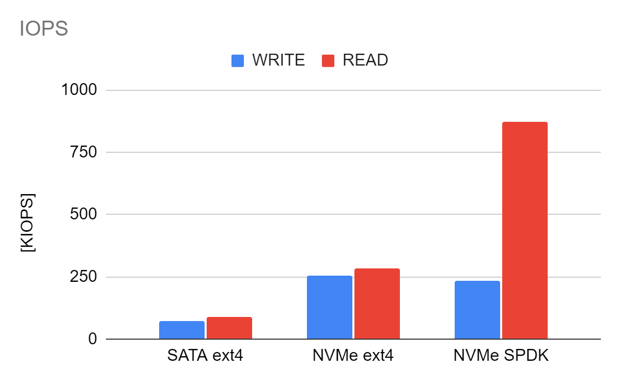
IOPS of SATA vs. NVMe and ext4 vs. SPDK
Specifications
SATA
READ: N/A
WRITE: N/A
NVMe
READ: 1000 K
WRITE: 200 K
Notes:
READ IOPS with ext4 on NVMe SSD is much lower than ideal performance. SPDK provides nearly ideal performance, in contrast.

Slide 9
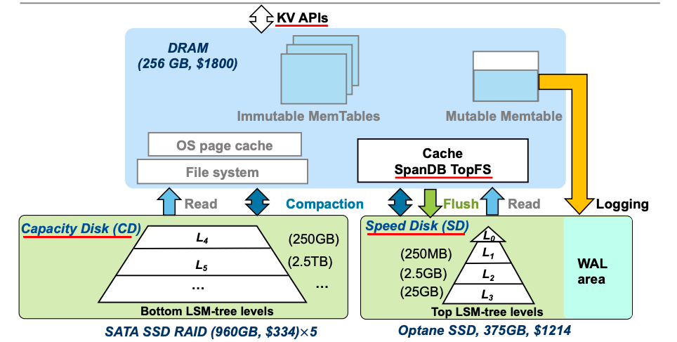
Existing Systems - SpanDB
Key Features:
Async KV request processing
Parallel Logging via SPDK
Dynamic LSM-Tree Level Placement
A Fast, Cost-Effective LSM-tree Based KV Store on Hybrid Storage
Notes:
Hot data in nvme
Faster expensive device
Does not utliize full bandwidth

Slide 10
Existing Systems - SpanDB [FAST ’21]
Parallel logging via SPDK
Tiering between NVMe and SATA
Hot: WAL, L0~L3 SSTables
Cold: L4~ SSTables
0
3
WAL
2
4
1
5
…
SATA
NVMe

Slide 11
Our Approach
SATA SSDs are also fast, why don’t we utilize total bandwidth?
0
0
4
3
2
4
3
1
2
1
5
5
…
…
SATA
NVMe
Notes:
-SATA is fast, can we split in a different way such that we can utlize both b/w

Slide 12
Problem Statement
Draft 1: Can simple data splitting strategies utilize fast NVMe disks when using RocksDB?

Slide 13
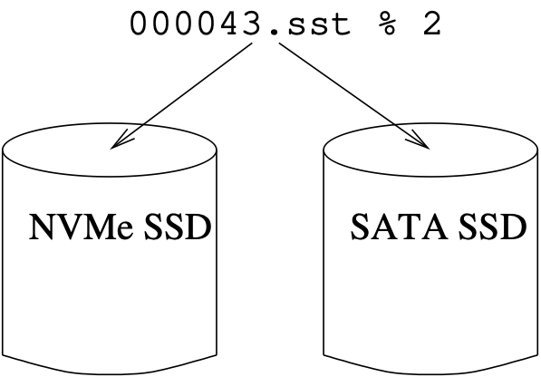
Strategies for splitting data
SST Files
modulo approach
Filesystem level
Software RAID 0 with mdadm

Slide 14
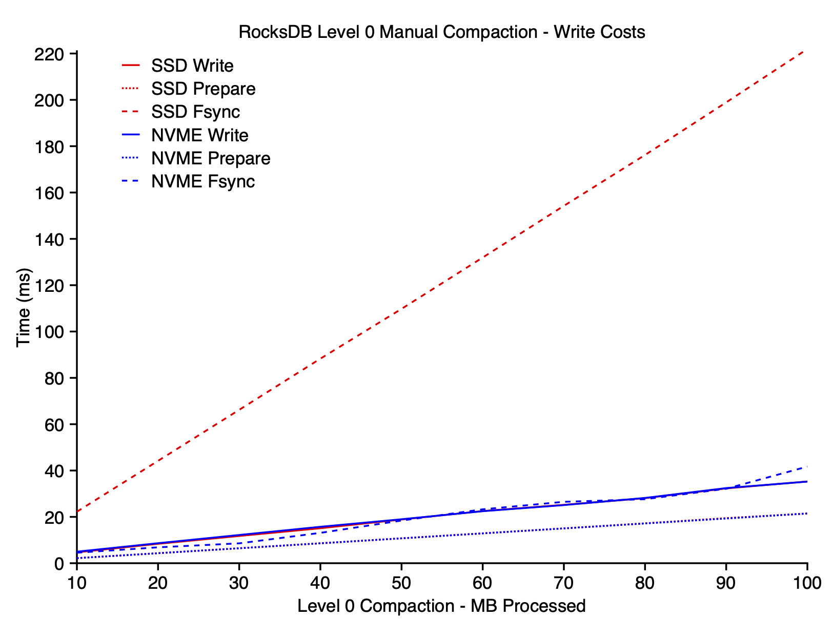
Splitting data, continued
Splitting data across disks could improve throughput
Write syscall performance depends on the OS, not the disk

Slide 15
Some Tips for Running db_bench
Use random write instead of sequential write
Sequential write does not incur compaction
Use synchronous write to see the device performance
WAL without sync shows cache performance
Increase number of values to insert
Default number of values is too few to incur compaction
Notes:
For our exp, DB Bench
Sequential write by db_bench means writing values in sequential key order. So, values are already sorted in key order, and it doesn’t incur read for sorting values.
WAL write without sync option seems replying just after the write to the OS buffer. So, it doesn’t show device’s performance.
Default –num is 1M and too small to incur compactions.

Slide 16
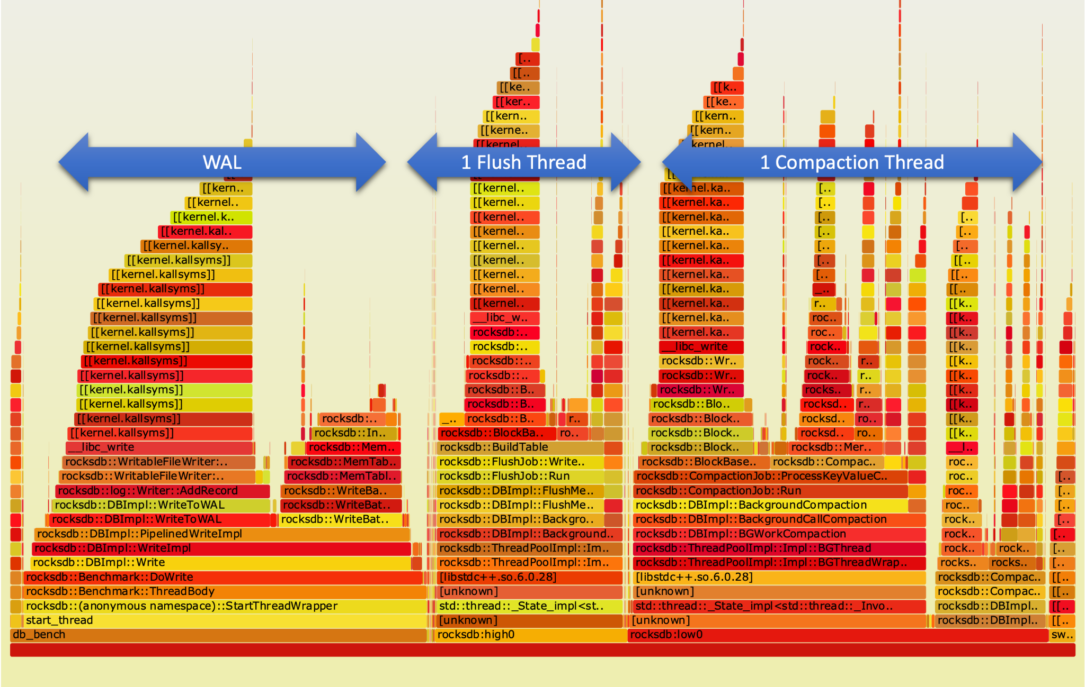
Experiment Method - Flamegraph (SSD)
Write-Ahead-Logging (WAL) consumes a significant time.
Flush and Compaction run in background to take advantage of storage technology concurrency.
Notes:
Flamegraph of db bench on running on SATA SSD. It consists of 3 peaks - WAL and background threads for flush and compaction.

Slide 17
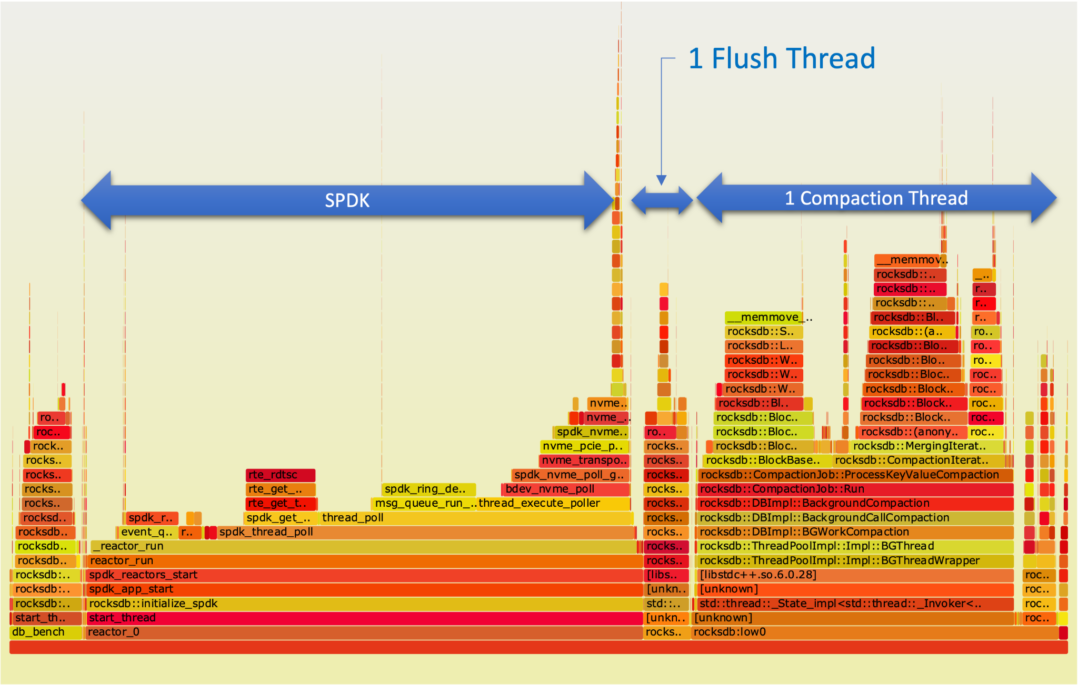
Experiment Method - Flamegraph (SPDK)
We disabled WAL for our experiments.
CPU cycles for flush jobs reduces from 21% to 4%.
Notes:
Hence, we disable WAL for our experiments. This flamegraph shows running db bench on SPDK.
Talk about CPU cycles for flush thread being reduced

Slide 18
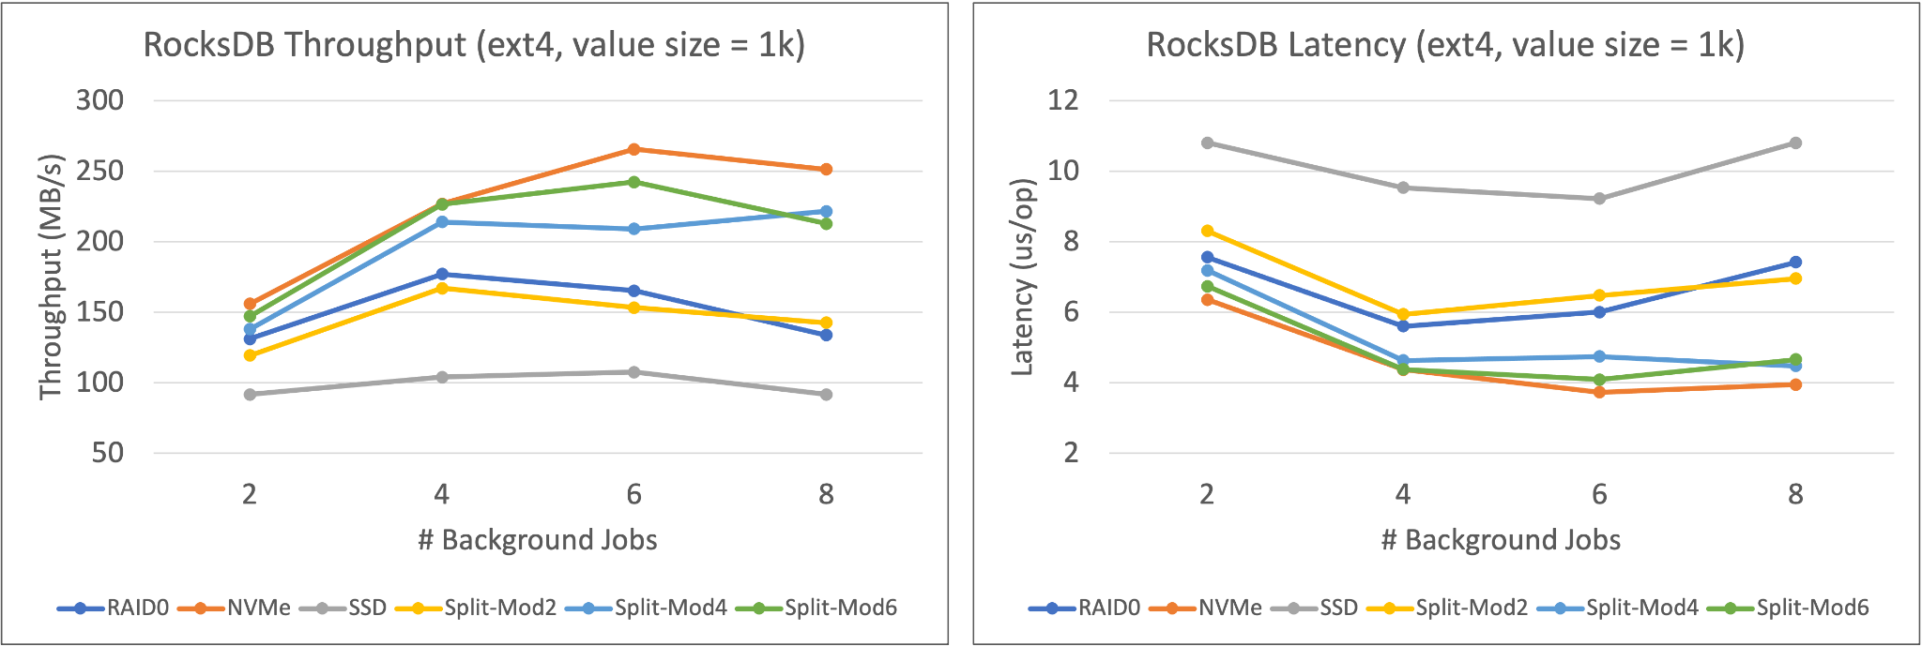
Results - ext4
NVMe >> Split-Mod6 >> Split-Mod4 >> RAID0 = Split-Mod2 >> SSD
Notes:
Measured ext4 performance by varying the number of jobs for different

Slide 19
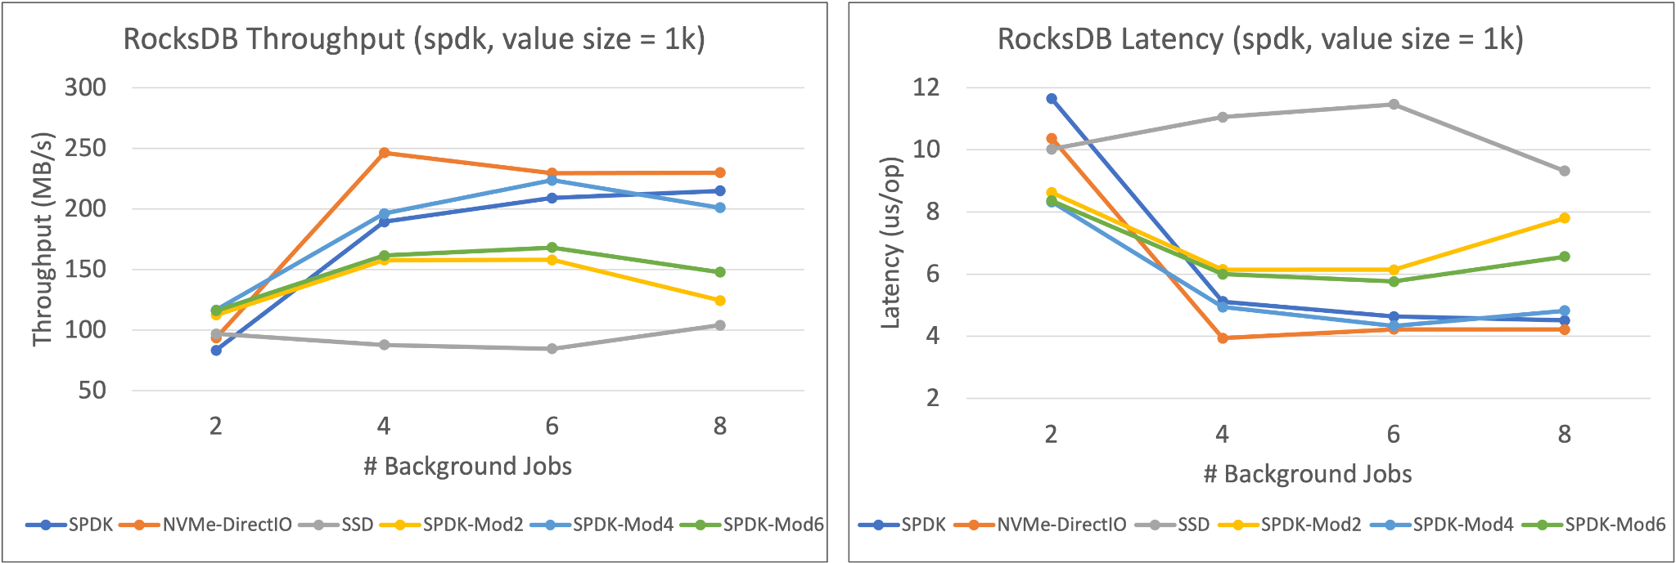
Results - SPDK
NVMe-DirectIO >> SPDK-Mod4 >> SPDK >> SPDK-Mod2 >> SSD
Notes:
Measured ext4 performance by varying the number of jobs for different

Slide 20
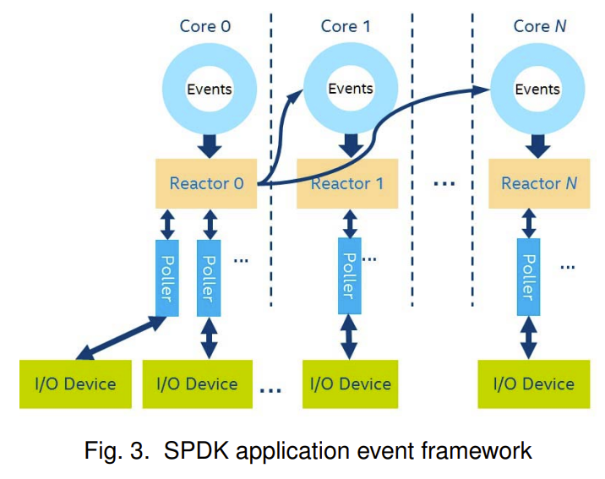
Future Work
SPDK uses blobfs. We can improve blobfs by:
Adding support for multiple write threads
Adding caching layer
Static split is not optimal, because of runtime variations:
Utilize SPDK events queue to decide where to place the data at runtime (like shenango!!)
Potential Issue: Might end up using faster disk for all the data

