Slide 1
URBAN OUTFITTERS
EXPANSION OPPORTUNITIES

Slide 2
Outline
EXECUTIVE SUMMARY AND INTRODUCTION
About the company
About the apparel industry worldwide
PROCESS AND FINDINGS
Selection of countries
About India
About Thailand
Possible geographic expansion
Macroeconomic analysis
Microeconomic analysis
Market strategy
Statistics
Conclusion
references

Slide 3

About
Urban Outfitters, Inc. (URBN) is a multinational lifestyle retail corporation headquartered in Philadelphia, Pennsylvania.
It is already operational in the United States, Sweden, UnitedKingdom, Spain, Denmark, France, Germany, Ireland, Belgium, Canada, Italy, the Netherlands, Israel, Poland, and the United Arab Emirates.
The brand targets young adults with a merchandise mix of women's and men's fashion apparel, footwear, beauty and wellness products, accessories, activewear and gear, and housewares, as well as music, primarily vinyl records and cassettes.
their revenue as of 2019 was 3.9 billion USD..

Slide 4
Industry overview
The global apparel market is projected to grow in value from 1.3 trillion U.S. dollars in 2015 to about 1.5 trillion dollars in 2020, showing that the demand for clothing and shoes is on the rise across the world. | The three world regions with the largest apparel markets are the 28 member states of the European Union, the United States, and China, in descending order. | The apparel industry constitutes about a little more than 4% of the market share of the world

Slide 5
Selection of countries
Factors considered and their respective weights
Country | GDP in millions | CPI | Trade openess | household spend on apparel | Ease of doing business | rank
thailand | $5,43,649.98 | 36 | 123 | 109617 | 21 | 1
india | $28,75,142.31 | 41 | 43 | 28365.18 | 63 | 2
turkey | $7,54,411.71 | 91 | 60 | 11493 | 33 | 3
vietnam | $2,61,921.24 | 37 | 208 | 2018.03 | 70 | 4
brazil | $18,39,758.04 | 35 | 29 | 51591.89 | 124 | 5
bulgaria | $67,927.18 | 43 | 131 | 743.7 | 61 | 6
indonesia | $11,19,190.78 | 40 | 43 | 5139.12 | 73 | 7
nepal | $30,641.38 | 34 | 55 | 640.43 | 94 | 8
sri lanka | $84,008.78 | 38 | 53 | 660 | 99 | 9
paraguay | $38,145.29 | 28 | 70 | 519.58 | 125 | 10
Corruption perception index (0.1)
GDP (0.2)
Trade openness (0.15)
Ease of doing business (0.25)
Household spend on apparel (0.3)

Slide 6

About india
India, the country of flying carpets and computer engineers, diversity and the taj mahal is a rapidly growing economy and market for brands all over the world.
According to McKinsey and company India is increasingly becoming a focal point for the fashion industry, reflecting a rapidly growing middle class and an increasingly powerful manufacturing sector.
Comprising of a Large population, India serves not only as a market for finished goods but also offers a cost efficient workforce
With the ban of Chinese clothing apps, a large business opportunity has opened up

Slide 7

About thailand
Thailand known initially for it’s tropical beaches, opulent royal palaces, ancient ruins and ornate temples is now also a thriving economy and manufacturing hub
The economy is welcoming and ranks 21st in ease of business.
It provides a cost effective work force and raw materials as well as a Strategic location for penetrating the Asian market

Slide 8
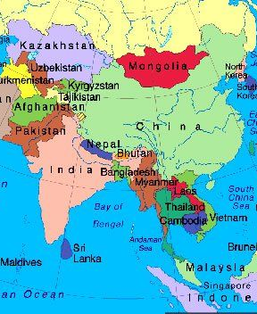
Geographic expansion
India lies along the coastline which enables trade to a lot of countries like sri lanka, Malaysia, Thailand,Singapore all potential markets
India is a strategic location to target countries towards the west like Maldives where as Thailand can be used to supply products to countries in the east like japan
However due to close proximity the geographical advantage provided by both is more or less similar

Slide 9
MACROECONOMIC ANALYSIS
The GDP growth rate is very similar for both the countries.
India has a lower GDP per capita but a higher overall GDP.
Both rebounded really well from 2008 recession which may be an indicator of their response to the COVID-19 crisis
Companies moving out of china are likely to set shop in either India, Thailand or Vietnam

Slide 10
Macroeconomic analysis
The high inflation rate in India could be either due to the steady increase of wages or declining supply. This means that costs of operation can increase substantially over time.
Thailand’s inflation rate is more stable
The Indian economy thrives on the service sector where as the Thailand economy thrives on the manufacturing sector
Inflation is likely to increase in 20-21 for both the countries due to the COVID-19 recession but also benefit from the relocation of manufacturing units from china and provide a lot more jobs bringing down the unemployment.

Slide 11
MACROECONOMIC ANALYSIS
economy | Ease of Doing Business Rank | Starting a Business | Dealing with Construction Permits | Getting Electricity | Registering Property | Getting Credit | Protecting Minority Investors | Paying Taxes | Trading across Borders | Enforcing Contracts | Resolving Insolvency
Thailand | 21 | 47 | 34 | 6 | 67 | 48 | 3 | 68 | 62 | 37 | 24
India | 63 | 136 | 27 | 22 | 154 | 25 | 13 | 115 | 68 | 163 | 52
As can be seen enforcing contracts and starting a business india are relatively tougher
Both the countries require businesses to pay very high taxes
India doesn’t trade as openly as Thailand who’s economy is almost entirely export based
parameter | India | Thailand
Ease of business | 63 | 21
CPI | 41 | 36
Ease of trade | 43 | 123

Slide 12
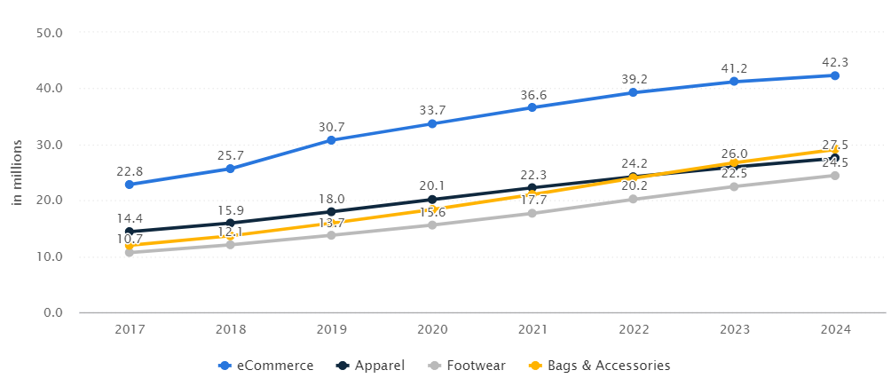
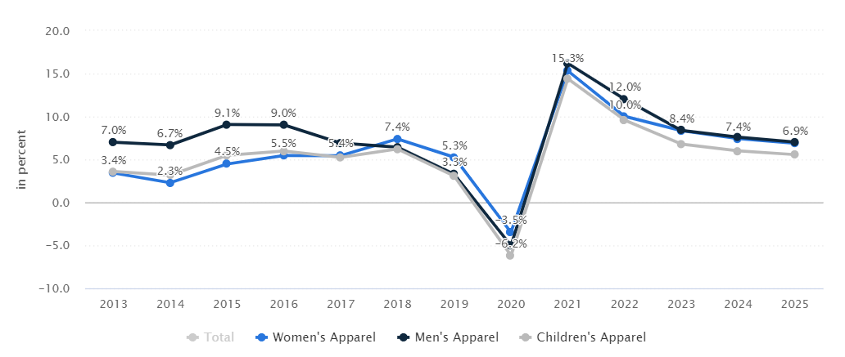
Microeconomic analysis
Factors effecting demand in India
Increase in incomes :The aggregate income of the addressable population (individuals with more than $9,500 in annual income) is expected to triple between now and 2025
Trends in fashion: Traditional clothing is still very much the default choice for women, making up an estimated 70 percent of women’s apparel sales in 2017. The appetite for Western styles is likely to increase, but traditional wear is still expected to account for a 65 percent market share by 2023
Customer expectations about the future: this is uncertain and rather bleak. After the covid-19 recession the demand is likely to shrink. The graph of revenue growth below shows the negative forecasted growth
Demand Analysis
India’s apparel market will be worth $59.3 billion in 2022, making it the sixth largest in the world, comparable to the United Kingdom’s ($65 billion) and Germany’s ($63.1 billion), according to data from McKinsey’s FashionScope
The revenue of the apparel industry in Thailand is depicted in the graph below

Slide 13
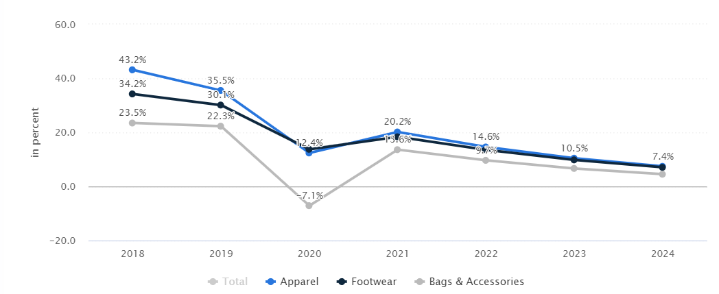
Microeconomic analysis
Factors effecting demand in Thailand
Customer expectation about the future : the revenue growth is expected to fall on account of the COVID-19 recession as can be seen alongside

Slide 14
MiCROECONOMIC ANALYSIS
Factors effecting supply in India
Factors effecting supply in Thailand
Government policies and technology : Thailand is shifting away from labor-intensive manufacturing to more advanced manufacturing to address skilled worker shortages. The government has announced several incentives to encourage private sector participation in the initiative and offset the costs involved in adopting new technologies. Among the incentives offered are:
The option to establish companies with 100 percent foreign ownership
Import duties exemptions on raw materials and machinery used for research and development and products meant for export
Exemption of corporate income taxes for a period of up to 13 years
A tax-deductible allowance equivalent to 70 percent of invested capital
A tax holiday of up to 15 years for enterprises involved in new technologies
Matching grants for innovation and R&D in selected sectors
Prices of raw materials and labour: Thailand’s labor costs are among the highest in Southeast Asia.The minimum wage is significantly higher than the rate in smaller Chinese cities—although major Chinese cities have comparable minimum wages.
Ban on Chinese clothing companies : The ban on apps like shein has left a huge business opportunity for clothing brands to leverage. Shein had taken up a huge percentage of the apparel market and now consumers are looking for a substitute.
Prices of raw materials and labour: According to a 2017 McKinsey survey, 41 percent of chief procurement officers expect to increase the share of their sourcing from India, where average labor costs are significantly lower than China’s and comparable to Vietnam’s. Raw materials (such as cotton, wool, silk, and jute) are highly available, which enables participation in the entire fashion value chain.
Government policies : the FDI Policy permits 51% foreign investment in multi-brand retail, subject to approval of the Indian government and fulfilment of certain conditions including the foreign investor needing to bring in a minimum of US$ 100 million; 50% of the total foreign investment being invested in backend infrastructure (including investment towards processing, manufacturing, storage etc.). This is cumbersome and discourages a lot of comapnies
Supplier expectation :Though the Indian government is helping industries stay afloat a lot of companies are having to cut down supplies due to the covid-19 recession
Infrastructure and technology: Another challenge is the low quality of India’s infrastructure, which continues to lag behind that of many other Asian countries. Nearly 40 percent of the Indian road network was unpaved as of 2016. Poor infrastructure can make last-mile deliveries difficult.

Slide 15
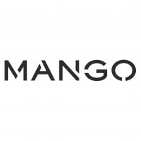




Target market characteristics
COST
Younger people (below 40)
High or medium income group
People who value quality over price
high
Q
UA
L
I
T
Y
high
low
Market positioning should focus on
Marginally lower cost than competition
Brand uniqueness
Mid quality products
Focus on both store bought products and ecommerce in the nearby countries as well
low

Slide 16
Statistics for our target segment
In the year 2019 a share of 39.8% of apparel users in india were between 25-34 years old.
In the year 2019 a share of 33.0% of apparel users in thailand were between 25-34 years old
In the Fashion segment, in Thailand 6% of total market revenue will be generated through online sales by 2024.
In the Fashion segment, in India, 8% of total market revenue will be generated through online sales by 2024
In the year 2019 , in Thailand a share of 42.3% of apparel consumers are in the high income group
In the year 2019, in India a share of 34.6% of users is in the high income group.

Slide 17
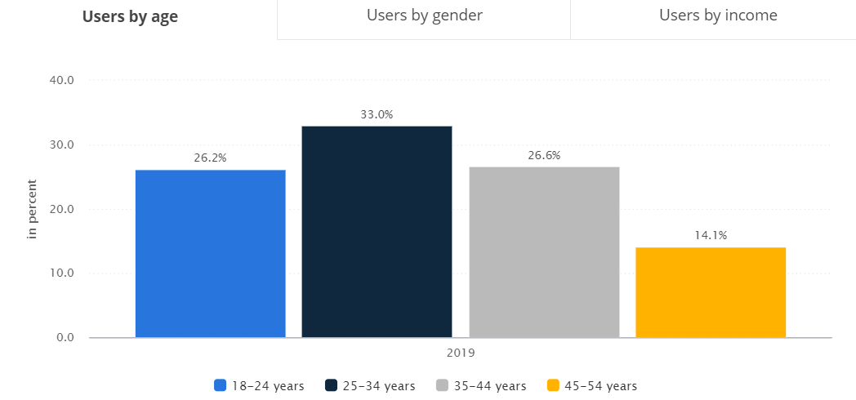
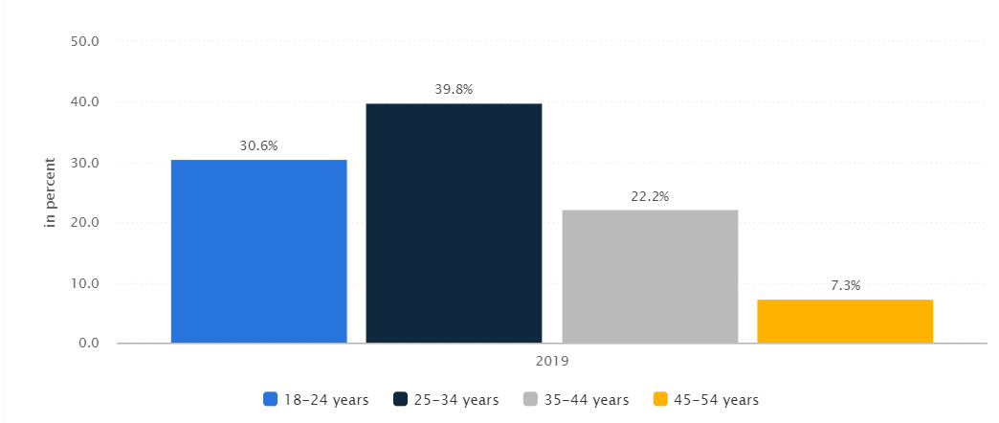
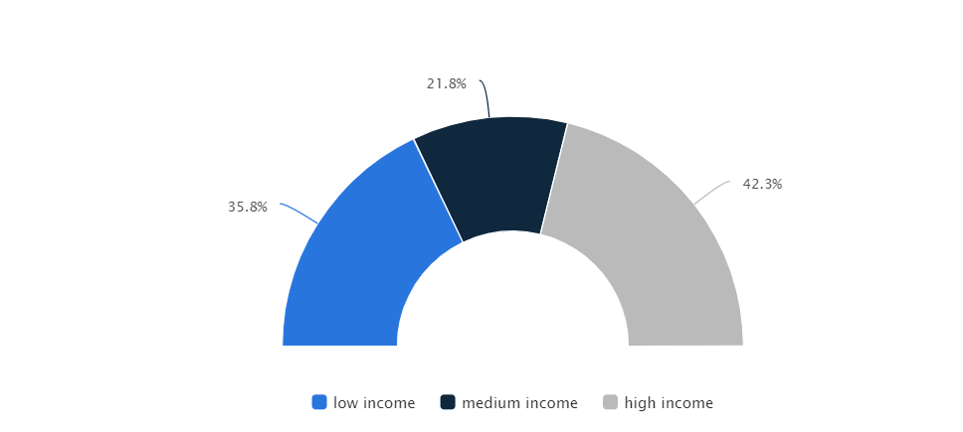
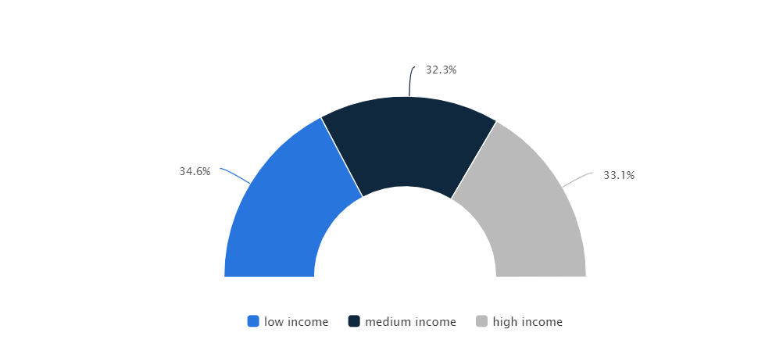
Apparel market in Thailand by age and income
Apparel market in India by age and income

Slide 18
Conclusions and recommendations
Both the countries have their pros and cons
India’s large internal market , cost efficient labour and raw material are major advantages whereas their restrictive FDI policies and limited infrastructure are a disadvantage
In my opinion India should be the country to be invested in. The potential market as well as cost effectiveness is a huge advantage which cannot be ignored

Slide 19



References https://www.mckinsey.com/industries/retail/our-insights/how-indias-ascent-could-change-the-fashion-industry https://www.statista.com/outlook/244/126/fashion/thailand#market-revenue http://www.technopak.com/Files/fashion-retail-scenario-in-india.pdf https://www.intouch-quality.com/blog/thailand-manufacturing-an-alternative-to-sourcing-from-china

