Slide 1

MTC COST AND REVENUE OPTIMISATION
BY MOHINI NATH

Slide 2
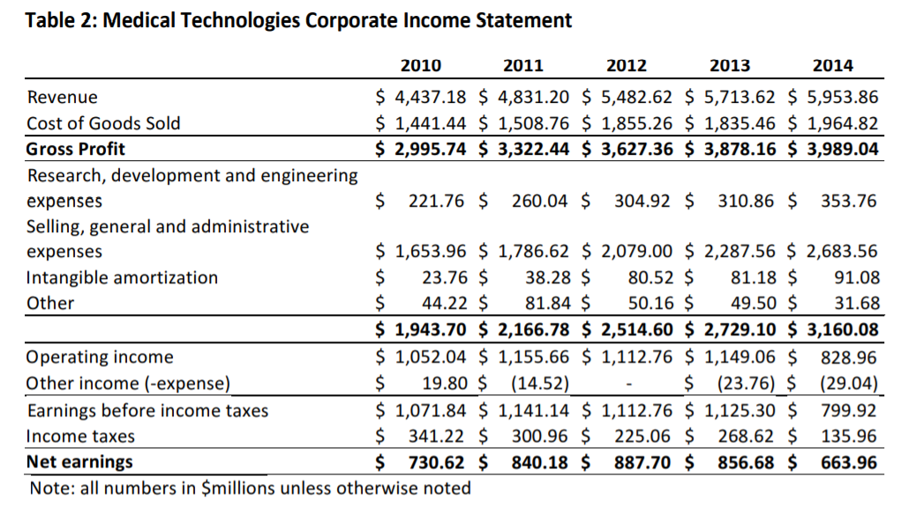
Overview
Medical Technologies Corporation (MTC) headquarters in Collegeville, Pennsylvania
The introduction of the ACA introduces a taxation of 2.3% on their revenues causing a 10% decrease in their profits
Their main markets are
Hospitals and clinics (partly through GPOs) 35%,
Specialists and alternate-care providers 16%,
Third-party healthcare providers and Distributors 12%,
Exports 37%
As can be seen from the chart net earnings have been going down while the SGA spend is on the rise
The table shows the approximate spending and earnings of the company

Slide 3
Financial Analysis
The revenue growth stagnated for the last 2 years at 4% after having a massive 13.5% growth in 2012.
The SGA spendings have been increasing year in and year out
RnD hasn’t seen a sizable increase in investment
Net earnings was on a decline post 2012 and saw a huge decline in 2014

Slide 4
Problems the company faces
The current supply chain
manufacturers
The additional 48 hours in lead time and transport cost due to offsite sterilization
Customers prefer buying through distributors to whom we can only sell at retail prices
High commission charged by sales representatives
Standard quantity being shipped per week and the left overs are sent back to the distributors for re sterlization before selling else where
The GPOs formed have set the cost very low
MTC
Sterlization
process
distributor
3PL
Healthcare
provider
Hospital
rooms

Slide 5
Proposed solutions
Short term goals
Intermediate term goals
Long term goals
Remove the sterilization plant to manufacturer leg of supply chain
Introduce a commission based salary for the sales representatives
Offer increased discounts on increased quantities sold to the distributor
Lessen the number of head offices and regroup or reduce staff
Introduction of the smart kiosks for better inventory management
Phase out non distributor type sales. Continue with sales that take place only through distributors
Consider new avenues of income which aren’t taxed as aggressively
Notes:
Commission based salary not only motivates sellers to work harder but also may help reduce the salary paid to the sales representatives.

Slide 6
Supply chain optimization
Newly proposed supply chain
Approximate savings
manufacturers
An approximate of 6% of cost of goods is spent on logistics and transport. We hope to reduce it by 2 % resulting in the following savings
MTC
Sterlization
process
 | 2010 | 2011 | 2012 | 2013 | 2014
revenue | 4,437.18 | 4,831.20 | 5,482.62 | 5,713.62 | 5,953.86
COGS | 1,441.44 | 1,508.76 | 1,855.26 | 1,835.46 | 1,964.82
gross proft | 2,995.74 | 3,322.44 | 3,627.36 | 3,878.16 | 3,989.04
new COGS | 1412.611 | 1478.585 | 1818.1548 | 1798.751 | 1925.524
new profit | 3,024.57 | 3,352.62 | 3,664.47 | 3,914.87 | 4,028.34
savings | 28.83 | 30.18 | 37.11 | 36.71 | 39.30
savings % | 0.962327 | 0.908224 | 1.022925764 | 0.946562 | 0.985109
distributor
All the figures are in millions of dollars
Healthcare
provider
Hospital
rooms
Notes:
We have removed any use of 3PL logistics which supplies our products to individual buyers who do not purchase through a distributer. Since we know that most of our sales comes through the distributer the elimination of 3PL logistics cost is a huge saving. The unnecessary transport from sterilization plant to MTC again causes a loss of close to 24 hours and also increases the expense due to additional transport. We should devise a process such that the products are shipped directly from the sterilization plant to the distributor. According to the internet logistics makes up 6% of cog. Therefore that Is the figure I have used.
https://yourstory.com/2017/03/gst-logistics?utm_pageloadtype=scroll

Slide 7
Reduction of administrative office and staff
With the decision of supplying only to distributors and not individual customers the requirement for these offices are considerably less.
Selling of these buildings can increase MTC’s liquidity and this money can be used to implement the smart kiosk
The reduction of staff also has savings. I estimate a 0.5% saving from reducing administrative staff by 20%
Original SGA spending | 1,653.96 | 1,786.62 | 2,079.00 | 2,287.56 | 2,683.56
new spending | 1571.262 | 1697.289 | 1975.05 | 2173.182 | 2549.382
saving | 82.70 | 89.33 | 103.95 | 114.38 | 134.18

Slide 8
Implementation of kiosks
Benefits
Finances
Better idea of in stock inventory
Incentive for hospitals to partner with us
Lesser “trunk load”
People from administration can be regrouped to work at the kiosks.
The money that we acquired from the sales of offices can be used
A lot of government agencies are willing to finance companies working to streamline healthcare
Hospitals could also be approached as it helps them with their inventory management too
Notes:
Lesser trunk loads saves inventory from breakage and spoil because of all the extra transport involved
Hospitals will have more control over their inventory. Inventory is stored at random places scattered across the hospital and the supply chain, the RFID tags will help locate the requirements and it will be better managed.
The number of items returned can be updated in the system at the kiosks giving MTC a better idea of in stock inventory and they can better plan their next production run and keep a better track of consumption to forecast their needs.

Slide 9
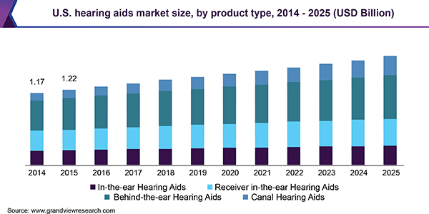
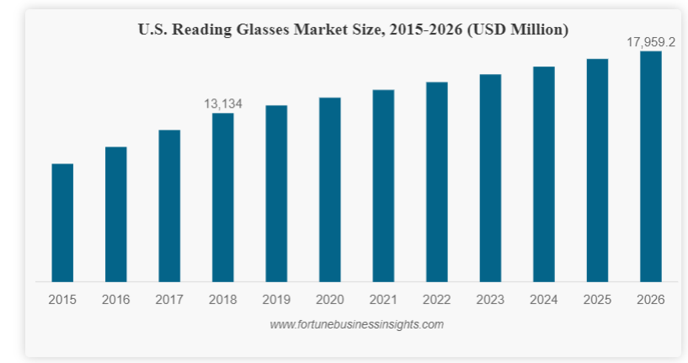
Alternate avenues of income
Hearing aids
Reading glasses
The growth of the hearing aid market is impressive as can be seen from the figure below
The growth of the reading glasses market is impressive as can be seen from the figure below
Notes:
As we know hearing aids and reading glasses are not taxed under the ACA.

Slide 10
Thank you

