Slide 1


Automotive ECU Watchdog &Recovery Framework
STATE LEVEL HACKATHON
Real-Time ECU Health Monitoring, Fault Detection and Selective Process Recovery using QNX RTOS
Monitor → Detect → Isolate → Recover → Verify
A QNX-based automotive ECU monitoring and recovery framework that detects ECU failures and selectively recovers individual processes without disrupting healthy ECU services.
Team: QNX Sentinel
Theme: Automotive
Institution: Dhanekula Institute of Engineering and Technology
Automotive | QNX 8.0 | Raspberry Pi 4

Slide 2
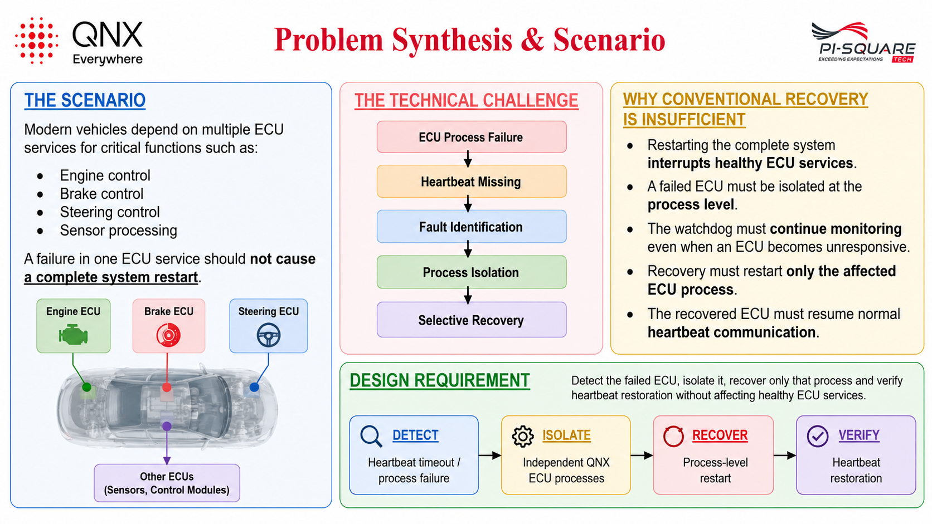
Design and Execution

Slide 3
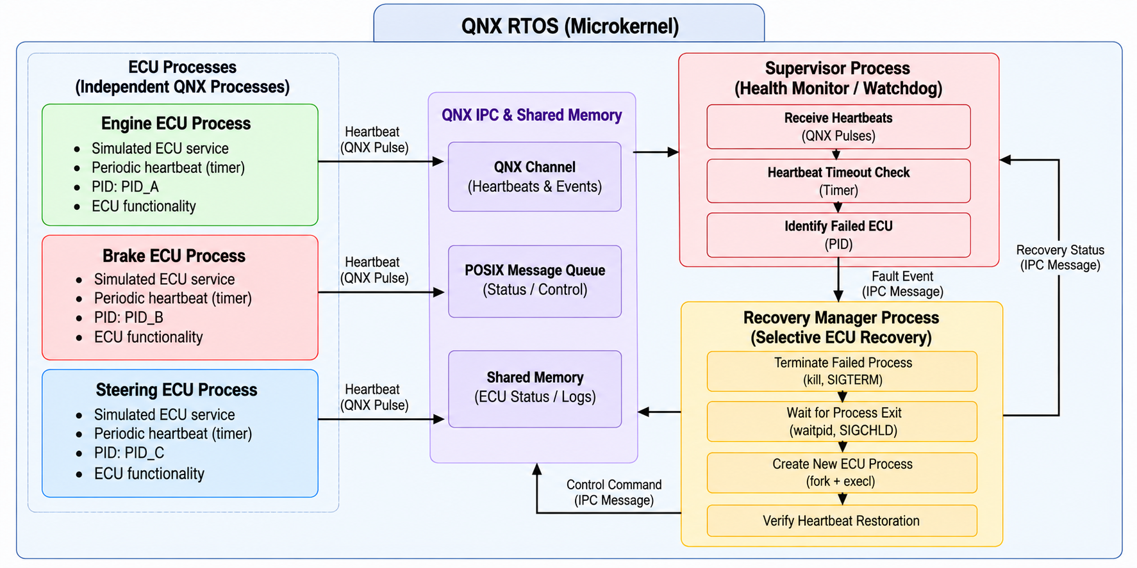
QNX Architectural Approach
Design and Execution
QNX Mechanisms Used
Process Management
Independent ECU processes
Process-level isolation
fork()
execl()
pid_t
getpid()
Inter-Process Communication
QNX Channels
ConnectAttach()
MsgSendPulse()
MsgReceivePulse()
IPC messages for fault/recovery signalling
Real-Time Monitoring
Periodic heartbeat generation
Heartbeat timeout detection
QNX timers
clock_gettime()
Priority-based scheduling
Fault Detection & Recovery
SIGCHLD — child-process termination detection
kill() / SIGTERM — failed-process termination
waitpid() — process-exit monitoring
Selective restart of affected ECU
Heartbeat restoration verification

Slide 4
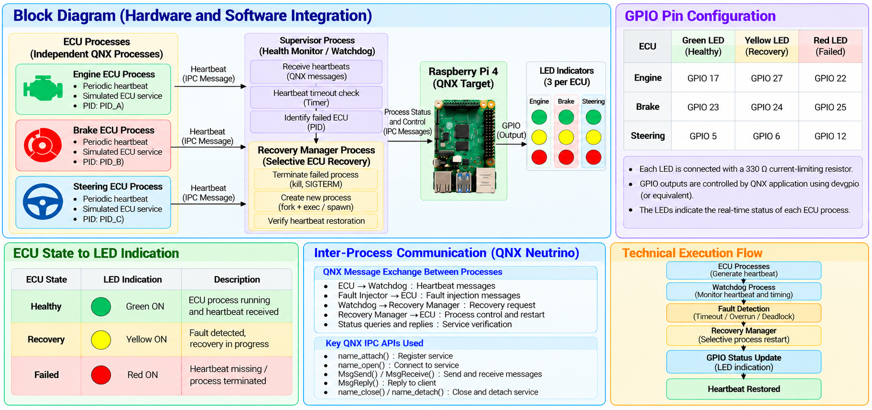
Technical Execution (Hardware & Logic)

Slide 5
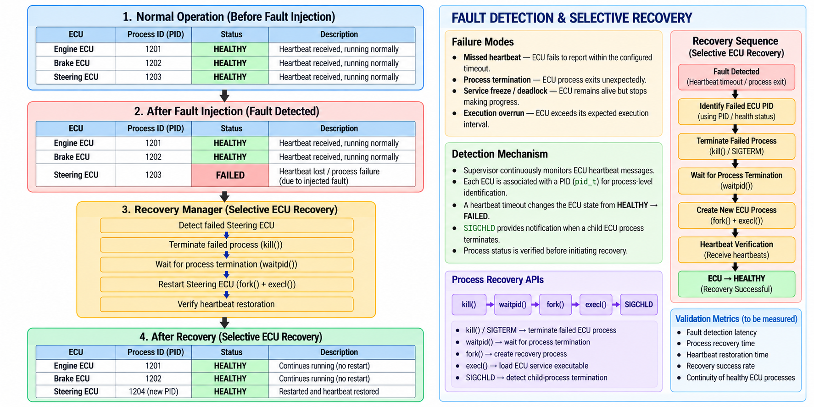
Resilience & "The Hack" Response

Slide 6
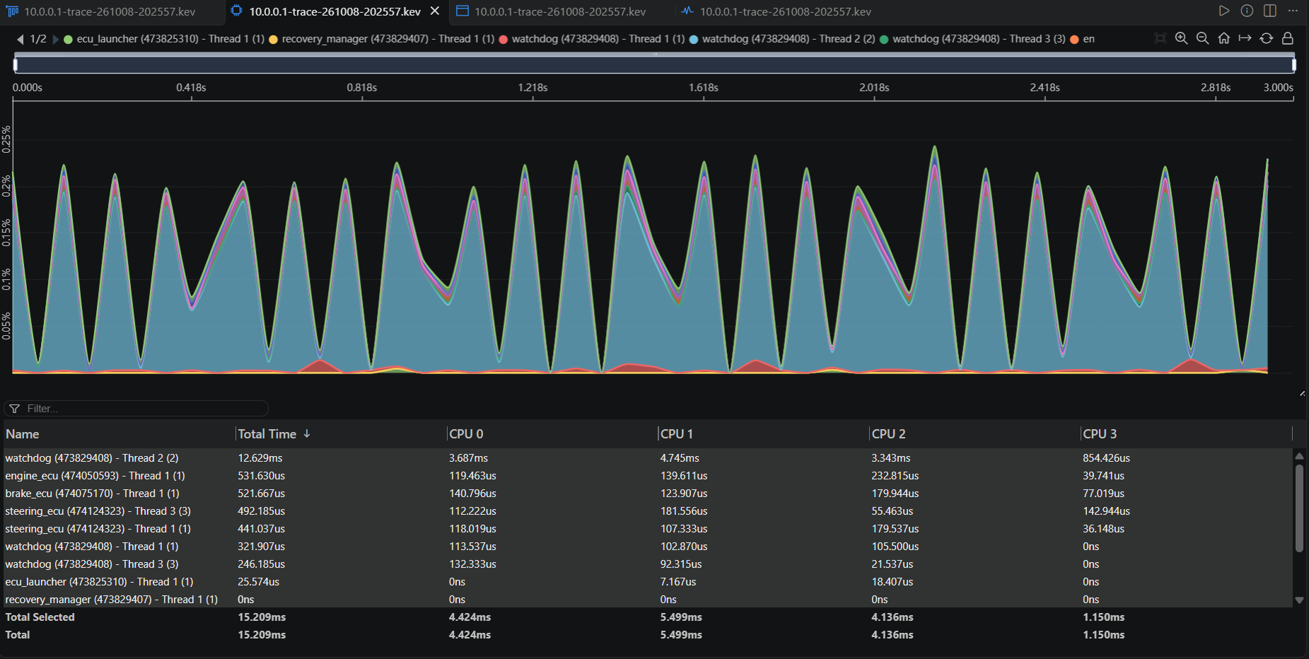
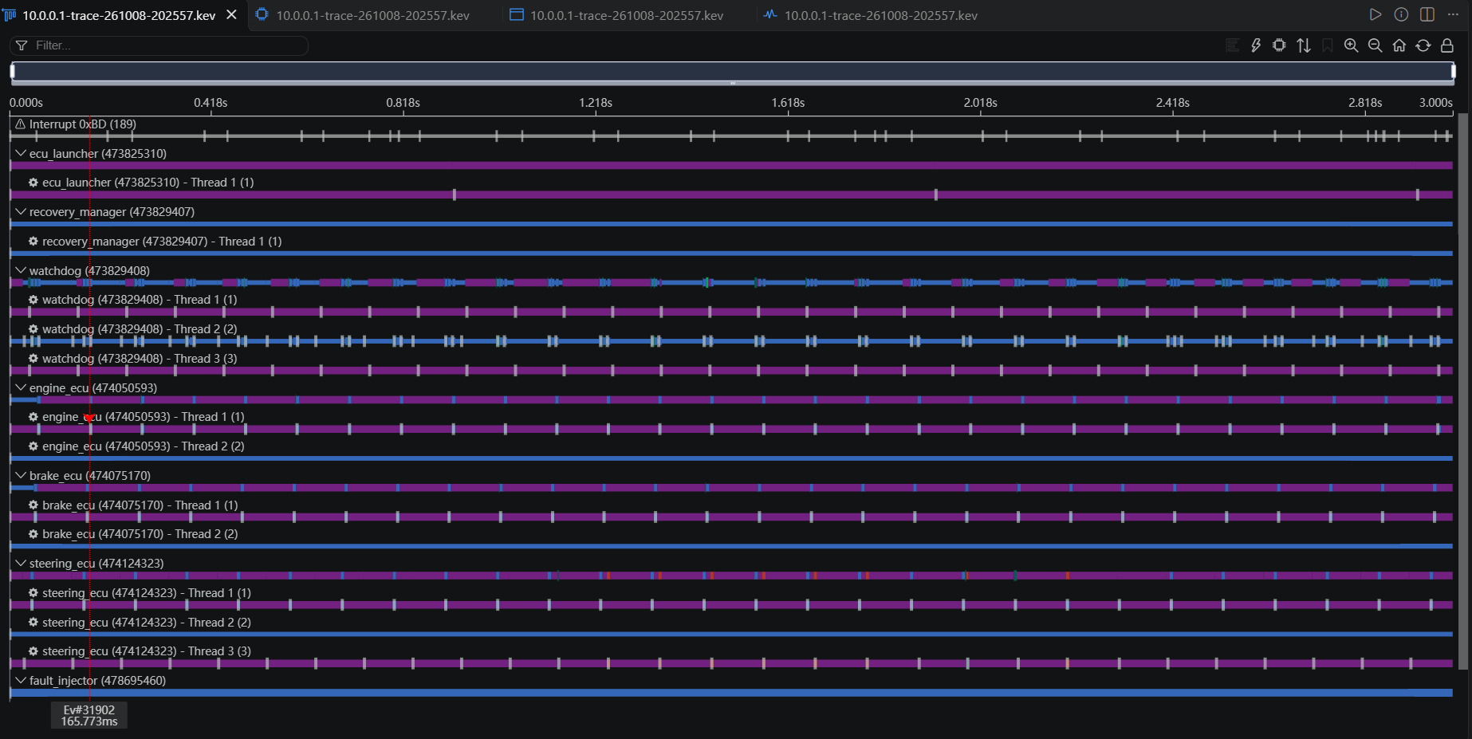
Performance Proof (The Profiler Slide)
Metric | Measured
Target Platform | Raspberry Pi 4B
QNX Version | 8.0.0
CPU Cores | 4
Total Memory | 4032 MB
Used Memory | 327 MB
Total Processes | 37
CPU Usage Summary | 92.246 ms
CPU 0 | 37.286 ms
CPU 1 | 31.555 ms
CPU 2 | 17.754 ms
CPU 3 | 5.649 ms
Engine Missed-Heartbeat Interval | 1012 ms
Brake Missed-Heartbeat Interval | 1024 ms
GPIO Status Outputs | 9 LEDs verified

Slide 7
Future Scalability & Conclusion
PRIORITY SETUP
From prototype to automotive-grade ECU recovery
Extend the framework to additional ECU services
Integrate real automotive ECU interfaces and CAN/CAN-FD
Deploy on automotive-grade QNX hardware
Extend fault detection with advanced failure classification
Add persistent fault and recovery logging
Scale the watchdog architecture to distributed ECU nodes
The process isolation, heartbeat monitoring and selective recovery architecture remains unchanged.
WHAT WE ACHIEVED
Implemented independent ECU processes using QNX RTOS
Implemented periodic heartbeat-based health monitoring
Developed watchdog-based fault detection
Implemented process-level selective ECU recovery
Prevented healthy ECU processes from being restarted
Integrated Raspberry Pi GPIO for physical ECU status indication
Integrated UART for communication and monitoring
Developed controlled ECU fault-injection and recovery workflow
Core capability:
Detect → Isolate → Recover → Verify
CONCLUSION
“When one ECU fails, recover the ECU — not the entire system.”
QNX Sentinel demonstrates a QNX-based automotive ECU watchdog and recovery framework that continuously monitors independent ECU processes, detects faults through heartbeat supervision, and selectively recovers only the failed ECU process.
The combination of QNX process isolation, real-time monitoring, IPC, process management, and Raspberry Pi hardware-based status indication provides a foundation for building more resilient automotive control systems.

