Slide 1

SQL
MY
Library
M
management
s
ystem
Prepared By: Mohini Ubale

Slide 2
B_PRICE
B_PRICE
B_AUTHOR
B_PRICE
B_CPICTURE
B_PRICE
B_PRICE
B_PRICE
B_PRICE
B_NAME
B_TYPE
BOOK
PUBLISH
PUBLISHER
READER
PURCHES
B_PRICE
B_CATEGEORY
B_PRICE
B_PRICE
B_PRICE
B_TITLE
B_QUALITY
B_PRICE
B_PRICE
B_WDATE
E-R diagram;(library management system)

Slide 3
The project’s query's :-
Book table:-
create table book
(b_id int primary key,
b_name varchar(20),
b_author varchar(20),
b_coverpicture varchar(10),
b_type varchar(10),
b_price float,
b_category varchar(20),
b_title varchar(10),
b_writtendate date,
b_guality varchar(20));

Slide 4
Publisher table:-
create table publisher
(pub_id int primary key,
pub_fname varchar(10),
pub_lname varchar(20),
pub_date date,
pub_gender varchar(20));

Slide 5
Reader table:-
create table reader
(r_id int primary key,
r_fname varchar(2),
r_lname varchar(20),
r_email varchar(20),
r_phone varchar(20),
r_address varchar(10));

Slide 6
Purches table:-
create table purches(
b_id int,
pub_id int,
r_id int,
p_date date,
p_place varchar(20),
foreign key(b_id) references book(b_id),
foreign key(pub_id) references publisher(pub_id),
foreign key(r_id) references reader(r_id));

Slide 7
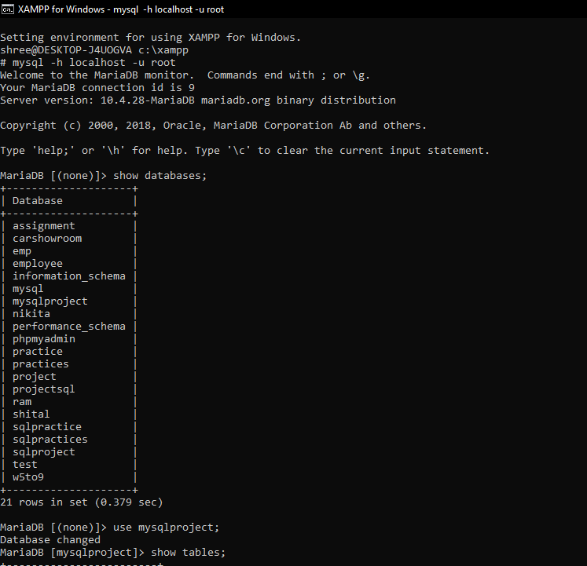

Slide 8
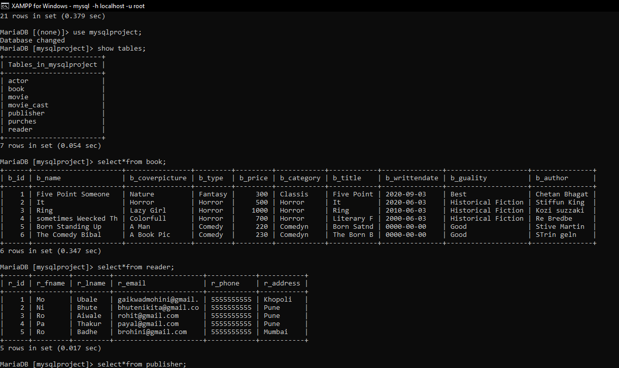

Slide 9
