Slide 1
Social Media Data Analysis on Nokia Company Presentation

Slide 2
Project analysis slide 6
INTRODUCTION
Social media is a pot of a lot of information that is more helpful to extend the business and efficient selling.
By using Social media applications Nokia can Easily Expand your business in a different country. and improve our bad image
Facebook twitter and other social media platform helps in way of promoting and expanding Business.
These social media also tells about all the positive and negative things related to Business or Company. That help to overcome our fails activities.
Nokia use to internet-based life as a stage for tending to customer grumblings and to effectively give customer support.

Slide 3
Project analysis slide 3
What Social Media Allow us to do
Social media allows us to use as a Developer and get access to scrape the comments.
Social media provides all the latest trends current details and news and any announcements in form of tweets.
It also Allows us to get the all old data Download and use for
Business analysis purpose.
Social Media allows us get the user activities Details like eg:likes, userid, date, etc.

Slide 4
Project analysis slide 6
How Nokia Company use Social media data
For Business
Recognize Influencers and Engage with Them
Use Social media Ads to Target their Email List .
Research their Competitors' Audiences
Based on analysis improve the
Customer services and aim to provide all facilities in cheap prerequisites.
according to the based on analysis data it change in our productivity and provide customer satisfaction.
Get positive and negative response and improve our Business
Assemble their Social Media Followers
Use Social Media Lists to Manage Their Contacts

Slide 5
Project analysis slide 2
Basic Stage of Analysis
Visualization Report
Scraping using
Different Third party tools
Row Data
Implement Model
Data Preprocessing
Create New clean
Data Frame
Data Cleaning

Slide 6
Project analysis slide 4
Working Block Diagram
Create bar plot between Frequency no of Tweets and sentiments .
Data Visualization
Scrape the Wikipedia Table data using the BeautifulSoup tool.
Data Scraping
Data Cleaning
Model implementation
Make a Data Frame using through the Json file.
Make a Data Frame
Convert row data to usable data
Apply conditional statements and make columns of polarity and subjectivity
Create table based on no of positive negative and neutral reviews.
Create table
And visualize

Slide 7
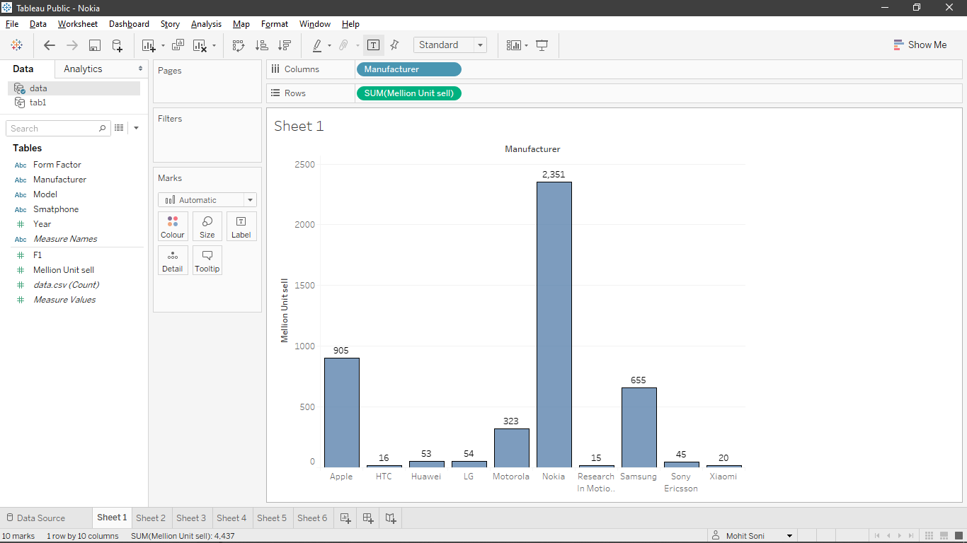
Project analysis slide 5
Analysis Report Of Different Companies
Based on Unit Sale

Slide 8
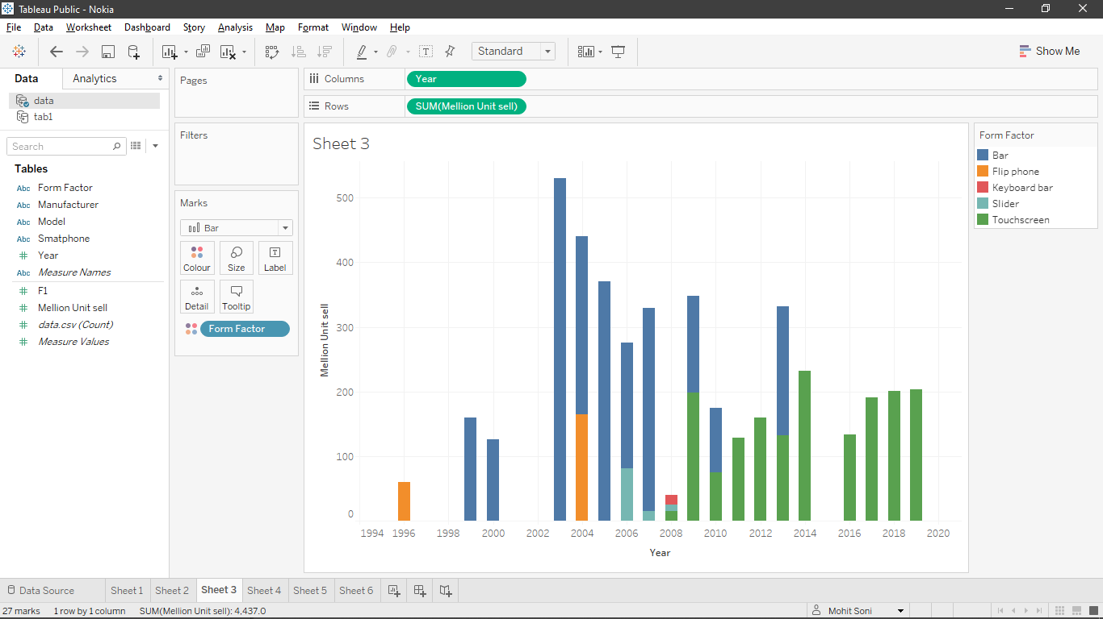
Project analysis slide 5
Million Unit Sales Based on FormFactor

Slide 9
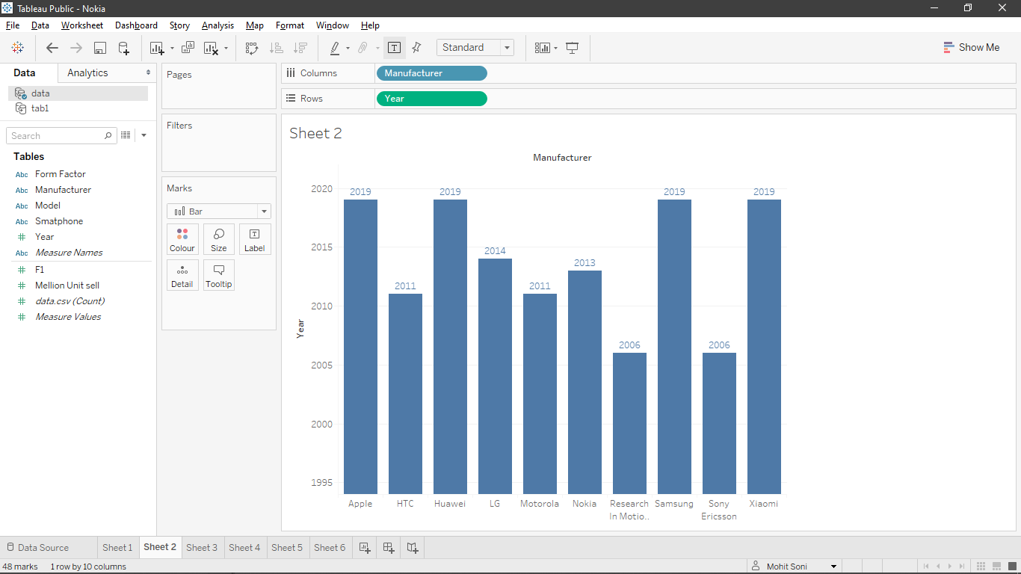
Sales Report Of Companies Manufacturer
Based on Seasons

Slide 10
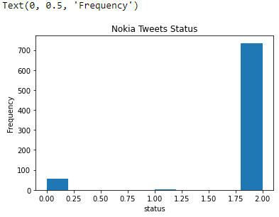
Project analysis slide 5
Nokia Company Analysis Report Based on Sentiment in %
POSITIVE
NAGATIVE
NEUTRAL
92.45%
7.16%
0.37%

Slide 11
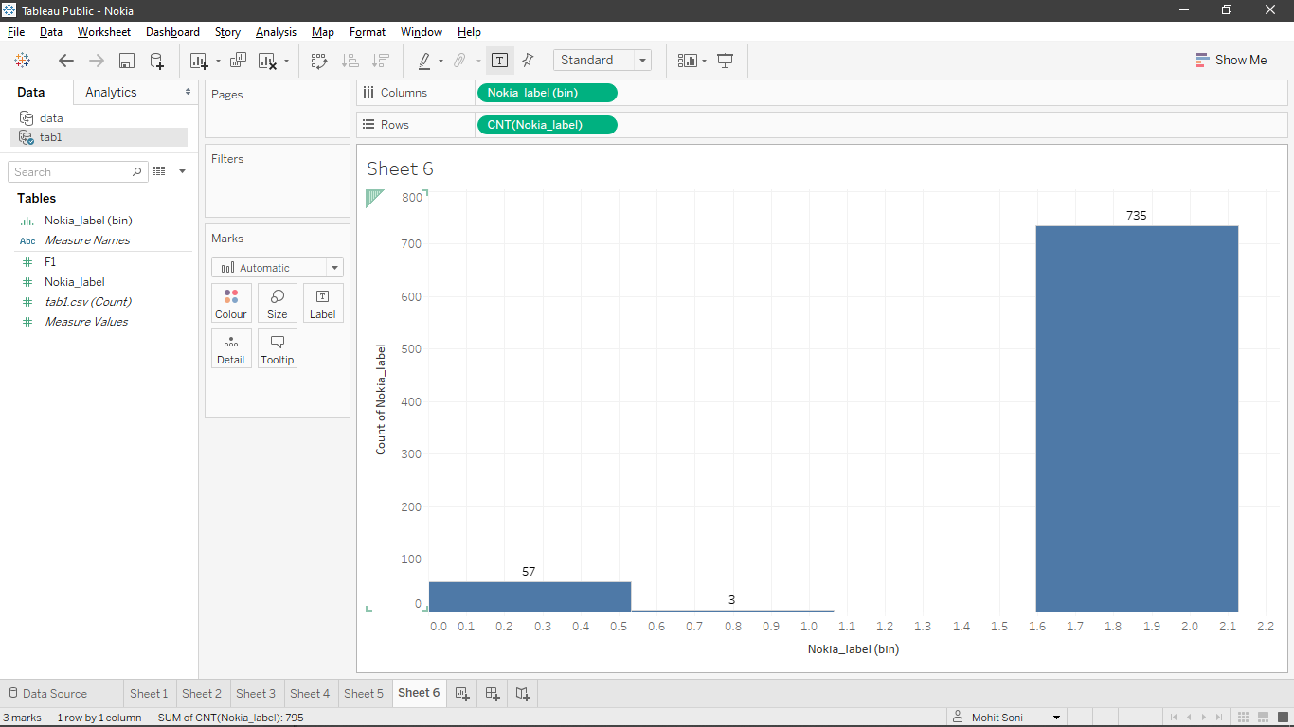
Nokia Company Analysis Report Based on Sentiment in %
POSITIVE
NAGATIVE
NEUTRAL
92.45%
7.16%
0.37%

Slide 12
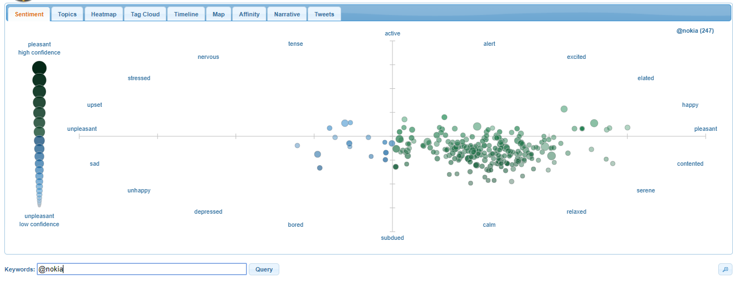
Nokia Company Analysis Report Based on Sentiment in Tweetviz

Slide 13
Business Story Telling
Getting a positive reaction to your item isn't in every case enough. The client assistance arrangement of your organization ought to consistently be faultless regardless of how sensational your administrations are
Keeping the negative estimations in information, you can grow all the more engaging marking methods and showcasing methodologies to change from lethargic to spectacular brand status
Slant investigation in business helps in measuring the impression of the present and the potential clients with respect to every one of these variables.
A business inhales on the satisfaction of its clients. The experience of the clients can either be sure, negative or impartial.

Slide 14
Project analysis slide 8
Pro and Cons of the Project
Advantages
Disadvantages
Prevalence
Client assistance
Promoting
Increment in deals
Increment in Traffic to your site
On the off chance that your substance is exhausting and dull…
Awful Publicity
Your issues will be increasingly noticeable
You are presented to trolls
You may have coercion issues
You may have protection or security issues.
Contenders could consider your business

Slide 15
Project analysis slide 10
Any Queries………????

Slide 16
Thank You

