Slide 1
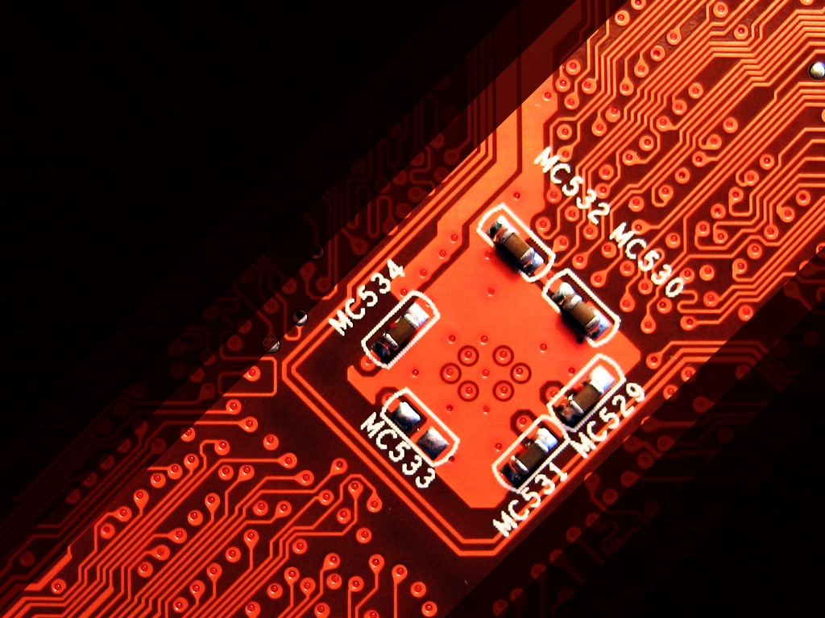

PRESENTATION ON :
CLASSIFICATION OF SEMICONDUCTORS ON THE BASIS OF THEIR
ELECTRICAL PROPERTIES
Presented by:
Pushpendra Upadhyay-2215001372
Racheet Saraswat-2215001373
Radhika Mittal-2215001377
Rajesh Kumar-2215001419
Ratna Khewariya-2215001442
Mentored by:
Dr. Monika Goyal

Slide 2
Table of Content
Holes and Electrons
Band Theory
Properties of Semiconductors
Types of Semiconductors
Intrinsic Semiconductor
Extrinsic Semiconductor
N-Type Semiconductor
P-Type Semiconductor
Intrinsic vs Extrinsic
P-N Junction diode
Applications

Slide 3
What are Semiconductors?
Semiconductors are the materials which have a conductivity between conductors and non-conductors or insulators.
Semiconductors can be compounds such as gallium arsenide or pure elements, such as germanium or silicon.
Physics explains the theories, properties and mathematical approach governing semiconductors.
Examples of Semiconductors:
Gallium arsenide, germanium, and silicon are some of the most commonly used semiconductors. Silicon is used in electronic circuit fabrication and gallium arsenide is used in solar cells, laser diodes, etc.

Slide 4
Holes and Electrons in Semiconductors
Holes and electrons are the types of charge carriers accountable for the flow of current in semiconductors.
Holes (valence electrons) are the positively charged electric charge carrier whereas electrons are the negatively charged particles.
Both electrons and holes are equal in magnitude but opposite in polarity.

Slide 5
Mobility of Electrons and Holes
In a semiconductor, the mobility of electrons is higher than that of the holes. It is mainly because of their different band structures and scattering mechanisms.
Electrons travel in the conduction band whereas holes travel in the valence band. When an electric field is applied, holes cannot move as freely as electrons due to their restricted moment.
The elevation of electrons from their inner shells to higher shells results in the creation of holes in semiconductors.
Since the holes experience stronger atomic force by the nucleus than electrons, holes have lower mobility.
The mobility of a particle in a semiconductor is more if:
Effective mass of particles is lesser.
Time between scattering events is more.
For intrinsic silicon at 300 K, the mobility of electrons is 1500 cm² (V∙s)⁻¹ and the mobility of holes is 475 cm² (V∙s)⁻¹.

Slide 6
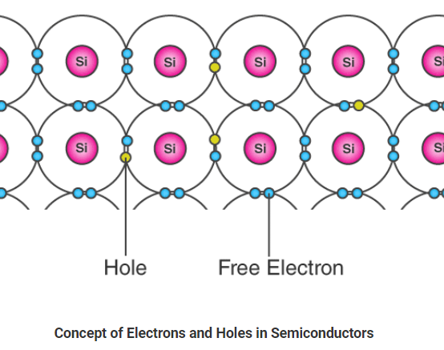
The bond model of electrons in silicon of valency 4 is shown here.
Here, when one of the free electrons (blue dots) leaves the lattice position, it creates a hole (yellow dots).
This hole thus created takes the opposite charge of the electron and can be imagined as positive charge carriers moving in the lattice.

Slide 7
Band Theory of Semiconductors
Walter Heitler and Fritz London discovered the energy bands.
We know that the electrons in an atom are present in different energy levels.
When we try to assemble a lattice of a solid with N atoms, then each level of an atom must split up into N levels in the solid.
This splitting up of sharp and tightly packed energy levels forms Energy Bands.
The gap between adjacent bands representing a range of energies that possess no electron is called a Band Gap.

Slide 8
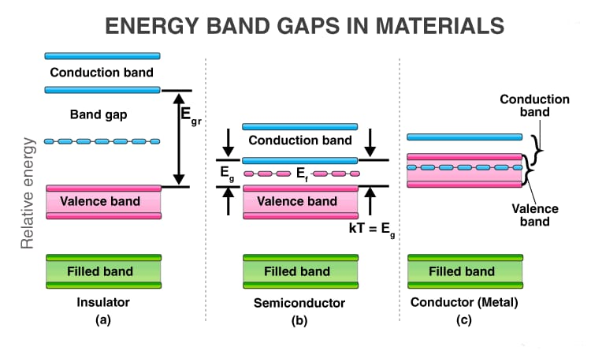

Slide 9
Conduction Band and Valence Band in Semiconductors
Valence Band:The energy band involving the energy levels of valence electrons is known as the valence band. It is the highest occupied energy band.
Conduction Band:It is the lowest unoccupied band that includes the energy levels of positive (holes) or negative (free electrons) charge carriers. It has conducting electrons resulting in the flow of current. The conduction band in semiconductors accepts the electrons from the valence band.

Slide 10
What is Fermi Level in Semiconductors?
Fermi level (denoted by EF) is present between the valence and conduction bands.
It is the highest occupied molecular orbital at absolute zero. The charge carriers in this state have their own quantum states and generally do not interact with each other.
When the temperature rises above absolute zero, these charge carriers will begin to occupy states above Fermi level.

Slide 11
Properties of Semiconductors
Semiconductors can conduct electricity under preferable conditions or circumstances.
This unique property makes it an excellent material to conduct electricity in a controlled manner as required.
Unlike conductors, the charge carriers in semiconductors arise only because of external energy (thermal agitation).
It causes a certain number of valence electrons to cross the energy gap and jump into the conduction band, leaving an equal amount of unoccupied energy states, i.e. holes.
Conduction due to electrons and holes are equally important.
Resistivity: 10⁻⁵ to 10⁶ Ωm
Conductivity: 10⁵ to 10⁻⁶ mho/m
Temperature coefficient of resistance: Negative
Current Flow: Due to electrons and holes

Slide 12
Why does the Resistivity of Semiconductors go down with Temperature?
The difference in resistivity between conductors and semiconductors is due to their difference in charge carrier density.
The resistivity of semiconductors decreases with temperature because the number of charge carriers increases rapidly with increase in temperature, making the fractional change i.e. the temperature coefficient is negative.

Slide 13
Some Important Properties of Semiconductors are:
Semiconductor acts like an insulator at Zero Kelvin. On increasing the temperature, it works as a conductor.
Due to their exceptional electrical properties, semiconductors can be modified by doping to make semiconductor devices suitable for energy conversion, switches, and amplifiers.
Lesser power losses.
Semiconductors are smaller in size and possess less weight.
Their resistivity is higher than conductors but lesser than insulators.
The resistance of semiconductor materials decreases with the increase in temperature and vice-versa.

Slide 14
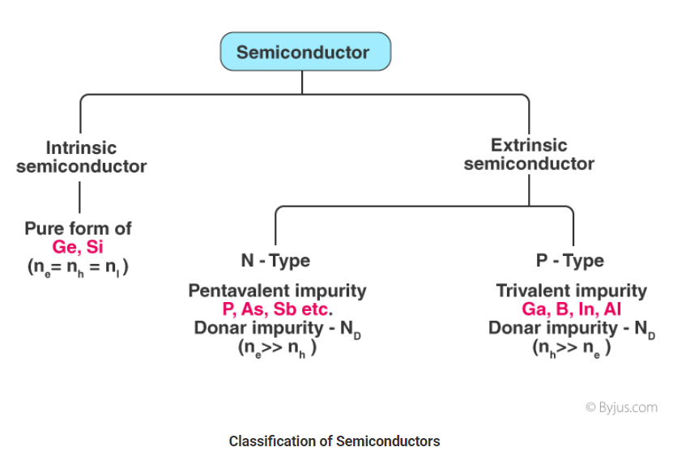
Types of Semiconductors
Semiconductors can be classified as:
Intrinsic Semiconductor
Extrinsic Semiconductor

Slide 15
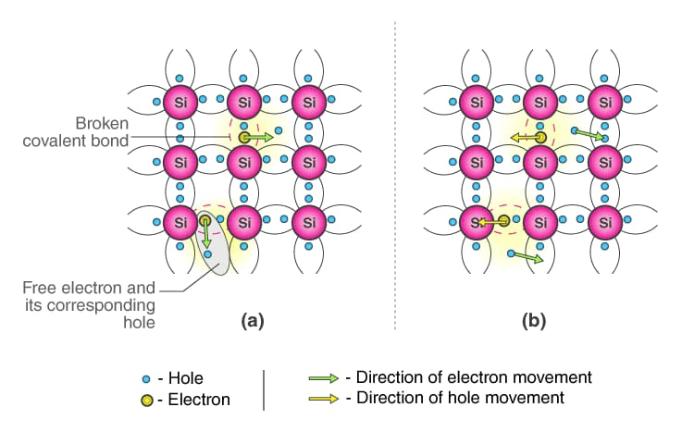
Intrinsic semiconductor
An intrinsic type of semiconductor material is made to be very pure chemically. It is made up of only a single type of element.
Germanium (Ge) and Silicon (Si) are the most common type of intrinsic semiconductor elements.
They have four valence electrons (tetravalent). They are bound to the atom by covalent bond at absolute zero temperature.

Slide 16
The Lattice of Pure Silicon Semiconductor at Different Temperatures
At absolute zero Kelvin temperature: At this temperature, the covalent bonds are very strong and there are no free electrons and the semiconductor behaves as a perfect insulator.
Above absolute temperature: With the increase in temperature few valence electrons jump into the conduction band and hence it behaves like a poor conductor.

Slide 17
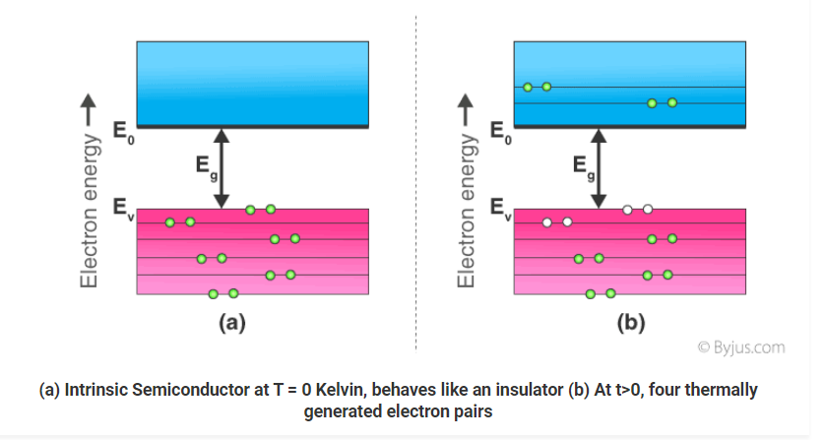
Energy Band Diagram of Intrinsic Semiconductor
The energy band diagram of an intrinsic semiconductor is shown here:
In intrinsic semiconductors, current flows due to the motion of free electrons as well as holes. The total current is the sum of the electron current I_{e} due to thermally generated electrons and the hole current I_{h}
Total Current (I) = I_{e} + I_{h}
For an intrinsic semiconductor, at finite temperature, the probability of electrons to exist in conduction band decreases exponentially with increasing bandgap (E_{g})
n = n₀e^{-Eg/2.Kb.T}
Where,
Eg = Energy bandgap
K_{b} = Boltzmann’s constants

Slide 18
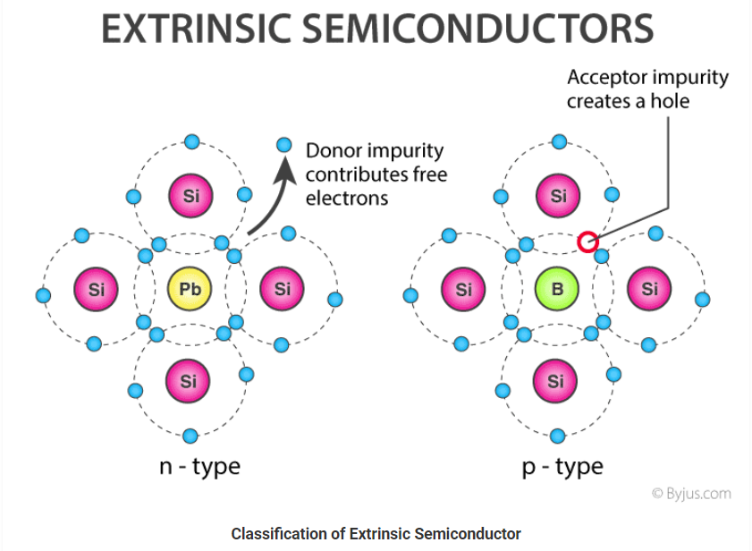
Extrinsic Semiconductor
The conductivity of semiconductors can be greatly improved by introducing a small number of suitable replacement atoms called IMPURITIES.
The process of adding impurity atoms to the pure semiconductor is called DOPING.
Usually, only 1 atom in 10⁷ is replaced by a dopant atom in the doped semiconductor.
An extrinsic semiconductor can be further classified into:
N-type Semiconductor
P-type Semiconductor

Slide 19
N-Type Semiconductor
Mainly due to electrons
Entirely neutral
I = I_{h} and n_{h} >> n_{e}
Majority – Electrons and Minority – Holes
When a pure semiconductor (Silicon or Germanium) is doped by pentavalent impurity (P, As, Sb, Bi).
The fifth electron of the dopant is set free. Thus, the impurity atom donates a free electron for conduction in the lattice and is called “Donar“.
Since the number of free electron increases by the addition of an impurity, the negative charge carriers increase. Hence, it is called n-type semiconductor.

Slide 20
P-Type Semiconductor
Mainly due to holes
Entirely neutral
I = I_{h} and n_{h} >> n_{e}
Majority – Holes and Minority – Electrons
When a pure semiconductor is doped with a trivalent impurity (B, Al, In, Ga ) then, the three valence electrons of the impurity bonds with three of the four valence electrons of the semiconductor.
This leaves an absence of electron (hole) in the impurity. These impurity atoms which are ready to accept bonded electrons are called “Acceptors“.
With the increase in the number of impurities, holes (the positive charge carriers) are increased. Hence, it is called p-type semiconductor.

Slide 21
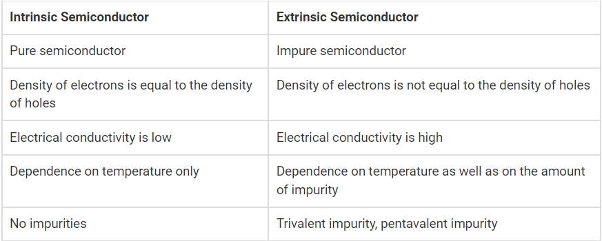
Difference Between Intrinsic and Extrinsic Semiconductors

Slide 22
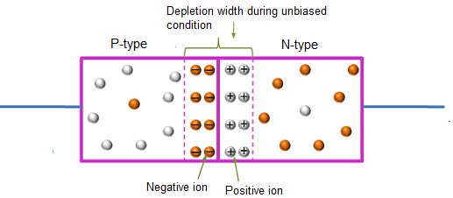

P-N Junction Diodes
A P-N junction diode is a piece of silicon that has two terminals.
One of the terminals is doped with P-type material and the other with N-type material.
The P-N junction is the basic element for semiconductor diodes.
Diode facilitates the flow of electrons completely in one direction only – which is the main function of a diode.
It can also be used as a Rectifier.
It is operated in Forward as well as Reverse Biasing according to the needs or requirements.

Slide 23
Applications of Semiconductors
Let us now understand the uses of semiconductors in daily life. Semiconductors are used in almost all electronic devices. Without them, our life would be much different.
Their reliability, compactness, low cost and controlled conduction of electricity make them ideal to be used for various purposes in a wide range of components and devices. transistors, diodes, photosensors, microcontrollers, integrated chips and much more are made up of semiconductors.

Slide 24
Uses of Semiconductors in Everyday life
Temperature sensors are made with semiconductor devices.
They are used in 3D printing machines
Used in microchips and self-driving cars
Used in calculators, solar plates, computers and other electronic devices.
Transistor and MOSFET used as a switch in Electrical Circuits are manufactured using the semiconductors.

Slide 25
Industrial Uses of Semiconductors
The physical and chemical properties of semiconductors make them capable of designing technological wonders like microchips, transistors, LEDs, solar cells, etc.
The microprocessor used for controlling the operation of space vehicles, trains, robots, etc is made up of transistors and other controlling devices which are manufactured by semiconductor materials.

Slide 26
Importance of Semiconductors
Here we have discussed some advantages of semiconductors which makes them highly useful everywhere.
They are highly portable due to the smaller size
They require less input power
Semiconductor devices are shockproof
They have a longer lifespan
They are noise-free while operating

Slide 27
Findings and Conclusion

Slide 28
Some Important Properties of Semiconductors are:
Semiconductor acts like an insulator at Zero Kelvin. On increasing the temperature, it works as a conductor.
Due to their exceptional electrical properties, semiconductors can be modified by doping to make semiconductor devices suitable for energy conversion, switches, and amplifiers.
Lesser power losses.
Semiconductors are smaller in size and possess less weight.
Their resistivity is higher than conductors but lesser than insulators.
The resistance of semiconductor materials decreases with the increase in temperature and vice-versa.

Slide 29
Types of Semiconductors
Semiconductors can be classified as:
• Intrinsic Semiconductor: An intrinsic type of semiconductor material is made to be very pure chemically. It is made up of only a single type of element.
Extrinsic Semiconductor: Extrinsic semiconductors are semiconductors formed when a small measured amount of chemical impurity is added to intrinsic semiconductors. They are also called doped semiconductors or impurity semiconductors. An extrinsic semiconductor can be further classified into:
o N-type Semiconductor: When a pure semiconductor (Silicon or Germanium) is doped by pentavalent impurity (P, As, Sb, Bi) then, four electrons out of five valence electrons bonds with the four electrons of Ge or Si
o P-type Semiconductor: When a pure semiconductor is doped with a trivalent impurity (B, Al, In, Ga ) then, the three valence electrons of the impurity bonds with three of the four valence electrons of the semiconductor.

Slide 30
THANK YOU

