Slide 1
Discussion
Data Science Project
Presenter - Shubham Sunwalka Mentors - Rishi, Abhishek
(Data Scientist)
Date - xx xxxx 2021 | x.xx PM

Slide 2
Problem Statement
Technologies Extraction From Linkedin Summaries
Data Available-
Technologies Names
Scraped Linkedin Profiles

Slide 3
Important Requirement
Tagged Dataset for Obtaining Accuracy Matrix
Solution
Manually Tagged Data with Context|String Match Run
Drawback
Human Intervention
Takes high amount of time

Slide 4
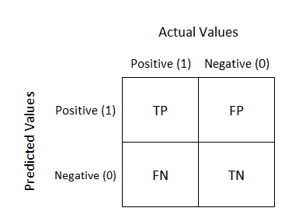
Important Requirement(2)
Accuracy Matrix
Decided to Use Confusion Matrix
True Positive (TP)
False Positive (FP)
False Negative (FN)
True Negative (TN)

Slide 5
Precision (true positives/predicted positives)=TP/TP+FP
Recall (true positives/all actual positives)=TP/TP+FN
F Score : Harmonic Mean of Precision and Recall
2*(precision*recall)/(precision+recall)
Range : (0,1)
Higher the better

Slide 6
Classification of Approach Type :
DATASET TYPE
TRAINING
NO TRAINING
TRAIN SPACY NER
CRF, NEURAL NETWORKS TRAINING
RULE BASE
PRE-TRAINED MODEL
ENSEMBLING
STRING-MATCH/REGEX
SPACY/FLAIR/BERT
STRING(Tech)+SPACY(Eng)

Slide 7
Approach - 1
String Matching
“XYZ Company uses A technology.” (text) || A,B,C (Technology to match) || A(Matched Entry)
Drawbacks-
Non-Semantic Approach (No Context)
Slow to run
High False Positives

Slide 8
String Matching(contd.)
Major Ponder Points| Pre-Processing
Generic English Words Extracted|Technology Names
Less Technology Extracted due to small/lesser summary length/words
Solution
Remove Highly Frequent Words
Sorted Summary on length by decreasing order |Ran String Match

Slide 9
Approach - 2
Named Entity Recognition
Locate and classify text into predefined categories like “ORG”, “PERSON”, etc.
Simple NER spacy run {tag = (“ORG”)}
Blocker Encountered:
2 extraction out of 100 profiles
Reason: Lowercase Data (Summaries), i.e. 34018 (LowerCased); 67 (UpperCased); 65915 (Mixed) out of 1 lakh.

Slide 10
Solution: Truecase Package.

Slide 11
Approach - 3
Truecasing|NER spacy run {tag = (“ORG”)}
Pondering Point:
No. of Technologies Extracted: 34/112
Increase number of Technologies Extraction
HOW ????

Slide 12
Approach - 4
Truecasing|NER spacy run|More Tags
{tag = “ORG”, “PERSON”, “PRODUCT”, etc}
Improvement:
Increased number of Technologies : 48/112

Slide 13
Approach - 5
Truecasing|NER spacy run|Own Vocabulary(Entity Ruler)
{tag = “ORG”, “PERSON”, “PRODUCT”, etc}
Added Technologies into spacy’s Entity Ruler
{label:”ORG”, pattern:”Technology Name”}
Improvement:
Increased number of Technologies : 50/112

Slide 14
Approach - 6
Truecasing|NER spacy run|Hugging Face Models
Tried Different Models
Improvement (large-flair):
Increased number of Technologies : 52/112
Ponder Point:
No Proper Documentation and extension
Explore and Exhaust spacy

Slide 15
Approach - 7
Truecasing|NER spacy run|More POS tags (Noun, etc)
Improvement:
Increased number of Technologies : 93/112
Drawbacks:
Very High False Positives

Slide 16
Approach - 8
String Match(Technology Words)
Improvement:
Decreased number of FP, FN : 49, 69
Drawbacks:
High False Positives
Reduced True Positives to 67

Slide 17
Approach - 9
String Match(Technology)+NER spacy run(English Words)
Improvement:
Decreased number of FP, FN : 55, 39.
Increased TP to 77 from 67 before.
Drawbacks:
High False Positives

Slide 18
Approach - 10
String Match(Technology)+NER spacy run(English Words)|| Multiwords Handling
Improvement:
Lowest number of FP : 36
Drawbacks:
Still High False Positives

Slide 19
Latest Accuracy Figures:100 Profiles
 | TP | FP | FN | Precision | Recall | F1 Score
String Match | 112 | 384 | 60 | 0.22580 | 0.6511 | 0.33531
Simple Spacy | 48 | 79 | 124 | 0.37795 | 0.2790 | 0.321023
Spacy | Tags | 93 | 370 | 79 | 0.20086 | 0.54069 | 0.29290
Spacy | Own Vocabulary | 50 | 99 | 122 | 0.33557 | 0.29069 | 0.311521
Flair (En Large) | 52 | 84 | 120 | 0.38235 | 0.30232 | 0.33765

Slide 20
Latest Accuracy Fig:100 Profiles
 | TP | FP | FN | Precision | Recall | F1 Score
String Match | Technology(Dictionary) | 67 | 49 | 69 | 0.57758 | 0.49264 | 0.531739
String Match (Technology) & NER-spacy (English Words) | 77 | 55 | 39 | 0.58333 | 0.66379 | 0.6209644
String Match (Technology) & NER-spacy (English Words) with Multiwords | 68 | 36 | 48 | 0.6538461 | 0.58620 | 0.618177

Slide 21
Latest Accuracy Fig:1000 Profiles
 | TP | FP | FN | Precision | Recall | F1 Score
String Match (Technology) | 542 | 96 | 0 | 0.849529 | 1 | 0.9186436
String Match (Technology) & NER-spacy (English Words) with Multiwords | 603 | 132 | 184 | 0.8204081 | 0.766200 | 0.79237801

Slide 22
Challenges -
TRAINING DATA
Data Ops Team / Data Science Team (Skilled Tagging) ??
Human Intervention
High Amount of Time
Summaries - Improper English
Cases
Punctuations
Gramatically Incorrect, etc...

Slide 23
Future Approaches
No Training Data
Regex
All Pattern Known ??
Rule Based on Relationship
Subject, Object, Verb triplets Extraction (Relation)
eg I am working at Slintel as a Data Science Intern.
TF-IDF
Preprocessing Limitations (Multiwords Company, etc)

Slide 24
Future Approaches
No Training Data (contd.)
Scoring on Words
Greenhouse (ORG) +ve score, Greenhouse Gas (-ve) score.
High Manual Work.
Train High Amount of Word Embeddings.

Slide 25
Future Approaches
Training Data (MAJOR SHORTCOMING)
Train spacy NER on our Data
Neural Networks Training like
CRF, LSTM ,Bi-directional LSTM, fine tuning NN’s, etc

Slide 26
Future Approaches
Training Data (MAJOR SHORTCOMING) contd...
BOW / Classifier
Summaries-> BOW -> eg Greenhouse
Relevant
Non Relevant

Slide 27
Annotation Tool Links:
https://tryswivl.com/blog/customer-experience/10-easy-nlp-nlu-tools-for-tagging-data/
https://pypi.org/project/spacy-annotator/
https://github.com/heartexlabs/awesome-data-labeling
https://docs.dataturks.com/
https://www.mturk.com/
https://www.ontotext.com/solutions/semantic-tagging/

Slide 28
Approach - 11
Spacy (lg model) training on our tagged dataset
Validation sample(189) set - Only 1 tech extracted, poor result
Cons:
Requires high amount of training Data

Slide 29
Approach - 12 (in progress)
BERT | Fine Tuning | Train : 2000 samples | Test : 500
Validation set (500 samples)-on english labels only
TP | FP | FN | Precision | Recall | f1-score
143 | 27 | 49 | 0.841 | 0.744 |0.790
Accuracy Sheet

Slide 30
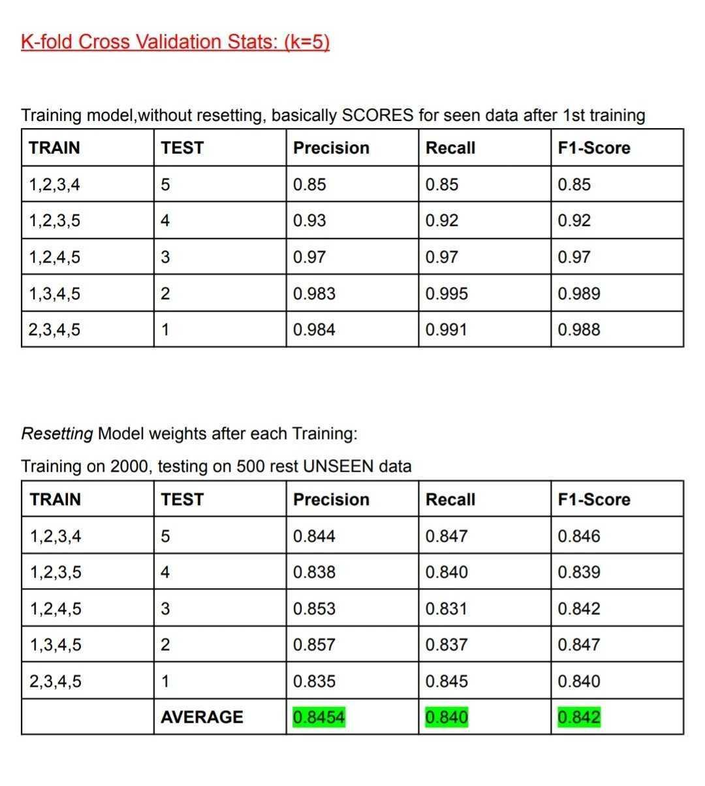
Approach - 12 (in progress)
Cross Validation Check
Epochs =2
Remark:
Optimisation
can be done

Slide 31

THANK YOU TEAM !!

