Slide 1
Dimensionality Reduction Methods Comparison
- Mohit Baliyan

Slide 2

Problem Description
Dimensionality Reduction is one of the major sub problems from Data Mining’s 6 historical problems. Principal Component Analysis is one of the mathematical tools which is used widely to project high dimensional data into lower dimensional data. There is no validated choice of selecting the number of principle components to represent the original data.

Slide 3
Heuristics to select number of principal components
There are three main heuristics to select number of informative (useful, meaningful, etc.) component
Kaiser
Broken Stick
Conditional Number

Slide 4
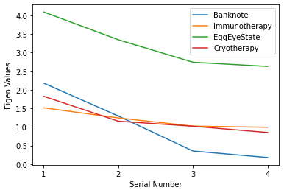
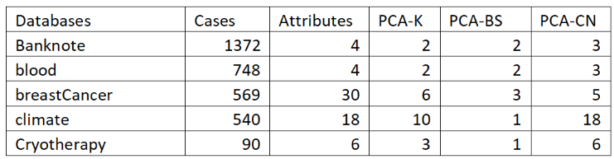
Databases used for study

Slide 5
We used 3 classifiers for performance measurement:
KNN
Logistic Regression
Fisher Discriminant Analysis

Slide 6
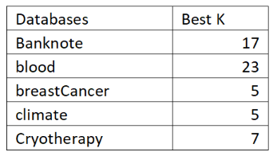
For selecting K for each dataset, we used leave one out cross validation technique.

Slide 7
For logistic Regression, we use threshold selection technique to select the best decision boundary during prediction at each fold and each iteration.
Steps:
Define a set of unique values with all possible points.
Add all borders
Select threshold which gives the least error rate

Slide 8
Performance Metrics:
Balanced Accuracy
Balanced accuracy was calculated for 10 times repeated 10 fold cross validation.

Slide 9
Ranking protocols
We used 2 ranking protocols to rank each dimensionality reduction method.
Average Ranking
Ranking based on test of statistical significance of differences of performances

Slide 10
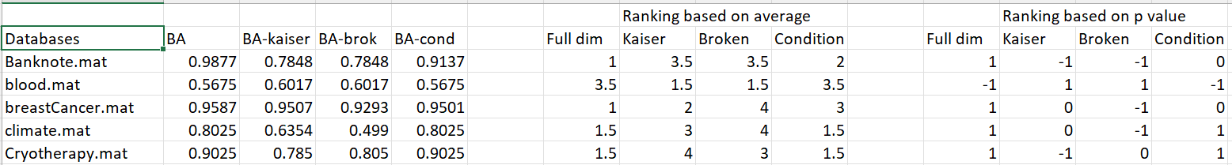
For Example
For Fisher,

Slide 11
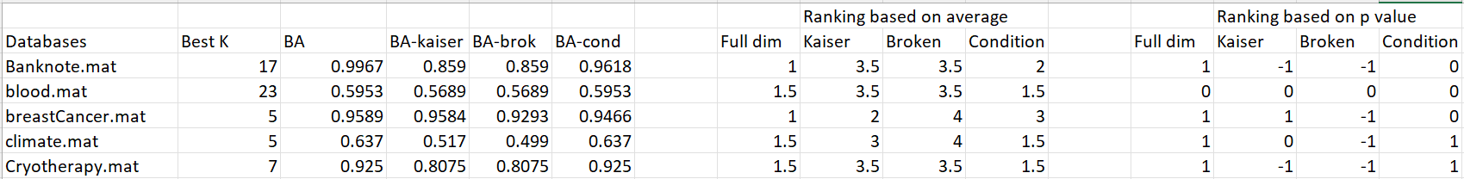
For Example
For KNN,

Slide 12
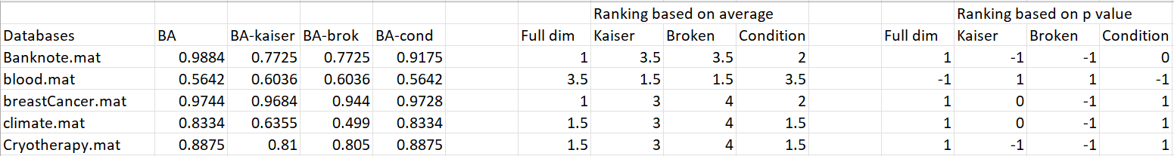
For Example
For Logistic,

Slide 13
For p-value based ranking
1 means statistically insignificantly different from the best
0 means statistically significantly different from the best and the worst
-1 means statistically insignificantly different from the worst

Slide 14
Conclusion
There is no one universal answer which of intrinsic dimension is better.
In average, dimensionality reduction on base of conditional number is better.

Slide 15
THANK YOU
Any Questions?

