Slide 1

Enabling Branch Protection and Automated Notifications for New Repositories Mohit Dharmadhikari

Slide 2
Agenda
TO PROVIDE A SOLUTION FOR AUTOMATIC BRANCH PROTECTION ON REPOSITORIES.
TO ENABLE AUTOMATED NOTIFICATIONS THROUGH ISSUE CREATION.

Slide 3

Current Challenges Unprotected Branches:
Risk of accidental changes to critical branches.
Lack of enforcement for code reviews and testing.
Manual Notifications:
Inconsistent communication about new repositories.
Potential delays in informing team members about repository updates.

Slide 4

Proposed Solution Overview
Automatic Branch Protection:
Default settings applied to all new repositories.
Protection rules to ensure code reviews, status checks , and restricted push access.
Automated Notifications:
Creation of issues to notify relevant team members about new repositories.

Slide 5
Technical Implementation
GitHub Webhook: Event notifications about repositories
API: Handler to respond to GitHub Webhook.
GitHub API Integration: To update branch protection rules and create issue notification

Slide 6

Benefits
•Enhances code quality and security.
•Ensures consistent repository management.
•Streamlines communication within the development team.

Slide 7
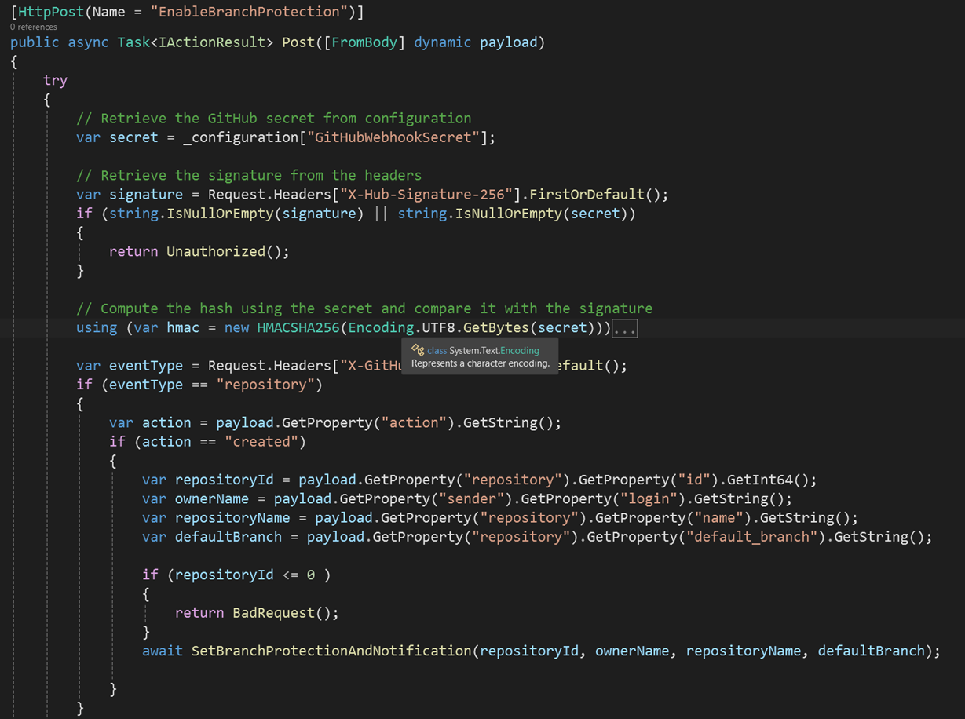
Example Webhook Handler:

Slide 8

Current Status
GitHub Account: Updated GitHub account with new personal access token (PAT) to communicate with GitHub APIs
GitHub Organization: Created an organization for repositories
Webhook: Created a Webhook to notify the repo created event in organization
.NET API: Created .NET API to listen to the events from Webhook
GitHub API: Integration of GitHub API using Octokit SDK to enable branch protection and create issue notification

Slide 9
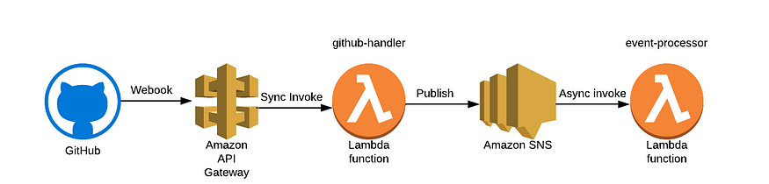
Next Steps

Slide 10
References
https://docs.github.com/en/webhooks/webhook-events-and-payloads.
https://github.com/zkoppert/Auto-branch-protect/blob/main/app.py.
https://smee.io/.
https://octokitnet.readthedocs.io/en/latest/getting-started/.

Slide 11
Thank you

