Slide 1

Login
Get Student list
Delete Course
Add Faculty
Update Student
Add Subjects
Update Faculty
Delete Student
Get Subjects list
Admin
Delete Faculty
Add Course
Update Subject
Add Student
Update Course
Delete Subject

Slide 2

Login
<<include>>
Add Questions
Update & Delete Q.
<<exclude>>
<<include>>
Add Options
Update & Delete Op.
<<exclude>>
Faculty
<<include>>
Add Exam
Update & Delete Exam
<<exclude>>
Get Students Result

Slide 3

Login
See Upcoming Exam
Can Give Exam
Student
See There Own Result
Previous Marks Report

Slide 4
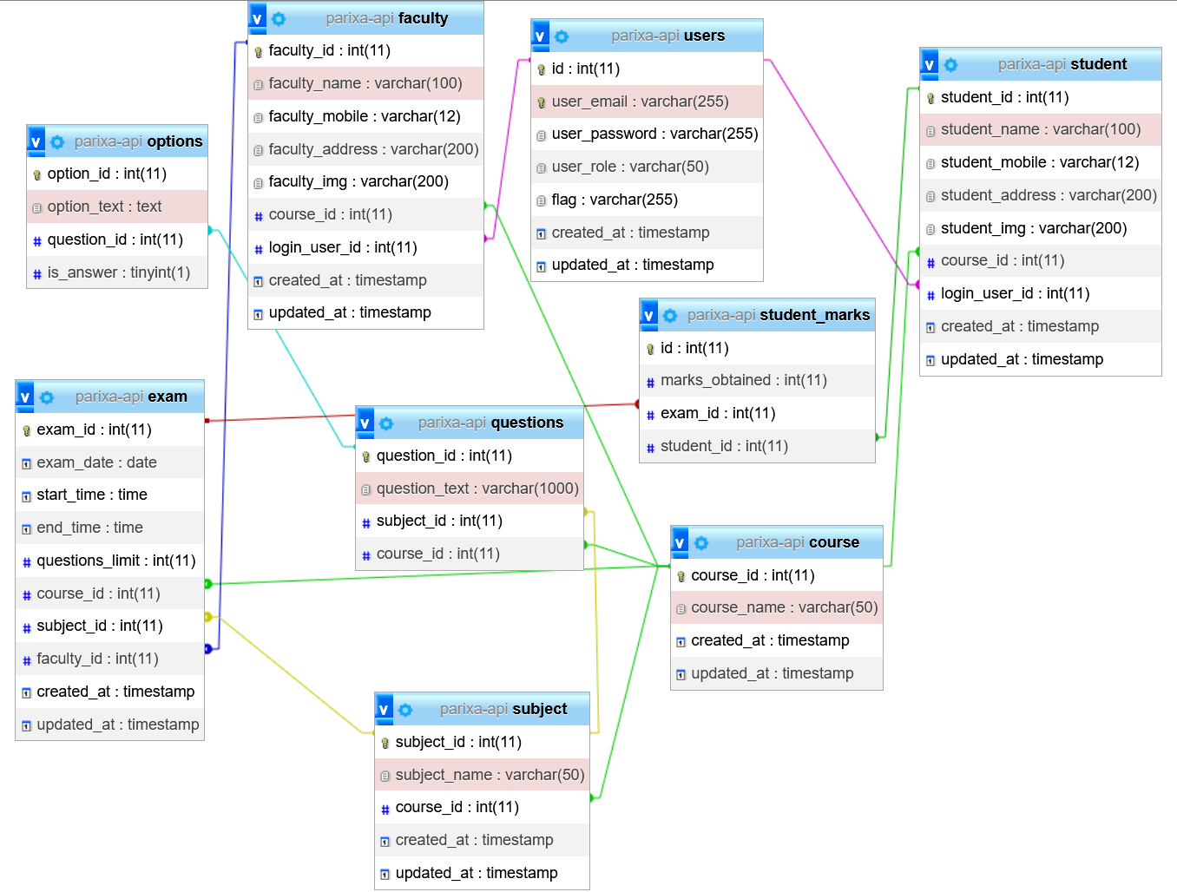

Slide 5
Online Exam Management System
Online Exam Management System
Online Exam Management System
Admin
Faculty
Student
Login
Login
Login
Success
Success
Success
Add Faculty
Add Questions
Request Schedule Exam List
Show
Show
Show
Add Student
Add Exam
Request for all marks
Show
Show
Show
Add Course
Student List
Request for join Exam
Show
Show
Show
Add Subject
Each Student Marks
Request for Result
Show
Show
Show
Interaction Diagram

Slide 6
Admin
Enter Email
Enter Password
Not Success
Dashboard
Add Faculty
Add Student
Add Course
Add Subject
View, Update, Delete Faculty
View, Update, Delete Student
View, Update, Delete Course
View, Update, Delete Subject

Slide 7
Faculty
Enter Email
Enter Password
Not Success
Dashboard
Add Questions
Add Exam
Marks
Student
View, Update, Delete Question
View, Update, Delete Exam
View Students Marks
View Total Student List

Slide 8
Student
Enter Email
Enter Password
Not Success
Dashboard
Schedule Exam
Join Exam
Marks
Result
View Future Schedule Exam
Student Give Exam
View Students their Marks
View All exam Total Result List

