Slide 1

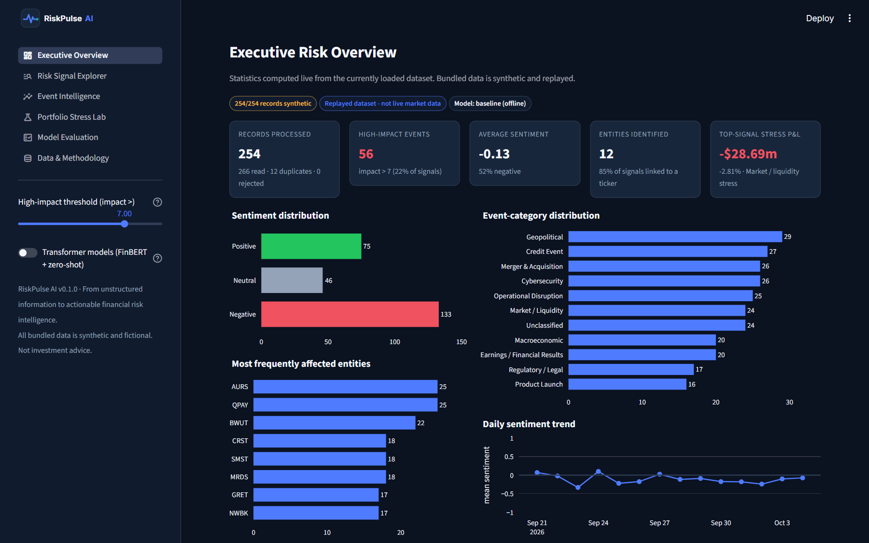
RiskPulse AI
Intelligent Financial Risk & Portfolio Stress Lab
From unstructured information to actionable financial risk intelligence.
Executive Risk Overview - live dashboard (synthetic data)
S&P Global & Crisil Campus Hackathon 2026
SIGNALS
HIGH IMPACT
TESTS PASS
Mohit Kumar Gautam · IIT Delhi
254
56
93
AI/NLP risk engine
Module B: stress testing
Offline · explainable
RiskPulse AI · S&P Global & Crisil Campus Hackathon 2026 · synthetic data
1 / 7
Notes:
RiskPulse AI turns news and social text into structured, explainable risk signals and shows what a high-impact event would do to a wholesale-banking portfolio. Everything runs offline on synthetic data.

Slide 2
PROBLEM & APPROACH
Turning noisy text into risk decisions
The problem
Our approach: one explainable pipeline
1
Volume
1
Ingest
Risk-relevant news and posts arrive faster than analysts can read them.
News + social adapters, validation, dedupe, stable IDs
2
Understand
2
Ambiguity
Entities & tickers, finance-tuned sentiment, 10 event types
Tone is not impact: a negative tweet about a logo is noise; a missed coupon is not.
3
Score
Impact 1-10 from transparent, configurable factors + explanation
3
Disconnect
Text insight rarely reaches portfolio numbers: what does this event cost us?
4
Stress
Impact > 7 auto-selects a scenario and revalues a 37-position book
Outputs: dashboard · REST API · JSON / CSV · printable report
RiskPulse AI · S&P Global & Crisil Campus Hackathon 2026 · synthetic data
2 / 7
Notes:
Three pain points: volume, ambiguity (tone vs impact) and the gap between text and P&L. Our pipeline ingests, understands, scores and stresses, with an explanation at every step.

Slide 3
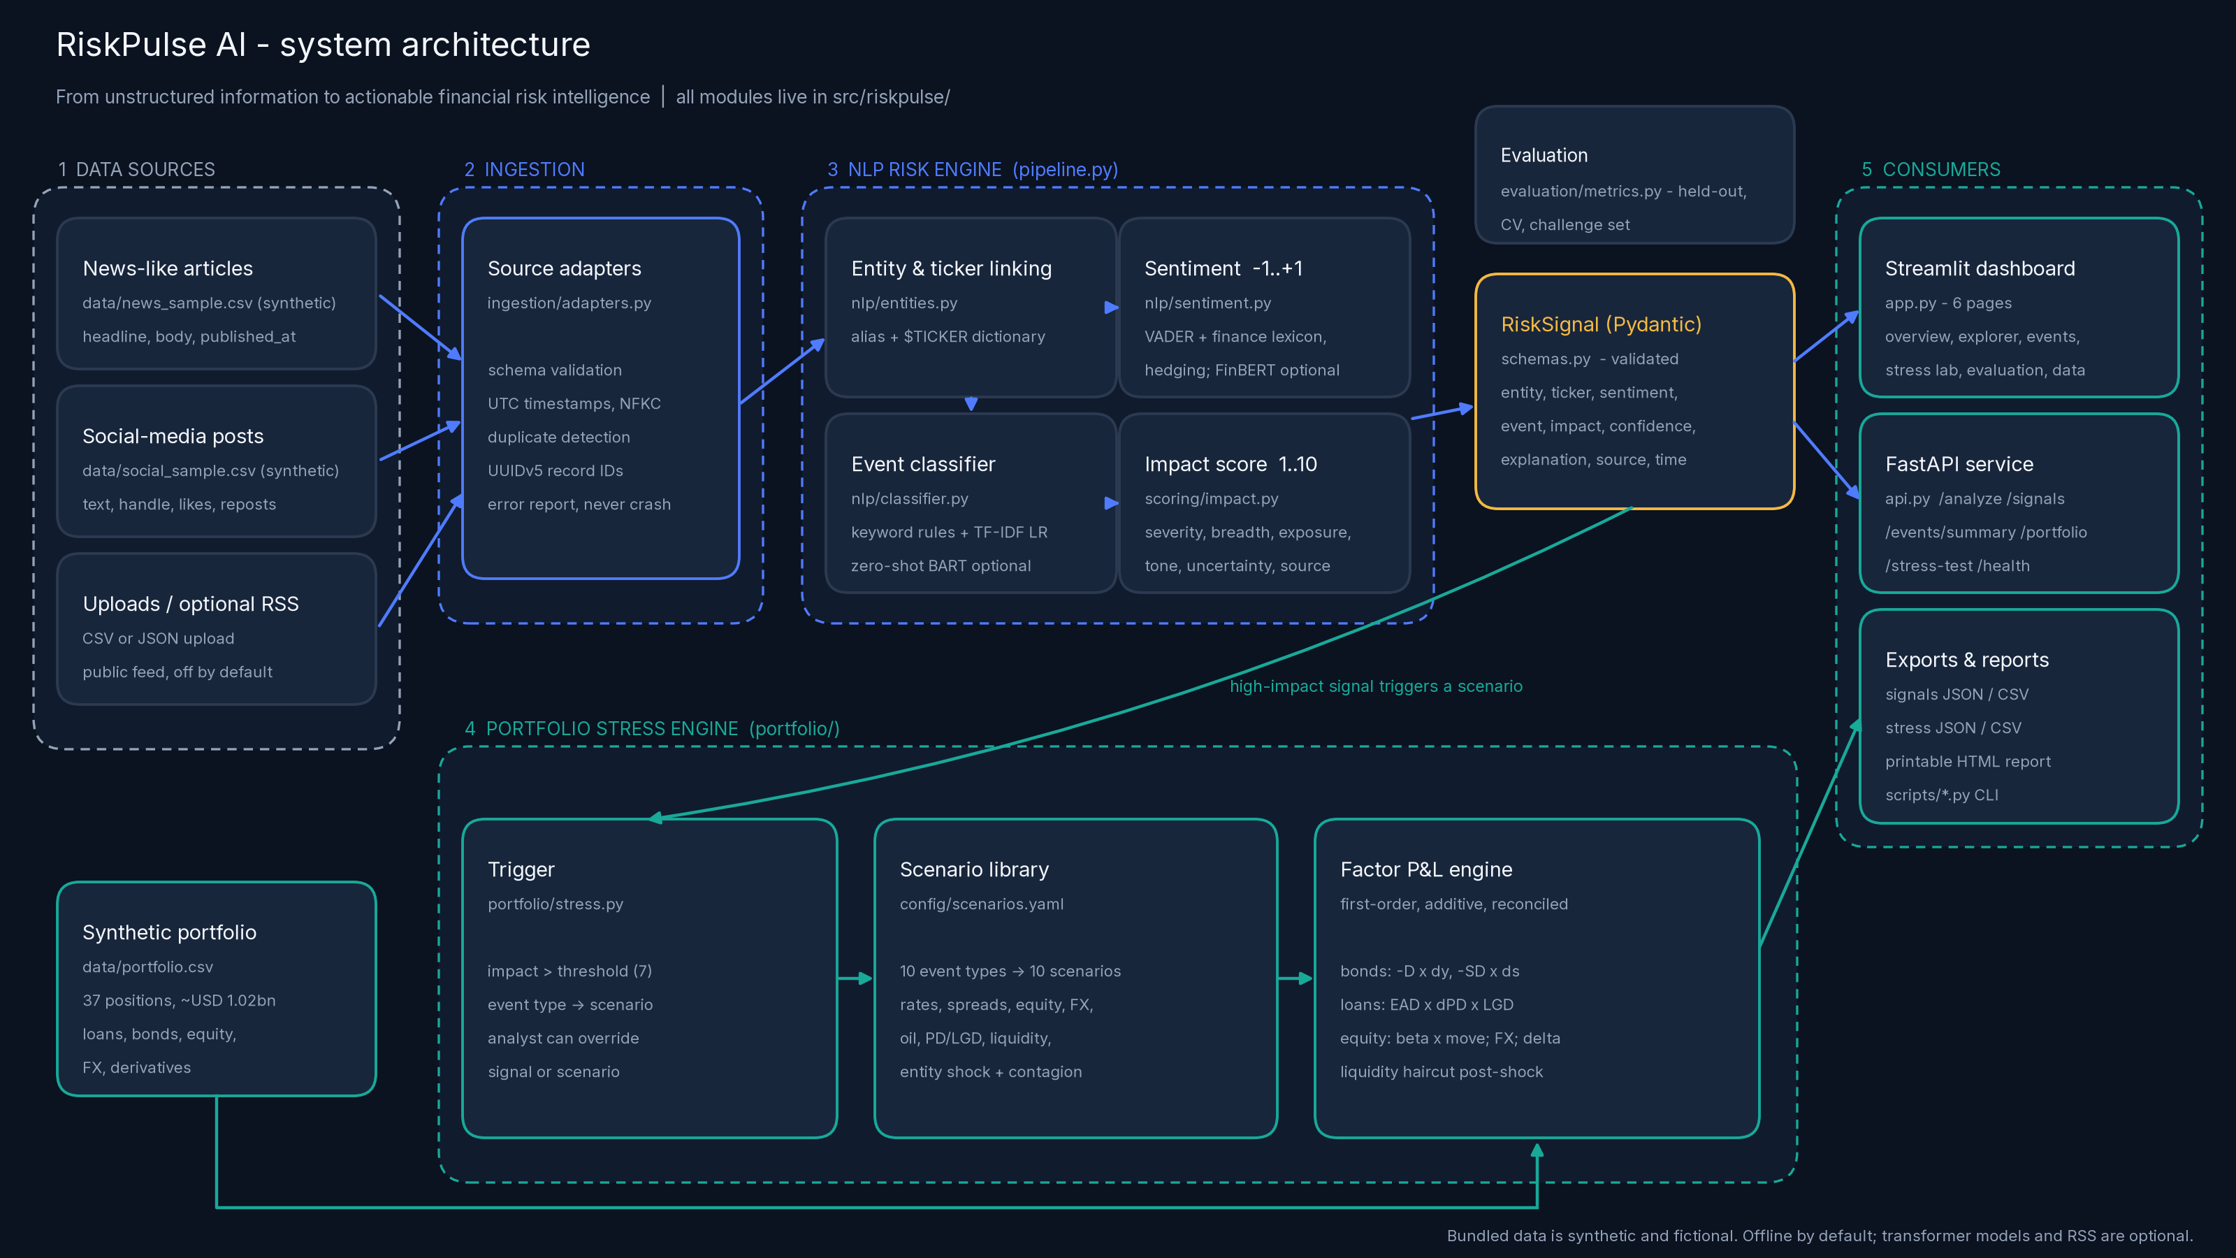
ARCHITECTURE
System design: modular, offline, one engine everywhere
Tech choices
Python 3.11
pandas, NumPy
scikit-learn
TF-IDF + logistic regression
VADER
+ finance lexicon
Pydantic
validated signal schema
FastAPI
REST for downstream apps
Streamlit + Plotly
6-page dashboard
PyYAML
editable scenarios & weights
Optional
FinBERT, BART-MNLI
Dashboard, API, CLI and reports call the same riskpulse modules: displayed and exported numbers always agree.
RiskPulse AI · S&P Global & Crisil Campus Hackathon 2026 · synthetic data
3 / 7
Notes:
Walk the diagram left to right: sources, ingestion, NLP, signal, stress, consumers.

Slide 4
RISK ENGINE
AI/NLP risk intelligence with a reason for every score
Sentiment -1 to +1
GENUINE OUTPUT - news record from data/news_sample.csv
1
VADER + 116-term finance lexicon, phrase rules, hedge dampening; company names masked. 57.5% -> 70.4% accuracy vs naive VADER.
“Meridian Shipping missed a coupon payment on its senior bonds. Rating agency downgrades Meridian Shipping to CCC and places it on negative watch ...”
Event classification
Entity / ticker
Meridian Shipping (MRDS)
2
Keyword rules (auditable evidence) + TF-IDF logistic regression over 10 categories; weak evidence -> 'Unclassified', close calls flagged ambiguous.
Event type
Credit Event (confidence 1.00)
Sentiment
-1.00 Negative
Impact score 1 to 10
Impact
9 / 10 -> stress trigger
3
Base severity + intensity + breadth + portfolio exposure + tone - uncertainty - source reliability. Impact is severity, not confidence.
Source / time
news · 2026-10-01 13:40 UTC
Why impact = 9
Explanation
base 6.5 + intensity 0.5 + exposure 0.8 + tone 1.5 = 9.3 -> rounded 9
4
Every signal carries keywords, sentiment drivers, entity exposure and the arithmetic behind its impact score.
Keywords: default, downgrad, missed a coupon, restructur
RiskPulse AI · S&P Global & Crisil Campus Hackathon 2026 · synthetic data
4 / 7
Notes:
Read the example: how event, sentiment, entity and impact are derived.

Slide 5
MODULE B
Event-driven portfolio stress testing
Auto-triggered: Market / Liquidity signal (impact 10 > 7) -> scenario 'Market / liquidity stress', severity scale 1.25
BEFORE
AFTER
P&L
P&L %
Assumptions (explicit)
$1.02bn
$990.41m
-$28.69m
-2.81%
• Rates -50 bp (flight to quality)
• Equities -18.8% x beta
• Spreads +125 bp BBB / +312 bp HY
• Loan PD x1.25, LGD +3.8 pp
• Liquidity haircut after market moves
• Bonds: -ModDur x dy (bp / 10,000)
• Derivatives: delta / DV01 approximations
Second example (entity-specific)
MRDS credit event: -$12.47m (-1.22%); CDS hedge offsets $3.26m. Totals reconcile to the cent.
RiskPulse AI · S&P Global & Crisil Campus Hackathon 2026 · synthetic data
5 / 7
Notes:
Explain trigger, scenario mapping, the factor waterfall and the CDS hedge.

Slide 6
RESULTS
Results, validation and domain impact
AUTOMATED TESTS
RECORDS INGESTED
GROUPED CV MACRO-F1
P&L RECONCILIATION GAP
Why it matters
93 / 93
266 -> 254
0.976
0.00
• Early warning: minutes from headline to quantified exposure
• Explainable scores an analyst can audit and challenge
• Links NLP output directly to portfolio P&L by asset class
• API + CSV/JSON feed limits, alerts and credit reviews
ingestion, NLP, maths, API, UI
12 duplicates removed
held-out templates (optimistic)
components = positions = total
All metrics measured on synthetic data by scripts/evaluate_model.py; they show the pipeline works, not real-market predictive power.
RiskPulse AI · S&P Global & Crisil Campus Hackathon 2026 · synthetic data
6 / 7
Notes:
Be explicit: synthetic evaluation, honest challenge set, engineering tests.

Slide 7
HONEST ASSESSMENT
Limitations and next steps
What remains unvalidated
Next steps
• Synthetic, template-generated text; no real-market labels or price reaction data
• Baseline classifier generalises poorly to unseen phrasing (23% on paraphrases)
• Impact weights and scenario shocks are expert-set, not calibrated to history
• First-order stress maths: no convexity, gamma/vega or full loan revaluation
• Dictionary entity linking over a fixed fictional universe; one primary entity per text
• Label real public news (with licences) and calibrate impact against market moves
• Fine-tune FinBERT / a small LLM for events; keep rules as an audit layer
• Historical scenario library (2008, 2020, 2022 rates) and full repricing
• Streaming ingestion (Kafka) with alerting and analyst feedback loop
• Coreference + entity resolution against reference data (LEI / tickers)
Benefit: headline-to-P&L in one explainable, offline workflow an analyst can audit. Key limitation: validated on synthetic data only; real-market calibration is the next step.
RiskPulse AI · S&P Global & Crisil Campus Hackathon 2026 · synthetic data
7 / 7
Notes:
Close with the benefit and the main limitation: synthetic validation only.

