Slide 1
EC²SP
Embedded C Coding Standards and Practices

Slide 2
General definition
Coding standard defines a set of rules for programmers to follow in a given language

Slide 3
WHY ?
Individual programmers do not own the software they write. The end product should be constructed in a workmanlike manner
The reliability and portability of code are more important than either execution efficiency or programmer convenience

Slide 4
Advantages
Increases the readability and portability of software
Firmware may be maintained and reused at lower cost
Easy to understand or review the work of peers
Coding standard can help keep bugs out
It's cheaper and easier to prevent a bug from creeping into code than it is to find and kill it

Slide 5
Available standards
MISRA-C for safety critical systems
Embedded Coding standards by Michael Barr

Slide 6

Ten Bug Killing Rules

Slide 7
Rule#1 Braces
Reasoning: Considerable risk is associated with the presence of empty statements and single statements that are not surrounded by braces. Code constructs of this type are often associated with bugs when nearby code is changed or commented out. This type of bug is entirely eliminated by the consistent use of braces.
// Don't do this ... if (timer.done) // A single statement needs braces timer.control = TIMER_RESTART; // Do this ... while (!timer.done) { // Even an empty statement should be surrounded by braces. }

Slide 8
Rule#2 Keyword “const”
Reasoning:
The upside of using const as much as possible is compiler-enforced protection from unintended writes to data that should be read-only.
The const keyword shall be used whenever possible, including:
To declare variables that should not be changed after initialization,
To define call-by-reference function parameters that should not be modified (for example, char const * p_data),
To define fields in structs and unions that cannot be modified (such as in a struct overlay for memory-mapped I/O peripheral registers), and
As a strongly typed alternative to #define for numerical constants

Slide 9
Rule#3 Keyword “static”
Reasoning:
C's static keyword has several meanings. At the module-level, global variables and functions declared static are protected from inadvertent access from other modules. Heavy-handed use of static in this way thus decreases coupling and furthers encapsulation.
The static keyword shall be used to declare all functions and variables that do not need to be visible outside of the module in which they are declared.

Slide 10
Rule#4 Keyword “volatile”
Reasoning:
Proper use of volatile eliminates a whole class of difficult-to-detect bugs by preventing the compiler from making optimizations that would eliminate requested reads or writes to variables or registers that may be changed at any time by a parallel-running entity.
The volatile keyword shall be used whenever appropriate, including:
To declare a global variable accessible (by current use or scope) by any interrupt service routine,
To declare a global variable accessible (by current use or scope) by two or more tasks, and
To declare a pointer to a memory-mapped I/O peripheral register set (for example, timer_t volatile * const p_timer)

Slide 11
Rule#5 Comments
Reasoning:
Nested comments and commented-out code both run the risk of allowing unexpected snippets of code to be compiled into the final executable.
Comments shall neither be nested nor used to disable a block of code, even temporarily. To temporarily disable a block of code, use the preprocessor's conditional compilation feature (for example, #if 0 ... #endif).
// Don't do this ... /* a = a + 1; /* comment */ b = b + 1; */ // Do this ... #if 0 a = a + 1; /* comment */ b = b + 1; #endif

Slide 12
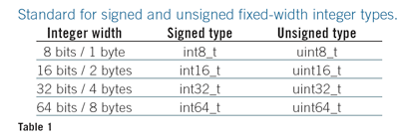
Rule#6 Fixed Width data types
Reasoning:
The ISO C standard allows implementation-defined widths for char, short, int, long, and long long types, which leads to portability problems. Though the 1999 standard did not change this underlying issue, it did introduce the uniform type names shown in the table, which are defined in the new header file <stdint.h>. These are the names to use even if you have to create the typedefs by hand.
Whenever the width, in bits or bytes, of an integer value matters in the program, a fixed-width data type shall be used in place of char, short, int, long, or long long

Slide 13
Rule#7 Bit wise Operators
Reasoning:
The C standard does not specify the underlying format of signed data (for example, 2's complement) and leaves the effect of some bit-wise operators to be defined by the compiler author.
None of the bit-wise operators (in other words, &, |, ~, ^, <<, and >>) shall be used to manipulate signed integer data.
// Don't do this ... int8_t signed_data = -4; signed_data >>= 1; // not necessarily -2

Slide 14
Rule#8 Signed and unsigned integers
Reasoning: Several details of the manipulation of binary data within signed integer containers are implementation-defined behaviors of the C standard. Additionally, the results of mixing signed and unsigned data can lead to data-dependent bugs.
Signed integers shall not be combined with unsigned integers in comparisons or expressions
// Don't do this ... uint8_t a = 6u; int8_t b = -9; if (a + b < 4){
…….
}

Slide 15
Rule#9 Parameterized macros vs inline function
Reasoning: There are a lot of risks associated with the use of preprocessor #defines, and many of them relate to the creation of parameterized macros. The extensive use of parentheses (as shown in the example) is important, but doesn't eliminate the unintended double increment possibility of a call such as MAX(i++, j++). Other risks of macro misuse include comparison of signed and unsigned data or any test of floating-point data.
Parameterized macros shall not be used if an inline function can be written to accomplish the same task
// Don't do this ... #define MAX(A, B) ((A) > (B) ? (A) : (B)) // ... if you can do this instead. inline int max(int a, int b)

Slide 16
Rule#10 Comma operator
The cost of placing each declaration on a line of its own is low. By contrast, the risk that either the compiler or a maintainer will misunderstand your intentions is high.
The comma (,) operator shall not be used within variable declarations.
// Don't do this ... char * x, y; // did you want y to be
// a pointer or not?

Slide 17
References
Embedded C coding standard from Michael Barr
http://www.barrgroup.com
http://www.ganssle.com
http://embedded.com

Slide 18
Watchdog

Slide 19
Software Reliability
Embedded systems must be able to cope with both hardware and software anomalies to be truly robust.
In many cases, embedded devices operate in total isolation and are not accessible to an operator.
Manually resetting a device in this scenario when its software “hangs” is not possible.
In extreme cases, this can result in damaged hardware or loss of life and incur significant cost impact.

Slide 20
Watchdog Timers
Watchdog timer is a piece of hardware, often built into a microcontroller that can cause a processor reset when it judges that the system has hung, or is no longer executing the correct sequence of code.
The hardware component of a watchdog is a counter that is set to a certain value and then counts down towards zero.
It is the responsibility of the software to set the count to its original value often enough to ensure that it never reaches zero.
The main purpose of the WDT is to make the device you are building robust and fault tolerant

Slide 21

First Aid
Watch dog has bitten what to do ?
Hardware assert reset line ,other action also possible.
MC with WDT contains internal status bit .
After bite check the bit ,decide to run or or switch to fail saif .
To recover quickly after bite ,skip initializations

Slide 22
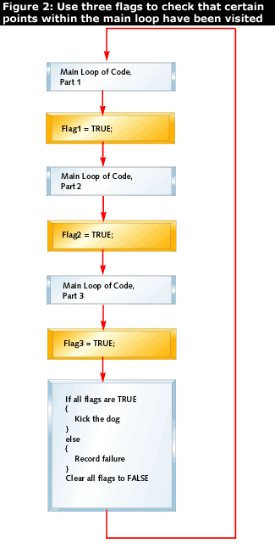
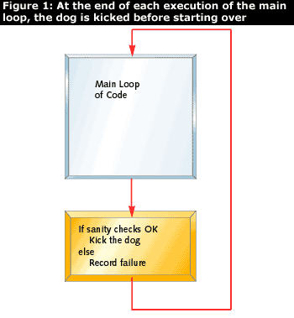
Sanity Checks

Slide 23
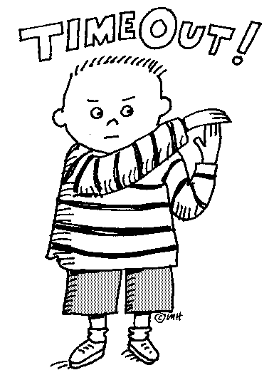
Choosing timeout
Software policy !Good ,make system less reliable.
Input to system and freq interrupts can affect length of single loop.
One approach : interval that is long (reset definitely hung systems – no detail timing required )
Consider the greatest amount of damage the device can do .when making calculations consider device start time + time out of WDT
Some WDT allows first time out to be longer than the timeout used for the rest of the checks.
Wdt can respond fast enough to halt mechanical systems ,offers little for damage that can be done by software.

Slide 24

Self Test
Assume that the watchdog hardware fails in such a manner that it never bites.
If u think watchdog failure is rare think again
Start up self test can be done by allowing WDT to timeout.

Slide 25
References
http://www.barrgroup.com/Embedded-Systems/How-To/Watchdog-Timer
http://www.ganssle.com/watchdogs.htm

Slide 26
Thank You

