Slide 1
8-bit Microcontrollers
  Introduction

Slide 2
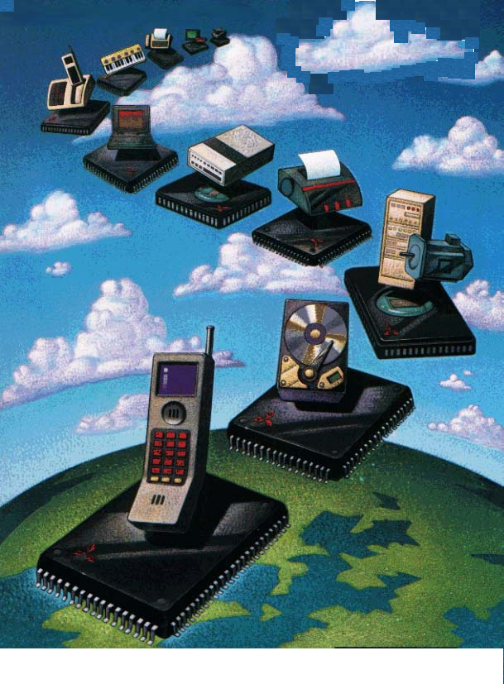
AGENDA
Embedded Systems
µP vs µC
Processor Architecture
Memories
I / O
BUSES
LAB

Slide 3
Why Learn ES
  Lot of hype
  Everybody else is doing it
  My friends got a job in ES,hence....
  Desktop would die soon
  My brother in US told me to learn it ....

Slide 4
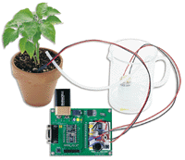
Embedded Systems Defined ?
No formal definition
Generally accepted to be a type of computer designed to solve a specific problem or task
A combination of hardware and software, and perhaps additional mechanical or other parts, designed to perform a dedicated function.
In some cases, embedded systems are part of a larger system or product

Slide 5
App1
App2
APP3
OS
App1
App2
APP3
HARDWARE
HARDWARE
Typical embedded system
General purpose computer System

Slide 6
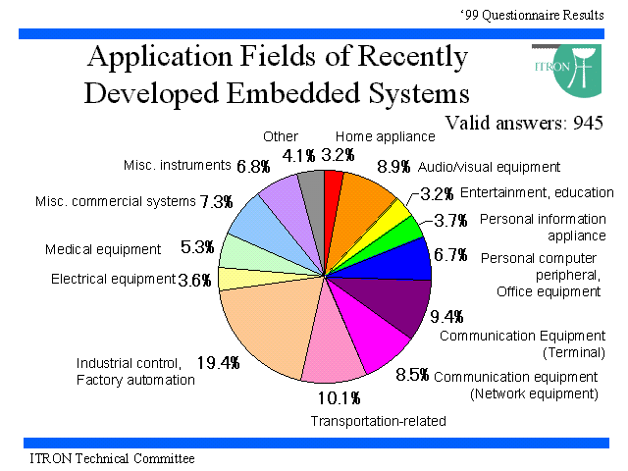
Embedded Market

Slide 7
Design Consideration
S/W
Reliability
Cost
development
time
Size
Embedded
Systems
Flexibility
Memory
Requrement
Performance
Power

Slide 8
General Framework
Embedded systems typically use a processor combined with other hardware and software to solve a specific computing problem.
The processors range from simple (by today’s standards) 8-bit microcontrollers to the worlds fastest and most sophisticated 64-bit microprocessors.
Embedded system software ranges from a small executive to a large real-time operating system (RTOS) with a graphical user interface (GUI).
Embedded systems range from large computers such as an air traffic control system to small computers.

Slide 9
Embedded System looks like . .
CPU
Memory chips
Serial Interface
Digital I/O
Analog I/O
LAN Interface
I/O controller chips

Slide 10
CPUs
CPUs can be
  Microprocessors or Micro controllers
Any CPU can be studied by knowing following features of CPU
  Clock speed, Address bus size, Data bus size, Register size
  Register set, Instruction set, Address spaces, Endian type
  Interrupt support, DMA support
  Instruction and Data cache
  Memory management
  Protection features (user/supervisor modes)‏

Slide 11
Micro Processors
Micro Processor is the Integration of a number of useful function in a single IC Package
These functions are
  Execute the stored set of instructions to carry out user defined task
  Ability to access external memory chips for both read and write data from and to the memory

Slide 12
Microprocessor Vs Microcontroller
Contains ALU, GP Registers, SP, PC, Clock timing circuit and interrupts
Requires more H/W, increase in PCB size
In addition in built ROM, RAM, IO devices, Timers
Requires less H/W, reduces PCB size & increases reliability

Slide 13
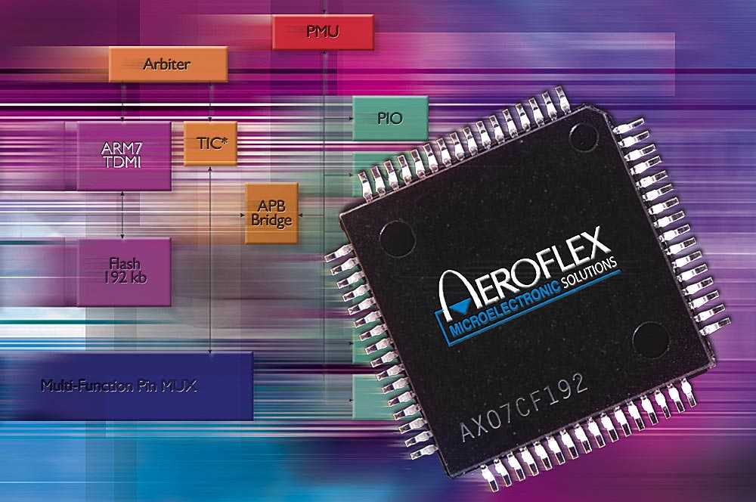
Microcontroller Defined
Very similar to a Microprocessor
It typically includes a CPU, memory, and other peripherals.

Slide 14
Classification of Microcontrollers
μc are classified into :
  8 bit μc e.g.: AVR 8515, Intel 8051, Motorola HC05
  16 bit μc e.g.: Siemens 80167, Intel 80C196
  32 bit μc e.g.:MCF5272, Power PC 8xxx
  64 bit μc e.g.: Texas 64xxx series
The number of bits indicate the internal data bus of a μc. It shows how many bits of data the μc can process simultaneously.

Slide 15
Processor Architecture
Princeton
Single Main Memory holding both program and Data
Simple memory structure
Harvard
Contains 2 separate memory spaces- code & data
Complex memory Structure
CPU
Code and Data
code
CPU
data

Slide 16
RISC vs CISC – Architecture
RISC
CISC
Fixed width instructions
Variable length instruction
Few formats of instructions
Several formats of instructions
Load/Store Architecture
Memory values can be used as operands in instructions
Large Register bank
Small Register Bank
Instructions are pipelinable
Cannot pipeline instructions

Slide 17
RISC vs CISC - Organization
RISC
CISC
Hardwired instruction decode
Microcode ROMS instruction decoder
Single cycle execution of instruction
Multi cycle execution on instruction

Slide 18
RISC vs CISC - Organization
RISC
CISC
Hardwired instruction decode
Microcode ROMS instruction decoder
Single cycle execution of instruction
Multi cycle execution on instruction

Slide 19
RISC
CISC
Feature
Low Power RISC
PC/Desktop CISC
Power
A few hundreds of milliwatts
Many watts
Compute Speed
200-520 Mega Hz
2-5 Giga Hz
Memory Management
Cost
Dollars
Tens to hundreds of Dollars
Environmental
High Temp, Low EM Emissions
Needs Fans, FCC/CE approval an issue

Slide 20
Life cycle of an instruction
As the instruction moves through the processor it goes through the following stages.
  Fetch : Instruction fetched from the address stored in the program counter.
  Decode : Instruction decoded and registers read
  Execute : in the ALU
  Write back : Results written back to registers or memory.
Note : each stage takes one clock cycle
The Instruction execution requires 4 clock cycles
Fetch
Decode
Execute
Writeback
Cycle 1 Cycle 2 Cycle 3 Cycle 4

Slide 21
Non Pipelined Example
1ns
2ns
3ns
4ns
5ns
6ns
7ns
8ns
F1
D1
E1
W1
F2
D2
E2
W2
Instruction 1
Instruction 2
2 instructions take 4ns each
A stage is used once every 4ns
The resultant throughput is 4 cycles per instruction (CPI)‏

Slide 22
Pipeline Example
Each stage is utilized at every clock cycle.
5 Instructions are executed in 8ns
Resultant throughput is 1 instruction per cycle
1ns
2ns
3ns
4ns
5ns
6ns
7ns
8ns
F1
D1
E1
W1
F2
D2
E2
W2
F3
D3
E3
W3
F4
D4
E4
W4
F5
D5
E5
W5
F6
D6
E6
F7
D7
F8
Instruction 1
Instruction 2
Instruction 3
Instruction 4
Instruction 5

Slide 23
Big Endian Little Endian
Stores the most significant part first
e.g.: Motorola
Stores the least significant part first
e.g.: Intel
e.g.: consider data 0x4567 at location 0x5050
45
67
0x5050
67
45
0x5050
0x5051
0x5051

Slide 24
Memory Mapped IO IO Mapped IO
IO devices are treated as like memory
Memory related instructions should be used to access IO
IO devices are separately interfaced
Separate instruction set available
memory
memory
Input
CPU
CPU
Input
memory
output
output

Slide 25
Memory
RAM
Hybrid
ROM
DRAM
SRAM
NVRAM
FLASH
EEPROM
EPROM
PROM
Masked

Slide 26
Types of RAM
Static RAM (SRAM) and Dynamic RAM (DRAM)
SRAM retains its contents as long as electrical power is applied to the chip. If the power is turned off or lost temporarily, its contents will be lost forever.
DRAM has an extremely short data lifetime - typically about four milliseconds. This is true even when power is applied constantly.
When deciding which type of RAM to use, a system designer must consider access time and cost.
Many embedded systems include both types.

Slide 27
Types of ROM
Masked ROM - hardwired devices that contained a preprogrammed set of data or instructions. The primary advantage of a masked ROM is its low production cost.
PROM (programmable ROM) - Known as one-time programmable (OTP) devices. The device programmer writes data to the device one word at a time by applying an electrical charge to the input pins of the chip.
EPROM (erasable-and-programmable ROM) – Similar to PROM. However, EPROMs can be erased and reprogrammed. To erase an EPROM, simply expose the device to a strong source of ultraviolet light. An essential part of the software development and testing process.

Slide 28
Hybrid Memories
EEPROM(electrically-erasable-and-programmable) - the erase operation is accomplished electrically. Any byte within an EEPROM may be erased and rewritten.
Flash memory devices are
  High density, low cost, nonvolatile, fast (to read, but not to write), and electrically reprogrammable.
  These advantages are overwhelming and, as a direct result, the use of flash memory has increased dramatically in embedded systems.
  Flash devices can only be erased one sector at a time, not byte-by-byte.

Slide 29
Hybrid Memories
NVRAM (non-volatile RAM) - An NVRAM is usually just an SRAM with a battery backup.
  An NVRAM is usually just an SRAM with a battery backup.
  When the power is turned on, the NVRAM operates just like any other SRAM.
  When the power is turned off, the NVRAM draws just enough power from the battery to retain its data.
  NVRAM is fairly common in embedded systems, typically limited to the storage of a few hundred bytes of system-critical information

Slide 30
General components of a Microcontroller
CPU – Heart of the controller. Composed of registers, ALU, instruction decoder and the control circuitry.
On Chip Memory – Used to store information
Memory
ROM(Non Volatile)‏
1.PROM
2.UV-EPROM
3.EEPROM
4.FLASH
RAM (Volatile)‏
1.SRAM
2.DRAM
3.NV-RAM

Slide 31
General components of a Microcontroller
I/O Ports
  Used to interface with the peripheral devices and the controller.
  Analog I/O and Digital I/O
Timer/Counter
  For keeping Time and/or calculating the amount of time between events
  For counting the events
  Baud rate generation

Slide 32
FLASH MEMORY
Flash is believed to be close to perfect memory
Advantages
  Fast read speeds
  Long-term data retention at much lower cost
Drawbacks
  Doesn’t allow random bytes to be updated on the fly
  Limitations on number of times it can be re-written

Slide 33
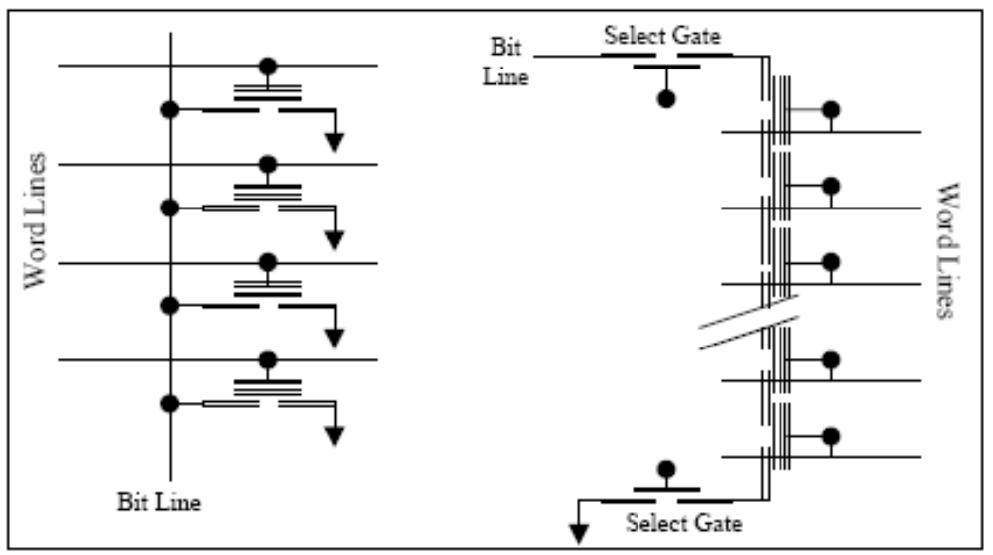
Types of Flash Memory
NOR NAND

Slide 34
NOR vs NAND
The parallel interconnection of the memory cells helps account for their fast random read accessibility.
The arrangement of these cells is significantly more compact than in NOR.
The select gates allow higher programming and erase voltages to be used without disturbing the charge stored in unselected cells.
fast programming and erase times
Poor random read performance

Slide 35
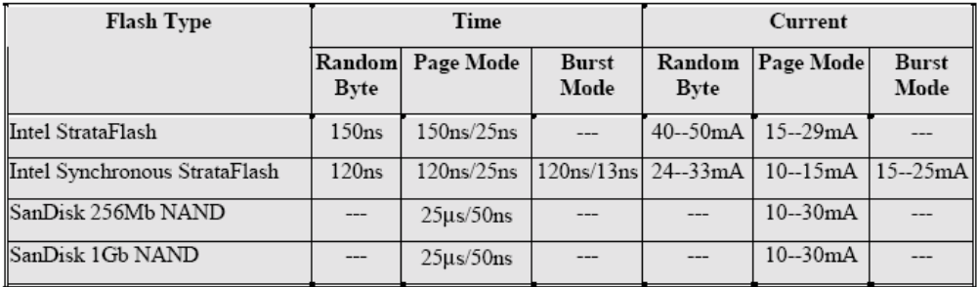
Flash memory read characteristics
Relatively long initial read delays
More severe in NAND due to read of redundant region

Slide 36
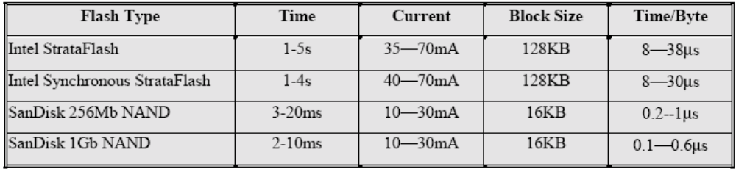
Flash memory write characteristics
Fast write time for NAND memory

Slide 37
The winner is . . .
NOR provides faster reads and allows random byte access
NAND writes and erases data faster, costs less per Mb and uses less power than NOR.
If the ROM (here flash) is rarely updated, then NOR is obvious choice
If data is being logged to a flash disk then NAND is the right memory

Slide 38
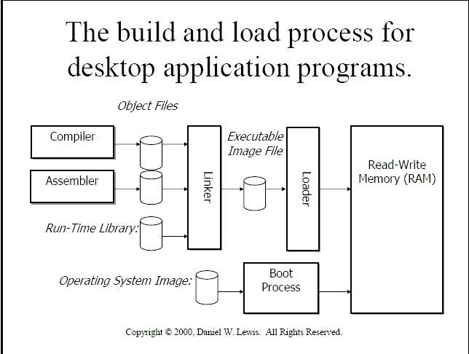

Slide 39
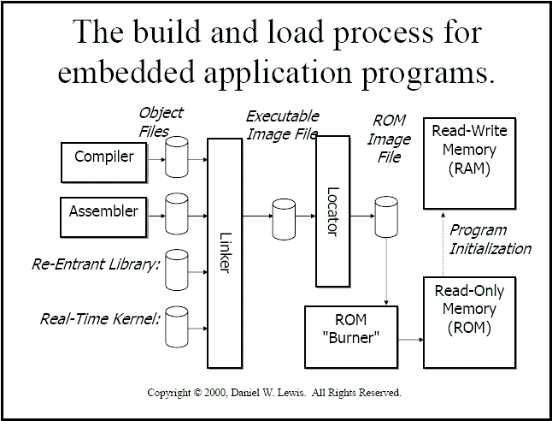

Slide 40
Bus Mechanisms
UART/ USART
SPI – 4 Mbps
I²C – 1 to 2 Mbps
CAN – few Mbps
PCI – 32 / 64 – 133 Mhz
USB
Firewire
Ethernet
Parallel port (IEEE 1284)‏

Slide 41
How to choose a bus
Bandwidth
Presence of I/O controllers

Slide 42
DEVELOPMENT ENVIRONMENT

Slide 43
Host - Target Development Environment
The distinguishing feature of embedded software development is host-target development environment
All the development tools like Editors, compilers and linkers are available on the host machine
Typical host machines are Windows 95/98, NT and Unix workstations where the above development tools are available
Application programs will be written on the host, get compiled, linked and get the executable file
Target systems are the ones where compiled and linked code is executed
Target systems being a microprocessor based boards does not offer any development environment themselves, so an host machine is required

Slide 44
Cross Compilers
Another distinguishing feature of embedded software development is cross compilers
Cross compilers are the ones, which runs on a machine based on one type of CPU and produces a machine instructions for a different kind of CPU

Slide 45
Downloading
Downloading is the process of loading the executable image prepared on the host system on to a target board
There are various methods to download the code to a target machine. They are:
  Serial ports
  EPROM/FLASH
  Floppy disks
  Ethernet
  Across a common Bus

Slide 46
Debug Monitor
Debug monitor is a software that resides in a ROM or EPROM of a target board during the development process
When a target board is powered on, the debug monitor program runs and provides facilities for downloading and debugging the application program
The debug features provided by the debug monitor are very low level ones
Once application program is debugged and ready, then the debug monitor could be replaced by the application program, so that whenever system is powered on, application program runs directly
In some cases both debug monitor and application program will reside in the ROM. First control goes to debug monitor which will pass control to the application program

Slide 47
ASSEMBLY
What’s Right With Assembly Language?
Speed. ALP’s are generally the fastest programs around.
Space. ALP’s are often the smallest.
Knowledge. Your knowledge of assembly language will help you write better programs, even when using HLLs.
What’s Wrong With Assembly Language?
Assembly is hard to learn & write.
Assembly language programming is time consuming.
Improved compiler technology has eliminated the need for assembly language.
Assembly language is not portable.

Slide 48
LAB
avr-gcc
avr-as
avr-ld
EXPLORE . . .. .

