Slide 1


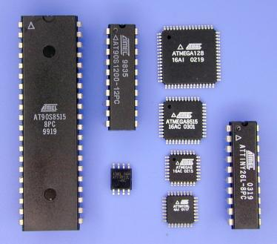
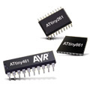

Atmel Avr
C-DAC Hyderabad

Slide 2

Brief History
AVR basic architecture was conceived by two students at the Norwegian Institute of Technology (NTH) Alf-Egil Bogen and Vegard Wollan.
The acronym AVR has been reported to stand for Advanced Virtual RISC, but it has also been rumored to stand for the initials of the chip's designers: Alf and Vegard [RISC].
Atmel says that the name AVR is not an acronym and does not stand for anything in particular.

Slide 3
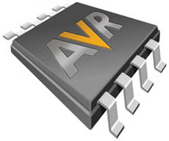
Device Overview
The AVR is a Harvard architecture machine with programs and data stored separately.
Three Basic Families
TinyAvr
  1-8 kB program memory
  8-32-pin package
  Limited peripheral set
  megaAVRs
    4-256 kB program memory
    28-100-pin package
    Extended instruction set
    Extensive peripheral set
Application specific AVRs
  megaAVRs with special features such as LCD controller, USB controller

Slide 4
Features in atmega8
Advanced RISC Architecture
  133 Powerful Instructions – Most Single Clock Cycle Execution
  32 x 8 General Purpose Working Registers + Peripheral Control Registers
  Up to 16 MIPS Throughput at 16 MHz
  On-chip 2-cycle Multiplier
  Nonvolatile Program and Data Memories
  8K Bytes of In-System Reprogrammable Flash
  Endurance: 10,000 Write/Erase Cycles
  512K Bytes EEPROM
  Endurance: 100,000 Write/Erase Cycles
  1K Bytes Internal SRAM

Slide 5
Peripheral Features
  Two 8-bit Timer/Counters with Separate Prescalers and Compare Modes
  One 16-bit Timer/Counters with Separate Prescaler, Compare Mode and Capture Mode
  Real Time Counter with Separate Oscillator
  Three PWM Channels
  Output Compare Modulator
  6-channel, 10-bit ADC
  Byte-oriented Two-wire Serial Interface
  Programmable Serial USARTs
  On-chip Analog Comparator
  Master/Slave SPI Serial Interface
  Programmable Watchdog– On-chip Analog Comparator

Slide 6
AVR Family Architecture
RISC Processor
Harvard Architecture
32 X 8 general purpose registers
On-chip programmable timer
SLEEP and POWER DOWN modes
Program
Flash
Program
Counter
Status and
Test
Control
Register
General
Purpose
Register
Interrupt
Unit
Instruction
Register
SPI
Unit
UART
Instruction
Decoder
ALU
Timer/
Counter
Data
SRAM
PWM
Watchdog
Timer
EEPROM
Analog
Comparator
I/O lines

Slide 7
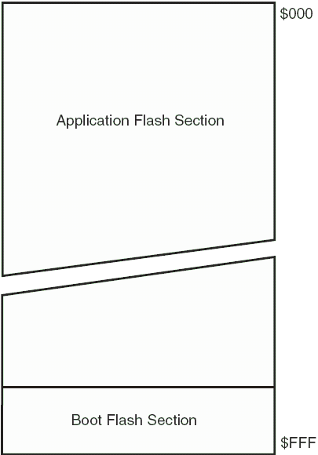
Flash in Atmega8
Since all AVR instructions are 16 or 32 bits wide, the Flash is organized as 4K x 16.
For software security, the Flash Program memory space is divided into two sections, Boot Program section and Application Program section.
Constant tables can be allocated within the entire program memory address space (LPM instruction).

Slide 8
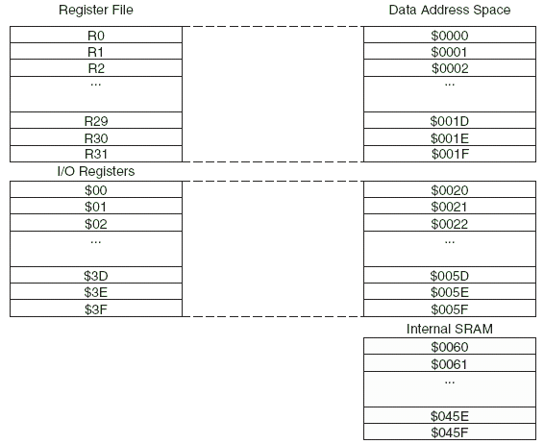
SRAM-1K

Slide 9
Registers
Program Counter (PC) [16 bit ]
Status Register (SREG) [8 bit ]
Sack Pointer (SP) [16 bit ] [SPH, SPL]
General Purpose Register ( R0 – R32) [8 bit]
X , Y , Z Register [16 bit ]

Slide 10

status register
The micro controller operates based on the Status Register (SREG) and other internal registers or components. Most important is the Status Register which holds information on the last instruction and its result and Interrupt enable status.
The SREG holds 8 Flags:

Slide 11
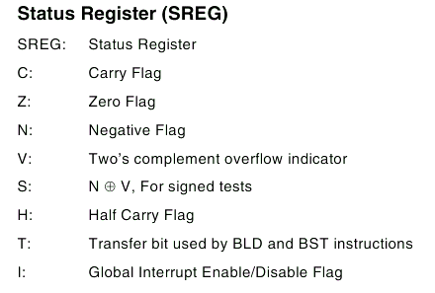

Slide 12

x, y and z registers
The register r28 -r31 have some additional function to their general purpose usage.
These register are 16 bit address pointer for indirect addressing of the data space .

Slide 13
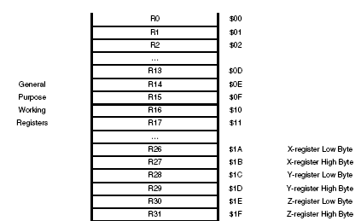
General purpose register file

Slide 14

Stack Pointer
The Stack is mainly used for storing temporary data, for storing local variables and for storing return addresses after interrupts and subroutine calls.
The Stack Pointer Register always points to the top of the Stack.
The Stack is used by the ALU to store return addresses from subroutines.

Slide 15
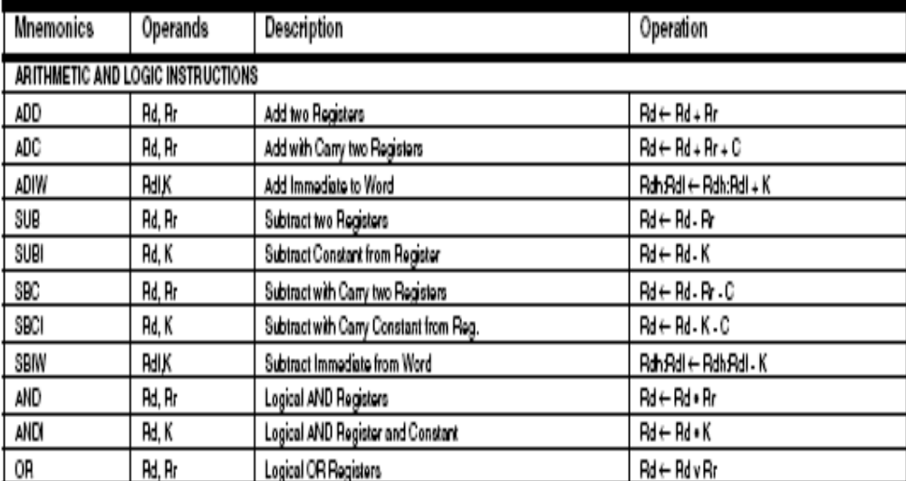
Avr instruction set

Slide 16
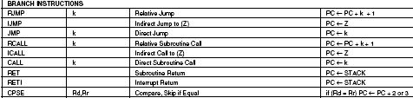

Slide 17
Branch instruction…..
The advantage of rjmp over jmp is that rjmp only needs 1 word of code space, while jmp needs 2 words. Example:rjmp go_here
rjmp: "Relative Jump". This instruction performs a jump within a range of +/- 2k words. Added together, it can reach 4k words or 8k bytes of program memory

Slide 18
Contd…
ijmp
"Indirect Jump" to (Z). This instruction performs a jump to the address pointed to by the Z index register pair. As Z is 16 bits wide, ijmp allows jumps within the lower 64k words range of code space (big enough for a mega128)‏
Example:
ldi ZL, low(go_there)‏
  ldi ZH, high(go_there)‏
  ijmp

Slide 19
Contd..
Jmp
"Jump". While rjmp is limited to +/- 2k words, jmp can be used to jump anywhere within the code space. The address operand of jmp can be as big as 22 bits, resulting in jumps of up to 4M words. The disadvantage over rjmp is that jmp needs 2 words of code space, while rjmp needs just one word.
Example: jmp go_far

Slide 20
subroutines
icall :"Indirect Call to (Z)". This instruction works similar to ijmp, but as a subroutine call.
rcall :"Relative Call Subroutine". Just as rjmp, rcall can reach addresses within +/- 2k words. When rcall is executed, the return address is pushed onto the stack.
call

Slide 21
conditional branches
Conditonal branches are branches based on the micro's Status Register. If the result of a previous operation left a status (for example "Zero"), this can be used to jump to code handling this result. Loops (for, while...) make use of this.
ldi r16, 5 ;load 5 inreg
loop:dec r16 ;
brne loop ;branch if not equal

Slide 22
Lab
avr-as -D –gstabs -ahlms -mmcu=atmega8 -o file.o file.s
avr-ld -Aatmega8 -o file file.o
simulavr -d atmega8 -g &
avr-gdb file

Slide 23
