Slide 1
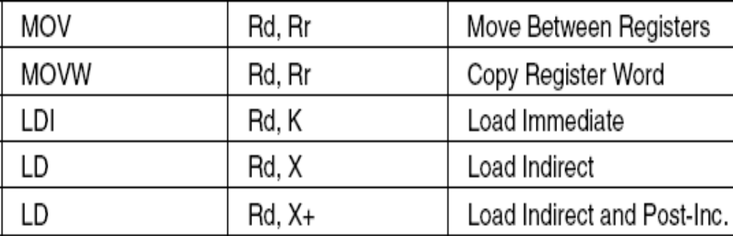
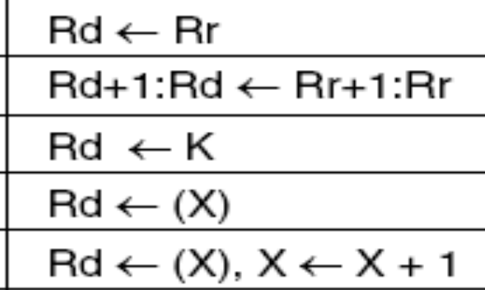

DATA TRANSFER INSTRUCTIONS

Slide 2
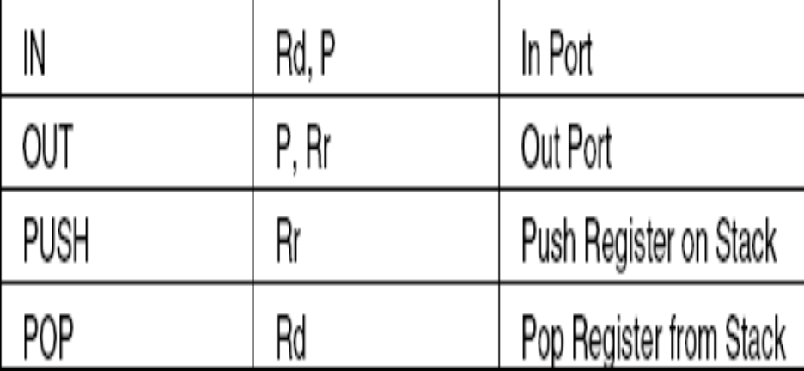
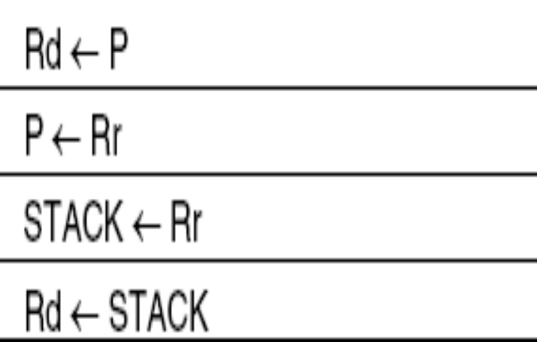
Some more instruction

Slide 3
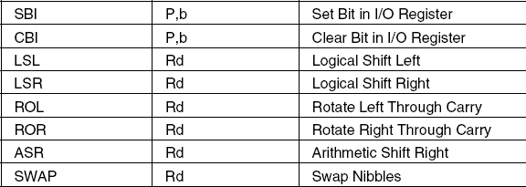
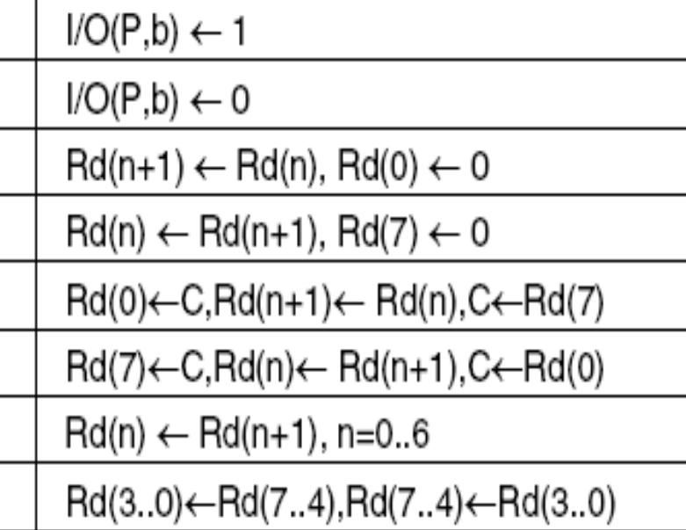
BIT AND BIT-TEST INSTRUCTIONS

Slide 4
macros
Macros are a good way to make code more readable, for example if it contains code that is often reused or if a lot of 16-bit calculations are done.
Macros in AVR assembler can be defined everywhere in the code as long as they're not used at a location before the macro definition
.macro stack
ldi r16, 0x10 ;
out SPH, r16 ;
ldi r16, 0xff ;
out SPL, r1 ;
.endmacro

Slide 5
for loops?
ldi r16, 0 ;clear the register loop: out PortB, r16 ;write register to port b
inc r16 ;inc the counter
cpi r16, 10 ;compare with 10
brne loop ;if less than 10 loop
ldi r16, 0
loop1: inc r16 ;this code differs slightly
out PortB, r16 ;find it
cpi r16, 10
brne loop1

Slide 6
another assignment>>
make code for WHILE (true) { } ;
and DO { }WHILE(true)‏

Slide 7
i/o ports
Atmega8 is having total 3 i/o ports B-D
All the ports are bi/directional
Port B ,PortD are 8bit and portC is 7 bit
The AVR I/O Ports are pretty simple to understand. They have a Port register, a Data Direction register and a Pin register. These are part of every I/O port in every AVR.

Slide 8
I/o REGISTERS
PINB(8bit)‏
PORTB (8bit)‏
DDRB(8bit)‏

Slide 9
i/o instructions
The simplest I/O instructions are in and out.
in : reads the value of an I/O Port into a register.Example: in r16, PinB
out :writes the value of a register to an I/O Port
but before this something is to be done??
some settings.

Slide 10
note>>>>
sbi and cbi don't operate on all I/O registers. The same is true for sbic/sbis. These can only be used for "classic" I/O Ports and other peripheral registers with addresses from 0 to 31 (0x00 to 0x1F).

Slide 11
......
thats all .........

Slide 12
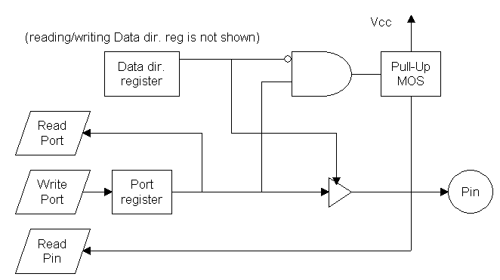
Port diagram

