Slide 1
Interrupts
An interrupts is an external or internal event that interrupts the microcontroller to inform that a device needs its service.

Slide 2
interrupt vs polling
micro controller can serve many devices. there are two ways to do that interrupt or polling
In polling the micro controller continuously monitors the status of a given device ,when the condition is met it performs specific service.after that it moves to the next device until every one is serviced.
in interrupt whenever any device needs its service the device notifies by sending an interrupt.

Slide 3
Advantages of interrupt.
We can assign priority in case of interrupts.
In interrupt micro controller can also ignore (mask ) a device request
Polling method waste time of micro controller

Slide 4
Sequence of event when interrupt happens.
Current instruction execution is completed
The address of next instruction is stored on stack
Address of ISR is loaded into PC
The processor executes the ISR
The ISR execution is indicated by RETI instruction.
The processor loads the PC with the value stored on the stack

Slide 5
note>>
Interrupt can occur at any time so status register (SREG) needs to be saved.
One method :use register
Second :use stack
Note>>> normally after the interrupt occurs & is being serviced , global interrupt is disabled

Slide 6
How the priorities are assigned?
These are fixed for avr
The priorities of interrupt is determined by the way interrupts vectors are assigned.
An interrupt vector at lower memory address is having a higher priority

Slide 7
;********************************************************************************
; PROGRAM FOR 2 FREQUENCY GENERATION BY PRESSING KEYS
;********************************************************************************
.INCLUDE "../8515def.inc" ;
.TEXT
.ORG 0X00
.GLOBAL _START
;*********************************************************************************
_START:
RJMP RESET_HANDLER ;
RJMP EXT_INT0_HANDLER ;
RJMP EXT_INT1_HANDLER ;
RJMP TIM_CAPT_HANDLER ;
RJMP TIM1_COMA_HANDLER ;
RJMP TIM1_COMB_HANDLER ;
RJMP TIM1_OVF_HANDLER ;
RJMP TIM0_OVF_HANDLER ;
RJMP SPI_STC_HANDLER ;
RJMP UART_RXCINT0_HANDLER ;
RJMP UART_DRE_HANDLER ;
RJMP UART_TXC_HANDLER ;
RJMP ANA_COMP_HANDLER ;
;************************************************************************************
RESET_HANDLER : rjmp main
EXT_INT0_HANDLER : reti
EXT_INT1_HANDLER : reti
TIM_CAPT_HANDLER : reti
TIM1_COMA_HANDLER : reti
TIM1_COMB_HANDLER : reti
TIM1_OVF_HANDLER : reti

Slide 8
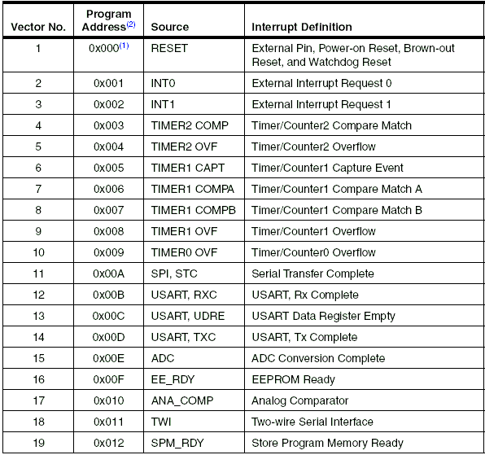

Slide 9


Various interrupt registers

Slide 10

Registers

Slide 11
Timers
Two 8-bit Timer/Counters with Separate Prescalers and Compare Modes
One 16 bit timers with seperate prescaler ,compare mode and capture mode

Slide 12
Purpose
To calculate time delays
To be use as the counters
Its advantage is that the input clock and operationof the timer is independent of the program execution.

Slide 13
Why different timers?
The answer is simple to have right timer for the right application
A timer with 16-bit resolution is certainly more flexible to use than one with 8-bit resolution.
for many application it is sufficient to have 8 bit resolution using higher resolution means higher program load & higher cost.

Slide 14
Different modes of operation
Normal mode
Capture mode
Pwm mode

Slide 15



Registers

Slide 16
