Slide 1
Modes of operation of timers
  Normal mode : start the timer , as the timer reaches the maximum value it overflows ,generate the interrupt if enabled ,set the corresponding timer overflow flag .
  The timer will continue to run unless u stop it or u reach the end of the program

Slide 2
compare mode & waveform generation
There is a 8 bit comparator that continuously compares the value in the TCNT2 and OCR2 when ever TCNT2 equals OCR2 the comparator signals a match .
it will set the corresponding flag
will generate the interrupt if enabled

Slide 3
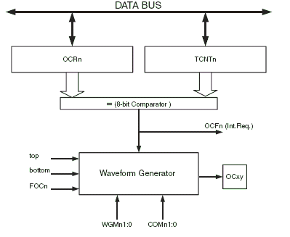

Slide 4


Register

Slide 5


Registers

Slide 6

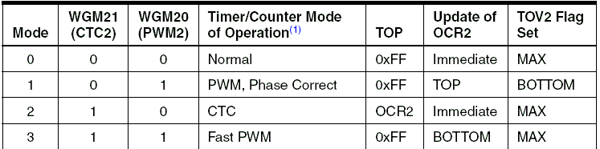

Slide 7
what are the two possibility that can happen ?
When there is a match we can clear the contents of the TCNT2 . this is nothing but clear the timer on compare match mode .
Let the timer run and overflow.

Slide 8
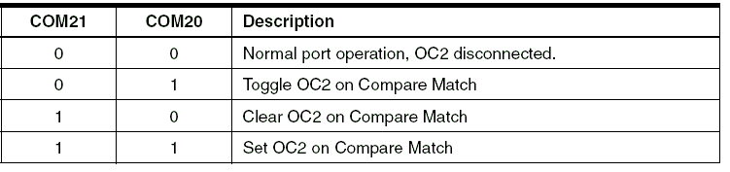
Com bits

Slide 9
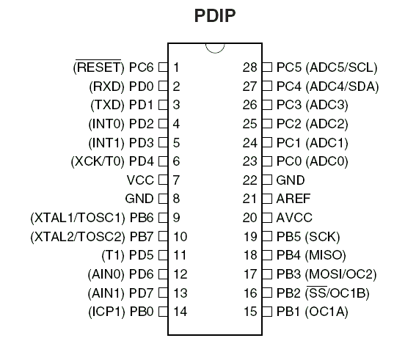

Slide 10
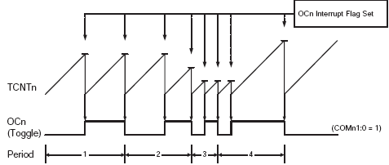

Slide 11
Timers can also be used for PWM generation
Fast PWM mode
Phase correct PWM mode

Slide 12
Phase correct PWM mode
It is based on the dual slope operation
The timer in this case act as count up & count down timer .
The resolution is fixed to the 8 bits
the timer overflow flag will be set when the timer reaches the bottom value .
The pwm is generated on OC2pin.

Slide 13
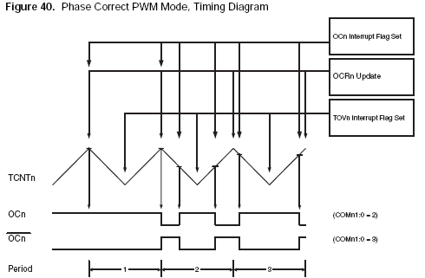

Slide 14

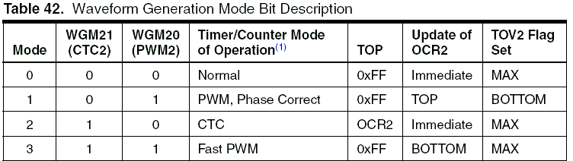
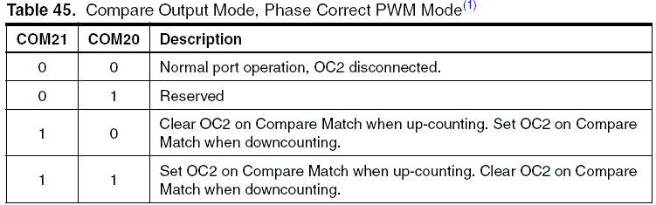

Slide 15
Fast PWM
It provides a high frequency PWM wave form generation .
It has a single slope operation .
The counter counts from bottom to max then then restart from bottom.

Slide 16
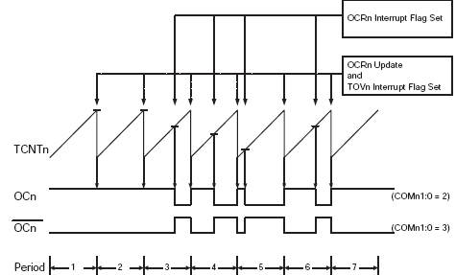

Slide 17

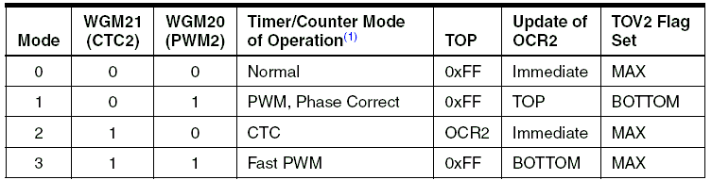
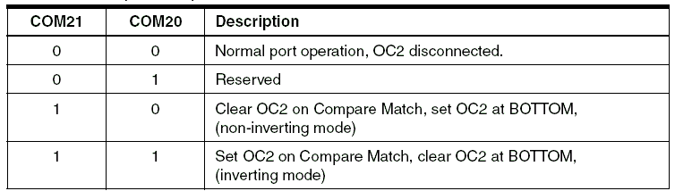

Slide 18
Refer datasheet .>>>
Page no. 104 – 120 for timer2(8 bit timer)

