Slide 1
Data communication
Some Embedded systems cannot work in isolation.
They may need to communicate with the other systems.
Two approaches of the communication is possible.
Serial communication & parallel communication.

Slide 2
Continued...
A bit is transmitted at a single time
Slower [ ↓ ]
Few wires [ ↑ ]
Byte or more at a time. [ ↑ ]
Faster [ ↑ ]
Large wire [ ↓ ]
Sender
Reciever
Sender
Receiver

Slide 3
Serial data transmission type
Transmission only in one direction
Data transmitted in one direction
Direction of data can be changed
Both direction & simultaneously
Simplex
DUPLEX
FULL DUPLEX

Slide 4
Serial com transmission mode
Synchronous mode
Asynchronous mode

Slide 5
Asynchronous mode
  Transmit one character at a time
  Data bits in a character ?
  Order of transmission LSB to MSB
  Start and stop bits tells receiver where one character stops and other starts
  Stop bits can be either one or two
  Parity bit for error detection
  Sending parity bit is optional

Slide 6
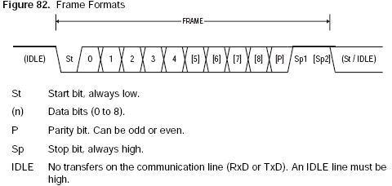
frame format

Slide 7
Async.. serial transfer
NO data- signal is kept high
Start bit – signal low for 1 bit time
The data transmission rates are specified in terms of Baud rate
Common values 2400,9600,19200,57600,115200
Baud rate

Slide 8
Atmega8 USART facts
Full duplex operation (independent receive and transmit register)
High resolution baud rate register (UBRR)
Serial frames with 5 -9 data bits ( 1-2 stop bits ,odd even parity generator,checking by H/W)
Errors data overrun :data loss due to receive buff full frame error : error in the stops bits received Parity error:

Slide 9
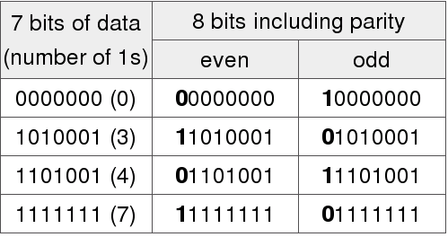
Parity Bit
A parity bit is a bit that is added to ensure that the number of bits with value of one in a given set of bits is always even or odd.
Parity bits are used as the simplest error detecting code.

Slide 10
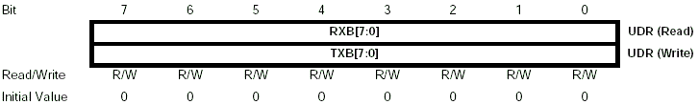

Registers

Slide 11


Registers

Slide 12
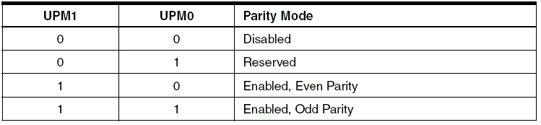
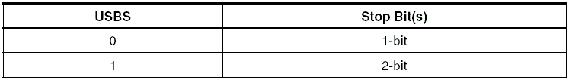
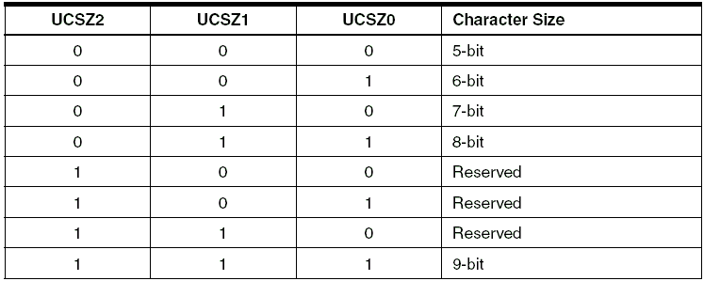

Slide 13
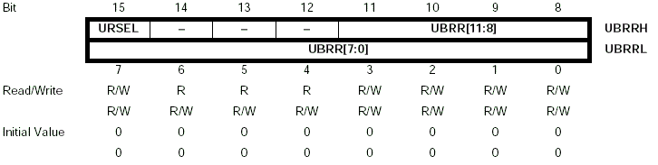
Baud Rate register

Slide 14
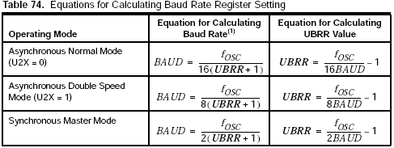
Equations

Slide 15
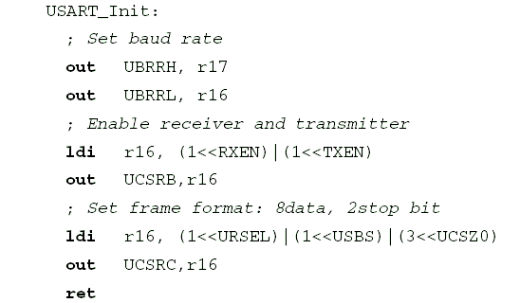
Uart Init

Slide 16
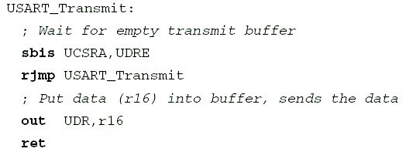
Transmit function

Slide 17
Refer>>>
page no (for usart registers) 153 – 159
page no 133 -159

