Slide 1
EEPROM
  EEPROM (Electrically Erasable Programmable Read Only Memory) is one of the three memory types of AVRs .
  EEPROM is able to retain its contents when there is no supply voltage.
  You can also change the EEPROM contents on runtime, so, EEPROM is useful to store information like calibration values, ID numbers, etc.

Slide 2
  To write in the EEPROM, you need to specify the data you want to write and the address at which you want to write this data.
  In order to prevent unintentional EEPROM writes (for instance, during power supply power up/down), a specific write procedure must be followed
  The write process is not instantaneous, it takes between 2.5 to 4 ms. For this reason, your software must check if the EEPROM is ready to write a new byte (maybe a previous write operation is not finished yet).

Slide 3
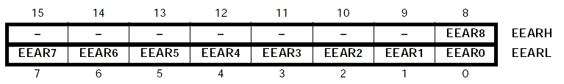
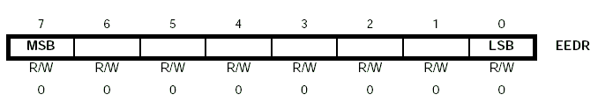
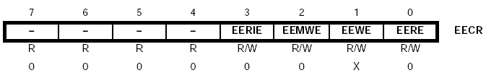
Registers

Slide 4
  The EEPROM Control Register (EECR) is used to control the operation of the EEPROM
  The EERE (EEPROM Read Enable) bit is used to read the EEPROM.
  In order to issue an EEPROM write, you must first set the EEMWE (EEPROM Master Write Enable) bit, and then set the EEWE (EEPROM write enable) bit. If you don't set EEMWE first, setting EEWE will have no effect.
  The EEWE bit is also used to know if the EEPROM is ready to write a new byte. While the EEPROM is busy, EEWE is set to one, and is cleared by hardware when the EEPROM is ready. So, your program can poll this bit and wait until is cleared before writing the next byte.

Slide 5
The following is a code snippet for writing the data 0xAA in address 0x10 :
  cli ; disable interrupts
  EEPROM_write: ;if write enable bit is cleared, EEPROM is
  sbic EECR, EEWE ;ready to be written to else loop until EEWE
  rjmp EEPROM_write ;cleared
  ldi r16, 0x10 ;load r16 with address (0x10)
  out EEAR, r16 ;and write it to the address register
  ldi r16, 0xAA ;load with the data we want to write (0xAA)
  out EEDR, r16 ;and write it to the data register
  sbi EECR; EEMWE ;set master write enable bit
  sbi EECR, EEWE ; set write enable bit
  sei ; and allow interrupts again

Slide 6
Eeeprom read
  To read a data from the EEPROM, you must first check that the EEPROM is not busy by polling the EEWE bit
  Then you set the EEAR register with the address you want to read, and then set the EERE bit in the EECR register.
  After that, the requested data is found in the EEDR register.

Slide 7
The following is a code snippet for reading the data stored in address 0x10. The read data is stored in r16.
  EEPROM_read:
  sbic EECR, EEWE ;check if the EEPROM is busy writing a ` ;byte
  rjmp EEPROM_read
  ldi r16, 0x10 ;load address register with 0x10
  out EEAR, r16
  sbi EECR, EERE ;set read enable bit
  in r16, EEDR ; and get the data from address 0x10

Slide 8
The Serial Peripheral Interface (SPI)
  The SPI (Serial Peripheral Interface) is a peripheral used to communicate between the AVR and other devices, like others AVRs, external EEPROMs, DACs, ADCs, etc.
  With this interface, you have one Master device which initiates and controls the communication, and one or more slaves who receive and transmit to the Master.

Slide 9
  The core of the SPI is an 8-bit shift register in both the Master and the Slave, and a clock signal generated by the Master.
  Let's say the Master wants to send a byte of data (call it A) to the Slave and at the same time receive another byte of data from the Slave (call it B).
  Before starting the communication, the Master places A in its shift register, and the Slave places B in its shift register.

Slide 10
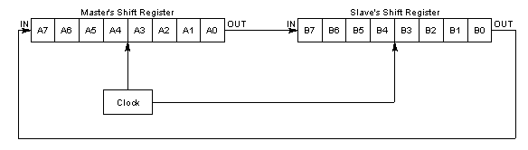
Then the Master generates 8 clock pulses, and the contents of the Master's shift register are transferred to the Slave's shift register and vice versa

Slide 11
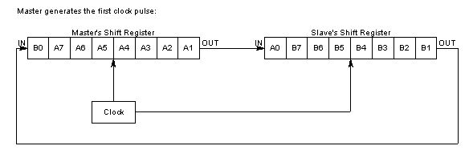
So, at the end of the clock pulses, the Master has completely received B, and the Slave has received A. As you can see, the transmission and reception occurs at the same time, so it is a full duplex data transfer

Slide 12
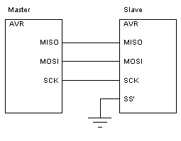
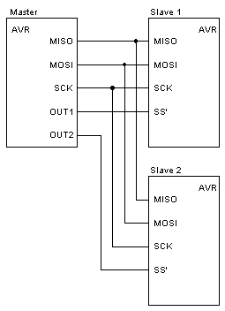

Slide 13
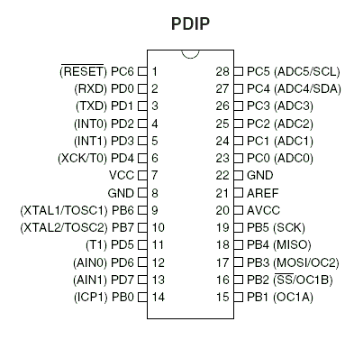

Slide 14
  In an AVR, four signals (pins) are used for the SPI: MISO, MOSI, SCK and SS' (SS' means SS complemented).
  MISO (Master In Slave Out): the input of the Master's shift register, and the output of the Slave's shift register.
  MOSI (Master Out Slave In): the output of the Master's shift register, and the input of the Slave's shift register.
  SCK (Serial Clock): In the Master, this is the output of the clock generator. In the Slave, it is the input clock signal.

Slide 15
  SS' (Slave Select): Since in an SPI setup you can have several slaves at the same time, you need a way to select which Slave you want to communicate to.
  If SS' is held in a high state, all Slave SPI pins are normal inputs, and will not receive incoming SPI data.
  On the other hand, if SS' is held in a low state, the SPI is activated. The software of the Master must control the SS'-line of each Slave.

Slide 16
  If the SPI-device is configured as a Master, the behavior of the SS' pin depends on the configured data direction of the pin.
  If SS' is configured as an output, the pin does not affect the SPI.
  f SS' is configured as an input, it must be held high to ensure Master SPI operation.
  If the SS' pin is driven low, the SPI system interprets this as another Master selecting the SPI as a Slave and starting to send data to it.
  Having two SPI Masters is quite unusual

Slide 17
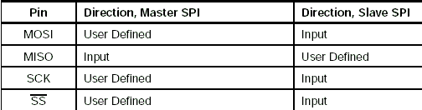
A word of caution about the SPI pin names. MISO, MOSI, SCK and SS' are the names used by AVRs. Other devices may use a different set of names. You must check the data sheet of the particular device you are using to get them right.
  What are the data directions of the SPI pins?
  It depends on the particular pin and on whether the SPI is set as a Master or Slave

Slide 18



Registers
[SPCR] [SPSR] [SPDR]

Slide 19
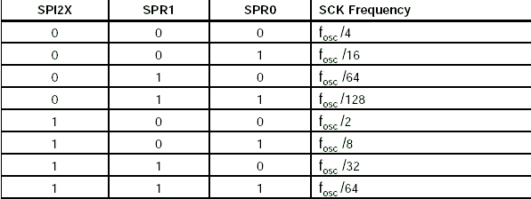
These two bits control the SCK rate of the device configured as a master. SPR1 and
SPR0 have no effect on the slave.

Slide 20
-
  CPOL: Clock Polarity-> When this bit is written to one, SCK is high when idle. When CPOL is written to zero,SCK is low when idle.
  CPHA: Clock Phase-> The settings of the clock phase bit (CPHA) determine if data is sampled on the leading (first) or trailing (last) edge of SCK.

Slide 21
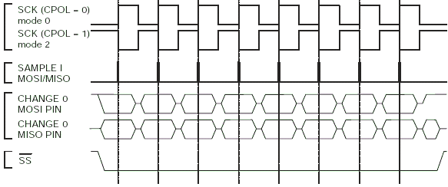
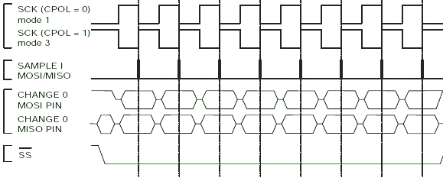

Slide 22
SPI is used to talk to a variety of peripherals
  Sensors: temperature, pressure, ADC, touchscreens
  Control devices: audio codecs, digital potentiometers, DAC
  Communications: Ethernet, USB, USART, CAN, IEEE 802.15.4
  Memory: flash and EEPROM
  Real-time clocks
  LCD displays, sometimes even for managing image data
  Any MMC or SD card

Slide 23
  For example program of SPI
  reffer to page number 124-132
  of Data Sheet

Slide 24
master side algo
  ->>Set MOSI as output.
  ->> Set SCK as output.
  ->> Set SS' as output.
  ->>Set SPI as a Master, with interrupt disabled,MSB first, SPI mode 3 and clock frequency .
  ->> Initiate data transfer.
  ->> Wait for transmission to complete.
  ->>The received data is placed in register.

Slide 25
Slave side algo
  Set MISO as an output.
  Set SPI as a Slave, with interrupt disabled,
  MSB first and SPI mode 3.
  Send data on Master request.
  Wait for reception to complete.
  The received data is placed in register.

Slide 26
watchdog timer
  A watchdog timer is a piece of hardware, often built into a microcontroller that can cause a processor reset when it judges that the system has hung, or is no longer executing the correct sequence of code

Slide 27

Kicking the dog
  The process of restarting the watchdog timer's counter is sometimes called "kicking the dog."

Slide 28
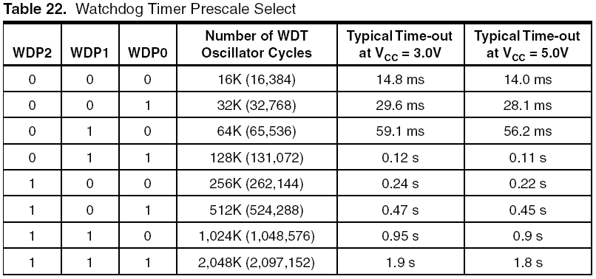

Slide 29
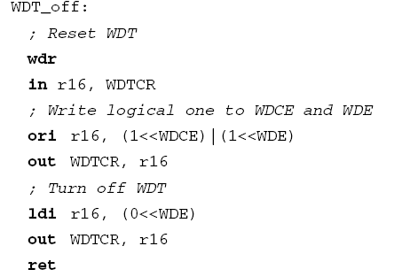
Disabling Watchdog

Slide 30
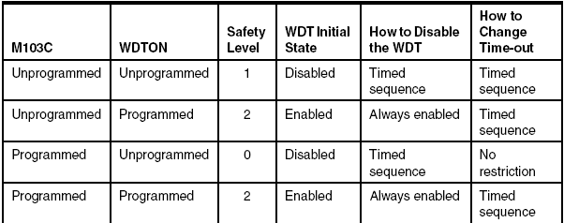
Default Values

