Slide 1
Analog to Digital
Converter
10-bit Resolution
Successive approximation
13 - 260 μs Conversion Time
6 Multiplexed Single Ended Input Channels
0 - VCC ADC Input Voltage Range
Selectable 2.56 V ADC Reference Voltage
Interrupt on ADC Conversion Complete
Sleep Mode Noise Canceler

Slide 2
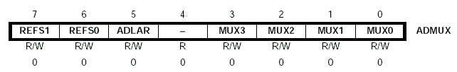
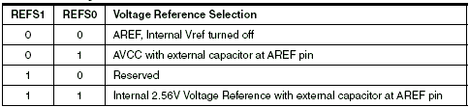

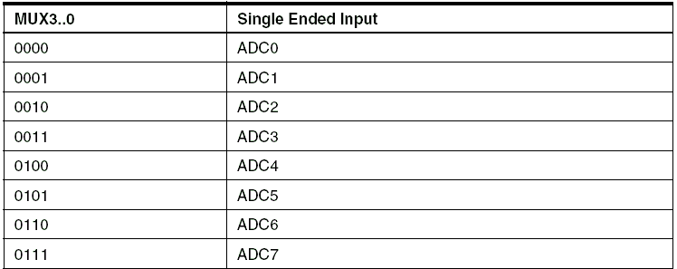

Slide 3

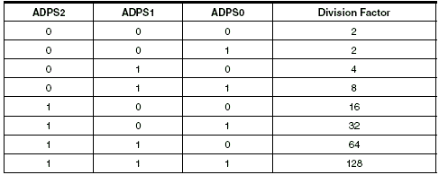
Registers

Slide 4
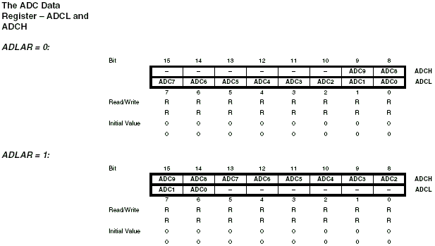

Slide 5
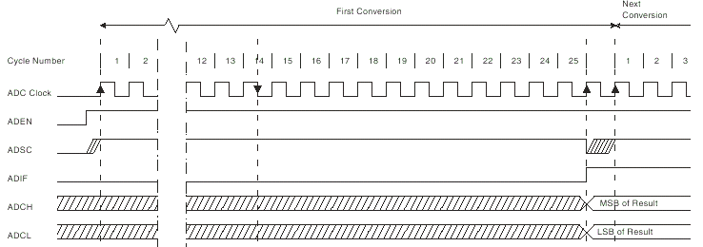
Single Conversion Mode

Slide 6
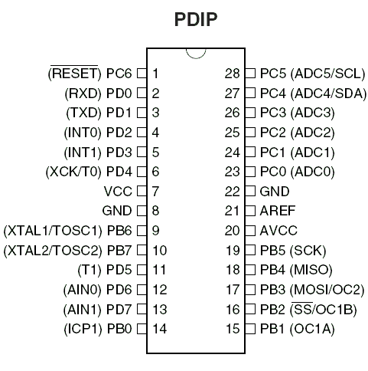
refer Page 196-205 of datasheet

