Slide 1
Real world Interfacing
In recent years the LCD is finding widespread use
replacing LEDs. This is due to the following reasons
Declining price of the LCD
The ability to display numbers ,characters, graphics in contrast to LED.
Ease of programming .

Slide 2
LCD Background
Frequently, an Microcontroller program must interact with the outside world using input and output devices that communicate directly with a human being. One of the most common devices attached to an AVR is an LCD display. Some of the most common LCDs connected to the LCD are 16x2 and 20x2 displays. This means 16 characters per line by 2 lines and 20 characters per line by 2 lines, respectively.
Fortunately, a very popular standard exists which allows us to communicate with the vast majority of LCDs regardless of their manufacturer. The standard is referred to as HD44780U, which refers to the controller chip which receives data from an external source and communicates directly with the LCD.

Slide 3
44780 BACKGROUND
The 44780 standard requires 3 control lines as well as either 4 or 8 I/O lines for the data bus
The user may select whether the LCD is to operate with a 4-bit data bus or an 8-bit data bus
If a 4-bit data bus is used the LCD will require a total of 7 data lines (3 control lines plus the 4 lines for the data bus)
If an 8-bit data bus is used the LCD will require a total of 11 data lines (3 control lines plus the 8 lines for the data bus).

Slide 4
contd.....
The three control lines are referred to as EN, RS, and RW
The EN line is called "Enable." This control line is used to tell the LCD that you are sending it data. To send data to the LCD, your program should make sure this line is low (0) and then set the other two control lines and/or put data on the data bus. When the other lines are completely ready, bring EN high (1) and wait for the minimum amount of time required by the LCD datasheet (this varies from LCD to LCD), and end by bringing it low (0) again.

Slide 5
contd...
The RS line is the "Register Select" line. When RS is low (0), the data is to be treated as a command or special instruction (such as clear screen, position cursor, etc.). When RS is high (1), the data being sent is text data which sould be displayed on the screen. For example, to display the letter "T" on the screen you would set RS high.
The RW line is the "Read/Write" control line. When RW is low (0), the information on the data bus is being written to the LCD. When RW is high (1), the program is effectively querying (or reading) the LCD. Only one instruction ("Get LCD status") is a read command. All others are write commands--so RW will almost always be low.
Finally, the data bus consists of 4 or 8 lines (depending on the mode of operation selected by the user). In the case of an 8-bit data bus, the lines are referred to as DB0, DB1, DB2, DB3, DB4, DB5, DB6, and DB7.

Slide 6
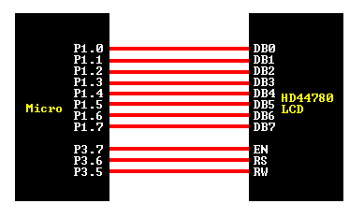
AN EXAMPLE HARDWARE CONFIGURATION

Slide 7
AN EXAMPLE HARDWARE CONFIGURATION
IN 4 Bit Mode

Slide 8
Programming Tip:
The LCD interprets and executes our command at the instant the EN line is brought low. If you never bring EN low, your instruction will never be executed. Additionally, when you bring EN low and the LCD executes your instruction, it requires a certain amount of time to execute the command. The time it requires to execute an instruction depends on the instruction and the speed of the crystal which is attached to the 44780's oscillator input.

Slide 9
Sending command to LCD
set RS to "control" =0
set R/W to "write" = 0
set "E" line
set data I/O lines to output (8bit)
output data, 8bits
DELAY
clear "E" line
DELAY

Slide 10
Sending data to LCD
set RS to "data" = 1
set R/W to "write" =0
set "E" line
set data I/O lines to output (8bit)
output data, 8bits
DELAY
clear "E" line
DELAY

Slide 11
LCD COMMAND CODES
0x1 clear screen
ox02 Return Home
0x04 Decrement cursor (shift to left)
0x06 Increment cursor
0x05 Shift display right
0x80 Force cursor to the beginning of first line
0xC0 Force cursor to the befinning of 2nd line
0x38 2 lines and 5X7 matrix

Slide 12
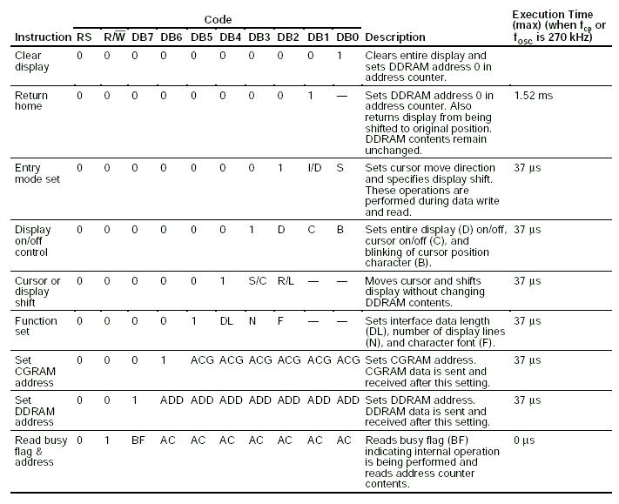

Slide 13
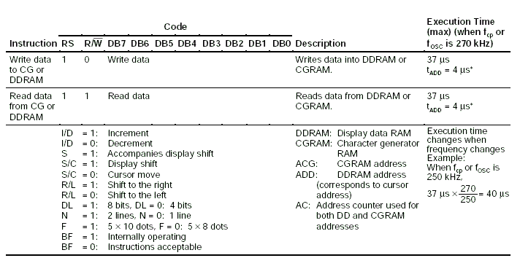

Slide 14
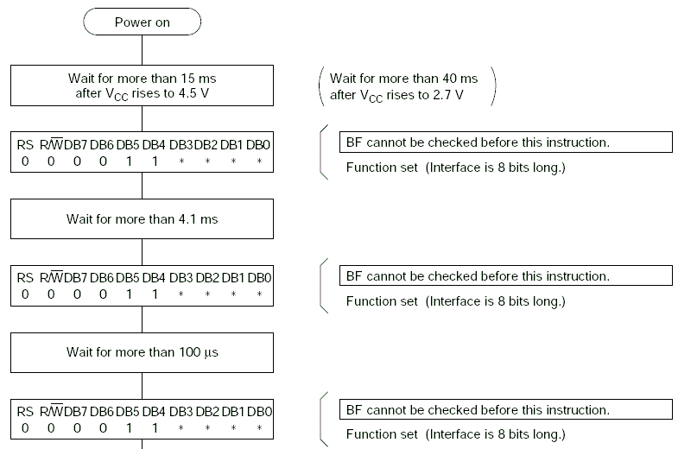
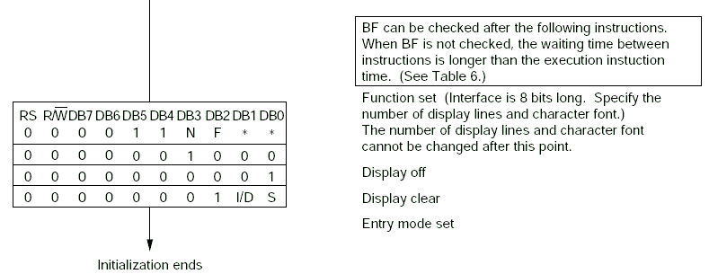

Slide 15
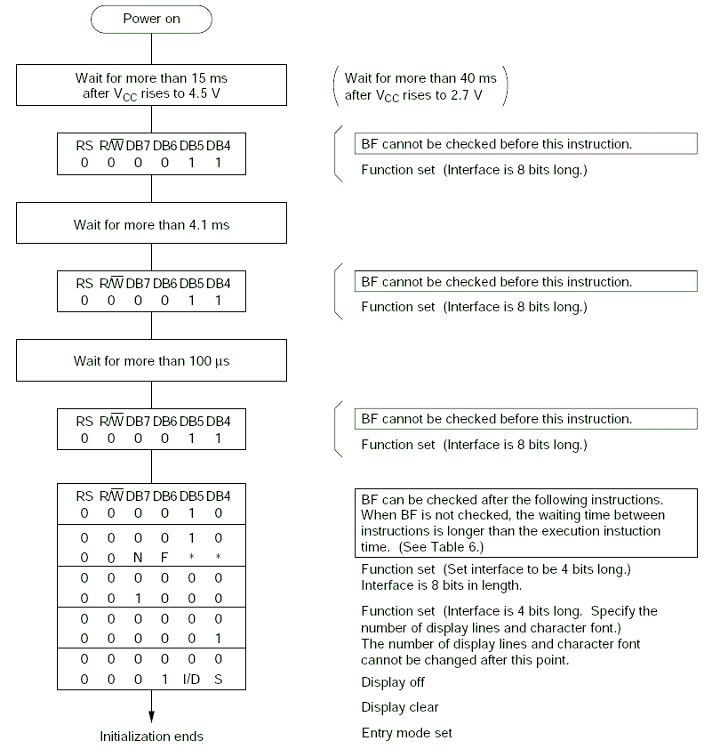


Slide 16
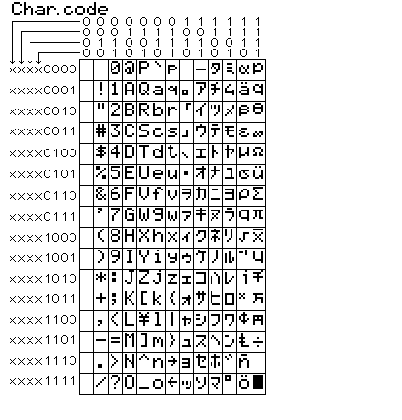
Character set for lcd

