Slide 1




Linux Module Programming
Santosh Sam Koshy
C-DAC, Hyderabad

Slide 2
Module Programming
Kernel Space vs User Space
Module Programming
Module Initialization
Module De-Initialization
Compilation & Loading a Module
Utilities
The Makefile
Module Parameters
Kernel Symbol Table

Slide 3
Applications vs Modules
Event Driven Execution
Libraries
Floating Point Operations
Segmentation Faults
Debugging
Stack Limitations
Infinite Looping

Slide 4
What are Modules???
Simple pieces of C Code.....
Loaded at Runtime within the kernel ... No Reboot required...
No main( ) function like normal C programs
Started using Module Initialization and removed using Module Cleanup functions

Slide 5
Module Initialization Functions
Module Initialization - A module always begins with the macro module_init()
This the entry point for the module
It tells the kernel what functionality module provides
Once it's done, init function returns and module remains in the kernel waiting to be called
Calls are executed by user space application or system hardware
module_init(Any Name for your init function)
The module init function takes no argument, and expects an integer return value.
Return value of 0 signifies that the module is correctly written

Slide 6
Module Cleanup Function
Module Cleanup - A module ends by calling module_exit() macro
Exit point for the module
It undoes whatever initialization function performed
It unregisters the module from the kernel
module_exit(A suitable name for your exit function)
Does not take any argument and Does not return any value

Slide 7
Important MACROs & Headers
Additional Macros - Declared anywhere within the module
MODULE_LICENSE(“GPL”); If not provided, module cannot use external functions
MODULE_AUTHOR(“AUTHOR_NAME”); author name
MODULE_DESCRIPTION(“DESCRIPTION ABOUT MODULE”);
MODULE_ALIAS(“ALIAS NAME FOR MODULE”);
Headers
#include <linux/init.h>
#include <linux/module.h>
Notes:
First thing which are compulsory for each module is module initialisation and then module exit. Module initialisaton function can be any name but that should be intiamted to kernel that this function is going to work for module initialisation. For that module_init() macro is there. The return value of this macro is zero for success and non-zero for some error. Similarly, to initiamte for exit function module_exit() is there.
Besides these compulsory macros few macros can be used as a optional macros which can tell some basic information about your module. Some example are given in the above slide.

Slide 8
The Hello World Module -Initialization
#include <linux/init.h>
#include <linux/module.h>
static int hello_init(void)‏
{
printk(“\nHello, World\n”);
return 0;
}
module_init(hello_init);

Slide 9
The Hello World Module -Cleanup
#include <linux/init.h>
#include <linux/module.h>
static void hello_exit(void)‏
{
printk(“\nGoodye, World\n”);
}
module_exit(hello_exit);

Slide 10
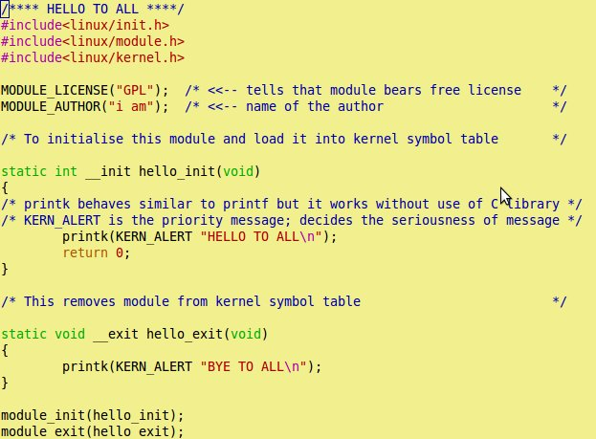
Hmmm..... So, How does the program look??
Your first C program
without main
Hello.c
To make it to local to this
module only
It says that the given
function is used only
at initialisation time
This unloads all
the resources
loaded by
__init function
It's like printf. Prints
value into kernel log
message
Notes:
Here you can see our “Hello To World” C program. One thing that you will notice here that there is no any main to start your program instead there is one init function and one exit function. Init function initialises your module and registers the module in kernel. Exit function unloads the module from the kernel. module_init() and module_exit(), are two macros which declare your hello_init and hello_exit, which are user defined, as the init and exit function respectively. Kernel module programming does not include any standard C library because C library is inaccessible in kernel space. To provide the similar functionality within kernel a symbol table is maintained which consists of required functions like printk needed by kernel modules. At the time of loading of kernel modules into the kernel, dependency check is done and required modules are loaded into kernel. Module loading we will discuss in later sections. There you will become more clear about the dependency and symbol table.
You must be able to see that functions are declared as static. Declaring it as static, keeps this function local to this module only. It is quite required to do so because this small module when inserted into the kernel can cause function name clash. There could be some other functions in kernel with same name, so it's necessary to make your function or variable as static to keep its scope local to the module only.

Slide 11
The Makefile
obj-m := hello.o
KERNELDIR = /lib/modules/$(shell uname -r)/build
PWD :=$(shell pwd)‏
default:
$(MAKE) -C $(KERNELDIR) M=$(PWD) modules
clean:
$(MAKE) -C $(KERNELDIR) M=$(PWD) clean

Slide 12
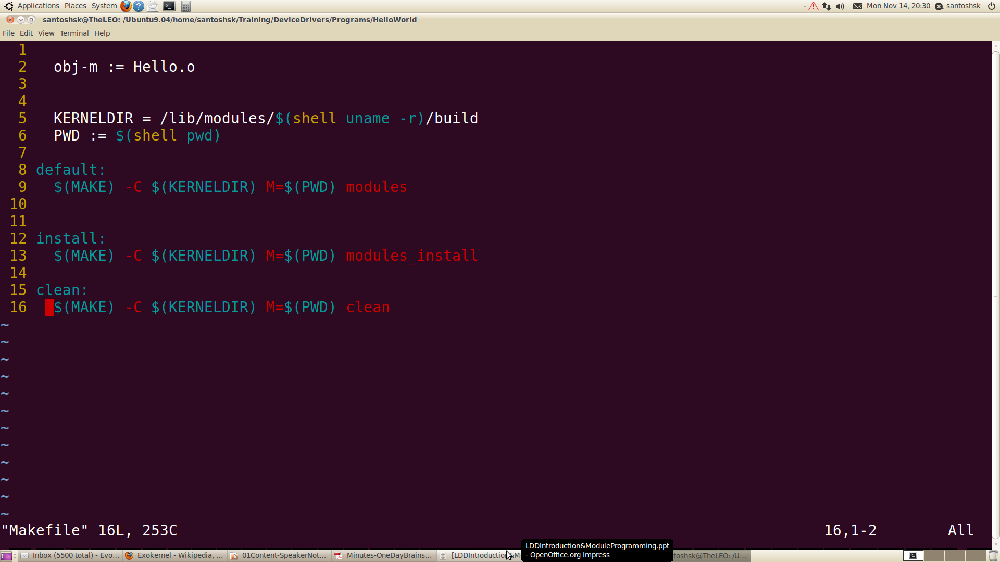
Makefile
This name should be
similar to source file.
Extension should be .o
These variables store the
path of main Makefile and
present working dir path
Notes:
Now when we are done with our kernel module, we need to compile it to create the kernel object file(.ko) which will be loaded into the kernel. But for compilation we make a Makefile that will do the cumbersome process of compilation for us. Above is the code you can see for the Makefile. The name of the file should be “Makefile”.

Slide 13
Compiling & Loading the Module
linux:~ $ make
linux:~ $ su
linux:~ # insmod ./hello.ko
linux:~ # dmesg
linux:~ # lsmod
linux:~ # rmmod hello
linux:~ # dmesg

Slide 14
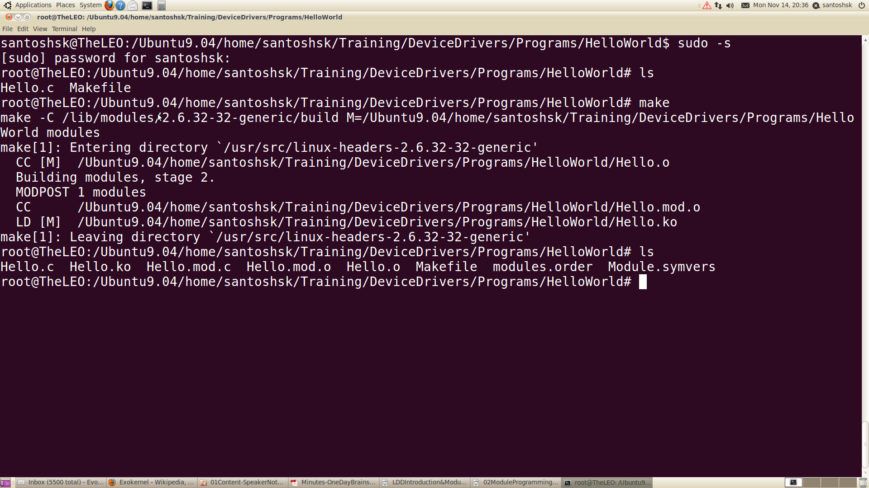
Compilation
Notes:
Our module nake is kern_mod.c. You can see the listing of files using ls command. Here we have two files one is the source code and other is Makefile. To compile your code using Makefile, use make command. This compiles your code and if everything is proper it creates .ko file along with some other files. Try to open and see those files. Explanations of these files are left as a assignment for you.
kern_mod.ko is our kernel object file which we will load into the kernel in next slide.

Slide 15
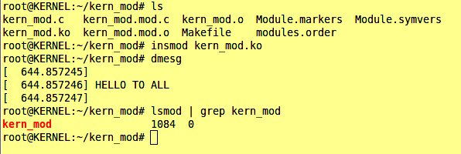
Inserting our “Hello To All” module
To insert modules commands are : insmod and modprobe
dmesg -c is for clearing
the kernel log messages
insmod is used to insert
our kernel module (.ko) into kernel space
Output can be seen from
kernel log messages which can be seen using dmesg command
lsmod: To see our module is inserted in kernel
Output message printed
by our module
Notes:
After compiling, we are ready for loading our module into the kernel. There are two tools that can do this for you: insmod and modprobe. Here we discuss insmod, modprobe will be discussed later. In the slide you can see how to insert our module into kernel. To load and unload, root permission is required. When that is done type dmesg command to see the output printed by our “Hello To All” module. Now when we inserted our module, hello_init function, which is our init function, gets executed and it prints the message.
Even we can see that our module is there in kernel or not. For that the command is lsmod. As you can see in the slide the output of lsmod shows our kern_mod.

Slide 16
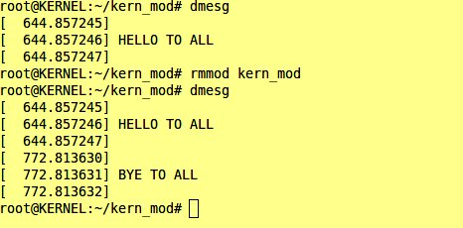
Module unloading
To remove kernel module : rmmod
Root permission is
required
rmmod and the name of your module, removes the module
In dmesg, we can see the output printed by our exit function
Now when you will do lsmod, our module will be missing from there.
Notes:
To unload the module rmmod command is used. As you can see the slide, after doing rmmod we got the hello_exit() function's output. But if your module is used by some other modules also and if you try to remove your module it will not be unloaded. Modules can be unloaded only when no other modules are using it.

Slide 17
Module Parameters
Parameters may be passed to the modules during module insertion
The macro “module_param(name, type,perm)” is used to initialize the parameter at runtime. It takes 3 arguments which are the parameter name, parameter type and the permissions associated with the parameter
This macro may be defined anywhere in the module

Slide 18
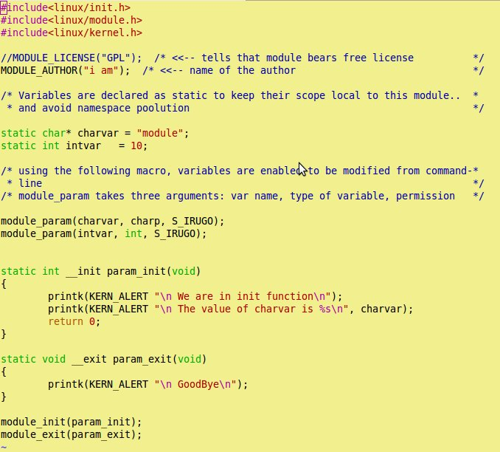
Parameter Passing
This Macro is used
to mention that these
variables can be
initialised from
command line
charp = character
pointer
bool = boolean
invbool = inverted
Boolean
Rest are same data
types
Notes:
Parameter passing to a module is similar to passing command line argument to the normal C program. Difference is only in the declaration portion. Here, there is no any concept of *argv or argc. To take any value for any variable from the command line, we have to declare that using a macro maodule_param() this takes three arguments: 1. variable name- which we want to pass value from command line; 2. data type of the variable; 3. permissions- who can enter the data for this variable.
In the above program you can see that we are using two variables charvar and intvar of data type charp and int respectively. If we are not passing any values from command line, variables are going to take default value with which we initailised it. But if we are passing any data to our variable through command line, default value will be overwritten.

Slide 19
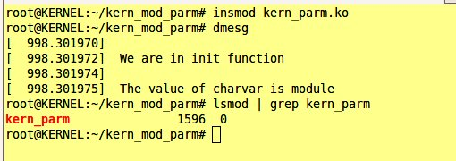
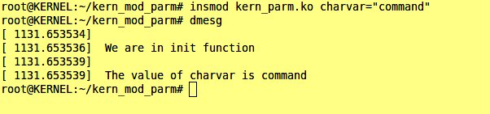
Parameter Passing ...
No parameter
Printed local value
Passing command line
parameters
charvar is a charp
variable we defined in
module
Printed command line value
Notes:
Here you can see that for the first case we are not passing any data to our variables. So, output printed is the default value that we have assigned to the variable at the time of initialisation. In the second case we can see how to pass values to the variable through command line. Even we can pass for multiple variables also, we just have to use variable name and the value we want to give for example, if we are passing data to intvar, it can be done in:
insmod kern_parm.ko charvar=”command” intvar=10

Slide 20
Function Libraries for Modules??
Standard C library functions cannot be used in module programming
Functions/Variables shared between modules have to be exported as kernel symbols into a global space
To see the symbols exported into the kernel “cat /proc/kallsyms”
printk() is one such example
External symbols used in a module (printk) should be resolved at runtime
If symbol is not found, module will not be loaded to kernel and return back with an error

Slide 21
The Kernel Symbol Table
lp
Parport_pc
Parport
Kernel Functions

Slide 22
The Kernel Symbol Table
Global Kernel Space
Modules can export services to other modules through the use of kernel macros “EXPORT_SYMBOL(name)” which takes the name of the parameter or function as argument
This exported function may be used by other modules in requirement of similar functionality as done by the exported function

Slide 23
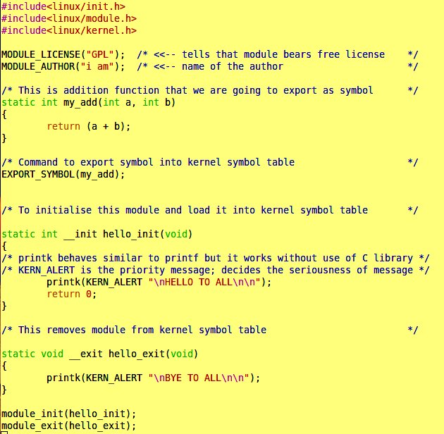

Exporting symbol
Program name kern_sym.c
This is a simple add
function declearation
that we are going to export
Command to export symbol
Header file containing
declaration of the add function
Notes:
Here, we are showing a sample program to export symbol to the kernel table. The funnction we want to export is my_add(). We defined the add function first anf then using EXPORT_SYMBOL() we exported it to kernel symbol table.

Slide 24
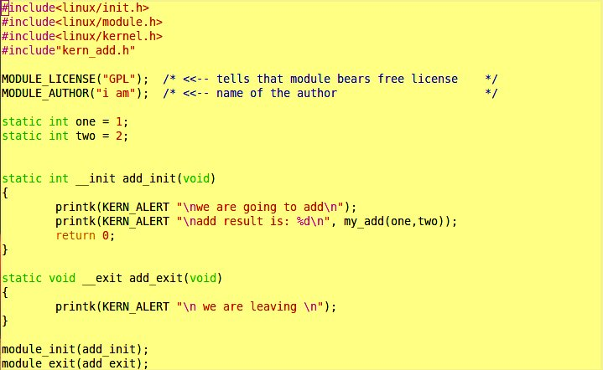
Exporting Symbol
Header containing
the declaration
of symbol
We are using the
symbol in this module
Notes:
Here, we are using the my_add function for the addition purpose.

Slide 25
insmod vs modprobe
modprobe works in similar way as that of insmod, but it also loads any other modules that are required by the module you want to load.
If your module depends upon three more modules, you have to do insmod three times plus once for loading that module itself
But with modprobe, one single time is enough. It solves the dependency and loads the modules which are required
However, modprobe searches for modules in standard directories, so if your module is in directories other than standard place, insmod is the way
Notes:
Both insmod and modprobe ultimately loads module in the kernel but insmod does not checks for the dependency of modules over any other modules or symbol while modprobe does this thing very smoothly. With insmod we have to repeatedly do insmod for each module over which your module is dependent but with modprobe just one modprobe is enough to load all other modules over which your module is dependent. One problem with modprobe is that it searches at standard location only to search for the modules to load. If your module is at some other loaction modprobe is not going to search it there and will not load the module. In that situation modprobe is the solution but we can still use modprobe by doing one more step after compiling our kernel module. Just add these lines in your Makefle:
install:
$(MAKE) -C $(KERNELDIR) M=$(PWD) modules_install
And use make install command after doing make. This make install instruction will copy your modules .ko file at the standard loaction and then modprobe can be used from any location to load modules.

Slide 26
How modprobe works?
Modprobe check the dependency of modules and loads those modules to resolve the dependency
To know the dependency, modprobe looks into modules.dep file
Location of modprobe.dep is /lib/modules/`uname -r`/
This file is updated by depmod
depmod only checks into some standard locations for the module object files
To make it to see into normal location also we can put absolute path of our module .ko file with depmod
e.g depmod -a /home/user/test/kern_sym.ko /home/user/test/kern_add.ko
modprobe now can search the module object and dependent modules and will load it accordingly
Notes:
How modprobe knows that which module is dependent upon which module or symbol? It's a first question that must be coming to your mind. modprobe maintains one modules.dep file which contains all these information. When we do modprobe it looks into that file to see what are the dependency of the module and accordingly loads it. You can see modules.dep at /lib/modules/`uname -r`/
To update the modules.dep file depmod command is used. On the slide, you can see that how we can use depmod for updation of modules.dep file

Slide 27
Other way to use modprobe
Other way to do use modprobe is to use “make install” after you are done with “make”
For that we need to modify the Makefile
Add these lines to Makefile:
install:
<next line><tab>$(MAKE) -C $(KERNELDIR) M=$(PWD) modules_install
Doing “make install” will create a “extra” named folder in /lib/modules/`uname -r`/ folder and copies all .ko files which are going to be used
When we do modprobe, it takes .ko files from there and loads into the kernel
Notes:
We already discussed this method in previous notes. Go through it to have better unbderstanding.

Slide 28
Exporting symbol
Program name kern_sym.c
This is a simple add
function declearation
that we are going to export
Command to export symbol
Header file containing
declaration of the add function
Notes:
Here, we are showing a sample program to export symbol to the kernel table. The funnction we want to export is my_add(). We defined the add function first anf then using EXPORT_SYMBOL() we exported it to kernel symbol table.

Slide 29
Exporting Symbol
Header containing
the declaration
of symbol
We are using the
symbol in this module
Notes:
Here, we are using the my_add function for the addition purpose.

Slide 30
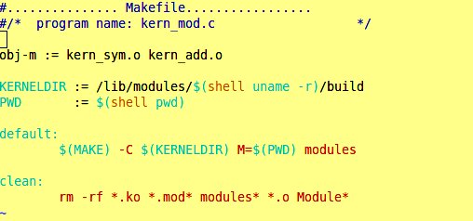
Exporting Symbol
Modification in Makefile
Add the name of both
files to compile
Notes:
Only we need to add both the function module to compile.

Slide 31
References
Jonathan Corbet, Alessandro Rubini and Greg Kroah-Hartman,”Linux Device Drivers”,3rd Edition, O'Reilly Publications, March 2005
http://www.senet.com.au/~cpeacock, “Interfacing the Serial/ RS-232 port,V 5.0”
http://www.kernel.org
http://en.wikipedia.org/wiki/Linux_kernel
http://lists.ucc.gu.uwa.edu.au/pipermail/ucc/2003-June/009997.html

Slide 32
Thank You

