Slide 1
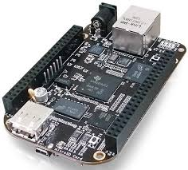
Hardware and Interrupts
Introduction to GPIO
Santosh Sam Koshy
Senior Technical Officer
C-DAC Hyderabad

Slide 2
Content
Device Description
Memory Mapped IO and IO mapped IO
IO Port Access
IO Memory Access
Interrupts
GPIO on the BBB
Case Studies

Slide 3
Device Memory (REGISTERS)
Peripheral devices are controlled by writing and reading its registers
Registers
  Data Registers (Reading and Writing)
  Control Registers (Configuring the device. Supports R&W Operations)
  Status Registers (Maintains state of the device. Generally Read Only)
Every peripheral has a number of such registers, generally allocated contiguously in Memory Address Space or IO Address Space

Slide 4
Conventional Memory
Load Memory into Registers
Initial Condition
Variable A
Variable A
Variable B
Variable B
Variable A
Variable B
Processor Registers
Main Memory
Processor Registers
Main Memory
ALU
ALU

Slide 5
Conventional Memory
Compute Arithmetic & Create Result
Store Result to Memory
Variable A
Variable A
Variable B
Variable B
Variable A
Variable A
Variable B
Variable B
Processor Registers
Main Memory
Processor Registers
Main Memory
ALU
ALU
Result

Slide 6
IO Memory
Device A
Device Reg
Device Reg
Device B
Processor Registers
Main Memory
ALU

Slide 7
Memory Caching in IO Ports
Volatile Keyword
Disable hardware caching during IO access. Done by the kernel itself

Slide 8
Data Reordering
Consider the Following Code Snippet
  Write (PIN FUNCTION, CLOCK DEVICE)
  Write (FREQUENCY SETTING, CLOCK DEVICE)
  Write (PRESCALAR VALUE, CLOCK DEVICE)
  Write (START CLOCK, CLOCK DEVICE)
Compiler Reorders the data for optimized performance
  Write (PIN FUNCTION, CLOCK DEVICE)
  Write (PRESCALAR VALUE, CLOCK DEVICE)
  Write (START CLOCK, CLOCK DEVICE)
  Write (FREQUENCY SETTING, CLOCK DEVICE)

Slide 9
Barriers
The code will be modified like this
  Write (PIN FUNCTION, CLOCK DEVICE)
  Write (FREQUENCY SETTING, CLOCK DEVICE)
  Write (PRESCALAR VALUE, CLOCK DEVICE)
  BARRIER();
  Write (START CLOCK, CLOCK DEVICE)

Slide 10
Barriers in Linux Kernel
The linux kernel provides 4 macros to cover all possible ordering needs
  void barrier(void)‏
    The kernel makes it a point that the compiler optimizations are absent across the barrier. The memory values present in the CPU registers are immediately stored in the memory
  void rmb(void);
  void read_barrier_depends(void);
  void wmb(void);
  void mb(void);
    These functions insert hardware memory barriers in the compiled instruction flow. They are supersets of the barrier macro.
    An rmb guarantees that any reads appearing before the barrier are completed prior to the execution of any subsequent read.
    wmb orders write and mb orders both read and write.
Header - #include <asm/system.h>

Slide 11
Device Addressing
Memory Mapped IO
  Peripheral devices are mapped into the system memory
  All access to this device space is performed using similar instructions that access memory
  Effective memory gets reduced and hardware complexity (on the device side) increases
IO Mapped IO
  Peripheral devices are mapped into IO space and are accesssed through special instructions
  Additional control lines are required to segregate IO access
  Memory is better utilized

Slide 12
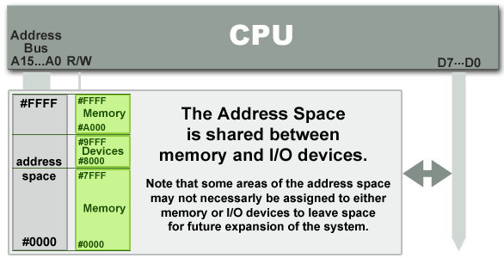
Memory Mapped IO (MMIO) or IO Memory

Slide 13
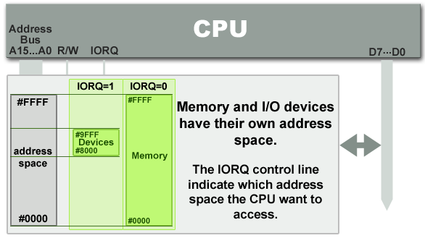
IO mapped IO (IOIO) or IO Ports

Slide 14
Communicating with IO Ports
Drivers communicate with many devices through the I/O ports. Linux introduces a set of functions that may be used to gain exclusive access to an I/O region and communicate data transfers to and from these ports.
Before embarking into communication with the I/O ports, the driver must gain access to the required ports by calling the function
  struct resource *request_region(unsigned long first, unsigned long n, const char *name);
    The argument first is the first address requested
    The argument long specifies the length of the addresses requested
    The argument name identifies the requested region by this name in /proc/ioports
Header - #include <linux/ioport.h>

Slide 15
Communicating with IO Ports
When the I/O ports have been used as per requirement, they should be returned to the kernel so that other drivers may avail their existence. The I/O ports are returned by the function
  void release_region(unsigned long start, unsigned long n);
Before using a I/O region, a check on the availability has to be conducted to be certain that the requested region will be available for our use. A special function allows this check.
  int check_region(unsigned long first, unsigned long n);
    This function returns a negative error code if the region is not available. This is a deprecated function and may not always prove to be true since it does not run atomic with the request_region function.

Slide 16
Communicating with IO Ports
On successfully being alloted the region, the actual communication to the ports may be carried out using the kernel provided functions.
These functions are specific to the port sizes on the I/O devices and provide interfaces for 8-bit, 16-bit and 32-bit ports
  unsigned inb (unsigned port);
  unsigned inw (unsigned port);
  unsigned inl (unsigned port);
    Get data from the port specified as an argument
  void outb (unsigned char byte, unsigned port);
  void outw (unsigned short word, unsigned port);
  void outl (unisgned long word, unsigned port);
    Send data to the port specified in the argument
Header - #include <asm/io.h>

Slide 17
Communicating with IO Ports
The kernel also supports string operations that render its services in allowing a string of ‘n’ bytes to be transferred between the driver and the I/O port
  void insb (unsigned port, void *addr, unsigned long count);
  Similarly..insw, insl
    Copies count bytes of information from the port to addr
  void outsb(unsigned port, void *addr, unsigned long count);
    Write count data pointed by addr to the port
The kernel provides mechanisms of synchronization between a high end processor and a relatively slower I/O by allowing a pause functionality in data transfer. This feature may be accessed by ending the function names previously discussed with an ‘_p’, such as inb_p, outb_p....

Slide 18
IO Memory
IO Memory regions must be allocated prior to use
  struct resource *request_mem_region(unsigned long start, unsigned long len, char *name);
IO Memory regions should when no longer in use
  void release_mem_region(unsigned long start, unsigned long len);
Accessing IO Memory regions should be preceded by a call to
  void *ioremap(unsigned long phys_addr, unsigned long size);
  void *ioremap_nocache(unsigned long phys_addr, unsigned long size);
After accessing the IO Memory region, unmap it using
  void iounmap(void * addr);

Slide 19
IO Memory
To read from IO memory,
  unsigned int ioread8(void *addr);
  unsigned int ioread16(void *addr);
  unsigned int ioread32(void *addr);
Writing to the IO memory through
  void iowrite8(u8 value, void *addr);
  void iowrite16(u16 value, void *addr);
  void iowrite32(u32 value, void *addr);
Reading a series of values
  void ioread8_rep(void *addr, void *buf, unsigned long count);
  void iowrite8_rep(void *addr, const void *buf, unsigned long count);

Slide 20
Interrupts - Definition
Means to notify the kernel that a device is requesting attention.
Characteristics of Interrupts
  Interrupts occur Asynchronously
    Complete current instruction being executed
    Jump to Interrupt Service Routine,
    Handle the Interrupt
    Return from Interrupt
  Global Interrupts are disabled. It may be enabled in the handler by the driver
  Interrupts must be handled quickly because the longer interrupts take to execute, the longer interrupts remain disabled
  No Sleep, or other delay functions should be called in an interrupt
  Less important functions of the interrupt should be performed in a bottom half (tasklet)

Slide 21
Interrupts
Components
  IRQ Line – Interrupt Number
    These are specific to a peripheral
    It could be shared between number of devices
    Limited number (32 in x86). You have to find out your IRQ number before you can use it. It is very specific to the hardware that you are using
  Interrupt Handler
    Each handler has to register itself with the kernel whenever an operation is to be performed on the device. Registering a handler is a notification by the driver to the kernel, claiming authority for access to the device through a requested IRQ number.
    On completion of access to the device, the handler may be unregistered and the irq number freed for allowing access to other applications.

Slide 22
Interrupts – Requesting an IRQ and binding a handler
Registering an interrupt handler to an irq number and notifying the kernel is done by
  int request_irq ( unsigned int irq, irqreturn_t (*handler) (int, void *, struct pt_regs *), unsigned long flags, const char *dev_name, void *dev_id);
    The value returned from request_irq to the is either 0 to indicate success or a negative error code, as usual.
    It is not uncommon for the function to return -EBUSY to signal that another driver is already using the requested interrupt line.
The handler is freed by calling
  void free_irq (unsigned int irq, void *dev_id);

Slide 23
Interrupts – Where to request for IRQ
There are two places where an IRQ can be requested.
  During the driver initialization at module_init function
    For this, it is advisable that the interrupt is requested as a shared IRQ
  In the open method of the driver
    If called in the open call, it allows the use of the interrupt line only when the application requests for it.
    The disadvantage of this technique is that a per device open count has to be maintained to know when interrupts can be disabled.

Slide 24
Interrupts – FLAGS passed to request_irq
FLAGS
  SA_INTERRUPT (May be deprecated.. Just check)
    This bit indicates a “fast” handler.
    Fast interrupt handlers run with all interrupts disabled on the local processor
  SA_SHIRQ
    This bit indicates that the interrupt can be shared between devices.
    The dev_id must be unique to each registered handler. A pointer to any per-device structure is sufficient. NULL cannot be passed to this field
    The interrupt handler must be capable of detecting whether its device generated an interrupt. This requires both hardware support and associated logic in the handler
  SA_SAMPLE_RANDOM
    Adds to the kernel entropy pool to increase the randomness.

Slide 25
Interrupts – The Handler Function
The Interrupt Handler
  static irqreturn_t intr_handler (int irq, void *dev_id, struct pt_regs *regs);
    The return value of an interrupt handler is the special type irqreturn_t.
    An interrupt handler can return two special values, IRQ_NONE or IRQ_HANDLED.
    IRQ_NONE is returned when the handler detects an interrupt for which its device was not the originator.
    IRQ_HANDLED is returned if the interrupt handler was correctly invoked

Slide 26
Interrupts – Disabling and Re-enabling
Single Interrupts
  Sometimes the driver may need to disable interrupt delivery for a specific line. This is achieved by using one of the functions
    void disable_irq(int irq);
    void enable_irq(int irq);
Disable all Interrupts
  void local_irq_save(unsigned long flags);
  void local irq_disable(void);
    shuts off the interrupts
  void local_irq_restore(unsigned long flags);
  void local_irq_enable(void);
    Re-enables the interrupts

Slide 27
Doing it on the Beagle Bone Black

Slide 28
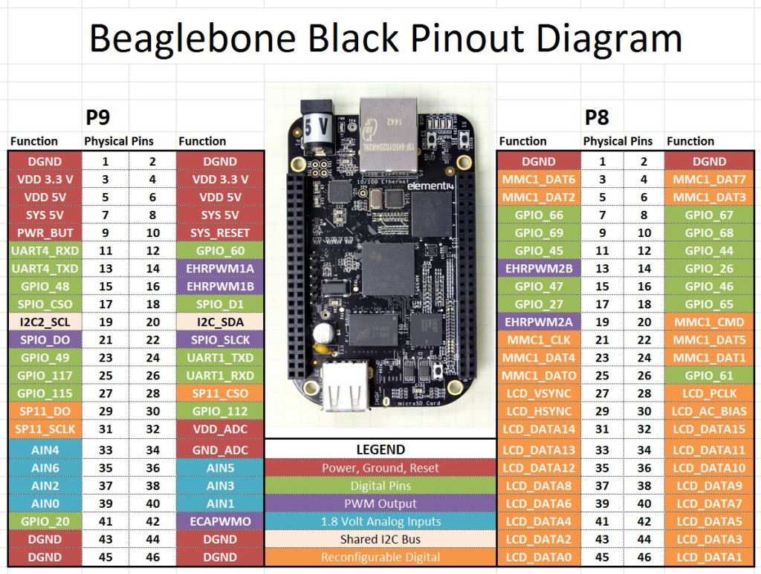

Slide 29
Introducing GPIO on BBB
Header - #include <linux/gpio.h>
Functions
  static inline bool gpio_is_valid(int number)
    check validity of GPIO number (max on BBB is 127)
  static inline int gpio_request(unsigned gpio, const char *label)
    allocate the GPIO number, the label is for sysfs
  static inline void gpio_free(unsigned gpio)
    deallocate the GPIO line
  static inline int gpio_export(unsigned gpio, bool direction_may_change)
    make available via sysfs and decide if it can change from input to output and vice versa
  static inline void gpio_unexport(unsigned gpio)
    remove from sysfs

Slide 30
Introducing GPIO on BBB
static inline int gpio_direction_input(unsigned gpio)
  an input line (as usual, return of 0 is success)
static inline int gpio_direction_output(unsigned gpio, int value)
  value is the state
static inline int gpio_get_value(unsigned gpio)
  get the value of the GPIO line
static void gpio_set_value(unsigned gpio, value)
  Set the value of the GPIO line
static inline int gpio_set_debounce(unsigned gpio, unsigned debounce)
  set debounce time in ms (platform dependent)
static inline int gpio_sysfs_set_active_low(unsigned gpio, int value)
  set active low (invert operation states)
static inline int gpio_to_irq(unsigned gpio)
  associate with an IRQ

Slide 31
Case Study – 1: Variable Frequency LED Toggle
Involves IOCTL, Kernel Timers and GPIO
Toggle an LED connected to GPIO_49 of your Beaglebone in a specific periodicity
Use Kernel Timers to maintain toggle periodicity
Using IOCTL from the user space, change the frequency of toggling by sending out a command through the driver to the LED
Demonstrate…

Slide 32
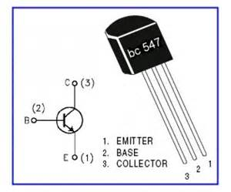
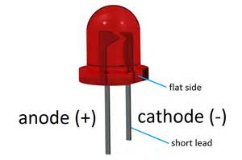
Required Circuit
VDD 3.3V
R = 100 Ohm
C
GPIO_49
B
E
DGND

Slide 33
Case Study – 2: Toggle an LED when Switch is Pressed
Connect a tactile switch to GPIO_115 on your BBB
The switch should be pulled up, through a 15K Ohm resistor
Whenever the switch is pressed, an interrupt should be generated and in the handler, the LED should be toggled
Register the corresponding interrupt handler and IRQ number through GPIO access

Slide 34
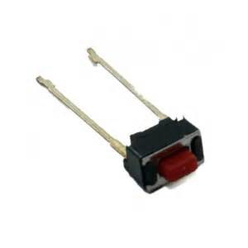
Required Circuit
VDD 3.3V
R = 100 Ohm
R = 15K Ohm
GPIO_115
C
GPIO_49
B
E
DGND

