Slide 1
Memory Protection: Kernel and User Address Spaces
Background
  Address binding
How memory protection is achieved.

Slide 2
Background and concepts
Raw memory
  A large array of words or bytes
  Each word/byte has its own address.
  Program counter stores the address of the instruction to be executed. Executing an instruction may cause operands to be fetched from memory.
  The memory unit sees a stream of memory addresses.
    It does not know how or why the addresses are generated.

Slide 3
Address binding:
  Let us assume that a process can reside in any part of the physical memory.
  How do we specify the memory addresses that the program uses?
    When the compiler generates executable, it must specify the addresses.
    E.g ‘load R1, mem[100]’
    Addresses used in the executables are logical addresses.
    Logical addresses may or may not be physical addresses, that addresses for raw memory.

Slide 4
Address binding:
  Mapping from logical address (used in user programs) to physical addresses (on raw memory)
    This can affect how addresses in an executable are generated (or how the executables are generated by the compiler).
  What kind of address does the CPU see, logical or physical?

Slide 5
When is address binding done?
  Steps to get our source program to run?
    Compile → .o files
    Link → a.out
    Load (after you type ‘a.out’).
  Depending on how memory is managed, address binding can be done in any of the steps:
    Compile time (compile/link). When the compiler knows the address where the program will be loaded, it can produce the absolute code.
      MS-DOS, or some embedded systems.
      Logical address = physical address
    Load time. When the process can be placed anywhere in the memory. The compiler can only generate relocatable code.
      Physical address = base address + logical address
    Execution time. The process can be moved during execution. Binding can only be done at run time. Need hardware support.

Slide 6
When is address binding done?
  Compile time, load time, and execution time, which one is the most common one on the current machines?
    Execution time through hardware support for virtual memory.
    In a typical virtual memory system:
      Logical (virtual) memory for a process is a continuous block (e.g. 0 – 2^32 bytes)
      Physically, different pages can be mapping to different locations of the physical memory.

Slide 7
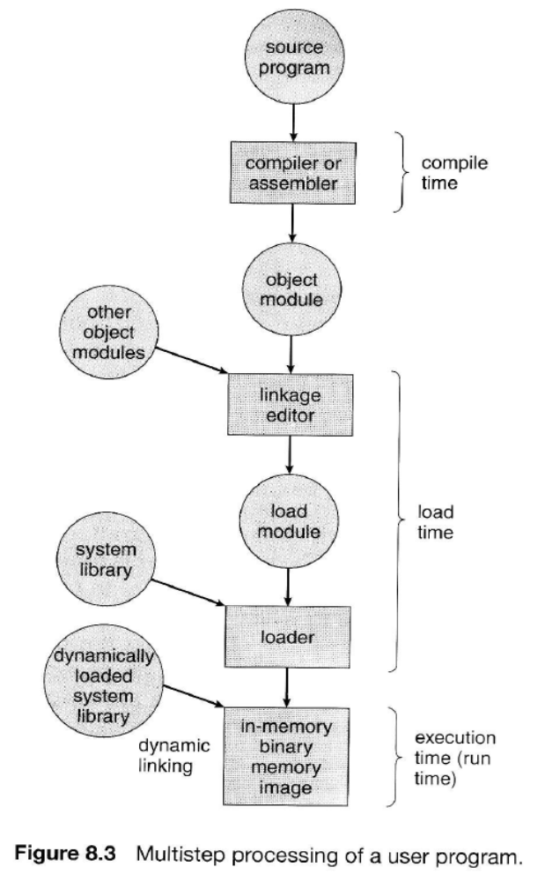

Slide 8
Dynamic loading
  So far, we have assumed that the whole program and data for the program must be in memory in order for a process to execute.
  Problem? Even if you code is small, the memory needed will be large. Why?
    Each program must be linked with the whole standard library.
    The whole library must be in memory even though most functions in that library are not used.

Slide 9
Dynamic loading
  Don’t load the whole program into memory before we run a program
  Just load the main routine at the beginning. When a new routine is called, it is loaded into the memory.
  The executable will still be large, but the memory used will be smaller.
    Routines that are not used will not be in the memory.
    Dynamic loading can introduce significant time penalty.
    Space/time trade-off

Slide 10
Dynamic linking and shared libraries
  With dynamic loading, the actual memory used may not be large, but the executable size is large. A program must be statically linked with all libraries.
  Dynamic linking is conceptually similar to dynamic loading (except apply to linking)
    Postpone the linking until execution.
    How it works:
      Use a stub to replace the whole library routine
      Enough information to locate the library routine.
      When the stub is executed, it replaces itself with the address of the routine and executes the routine.
        Only one copy of library code is needed for all programs.
        Such library is also known as a shared library.
    The executable is much smaller with such libraries.
    Windows DLL files (.dll) and UNIX shared object (.so) library

Slide 11
Dynamic linking and shared libraries
  Try ‘gcc a.c’ and ‘gcc –static a.c’ and check the size of the executable.
  One problem with dynamically linked executable is that it is less portable: assume the shared library is available and the same
    Statically linked executables are more self-contained.

Slide 12
Swapping
  The OS may choose to swap a process out of memory temporarily to swap space.
  Swap space is on disk (see ‘top’)

Slide 13
Memory protection
Isolate processes from one another and from the OS.

Slide 14
uniprogramming without memory protection
Simplest.
  Each application runs within a hardwired range of physical memory addresses
One application runs at a time
  Application can use the same physical addresses every time, across reboots

Slide 15
Uniprogramming Without Memory Protection
Applications typically use the lower memory addresses
An OS uses the higher memory addresses
An application can address any physical memory location
Application
Operating system
000000
ffffff
Physical memory

Slide 16
Multiprogramming Without Memory Protection
When a program is copied into memory, a linker-loader alters the code of the program (e.g., loads, stores, and jumps)
  To use the address of where the program lands in memory

Slide 17
Multiprogramming Without Memory Protection
Bugs in any program can cause other programs to crash, even the OS
Application 1
Application 2
Operating system
000000
ffffff
Physical memory

Slide 18
Multiprogrammed OS With Memory Protection
Memory protection keeps user programs from crashing one another and the OS
  The big idea: make all memory accesses go through an OS controlled agency
    The agency provides services (address translation) while checking all addresses
Two hardware-supported mechanisms
  Address translation (the OS controlled agency)
  Dual-mode operation

Slide 19
Address Translation
Each process is associated with an address space, or all the addresses a process can touch
  Each process believes that it owns the entire memory, starting with the virtual address 0
The missing piece is a translation table to translate every memory reference from virtual to physical addresses

Slide 20
Address Translation Visualized
Virtual
addresses
Translation table
Physical
addresses
Data reads or writes
(untranslated)

Slide 21
More on Address Translations
Address translation example:
  Translation table maintains <base, bound>
  If (virtual address > bound) error;
  Else Physical address = base + virtual address;
  This allows multiple processes to be in memory with protection.
Translation provides protection
  Processes cannot talk about other processes’ addresses, nor about the OS addresses
  OS uses physical addresses directly
    No translations

Slide 22
Dual-Mode Operation Revisited
Translation tables offer protection if they cannot be altered by applications
An application can only touch its address space under the user mode
Hardware requires the CPU to be in the kernel mode to modify the address translation tables

Slide 23
Switching from the Kernel to User Mode
To run a user program, the kernel
  Creates a process and initialize the address space
  Loads the program into the memory
  Initializes translation tables
  Sets the hardware pointer to the translation table
  Sets the CPU to user mode
  Jumps to the entry point of the program

Slide 24

To Run a Program
User level
Kernel level
Translation table
Hardware pointer
PC
user mode

Slide 25
Switching from User Mode to Kernel Mode
Voluntary
  System calls: a user process asks the OS to do something on the process’s behalf
Involuntary
  Hardware interrupts (e.g., I/O)
  Program exceptions (e.g., segmentation fault)

Slide 26
Switching from User Mode to Kernel Mode
For all cases, hardware atomically performs the following steps
  Sets the CPU to kernel mode
  Saves the current program counter
  Jumps to the handler in the kernel
    The handler saves old register values

Slide 27
Switching from User Mode to Kernel Mode
Context switching between processes
  Need to save and restore pointers to translation tables
To resume process execution
  Kernel reloads old register values
  Sets CPU to user mode
  Jumps to the old program counter

Slide 28

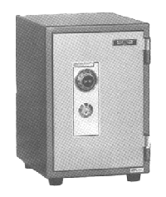
User → Kernel
User level
Kernel level
PC
set kernel mode
handler
trusted code
PC
register values
translation tables
(for processes)

Slide 29
Kernel → User
User level
Kernel level
PC
set kernel mode
handler
trusted code
PC
register values
translation tables
(for processes)

Slide 30
Kernel → User
User level
Kernel level
PC
handler
trusted code
user mode
PC
register values
translation tables
(for processes)

