Slide 1
RTOS Concepts
&
RTAI
Sowjanya
C-DAC, Hyderabad

Slide 2
Agenda
Real Time Systems
RTOS Vs GPOS
RTOS Services
Real Time Linux Variants
Real Time Application Interface(RTAI)

Slide 3
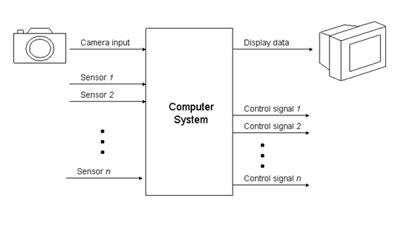
Real Time Systems
Typical real-time control system including inputs from sensors and imaging devices and producing control signals and display information.

Slide 4
Real Time Systems
Correctness
  The correctness of the system depends not only on the logical result, but also on the time at which the results are produced.
Predictability
  Possible to show at “design time” that all the timing constraints of the application will be met.
Deterministic
  For each possible state and each set of inputs, a unique set of outputs and next state of the system can be determined.

Slide 5
Real Time Systems
Classification of RT systems
  Soft real-time system
    Performance is degraded but not destroyed by failure to meet response-time constraints.
    Eg: Mutlimedia, Interactive video games
  Firm real-time system
    Missing more than few deadlines, may lead to catastrophe
    Eg: Robot weed killer
  Hard real-time system
    Failure to meet a single deadline may lead to catastrophic failure
    Eg: Aircraft Control Systems, Nuclear Power Stations, Chemical Plants, Life support systems

Slide 6
Real Time Systems Performance
Predictability
  Possible to show at “design time” that all the timing constraints of the application will be met.
    For static systems, 100% guarantee
    For dynamic systems, 100% guarantee cannot be given since the characteristics of tasks are not known a priori.
    In dynamic systems, once a task is admitted into the system, its guarantee should never be violated, as long as conditions hold.
Deterministic
  For each possible state and each set of inputs, a unique set of outputs and next state of the system can be determined.

Slide 7
Real Time Tasks
Periodic tasks
  Time-driven, characteristics are known a priori (pi, ci)
  Eg: Task monitoring temperature of a patient in an ICU
Aperiodic tasks
  Event-driven, characteristics not known a priori (ai, ri, ci, di)
  Task activated on detecting change in patient’s condition
Sporadic Tasks
  Aperiodic tasks with known minimum inter-arrival time.
pi : task period ai : arrival time ri : ready time di : deadline ci : worst case exec time

Slide 8
Real Time Tasks
The CPU utilization or time-loading factor, is a measure of the percentage of non-idle processing
  Utilization factor ui for a Task ti is (ci /pi )
  Overall system utilization (U) = ∑ ui

Slide 9
RTOS Vs GPOS
# | Metric of Evaluation | General Purpose OS | Real Time OS
1 | Determinism | Non Deterministic | Deterministic – Kernel functions should execute in a fixed amount of time
2 | Load Independent Timing | Not Applicable – Response becomes sluggish as number of tasks increase | Remains Constant – Generally Priority based execution. Time Slices are available only among tasks that hold the same priority
3 | Task Level Scheduling | Generally Round Robin Scheduling, Sometimes Priority based scheduling – Efforts are made to ensure that all tasks get a chance to execute | Priority based Preemptive Scheduling – Ensure that the Highest Priority task is always executed, even if it is the most frequent
4 | Interrupt Management | Nesting may be disabled. Interrupt latency, response and recovery are not performance metrics | Nesting is always enabled. Interrupt latency, response and recovery are very important performace metrics

Slide 10
RTOS Architecture
An RTOS consists of
  Kernel (micro-kernel)
  Device Manager
  Networking protocol s/w
  Libraries
  File sys (optional)
Application s/w
Operating system
comm sw
libraries
kernel
file sys
device mgr
Application Programming i/f

Slide 11
RTOS Services
Multi-tasking, Task & Thread Management
  Creation and scheduling of tasks.
  Priority based pre-emptive scheduling
Inter Task Synchronization and Inter Task Communications through mutual exclusions, signals, messages, shared memory, etc
Usually no Memory Management
Timer Services such as periodic and aperiodic interrupts

Slide 12
RTOS Services
Device drivers to service the needed special devices
Communication Protocol software (networking through ethernet, wireless, etc)
Application Programming Interface (APIs) to access kernel Services

Slide 13
Kernel Types – Non Preemptive Kernel
low priority task
1
2
ISR
ISR makes the high priority task ready
3
4
5
6
high priority task

Slide 14
Kernel Types – Preemptive Kernel
low priority task
1
2
ISR
3
high priority task
4

Slide 15
Task States
Waiting
Dormant
Ready
Running
ISR

Slide 16
Interrupts
When an interrupt occurs,
  CPU saves its context on the stack, Jumps to the Interrupt Servicing Routine (ISR), Executes ISR and Returns
  Interrupt Latency
    max time interrupts are disabled + time to begin servicing the interrupt
  Interrupt Response Time
    Interrupt Latency + time to start execution of 1st instruction in ISR
  Interrupt Recovery Time
    time for CPU to return to interrupted code / highest priority task

Slide 17
Interrupts in Non Preemptive Kernels
Interrupt
Request
CS
ISR
IL
IRec
IR
Time ->
Background Process
CPU Context Saved
User Code ISR

Slide 18
Interrupts in a preemptive kernel
Interrupt
Request
IRec1
CS
Entry
Exit
ISR
ISR
IL
IR
IRec2
Time ->
Background Process
Preemptive Kernel
CPU Context Saved
User Code ISR

Slide 19
Priority Inversion, Inheritance and Ceiling
Task HP
Task MP
Task LP
Shared Resource

Slide 20
Overview of available RTOS’s
Three categories of real-time operating systems:
  Small, proprietary kernels. e.g. VRTX32, pSOS, VxWorks, Windows CE, MicroC-OS/III*
  Real-time Linux extensions: RT-Linux, Xenomai, RTAI
  Research kernels: MARS, ARTS, Spring, Polis, MicroC-OS/II
Hard
Real Time Operating System
Vx Works, Lynx, QNX
Intime, HyperKernel, RTX
Windows CE
General Purpose Operating System
Linux, NT
Soft
RT Systems & RTOS

Slide 21
Variants of Real-Time Linux
Two primary variants of hard real-time Linux available are RTLinux and RTAI.
  Real Time Linux (RTLinux) was developed at the New Mexico Institute of Technology
    www.rtlinux.org
  Real-Time Application Interface (RTAI) was developed by programmers at the Department of Aerospace Engineering, Milano
    www.aero.polimi.it/~rtai

Slide 22
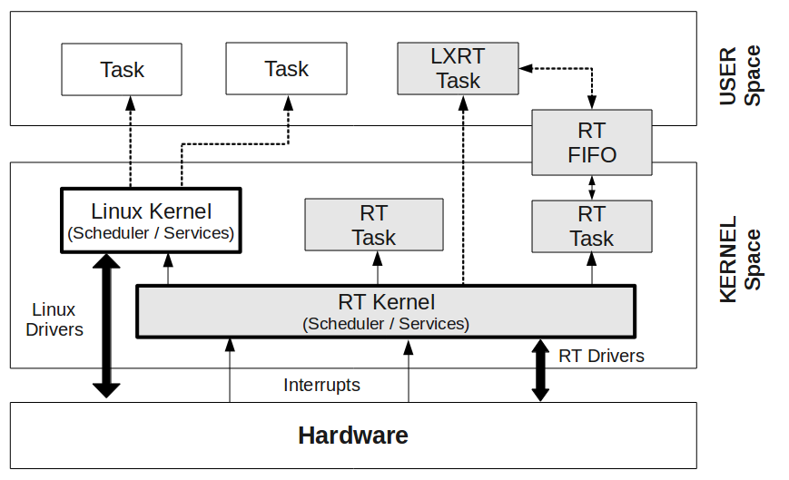
Real Time Linux

Slide 23
The Real-Time Linux
In a real-time Linux system
  Real-time linux scheduler treats Linux kernel as the idle task
    Linux only executes when there are no real time tasks to run, and when the real time kernel is inactive.
  Linux is not permitted to disable hardware interrupts, I.e cannot add latency to the interrupt response time
    When Linux code tries to disable interrupts, the real time system intercepts the request, records it. Doesn't actually disable ITRs
  When an interrupt occurs, the real time kernel intercepts the interrupt and dispatches
    First real time handlers are invoked then Linux handlers

Slide 24
The Real-Time Linux
Real time kernel never waits for the Linux side to release any resources.
  Communication links that are used to transfer data between real time tasks and Linux processes are non-blocking on the real time side.
Linux operating system does as much as is practicable
  System and Device initialization
  Blocking dynamic resource allocation
  Thread of execution that can be blocked
  Loadable module mechanism to install components of the Real-Time system.

Slide 25
The Real-Time Linux
The Real Time kernel, all its component parts, and the real time applications run in Linux kernel address space as kernel modules.
  Advantage: Aids in modularity
  Disadvantage: A bug in a real time task can crash the whole system.
Real-time Linux decouples the services of the real time kernel from the services of the general purpose Linux kernel.
  Real-time kernel can be kept small and simple, each service can be optimized independently

Slide 26
RTLinux and RTAI
In both RTLinux and RTAI, all interrupts are initially handled by the real time kernel and are passed to Linux only when there are no active real time tasks.
  When Linux has disabled interrupts, a emulation software will queue interrupts that have been passed on by the real time kernel.
  All the occurrences of cli, sti, and iret in the Linux source are replaced with emulating macros.

Slide 27
Real-Time Application Interface (RTAI)‏
RTAI versions over 3.0 use an Adeos kernel patch, comprising an Interrupt Pipeline, where different Operating System Domains register interrupt handlers.
  RTAI transparently takes over interrupts while leaving the processing of all others to Linux.
  Use of Adeos also frees RTAI from patent restrictions caused by RTLinux project.
  Note: Adeos was developed in the context of RTAI to separate the HAL from the real-time kernel.

Slide 28
Real-Time Application Interface (RTAI)‏‏
RTAI versions over 3.0 use an Adeos kernel patch, comprising an Interrupt Pipeline, where different Operating System Domains register interrupt handlers.
Adeos (Adaptive Domain Environment for Operating Systems) is a nanokernel hardware abstraction layer (HAL) that operates between computer hardware and the operating system that runs on it.
  Provides environment for sharing hardware resources among multiple OS, or multiple instances of a single OS

Slide 29
Real-Time Application Interface (RTAI)‏
RTAI provides deterministic and preemptive performance in addition to allowing the use of all standard Linux drivers, applications and functions.
RTAI's feactures:
  Traditional RTOS IPCs including: Semaphores, mailboxes, FIFOs, shared memory, and RPCs
  POSIX 1003.1c (Pthreads, mutexes and condition variables)‏ & POSIX 1003.1b (Pqueues only)‏ compatibility

Slide 30
Real-Time Application Interface (RTAI)‏
RTAI's feactures:
  /proc interface – which provides information on the real-time tasks, modules, services and processes extending the standard Linux /proc file-system support.
  LXRT – which allows the use of the RTAI system calls from within standard user space
  UniProcessor, Multi-UniProcessor and Symmetric Multi- processor (SMP) support
  One-shot and periodic schedulers

Slide 31
RTAI Performance
RTAI's performance is very competitive with the best commercial Real Time Operating Systems (such as VxWorks, QNX etc)‏
Offers:
  Context switch time: 4 uSec
  Interrupt response: 20 uSec
  100 KHz periodic tasks
  30 KHz one-shot task rate

Slide 32
RTAI Components
The three main RTAI components are:
  The Interrupt Dispatcher
  The Scheduler
  The FIFO

Slide 33
RTAI Interrupt Dispatcher
The dispatcher is a handler called via the IDT when interrupts occur.
  Activates the right handler depending on the owner of the driver: RTAI, Linux or both (RTAI first then Linux).
  The addresses of the Linux handlers are saved before changing the IDT in the HAL.
  Takes into account the “SRQ(service request) handlers”.
    SRQ is a handler used for a system call implementation. SRQ can be either RTAI handler (e.g.: fifo) or User handler.
  RTAI manages up to 31 SRQ's. SRQ handler addresses are stored in IDT.

Slide 34
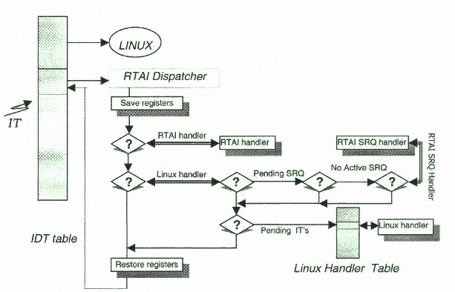
RTAI Interrupt Dispatcher

Slide 35
RTAI Scheduler
The scheduler is in charge of distributing the CPU to different tasks present in the system (including Linux).
  The RTAI distribution includes three different priority based, pre-emptive real time schedulers:
    Uni-Processor (UP) scheduler;
    Multi Uni-Processor (MUP) scheduler;
    Symmetric Multi-Processor (SMP) scheduler
  During the installation process, a scheduler is determined based on the hardware configuration of the target machine.

Slide 36
RTAI Scheduler
UP scheduler - For uni-processor platforms.
  Timer supports either one-shot or periodic scheduling but not both simultaneously.
SMP scheduler - For multi-processor machines.
  Timer supports either one-shot or periodic scheduling but not both simultaneously.
  Tasks can run symmetrically on any or a cluster of CPUs, or be bound to a single CPU.
  By default all tasks are defined to run on any of the CPUs and are automatically moved between CPUs as the system's processing and load requirements change.

Slide 37
RTAI Scheduler
Multi-Uniprocessor scheduler - For multiprocessor platforms only and supports both one-shot and periodic scheduling simultaneously.
  The main advantage is the ability to be able to use mixed timers simultaneously, i.e. periodic and one-shot timers.
  Periodic timers can be based on different periods.
  Like the SMP schedulers, the MUP can use inter-CPU services related to semaphores, messages and mailboxes.

Slide 38
Scheduler Functionality
The RTAI multitasking scheduler, uses interrupt-driven, priority-based task scheduling.
The scheduler elects the first highest priority task in a READY state.
  Priority 0 is the highest priority and 0x3fffFfff the lowest for rtai tasks
  Linux is given priority 0x7fffFfff.
  RTAI takes care of Linux activation. When timer handler is running and the next Linux time period is reached a Linux pending interrupt is raised and will be served by the dispatcher.

Slide 39
Scheduler Functionality
All RTAI schedulers incorporate standard RTOS scheduling services like resume, yield, suspend, make periodic, wait until etc.
The scheduler looks for ready tasks or tasks with expired period.
  A task may be in the following states : READY, SUSPENDED, DELAYED, SEMAPHORE, SEND, RECEIVE, RPC, RETURN, RUNNING, DELETED
  On Timer event, the timer handler changes the task state.

Slide 40
Scheduler Functionality
Applications using RTAI schedulers can be timed by three type of hard timers:
  8254: Allows one shot and periodic modes
    Special care is taken in maintaining Linux timing
    One-Shot mode is provided by Time Stamp Clock (TSC) or Counter2
  APIC: Allows one shot and periodic modes
    One-Shot mode is provided Time Stamp Clock (TSC)
  Real Time Clock (RTC): Allows just periodic mode
    Periodic ticking at a frequency that is set when configuring RTAI. Frequency can range from 2 to 8192 Hz in power of 2 always

Slide 41
RTAI FIFOs
Fifos allow Linux processes and RTAI tasks to exchange byte-oriented data steams.
  A fifo is a one way channel therefore a duplex communication needs 2 fifos.
  From a Linux process point of view the mechanism allows either blocking or non-blocking IO depending on user program.
  From a task point of view fifo allows non-blocking or asynchronous IO.
  To perform synchronous reads (and to avoid polling) RTAI makes it possible to attach a user real time handler to a fifo.

Slide 42
RTAI FIFOs
From a software point of view Fifo's are:
  A Linux device driver for processes
  System calls for real time tasks
Fifo's initialization exports procedural functions rtf_create, rtf_create_handler for tasks and installs a device driver used by Linux processes.
  The driver functions available for Linux processes are seek, read, write, poll, open, release

Slide 43
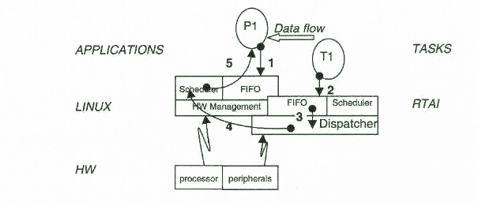
RTAI FIFOs
  blocking read.
  rtf_put call.
  SRQ initialization.
  wake-up action in queue.
  wake-up action de-queued at next Linux scheduling

Slide 44
RTAI LXRT Module
LXRT is a module that allows to use all the services made available by RTAI and its schedulers in user space, both for soft and hard real time.

