Slide 1


















Real Time Systems &
Real Time OS Concepts
Santosh Sam Koshy
STO, CDAC HYD

Slide 2
Agenda
Real Time Systems
RTOS Introduction
RTOS vs GPOS
RTOS Services
RTOS – Important Concepts
Priority Inversion
Overview of popular RTOS’s
RT Systems & RTOS
R0.2

Slide 3
Real Time Systems - Definitions
Reacts to events in the environment by performing predefined actions within specified time
A result produced after the deadline, even if correct, is considered wrong
Logical as well as timing correctness
A real-time deadline must be met, regardless of system load
The Misconception that Real time means barely fast is wrong

Slide 4
A bit more....
Often RT Systems are embedded computers in a plant. They acquire data from the environment and the plant through sensors, and control the plant through actuators
Examples of Real Time and Embedded systems vary from household appliances (Dish washer, etc) to Industrial Control, Aircraft and Missile Control systems, etc
Some RT Systems are identified as Safety-Critical systems. In a Safety-Critical system an incorrect operation, usually due to a missed deadline, may result in a catastrophe. Examples of Safety-Critical systems include Weapon Systems, Flight Control Systems, Life Support Systems, etc

Slide 5
Real Time Systems - Classifications
  Real Time Systems are classified as
    Hard RTS, which have stringent deadline requirements
      Missing a deadline is considered failure of the system
      In Firm, RTS missing a deadline is a catastrophe
    Soft RTS, where the deadlines are less restrictive
      Missing deadlines result in drop in performance of the system
  RT Systems are also classified as:
    Periodic (Time driven) – task activity occurs repeatedly
    Aperiodic (Event driven) – task activities are asynchronous
    Combination of both – Some tasks are periodic others, aperiodic
  Hard real time systems
    Aircraft Control Systems
    Nuclear Power Stations
    Chemical Plants
    Life support systems
  Soft real time systems
    Mutlimedia
    Online Transaction Systems
    Interactive video games
RT Systems & RTOS
santoshk@cdac.in

Slide 6
Characteristics of RT Systems
  The following characteristics are typical of Real Time Systems, especially Embedded Systems
  Specific timing specifications
  Dedicated Application
  Small Size
    Owing to size and power restrictions
    Low CPU Power (8/16 bit processors)
    Less Memory (Max 10 MB)
    No peripherals, disks
    Dedicated UI like buttons, keypad, switches, LEDs, LCDs, etc
  Inexpensively mass produced, especially for home appliances, consumer devices, etc
  System-on-chip (SOC) architecture, rather than bus architecture
RT Systems & RTOS
R0.5

Slide 7
RTOS vs GPOS
Determinism
  All RTOS functions should demonstrate determinism in the time they take to execute
Load-Independent Performance
  Irrespective of system load, performance of the RT system should remain predictable
Task Scheduling
  Priority based Task Scheduling. Time slicing only if two tasks have the same priority
  At any given instant, the highest priority task will be executing among tasks that are in the Ready Queue

Slide 8
RTOS vs GPOS
Interrupts
  Nesting is Allowed to ensure that always the highest priority task is made ready to execute
  Should be handled as quickly as possible, Critical to the RTOS are its Interrupt Latency, Response and Recovery time
Intertask Communication & Synchronization
  Should be handled in a deterministic manner
OS Scalability
  Based on the application scenario, the OS should be customizable

Slide 9
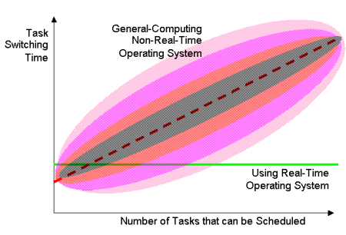
RTOS vs GPOS - Task Switching

Slide 10
Real Time Operating Systems - Services
Multi-tasking and threads
Task & Thread Management
Creation and scheduling of tasks. Since some tasks may have more stringent deadlines than others, they would be need to declared with high priority and the OS should ensure, if such tasks are ready to be run, they will be scheduled
Priority based pre-emptive scheduling
Vectored Interrupt Service Routines (avoid polling)
Inter Task Synchronization including mutual exclusion, signals, etc
Inter Task Communications through messages, shared memory, etc
Usually no Memory Management
Provision to lock in memory code/data for high priority tasks (In disk-less systems, the full OS and application Program will be in ROM, and some RAM for the data)
Memory-mapped files in flash memory
Timer Services such as periodic and aperiodic interrupts (watchdog timers)
Device drivers to service the needed special devices
Communication Protocol software (networking through ethernet, wireless, etc)
Application Programming Interface (APIs) to access kernel services
RT Systems & RTOS
R0.6

Slide 11
Kernel Types – Non Preemptive Kernel
low priority task
1
2
ISR
3
ISR makes the high priority task ready
4
5
6
high priority task

Slide 12
Kernel Types – Preemptive Kernel
low priority task
1
2
ISR
3
high priority task
4

Slide 13
Kernel Objects
Kernel objects
  Scheduler
  Tasks
  Interrupt Service Routines
  Semaphores
  Mutexes
  Mail boxes
  Message queues
  Pipes
  Event registers
  Signals
  Timers
Message
queues
Signals
Event
Registers
Mailboxes
Semaphores
Scheduler
Pipes
ISRs
Tasks
Mutexes
Timers

Slide 14
Real Time Tasks
TASK #1
TASK #2
TASK #3
Task Control Block
Task Control Block
Task Control Block
Memory
CPU
CPU Registers
Real Time application involves splitting the work to be done in Tasks.
A real time task, also called a thread, is a simple program that thinks it has the CPU all to itself. It is generally implemented as an infinite loop
Each Task is assigned its own set of CPU Registers, Stack Area and a Priority.

Slide 15
Task States
Waiting
Dormant
Ready
Running
ISR

Slide 16
Task Priority & Characteristics
A priority is assigned to each task. The more important the task the more the priority
Tasks can be created at compile time or at run-time
Two types of priority assigning
  Static (Assigned at Compile Time)‏
  Dynamic (Assigned at Execution Time)‏
Categories of Tasks
  Periodic Tasks
    Time-driven. Characteristics are known a priori
    E.g.: Task monitoring temperature of a patient in an ICU.
  Aperiodic Tasks
    Event driven. Characteristics are not known a-priori
    Eg: Task detected on change in patient's condition
  Sporadic Tasks
    A task with a minimum known interval
    Eg: Administer glucose once every hour

Slide 17
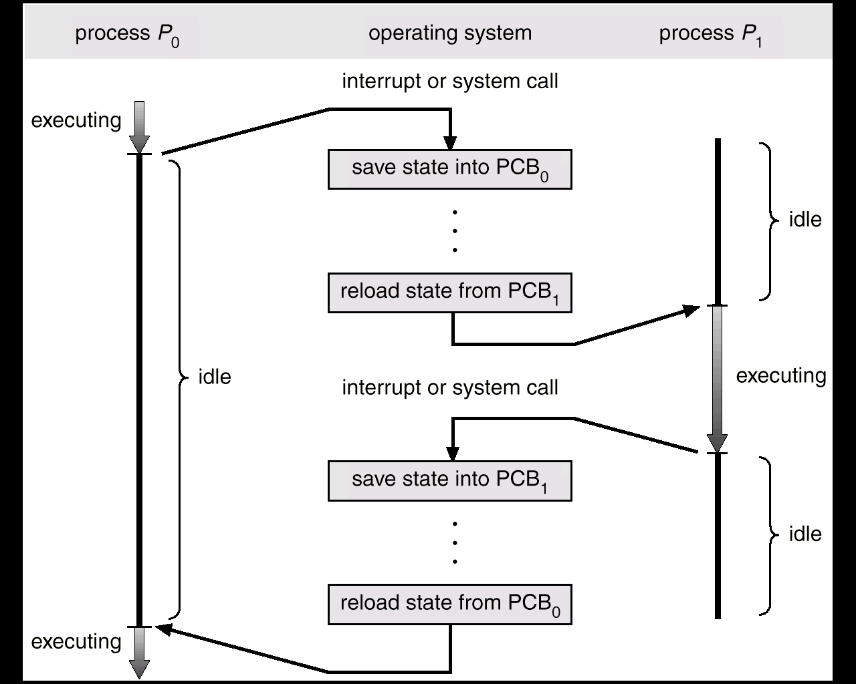
RTOS Context Switch

Slide 18
Interrupts
Interrupts are Interrupt is a h/w signal that needs CPU attention
When an interrupt occurs,
  CPU saves its context on the stack
  Jumps to the Interrupt Servicing Routine (ISR) {minimal registers saved by ISR}
  Executes ISR and Returns
After ISR processes the event, in a non-preemptive kernel, CPU returns to the task interrupted. In a preemptive kernel, highest priority task executes
Interrupt Latency
  max time interrupts are disabled + time to start execution of 1st instruction in ISR
Interrupt Response Time
  Interrupt Latency + time to start of code to handle the event
Interrupt Recovery Time
  time for CPU to return to interrupted code / highest priority task

Slide 19
Performance of RT Systems
Latency – time delay from interrupt to ISR start
Jitter – variations of timing of periodic events
Start of control event
Start of service routine
time
Preemption latency
ISR starts
Signal OS
Control task wakes up
interrupt
h/w response
ISR
Context switch
jitter

Slide 20
Important Note
A systems’s worst case response is its only response
Your system may respond to Interrupts in 50us 99% of the time, but if it responds to Interrupts in 250us the other 1% you must assume 250us Interrupt Response Time,

Slide 21
Interrupts in Non Preemptive Kernels
Interrupt
Request
CS
ISR
IL
IRec
IR
Time ->
Background Process
CPU Context Saved
User Code ISR

Slide 22
Interrupts in a preemptive kernel
Interrupt
Request
IRec1
CS
Entry
Exit
ISR
IL
ISR
IR
IRec2
Time ->
Background Process
CPU Context Saved
Preemptive Kernel
User Code ISR

Slide 23
Performance of Real-Time O/Ss
O/S | Application | Latency / Jitter
Std O/S | Non RT | 100us – 100ms
Std Linux | Soft RT | 1 ms
IEEE 1003.1d Linux | Hard RT | 10 – 100us
Micro-Kernel | Hard RT | 1 – 10us
RTOS Kenels | Hard RT | 1 – 10us

Slide 24
Priority Inversion, Inheritance and Ceiling
Task HP
Task MP
Task LP
Shared Resource

Slide 25
Priority Inversion Notes
In preemptive priority scheduling, priority inversion is the scenario where a lower priority task runs even when a higher priority task is ready to run. This happens when a low priority task holds a shared resource that is required by a high priority task. This causes the execution of the high priority task to be blocked until the low priority task has released the resource, effectively "inverting" the relative priorities of the two tasks. If some other medium priority task, one that does not depend on the shared resource, attempts to run in the interim, it will take precedence over both the low priority task and the high priority task, which can be blocked indefinitely
The trouble experienced by the Mars lander "Mars Pathfinder" is a classic example of problems caused by priority inversion in real-time systems
One of the solutions is Priority inheritance
  Under priority inheritance, whenever a high priority task has to wait for some resource shared with an executing low priority task, the low priority task is assigned the priority of the highest waiting priority task for the duration of its own use of the shared resource, thus keeping medium priority tasks from pre-empting the (originally) low priority task, and thereby effectively the waiting high priority task as well
Priority Ceiling
  Assign the resource with a priority greater than the priority of the highest task contending for the resource. All tasks alter their priorities when they take the resource

Slide 26
Overview of Other RTOSes

Slide 27
Overview of available RTOS’s
  Three categories of real-time operating systems:
    Small, proprietary kernels.
e.g. VRTX32,pSOS, VxWorks, Windows CE, MicroC-OS/II*
    Real-time extensions to commercial timesharing operating systems.
      RT-Linux, RT-NT, RTAI
    Research kernels
      MARS, ARTS, Spring, Polis, MicroC-OS/II
Vx Works, Lynx, QNX
Intime, HyperKernel, RTX
Hard
Real Time Operating System
Windows CE
General Purpose Operating System
Linux, NT
Soft
RT Systems & RTOS

Slide 28
Small Fast Proprietary Kernels
  Stripped down and optimized versions of timesharing operating systems.
  Intended to be fast
    a fast context switch
    external interrupts recognized quickly
    the ability to lock code and data in memory
    special sequential files that can accumulate data at a fast rate
  To deal with timing requirements
    a real-time clock with special alarms and timeouts
    bounded execution time for most primitives
    real-time queuing disciplines such as earliest deadline first
    primitives to delay/suspend/resume execution
    priority-driven best-effort scheduling mechanism or a table-driven mechanism
  Communication and synchronization via mailboxes, events, signals, and semaphores
RT Systems & RTOS
R0.22

Slide 29
QNX Neutrino
  Developed by Gordon Bell and the students at the University of Waterloo in 1980
  Supported on ARM, MIPS, Power PC, x86 and Pentium
  Excellent IDE (Eclipse)
  Micro-kernel based, and most of the OS is run in the form of a number of small tasks, known as servers
  Configurable and can be made small (64 K kernel ROM, 32 K kernel RAM)
  Neutrino supports Symmetric multiprocessing and strict priority-preemptive scheduling
  IEEE1003 real-time std compliant and POSIX threads
  Finds Applications in Embedded systems for over 20 years in mission and life critical systems, medical instrumentation, aviation and space systems, process control systems
  Avg Interrupt latency – 1.6us
RT Systems & RTOS

Slide 30
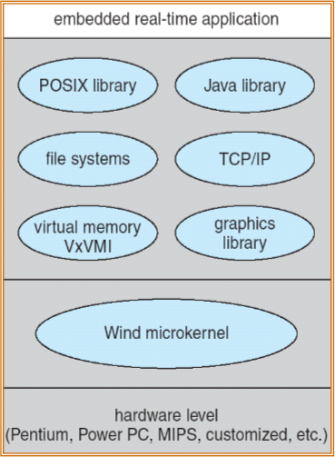
Vx Works
  VxWorks is a real time operating system developed by Wind River Systems of California, based on VRTX. Intel acquired Wind River Systems on July 17, 2009
  Used in automobiles, consumer devices, networking devices (routers, switches), Mars Pathfinder
  Micro-kernel based
  POSIX Compliant threads
  Preemptive and non-preemptive scheduling
  Manages interrupts (with bounded interrupt and dispatch latency times)
  Shared memory and message passing interprocess communication facilities.
  Intel Pentium, Motorola, Power PC, AR M processors
  Avg latency – 1.7us
RT Systems & RTOS

Slide 31
Microsoft Windows CE
  Supported on x86, MIPS, ARM processors for embedded systems
  Large parts of it are offered in source code form
  Windows Mobile, Pocket PC, SmartPhone are platforms based on CE
  Supports threads, priority inheritance and priority inversion
  Applications can be developed on Visual Studio
  Non - POSIX compliant, 10% of Win32 APIs
  Platform wizard
  Intel 486, 586, Pentium, MIPS, ARM processors
  Avg latency – 2.4us
LynxOS
  Lynx is a Unix like real time operating system
  Mostly used in embedded systems in avionics, aerospace, communications
  Developed for Motorola 68010, ported to x86, ARM, Power PC
  Support hard real time applications, due to extremely fast interrupt routines known as Multiple Priority Light Weight kernel Task-based Interrupt Handling
RT Systems & RTOS
R0.25

Slide 32
Thanks and Questions

