Slide 1
Real-time Scheduling
Santosh Sam Koshy
STO, C-DAC, Hyd

Slide 2
Topics
Goals of Real-time Scheduling
Task timing and Real-time System Properties
Rate-Monotonic(RM), Earliest Deadline First(EDF), Least Laxity First (LLF) algorithms
Classification of Real-time Scheduling
Scheduling of Sporadic and Aperiodic Tasks
Schedulability Analysis

Slide 3
Goals of Real-time Scheduling
Meeting the timing constraints of the system
Preventing simultaneous access to shared resources and devices
Attaining a high degree of utilization while satisfying the timing constraints of the system

Slide 4
Task Timing Properties
Each task(Ti) occurring in a real-time system has some timing properties, which should be considered when scheduling tasks.
  Release time (or ready time)
  Deadline(Di)
  Worst case execution time(Ci)
  Period(Ti or Pi) (For periodic tasks)

Slide 5
Real-time System Properties
Hard/Soft real-time tasks
Periodic/Aperiodic/Sporadic tasks
Preemptive/Non-preemptive tasks
Multiprocessor/Single processor systems
Fixed/Dynamic priority tasks
Flexible/Static systems
Independent/Dependent tasks

Slide 6
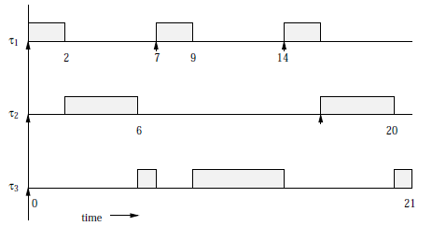
Sample methods of analysis
Timing diagrams provide a good way to visualize and even to calculate the timing properties of simple programs.

Slide 7

Sample methods of analysis
A better method of analysis is to derive conditions to be satisfied by the timing properties of a program, to meet its deadlines.
Necessary Conditions:

Slide 8
RM Scheduling
Uniprocessor static-priority preemptive scheme
Assumes that all tasks are periodic
The priorities are determined only by the period of the task.

Slide 9
EDF Scheduling
Uniprocessor dynamic-priority preemptive scheme
Higher priority is assigned to the request that has earlier deadline, and a higher priority request always preempts a lower priority one

Slide 10
LLF Scheduling
Dynamic priority scheduling
The laxity of a process is deﬁned as the deadline minus remaining computation time.
Highest priority is given to the active job with the smallest laxity

Slide 11
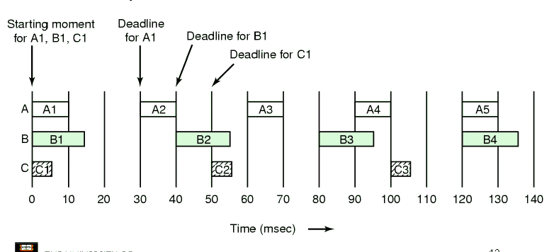
Scheduling Example
Consider 3 tasks with the following timing properties

Slide 12
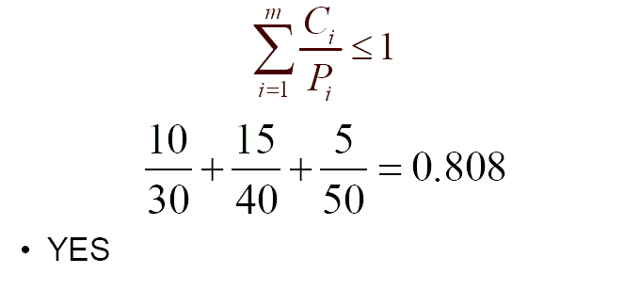
Scheduling Example

Slide 13
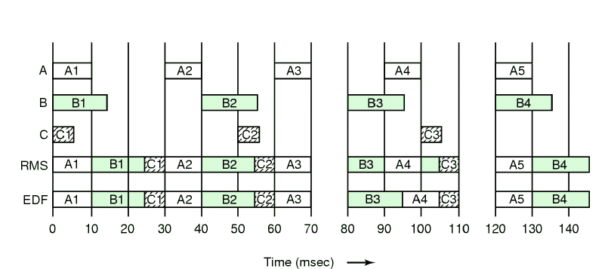
Scheduling with RM and EDF

Slide 14
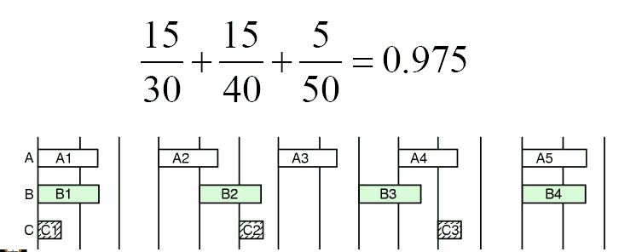
Modify Example
Increase A's CPU requirement to 15 msec. The system is still schedulable

Slide 15
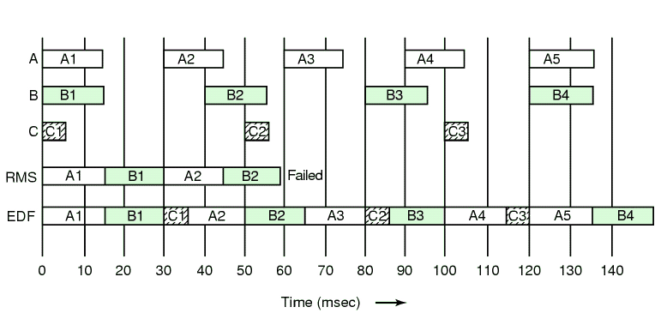
Scheduling using RM and EDF

Slide 16
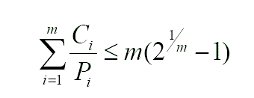
RM Scheduling Condition
RM Sceduling is guaranteed to work if the CPU utilization is not too high.
Condition of Schedulability
  Where m = number of tasks
  For three tasks, CPU utilization must be less than 0.780

Slide 17
Performance Comparison
RM Scheduling which is simple and easy to implement can be used for systems with low CPU utilization
EDF Scheduling always works for any schedulable set of tasks. Upto 100% CPU utilization
LLF Scheduling is similar in properties to EDF
  Takes into account that laxity time is more meaningful than deadline for tasks with mixed computing sizes

Slide 18
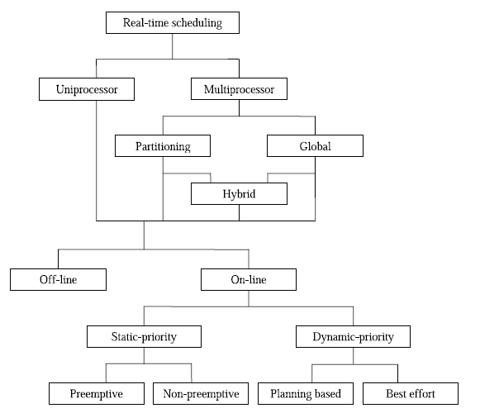
Classification of Real-time Scheduling

Slide 19
Uniprocessor Scheduling Algorithms
Off-line algorithms (Pre-run-time scheduling)
  Generate scheduling information prior to system execution and utilize it during runtime.
  Ordering of the execution of processes
    Uses precedence relations
    Prevents simultaneous access to shared resources
    Reduces the cost of context switches by choosing algorithms that do not result in a large number of preemptions, such as the EDF algorithm

Slide 20
Uniprocessor Scheduling Algorithms
Off-line algorithms (Pre-run-time scheduling)
  Suitable for applications where all characteristics are known a priori and change very infrequently
    Ready times, execution times, deadlines are known and environment is completly predictable
  Pros:
    Signiﬁcant reduction in run-time resources, including processing time, for scheduling
  Cons:
    Any change requires re-computing the entire schedule

Slide 21
Uniprocessor Scheduling Algorithms
On-line algorithms
  Generate scheduling information while the system is running
  Pros:
    No requirement to know tasks characteristics in advance
    Flexible and easily adaptable to environment changes
  Cons:
    Require a large amount of run-time processing time.

Slide 22
Uniprocessor Scheduling Algorithms
On-line algorithms
  Static-priority based algorithms
    Work well with fixed periodic tasks but do not handle aperiodic tasks particularly well
    Either preemptive or non-preemptive
    Example for preemptive: RM Scheduling
    In real-time systems with execution order known priori and each task completes before another task starts, non preemptive algorithms, avoid the overhead associated with multiple context switches per task

Slide 23
Uniprocessor Scheduling Algorithms
On-line algorithms
  Dynamic-priority based algorithms
    Require a large amount of on-line resources, but are flexible
    Better response to aperiodic tasks or soft tasks while still meeting the timing constraints of the hard periodic tasks
    Two subsets:
      Planning based - feasibility check at run-time, schedule produced. Eg: EDF, LLF
      Best effort - No feasibility check, attempts to meet deadlines but no guarantee.

Slide 24
Multiprocessor Scheduling Algorithms
Global Scheduling Algorithms
  Store the tasks that have arrived in a queue which is shared among all processors
  Each processor maintains
    Status table of tasks it has committed to run.
    Table of the surplus computational capacity at every other processor. (Each processor regularly sends to others the fraction of the next window that is free)
  A Overloaded processor selects a processor that is most likely to be able to successfully execute that task by its deadline and ships the tasks out.
  Eg: Focused addressing and bidding algorithm

Slide 25
Multiprocessor Scheduling Algorithms
Partitioning Scheduling Algorithms
  Tasks are partitioned such that all tasks in a partition are assigned to the same processor
    Tasks are not allowed to migrate
  Eg: Next fit algorithm for RM scheduling
    Tasks of same class, are guaranteed to satisfy the RM schedulability on one processor
  Partitioning usually has a low scheduling overhead compared to global scheduling, because tasks do not need to migrate across processors

Slide 26
Scheduling of Sporadic Tasks
Methods
  Consider sporadic tasks as periodic tasks with a period equal to their minimum interarrival time
  Define a fictitious periodic task of highest priority and when the task is scheduled, run any sporadic task awaiting service
  The Deffered server
    When sporadic tasks are scheduled and none is awaiting service, it schedules periodic tasks in order of priority
    Wastes less bandwidth

Slide 27
Scheduling of Aperiodic Tasks
Methods
  A Background Server executes at low priority, and makes use of CPU idle time to schedule aperiodic tasks. No guarantee of service
  The Polling Server executes as a high-priority periodic task, and every cycle checks if an event needs to be processed
  Priority Exchange and Deferrable Servers
    A aperiodic server(task) with highest priority is added. When there are no aperiodic tasks to service, exchange its priority with the next highest priority task, to allow it to execute

Slide 28
Schedulability Analysis
Timestool

Slide 29
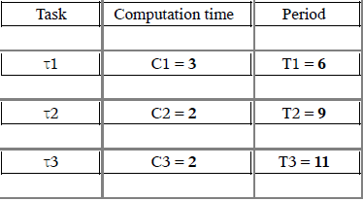
Exercise 1
Check the schedulabilty of the tasks using RMS and EDF schedulability

Slide 30
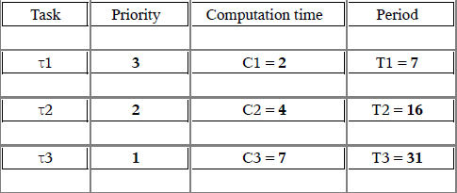
Exercise 2
Simulate the tasks using EDF and LLF scheduling

Slide 31
Thank You

