Slide 1

MicroC/OS-II
Kernel Structure-II

Slide 2
Task Control Blocks
When a task is created it is assigned a Task Control Block OS_TCB
OS_TCB is a Data Structure that is used by UCOS-II to maintain the state of a task when it is preempted
All OS_TCBs reside in RAM

Slide 3
Tasks and TCB Management
The maximum number of tasks required by the application should be maintained in OS_MAX_TASKS and is found in os_cfg.h
You can decrease the amount of memory maintained for the OS_TCBs by choosing appropriate number of tasks as reqd by the application
An OS_TCB is initialized by a function OS_TCBInit() when a task is created using OSTaskCreate() or OSTaskCreateExt()‏

Slide 4
OSTCBFreeList
OSTCBFreeList
OSTCBNext
OSTCBNext
OSTCBNext
0
OSTCBTbl[0]
OSTCBTbl[1]
OSTCBTbl [OS_MAX_TASKS + OS_N_SYS_TASKS - 1]

Slide 5
typedef struct os_tcb {
OS_STK *OSTCBStkPtr; /* Pointer to current top of stack */
#if OS_TASK_CREATE_EXT_EN
void *OSTCBExtPtr; /* Pointer to user definable data for TCB extension */
OS_STK *OSTCBStkBottom; /* Pointer to bottom of stack */
INT32U OSTCBStkSize; /* Size of task stack (in bytes) */
INT16U OSTCBOpt; /* Task options as passed by OSTaskCreateExt() */
INT16U OSTCBId; /* Task ID (0..65535) */
#endif
struct os_tcb *OSTCBNext; /* Pointer to next TCB in the TCB list */
struct os_tcb *OSTCBPrev; /* Pointer to previous TCB in the TCB list */
#if (OS_Q_EN && (OS_MAX_QS >= 2)) || OS_MBOX_EN || OS_SEM_EN
OS_EVENT *OSTCBEventPtr; /* Pointer to event control block */
#endif
#if (OS_Q_EN && (OS_MAX_QS >= 2)) || OS_MBOX_EN
void *OSTCBMsg; /* Message received from OSMboxPost() or OSQPost() */
#endif
INT16U OSTCBDly; /* Nbr ticks to delay task or, timeout waiting for event */
INT8U OSTCBStat; /* Task status */
INT8U OSTCBPrio; /* Task priority (0 == highest, 63 == lowest) */
INT8U OSTCBX; /* Bit position in group corresponding to task priority (0..7) */
INT8U OSTCBY; /* Index into ready table corresponding to task priority */
INT8U OSTCBBitX; /* Bit mask to access bit position in ready table */
INT8U OSTCBBitY; /* Bit mask to access bit position in ready group */
#if OS_TASK_DEL_EN
BOOLEAN OSTCBDelReq; /* Indicates whether a task needs to delete itself */
#endif
} OS_TCB;

Slide 6
OSTCBStkPtr
Contains pointer to the current top-of-stack for the task
Each task has its own stack & can be of any size
OSTCBStkPtr is the only field in the OS_TCB that is accessed from assembly language code( from context switching code)‏
OS_STK *OSTCBStkPtr;

Slide 7
#if OS_TASK_CREATE_EXT_EN
void *OSTCBExtPtr;
OS_STK *OSTCBStkBottom;
INT32U OSTCBStkSize;
INT16U OSTCBOpt;
INT16U OSTCBId;
#endif

Slide 8
struct os_tcb *OSTCBNext;
struct os_tcb *OSTCBPrev;
Used to doubly link OS_TCBS
This chain is used by OSTimeTick() to update OSTCBDly for each task

Slide 9
OSTCBEventPtr
Pointer to event control block
#if (OS_Q_EN && (OS_MAX_QS >= 2)) || OS_MBOX_EN || OS_SEM_EN
OS_EVENT *OSTCBEventPtr;
#endif

Slide 10
OSTCBMsg
Pointer to the message that is sent to a task
#if (OS_Q_EN && (OS_MAX_QS >= 2)) || OS_MBOX_EN
void *OSTCBMsg;
#endif

Slide 11
OSTCBDly
Used when task needs to be delayed for a certain number of clock ticks OR
Needs to pend for a event to occur with a timeout
(when 0 the task is not delayed or has no timeout while waiting for a event)‏

Slide 12
INT16U OSTCBDly;
INT8U OSTCBStat;
INT8U OSTCBPrio;
INT8U OSTCBX;
INT8U OSTCBY;
INT8U OSTCBBitX;
INT8U OSTCBBitY;

Slide 13
OSTCBStat
Contains the State of the task
0 => Ready to run etc
Refer ucos_ii.h

Slide 14
OSTCBPrio
Contains the priority of the task

Slide 15
OSTCBX, OSTCBY, OSTCBBitX, OSTCBBitY
Used for speeding up the process of making a task ready to run or to make the task wait for a event
Values for these variables are calculated when the task is created

Slide 16
Calculations
OSTCBY = priority >> 3;
OSTCBBitY = OSMapTbl[priority >> 3];
OSTCBX = priority & 0x07;
OSTCBBitX = OSMapTbl[priority & 0x07];

Slide 17
Ready List
A task owns a priority level between 0 and OS_LOWEST_PRIO.
Each task that is ready to run is placed in Ready List.

Slide 18

Components
OSRdyGrp
  Task priorities are grouped (8 tasks per group).
  Each bit indicates a task of any group is ready to run.
OSRdyTbl[]
  Size of OSRdyTbl[] is OS_LOWEST_PRIO/8+1.
  Task’s priority determines the bit location in table.

Slide 19
Components
OSRdyGrp
  Task priorities are grouped (8 tasks per group).
  Each bit indicates a task of any group is ready to run.
OSRdyTbl[]
  Size of OSRdyTbl[] is OS_LOWEST_PRIO/8+1.
  Task’s priority determines the bit location in table.

Slide 20
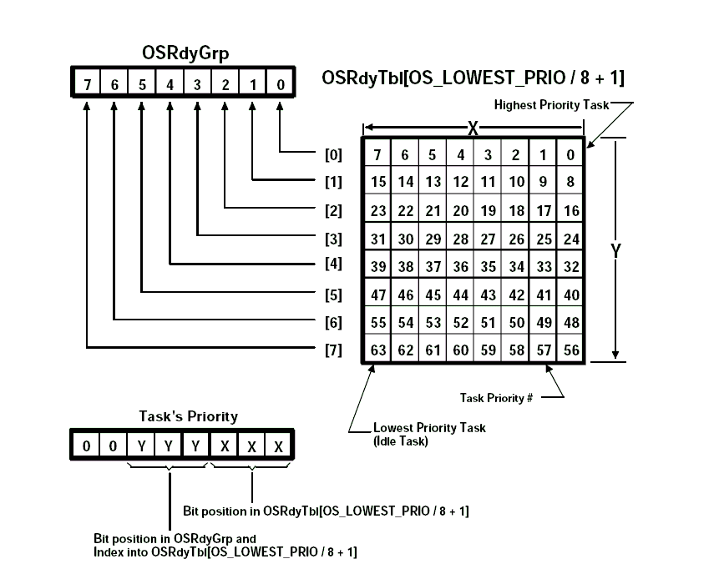

Slide 21
Ready List
OSMapTbl[]
  OSMapTbl[0] == 00000001b
  OSMapTbl[1] == 00000010b
  OSMapTbl[2] == 00000100b
  OSMapTbl[3] == 00001000b
  OSMapTbl[4] == 00010000b
  OSMapTbl[5] == 00100000b
  OSMapTbl[6] == 01000000b
  OSMapTbl[7] == 10000000b

Slide 22
Ready List
Make a task ready-to-run
OSRdyGrp |= OSMapTbl[prio >> 3];
OSRdyTbl[prio>>3] |= OSMapTbl[prio & 0x07];
Remove a task from the ready list
if((OSRdyTbl[prio>>3]&=~OSMapTbl[prio&0x07]) == 0)‏
OSRdyGrp &= ~OSMapTbl[prio >> 3];

Slide 23
Ready List
Find highest priority task ready-to-run
  y = OSUnMapTbl[OSRdyGrp];
  x = OSUnMapTbl[OSRdyTbl[y]];
  prio = (y << 3) + x;
OSUnMapTbl[] priority resolution table
  { 0, 0, 1, 0, 2,
    0, 1, 0, 3, 0,
    1, 0, 2, 0, 1,
    0, 4, 0, 1, 0,
    2, 0, 1, 0, 3,
    0, 1, 0, 2, 0,
    . . . }

Slide 24

The End

