Slide 1
Robot learning for imperfect scenario
By:
Mohit P
171001055
IVTH year

Slide 2
Introduction:
Deep reinforcement learning (DRL) uses deep learning and reinforcement learning principles in order to create efficient algorithms that can be applied on areas like robotics, video games, finance and healthcare. Implementing deep learning architecture (deep neural networks or etc.) with reinforcement learning algorithms (Q-learning, actor critic or etc.), a powerful model (DRL) can be created that is capable to scale to previously unsolvable problems. That is because DRL usually uses raw sensor or image signals as input as can be seen in DQN for ATARI games and can receive the benefit of end-to-end reinforcement learning as well as that of convolutional neural networks.

Slide 3
Purpose of the Project:
Robust learning in the real world can benefit from both presentations and interactions in the community. Current demonstration learning and reward methods conduct supervised learning on expert demonstration data and use reinforcement learning to further improve environmental reward-based performance.Crucially, both demonstrationlearning and interactive enhancement use the same target, unlike previous methods that combine separate losses of control and strengthening. This makes the algorithm robust to sub optimal demonstration data, as the method is not forced to imitate all of the data set’s examples. We demonstrate that when tested on several realistic driving games, our unified reinforcement learning algorithm can learn robustly and outperform existing baselines.

Slide 4
Survey:
The experiment here takes the imperfect situation by sterilization of the MuJoCo environments by removing limbs of various environments or changing the nature of physics by changing the values of friction, stability, etc. They’re trained and compared to the one that was trained within the perfect situation. The coaching was through with the assistance of interface from Open AI like baselines and stable baselines.
Open AI Gym:
Gym is a toolkit for developing and comparing reinforcement learning algorithms. It makes no assumptions about the structure of your agent, and is compatible with any numerical computation library, such as Tensor Flow or Theano.
The gym library is a collection of test problems — environments — that you can use to work out your reinforcement learning algorithms. These environments have a shared interface, allowing you to write general algorithms.

Slide 5
Baselines:
OpenAI Baselines is a set of high-quality implementations of reinforcement learning algorithms.
These algorithms will make it easier for the research community to replicate, refine, and identify new ideas, and will create good baselines to build research on top of. Our DQN implementation and its variants are roughly on par with the scores in published papers. We expect they will be used as a base around which new ideas can be added, and as a tool for comparing a new approach against existing ones.
Stable Baselines:
Stable Baselines is a set of improved implementations of reinforcement learning algorithms based on OpenAI Baselines.
These algorithms will make it easier for the research community and industry to replicate, refine, and identify new ideas, and will create good baselines to build projects on top of. We expect these tools will be used as a base around which new ideas can be added, and as a tool for comparing a new approach against existing ones. We also hope that the simplicity of these tools will allow beginners to experiment with a more advanced toolset, without being buried in implementation details.
Main differences with OpenAI Baselines
Unified structure for all algorithms
PEP8 compliant (unified code style)
Documented functions and classes
More tests & more code coverage
Additional algorithms: SAC and TD3 (+ HER support for DQN, DDPG, SAC and TD3)

Slide 6
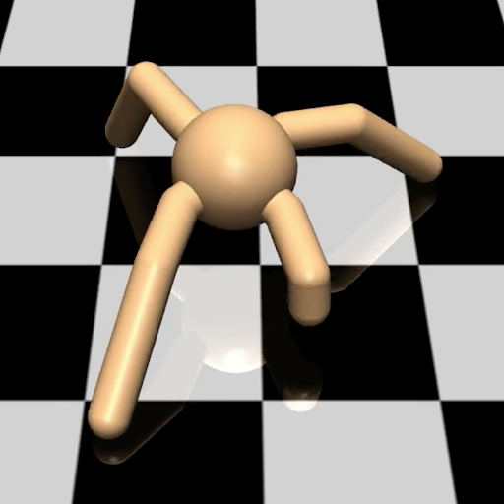
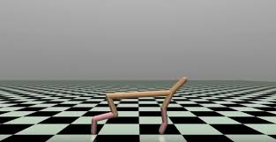
MuJoCo Environments :
MuJoCo (Multi-Joint dynamics with Contact) is a proprietary physics engine for detailed, efficient rigid body simulations with contacts. MuJoCo can be used to create environments with continuous control tasks such as walking or running. Thus, many policy gradient methods (TRPO, PPO) have been tested on various MuJoCo environments.

Slide 7
Policy Gradients:
The goal of reinforcement learning is to find an optimal behavior strategy for the agent to obtain optimal rewards. The policy gradient methods target at modeling and optimizing the policy directly. The policy is usually modeled with a parameterized function respect to θ, πθ(a|s)πθ(a|s). The value of the reward (objective) function depends on this policy and then various algorithms can be applied to optimize θ for the best reward.
Certain Policy Gradients are :
PPO2
DQN
ACKTR
DDPG
A2C
GAIL

Slide 8
Proposed Solution:
The Model is trained in the MuJoCo environment using DDPG. All the environments mentioned above, have been trained for seed values of 30,69,75,100,343 (the seed values namely 1221, 5000, 2048, 6557, 7331 are kept to train later). After the training of the above environments, we chose to work on Half-Cheetah and Hopper in-depth and compare its results by creating an imperfect scenario by changing the friction values of the body with the environment in their XML files of mujoco environment.

Slide 9
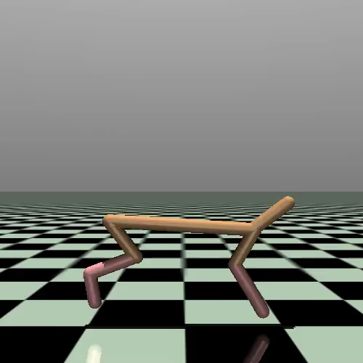
Experimental Result:
Half Cheetah :

Slide 10
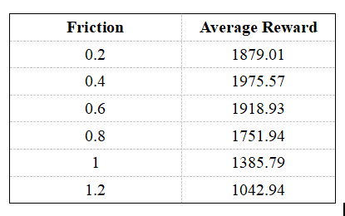

Slide 11
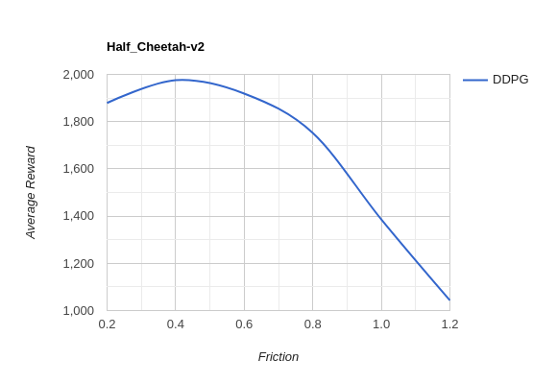

Slide 12
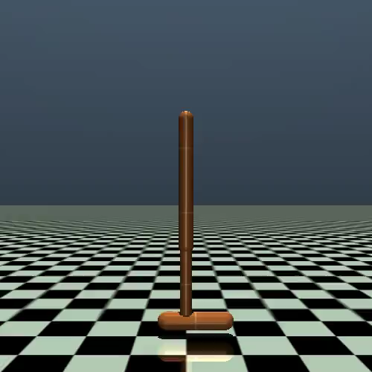
Hopper 2D:

Slide 13
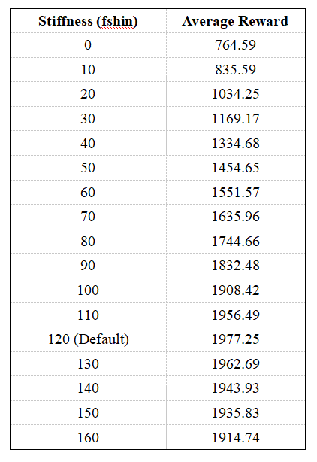

Slide 14
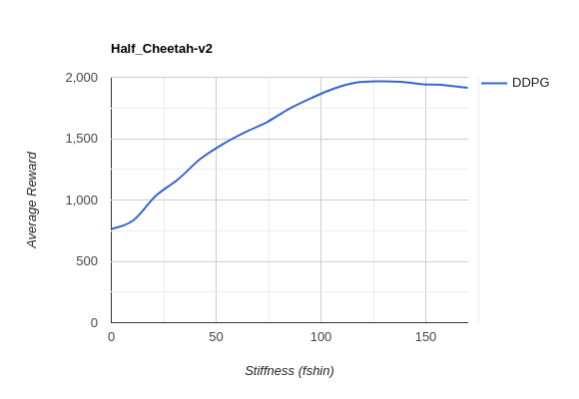

Slide 15
Conclusion:
After the deep study on the Mujoco environments of Gym by training them on various seed values, taken from stable baselines and baselines, Stable baselines are having better results of the trained models when compared to that of baselines.
After creating an imperfect scenario by varying the stiffness or friction of anybody in the Mujoco environment, say Half-Cheetah, it was evaluated and results were recorded for different values of the changed scenario. When compared with the mean rewards with default stiffness value or the friction values, It is observed that the mean rewards in the imperfect scenario were comparably less and were decreasing when the absolute difference between the default values to the changed values increases.
The body trained to work well with reasonable reward in an imperfect scenario. So it is also made sure that it worked better for a perfect scenario.

Slide 16
Thank You

