Slide 1

Pandas

Slide 2
Pandas
Let’s quickly review our ML Pathway...

Slide 3

ML Pathway
Report
Visualization
Collect & Store
Data
Clean & Organize Data
Exploratory Data Analysis
Communication
Real
World
Data
Analysis
Make Decisions
Answer Key Questions

Slide 4
ML Pathway
Collect & Store
Data
Clean & Organize Data
Exploratory Data Analysis
Machine Learning
Models
Real
World
Service
Data
Product
Dashboard
Application
Predict Future Outcomes
Gain Insight on Data

Slide 5

ML Pathway
Collect & Store
Data
Clean & Organize Data
Exploratory Data Analysis
Real
World

Slide 6
Pandas
Pandas is a library for Data Analysis.
Extremely powerful table (DataFrame) system built off of NumPy.
Fantastic documentation:
https://pandas.pydata.org/docs/

Slide 7
Pandas
What can we do with Pandas?
Tools for reading and writing data between many formats.
Intelligently grab data based on indexing,logic, subsetting, and more.
Handle missing data.
Adjust and restructure data.

Slide 8
Pandas - Section Overview
Series and DataFrames
Conditional Filtering and Useful Methods
Missing Data
Group By Operations
Combining DataFrames
Text Methods and Time Methods
Inputs and Outputs

Slide 9
Let’s get started!

Slide 10
Series

Slide 11
Pandas
A Series is a data structure in Pandas that holds an array of information along with a named index.
The named index differentiates this from a simple NumPy array.
Formal Definition: One-dimensional ndarray with axis labels

Slide 12
Pandas
NumPy array has numeric index
0 | 1776
1 | 1867
2 | 1821

Slide 13
Pandas
NumPy array has numeric index
Index | Data
0 | 1776
1 | 1867
2 | 1821

Slide 14
Pandas
Pandas Series adds on a labeled index
Labeled Index | Data
USA | 1776
CANADA | 1867
MEXICO | 1821

Slide 15
Pandas
Data is still numerically organized
Numeric Index | Labeled Index | Data
0 | USA | 1776
1 | CANADA | 1867
2 | MEXICO | 1821

Slide 16
Pandas
Let’s explore the various ways to create a Pandas Series object.
We’ll also learn about some key properties and operations.
Later on we will learn how to combine Series with a shared index to create a tabular data structure called a DataFrame.

Slide 17
Series
PART TWO

Slide 18
DataFrames
Part One

Slide 19
Pandas
A DataFrame is a table of columns and rows in pandas that we can easily restructure and filter.
Formal Definition: A group of Pandas Series objects that share the same index.

Slide 20
Pandas
Example of a Series
Index | Year
USA | 1776
CANADA | 1867
MEXICO | 1821

Slide 21
Pandas
Example of Series with Same Index
Index | Year
USA | 1776
CANADA | 1867
MEXICO | 1821
Index | Pop
USA | 328
CANADA | 38
MEXICO | 126
Index | GDP
USA | 20.5
CANADA | 1.7
MEXICO | 1.22

Slide 22
Pandas
Example of Series with Same Index
Index | Year
USA | 1776
CANADA | 1867
MEXICO | 1821
Index | Pop
USA | 328
CANADA | 38
MEXICO | 126
Index | GDP
USA | 20.5
CANADA | 1.7
MEXICO | 1.22

Slide 23
Pandas
DataFrame
Index | Year | Pop | GDP
USA | 1776 | 328 | 20.5
CANADA | 1867 | 38 | 1.7
MEXICO | 1821 | 126 | 1.22

Slide 24
Pandas
DataFrame is the main Pandas object we will work with and it is extremely useful!
This series covers first the “basics”
Create a DataFrame
Grab a column or multiple columns
Grab a row or multiple rows
Insert a new column or new row

Slide 25
Pandas
Quick Note: Each video lecture in this DataFrames series refers to the same 01-DataFrames.ipynb notebook!

Slide 26
DataFrames
Part Two

Slide 27
DataFrames
Part Three

Slide 28
DataFrames
Part Four

Slide 29
Conditional Filtering

Slide 30
Pandas
Typically in data analysis our datasets are large enough that we don’t filter based on position, but instead based on a condition.
Conditional Filtering allows us to select rows based a condition on a column.
This leads to a discussion on organizing our data...

Slide 31
Pandas
Organizing Data
Index | Year | Pop | GDP
USA | 1776 | 328 | 20.5
CANADA | 1867 | 38 | 1.7
MEXICO | 1821 | 126 | 1.22

Slide 32
Pandas
Columns are Features
Index | Year | Pop | GDP
USA | 1776 | 328 | 20.5
CANADA | 1867 | 38 | 1.7
MEXICO | 1821 | 126 | 1.22

Slide 33
Pandas
Rows are instances of data
Index | Year | Pop | GDP
USA | 1776 | 328 | 20.5
CANADA | 1867 | 38 | 1.7
MEXICO | 1821 | 126 | 1.22

Slide 34
Pandas
This format is required for ML later on!
Index | Year | Pop | GDP
USA | 1776 | 328 | 20.5
CANADA | 1867 | 38 | 1.7
MEXICO | 1821 | 126 | 1.22

Slide 35
Pandas
This allows to directly answer questions
Index | Year | Pop | GDP
USA | 1776 | 328 | 20.5
CANADA | 1867 | 38 | 1.7
MEXICO | 1821 | 126 | 1.22

Slide 36
Pandas
What countries have Pop greater than X?
Index | Year | Pop | GDP
USA | 1776 | 328 | 20.5
CANADA | 1867 | 38 | 1.7
MEXICO | 1821 | 126 | 1.22

Slide 37
Pandas
What countries have Pop greater than 50?
Index | Year | Pop | GDP
USA | 1776 | 328 | 20.5
CANADA | 1867 | 38 | 1.7
MEXICO | 1821 | 126 | 1.22

Slide 38
Pandas
df[“Pop”]
Index | Year | Pop | GDP
USA | 1776 | 328 | 20.5
CANADA | 1867 | 38 | 1.7
MEXICO | 1821 | 126 | 1.22

Slide 39
Pandas
df[“Pop”] > 50
Index | Year | Pop | GDP
USA | 1776 | 328 | 20.5
CANADA | 1867 | 38 | 1.7
MEXICO | 1821 | 126 | 1.22

Slide 40
Pandas
df[“Pop”] > 50
Index | Year | Pop | GDP
USA | 1776 | 328 | 20.5
CANADA | 1867 | 38 | 1.7
MEXICO | 1821 | 126 | 1.22

Slide 41
Pandas
df[“Pop”] > 50
Index | Year | Pop | GDP
USA | 1776 | True | 20.5
CANADA | 1867 | False | 1.7
MEXICO | 1821 | True | 1.22

Slide 42
Pandas
df[df[“Pop”] > 50]
Index | Year | Pop | GDP
USA | 1776 | True | 20.5
CANADA | 1867 | False | 1.7
MEXICO | 1821 | True | 1.22

Slide 43
Pandas
df[df[“Pop”] > 50]
Index | Year | Pop | GDP
USA | 1776 | True | 20.5
MEXICO | 1821 | True | 1.22

Slide 44
Pandas
Conditional Filtering:
Filter by single condition
Filter by multiple conditions
Check against multiple possible values

Slide 45
Useful Methods
PART ONE - APPLY METHODS

Slide 46
Pandas
We now understand the basics of how to grab and filter data from a Series or DataFrame in pandas.
We are now going to cover a wide variety of method calls available in Pandas.
This will be part of a series of lectures since there are quite a few methods to cover.

Slide 47
Pandas
For your convenience, the lecture notebook for this series has a list at the top with links that take you directly to the relevant section of the notebook for a topic.

Slide 48
Pandas
While pandas has many built in methods, we can use the .apply() method call to apply any custom python function of our own to every row in a Series.
We can use either one or multiple columns as input, let’s explore this in the notebook!

Slide 49
Useful Methods
PART TWO - APPLY WITH MULTIPLE COLUMNS

Slide 50
Useful Methods
PART THREE - DESCRIBING AND SORTING

Slide 51
Useful Methods
PART THREE - METHOD CALLS

Slide 52
Missing Data
PART ONE - OVERVIEW

Slide 53
Pandas
Real world data will often be missing data for a variety of reasons.
Many machine learning models and statistical methods can not work with missing data points, in which case we need to decide what to do with the missing data.

Slide 54
Pandas
When reading in missing values, pandas will display them as NaN values.
There are also newer specialized null pandas values such as pd.NaT to imply the value missing should be a timestamp.

Slide 55
Pandas
Options for Missing Data
Keep it
Remove it
Replace it
Note, there is never 100% correct approach that applies to all circumstances, it all depends on the exact situation you encounter!

Slide 56
Pandas
Keeping the missing data
PROS:
Easiest to do
Does not manipulate or change the true data
CONS:
Many methods do not support NaN
Often there are reasonable guesses

Slide 57
Pandas
Dropping or Removing the missing data
PROS:
Easy to do.
Can be based on rules.
CONS:
Potential to lose a lot of data or useful information.
Limits trained models for future data.

Slide 58
Pandas
Removing or Dropping missing data
Dropping a Row
Makes sense when a lot of info is missing
 | Year | Pop | GDP | Area
USA | 1776 | NAN | NAN | NAN
CANADA | 1867 | 38 | 1.7 | 3.86
MEXICO | 1821 | 126 | 1.22 | 0.76

Slide 59
Pandas
Removing or Dropping missing data
Dropping a Row
Clearly this data point as a row should probably be dropped
 | Year | Pop | GDP | Area
USA | 1776 | NAN | NAN | NAN
CANADA | 1867 | 38 | 1.7 | 3.86
MEXICO | 1821 | 126 | 1.22 | 0.76

Slide 60
Pandas
Removing or Dropping missing data
Dropping a Row
Often a good idea to calculate a percentage of what data is dropped
 | Year | Pop | GDP | Area
USA | 1776 | NAN | NAN | NAN
CANADA | 1867 | 38 | 1.7 | 3.86
MEXICO | 1821 | 126 | 1.22 | 0.76

Slide 61
Pandas
Removing or Dropping missing data
Dropping a Column
Good choice if every row is missing that particular feature
 | Year | Pop | GDP | Area
USA | 1776 | 328 | 20.5 | NAN
CANADA | 1867 | 38 | 1.7 | NAN
MEXICO | 1821 | 126 | 1.22 | 0.76

Slide 62
Pandas
Filling in the missing data
PROS:
Potential to save a lot of data for use in training a model
CONS:
Hardest to do and somewhat arbitrary
Potential to lead to false conclusions

Slide 63
Pandas
Filling in missing data
Fill with same value
Good choice if NaN was a placeholder
 | Year | Pop | GDP | Carriers
USA | 1776 | 328 | 20.5 | 11
CANADA | 1867 | 38 | 1.7 | NAN
MEXICO | 1821 | 126 | 1.22 | NAN

Slide 64
Pandas
Filling in missing data
Fill with same value
Good choice if NaN was a placeholder
 | Year | Pop | GDP | Carriers
USA | 1776 | 328 | 20.5 | 11
CANADA | 1867 | 38 | 1.7 | NAN
MEXICO | 1821 | 126 | 1.22 | NAN

Slide 65
Pandas
Filling in missing data
Fill with same value
Here NAN can be filled in with zero
 | Year | Pop | GDP | Carriers
USA | 1776 | 328 | 20.5 | 11
CANADA | 1867 | 38 | 1.7 | 0
MEXICO | 1821 | 126 | 1.22 | 0

Slide 66
Pandas
Filling in missing data
Fill with interpolated or estimated value
Much harder and requires reasonable assumptions
 | Year | Pop | GDP | Perct
USA | 1776 | 328 | 20.5 | 75%
CANADA | 1867 | 38 | 1.7 | NAN
MEXICO | 1821 | 126 | 1.22 | 25%

Slide 67
Pandas
Filling in missing data
Fill with interpolated or estimated value
Much harder and requires reasonable assumptions
 | Year | Pop | GDP | Perct
USA | 1776 | 328 | 20.5 | 75%
CANADA | 1867 | 38 | 1.7 | 50%
MEXICO | 1821 | 126 | 1.22 | 25%

Slide 68
Pandas
Let’s explore the code syntax in pandas for dealing with missing values.
Later on in the course we will have a deeper discussion on trying to decide between keep,remove, and replace options.

Slide 69
Missing Data
PART TWO - PANDAS

Slide 70
Groupby Operations

Slide 71
Pandas
A groupby() operation allows us to examine data on a per category basis.
Let’s explore what this looks like in pandas...

Slide 72
Pandas
Category | Data Value
A | 10
A | 5
B | 2
B | 4
C | 12
C | 6

Slide 73
Pandas
Category | Data Value
A | 10
A | 5
B | 2
B | 4
C | 12
C | 6
We need to choose a categorical column to call with groupby().
Categorical columns are non-continuous.
Keep in mind, they can still be numerical, such as cabin class categories on a ship (e.g. Class 1, Class 2, Class 3)

Slide 74
Pandas
Category | Data Value
A | 10
A | 5
B | 2
B | 4
C | 12
C | 6
Let’s now see what happens with a .groupby() call combined with an aggregate function call.

Slide 75
Pandas
A | 10
A | 5
Category | Data Value
A | 10
A | 5
B | 2
B | 4
C | 12
C | 6
B | 2
B | 4
C | 12
C | 6

Slide 76
Pandas
A | 10
A | 5
Aggregate Function
.sum()
Category | Data Value
A | 10
A | 5
B | 2
B | 4
C | 12
C | 6
Category | Result
A | 15
B | 6
C | 18
B | 2
B | 4
C | 12
C | 6

Slide 77
Pandas
A | 10
A | 5
Aggregate Function
.mean()
Category | Data Value
A | 10
A | 5
B | 2
B | 4
C | 12
C | 6
Category | Result
A | 7.5
B | 3
C | 9
B | 2
B | 4
C | 12
C | 6

Slide 78
Pandas
A | 10
A | 5
Aggregate Function
.count()
Category | Data Value
A | 10
A | 5
B | 2
B | 4
C | 12
C | 6
Category | Result
A | 2
B | 2
C | 2
B | 2
B | 4
C | 12
C | 6

Slide 79
Pandas
Note that in pandas calling groupby() by itself creates a “lazy” groupby object waiting to be evaluated by an aggregate method call.
Let’s explore this further in pandas!

Slide 80
Groupby Operations
MULTI-LEVEL INDEX CONTINUED...

Slide 81
Combining DataFrames
Concatenation

Slide 82
Pandas
Often the data you need exists in two separate sources, fortunately, Pandas makes it easy to combine these together.
The simplest combination is if both sources are already in the same format, then a concatenation through the pd.concat() call is all that is needed.

Slide 83
Pandas
Concatenation is simply “pasting” the two DataFrames together, by columns:
 | Year | Pop
USA | 1776 | 328
CANADA | 1867 | 38
MEXICO | 1821 | 126
 | GDP | Perct
USA | 20.5 | 75%
CANADA | 1.7 | NAN
MEXICO | 1.22 | 25%

Slide 84
Pandas
Concatenation is simply “pasting” the two DataFrames together, by columns:
 | Year | Pop | GDP | Perct
USA | 1776 | 328 | 20.5 | 75%
CANADA | 1867 | 38 | 1.7 | NAN
MEXICO | 1821 | 126 | 1.22 | 25%

Slide 85
Pandas
Concatenation is simply “pasting” the two DataFrames together, by rows:
 | Year | Pop | GDP
USA | 1776 | 328 | 20.5
CANADA | 1867 | 38 | 1.7
 | Year | Pop | GDP
MEXICO | 1821 | 126 | 1.22
BRAZIL | 1822 | 209 | 1.86

Slide 86
Pandas
Concatenation is simply “pasting” the two DataFrames together, by rows:
 | Year | Pop | GDP
USA | 1776 | 328 | 20.5
CANADA | 1867 | 38 | 1.7
BRAZIL | 1822 | 209 | 1.86
MEXICO | 1821 | 126 | 1.22

Slide 87
Pandas
Pandas will also automatically fill NaN where necessary.
Let’s explore some examples in Pandas!

Slide 88
Combining DataFrames
“Inner” Merge

Slide 89
Pandas
Often DataFrames are not in the exact same order or format, meaning we can not simply concatenate them together.
In this case, we need to merge the DataFrames.
This is analogous to a JOIN command in SQL.

Slide 90
Pandas
The .merge() method takes in a key argument labeled how
There are 3 main ways of merging tables together using the how parameter:
Inner
Outer
Left or Right

Slide 91
Pandas
The main idea behind the argument is to decide how to deal with information only present in one of the joined tables.

Slide 92
Pandas
Let’s imagine a simple example.
Our company is holding a conference for people in the movie rental industry.
We’ll have people register online beforehand and then login the day of the conference.

Slide 93
Pandas
After the conference we have these tables
REGISTRATIONS
reg_id | name
1 | Andrew
2 | Bob
3 | Charlie
4 | David
LOGINS
log_id | name
1 | Xavier
2 | Andrew
3 | Yolanda
4 | Bob

Slide 94
Pandas
The respective id columns indicate what order they registered or logged in on site.
REGISTRATIONS
reg_id | name
1 | Andrew
2 | Bob
3 | Charlie
4 | David
LOGINS
log_id | name
1 | Xavier
2 | Andrew
3 | Yolanda
4 | Bob

Slide 95
Pandas
For the sake of simplicity, we will assume the names are unique.
REGISTRATIONS
reg_id | name
1 | Andrew
2 | Bob
3 | Charlie
4 | David
LOGINS
log_id | name
1 | Xavier
2 | Andrew
3 | Yolanda
4 | Bob

Slide 96
Pandas
(e.g. There is only one person in the company named “Andrew”)
REGISTRATIONS
reg_id | name
1 | Andrew
2 | Bob
3 | Charlie
4 | David
LOGINS
log_id | name
1 | Xavier
2 | Andrew
3 | Yolanda
4 | Bob

Slide 97
Pandas
To help you keep track, Registrations names’ first letters go A,B,C,D
REGISTRATIONS
reg_id | name
1 | Andrew
2 | Bob
3 | Charlie
4 | David
LOGINS
log_id | name
1 | Xavier
2 | Andrew
3 | Yolanda
4 | Bob

Slide 98
Pandas
First we need to decide on what column to merge together.
REGISTRATIONS
reg_id | name
1 | Andrew
2 | Bob
3 | Charlie
4 | David
LOGINS
log_id | name
1 | Xavier
2 | Andrew
3 | Yolanda
4 | Bob

Slide 99
Pandas
The on column should be a primary identifier, meaning unique per row.
REGISTRATIONS
reg_id | name
1 | Andrew
2 | Bob
3 | Charlie
4 | David
LOGINS
log_id | name
1 | Xavier
2 | Andrew
3 | Yolanda
4 | Bob

Slide 100
Pandas
The on column should also be present in both tables being merged.
REGISTRATIONS
reg_id | name
1 | Andrew
2 | Bob
3 | Charlie
4 | David
LOGINS
log_id | name
1 | Xavier
2 | Andrew
3 | Yolanda
4 | Bob

Slide 101
Pandas
Since we assume names are unique here, will we merge on= “name”.
REGISTRATIONS
reg_id | name
1 | Andrew
2 | Bob
3 | Charlie
4 | David
LOGINS
log_id | name
1 | Xavier
2 | Andrew
3 | Yolanda
4 | Bob

Slide 102
Pandas
Next we need to decide how to merge the tables on the name column.
REGISTRATIONS
reg_id | name
1 | Andrew
2 | Bob
3 | Charlie
4 | David
LOGINS
log_id | name
1 | Xavier
2 | Andrew
3 | Yolanda
4 | Bob

Slide 103
Pandas
With how=“inner” the result will be the set of records that match in both tables.
REGISTRATIONS
reg_id | name
1 | Andrew
2 | Bob
3 | Charlie
4 | David
LOGINS
log_id | name
1 | Xavier
2 | Andrew
3 | Yolanda
4 | Bob

Slide 104
Pandas
With how= “inner” the result will be the set of records that match in both tables.
REGISTRATIONS
reg_id | name
1 | Andrew
2 | Bob
3 | Charlie
4 | David
LOGINS
log_id | name
1 | Xavier
2 | Andrew
3 | Yolanda
4 | Bob

Slide 105
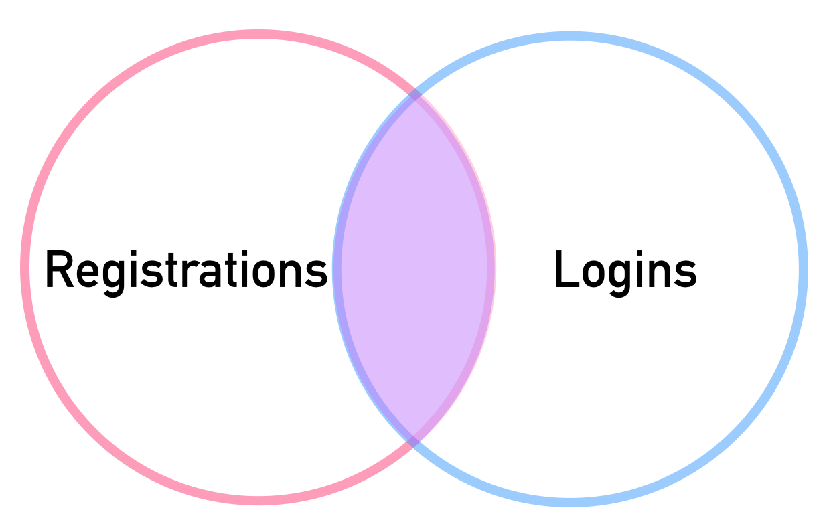
Pandas
Merges are often shown as a Venn diagram
pd.merge(registrations,logins,how='inner',on='name')
REGISTRATIONS
reg_id | name
1 | Andrew
2 | Bob
3 | Charlie
4 | David
LOGINS
log_id | name
1 | Xavier
2 | Andrew
3 | Yolanda
4 | Bob

Slide 106
Pandas
pd.merge(registrations,logins,how='inner',on='name')
REGISTRATIONS
reg_id | name
1 | Andrew
2 | Bob
3 | Charlie
4 | David
LOGINS
log_id | name
1 | Xavier
2 | Andrew
3 | Yolanda
4 | Bob

Slide 107
Pandas
pd.merge(registrations,logins,how='inner',on='name')
REGISTRATIONS
reg_id | name
1 | Andrew
2 | Bob
3 | Charlie
4 | David
LOGINS
log_id | name
1 | Xavier
2 | Andrew
3 | Yolanda
4 | Bob

Slide 108
Pandas
pd.merge(registrations,logins,how='inner',on='name')
REGISTRATIONS
reg_id | name
1 | Andrew
2 | Bob
3 | Charlie
4 | David
LOGINS
log_id | name
1 | Xavier
2 | Andrew
3 | Yolanda
4 | Bob
RESULTS
reg_id | name | log_id
1 | Andrew | 2
2 | Bob | 4

Slide 109
Pandas
Let’s quickly explore this in pandas!

Slide 110
Combining DataFrames
“left” and “right” merge

Slide 111
Pandas
Now that we understand an “inner” merge, let’s explore “left” versus “right” merge conditions.
Note! Order of the tables passed in as arguments does matter here!

Slide 112
Pandas
Let’s explore an how= “left” condition with our two example tables.
REGISTRATIONS
reg_id | name
1 | Andrew
2 | Bob
3 | Charlie
4 | David
LOGINS
log_id | name
1 | Xavier
2 | Andrew
3 | Yolanda
4 | Bob

Slide 113
Pandas
Note: Registrations is the left table, logins will be the right table
REGISTRATIONS
reg_id | name
1 | Andrew
2 | Bob
3 | Charlie
4 | David
LOGINS
log_id | name
1 | Xavier
2 | Andrew
3 | Yolanda
4 | Bob

Slide 114
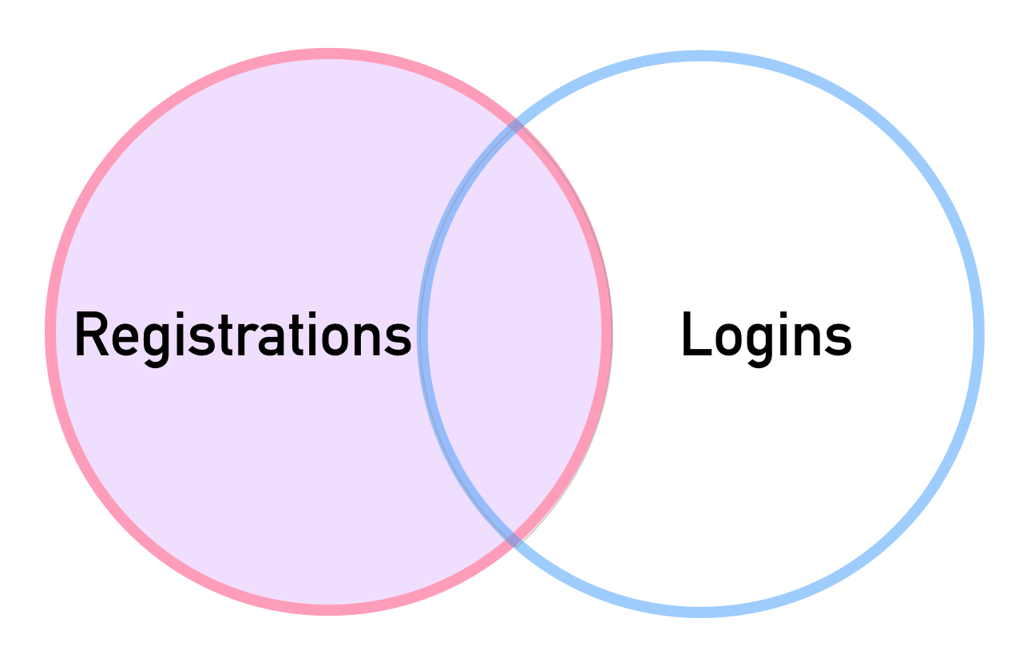
Pandas
pd.merge(registrations,logins,how='left',on=’name’)
REGISTRATIONS
reg_id | name
1 | Andrew
2 | Bob
3 | Charlie
4 | David
LOGINS
log_id | name
1 | Xavier
2 | Andrew
3 | Yolanda
4 | Bob

Slide 115
Pandas
pd.merge(registrations,logins,how='left',on=’name’)
REGISTRATIONS
reg_id | name
1 | Andrew
2 | Bob
3 | Charlie
4 | David
RESULTS
reg_id | name | log_id
1 | Andrew | 2
2 | Bob | 4
3 | Charlie | NaN
4 | David | NaN
LOGINS
log_id | name
1 | Xavier
2 | Andrew
3 | Yolanda
4 | Bob

Slide 116
Pandas
pd.merge(registrations,logins,how='left',on=’name’)
REGISTRATIONS
reg_id | name
1 | Andrew
2 | Bob
3 | Charlie
4 | David
RESULTS
reg_id | name | log_id
1 | Andrew | 2
2 | Bob | 4
3 | Charlie | NaN
4 | David | NaN
LOGINS
log_id | name
1 | Xavier
2 | Andrew
3 | Yolanda
4 | Bob

Slide 117
Pandas
Now let’s see what happens in a how=“right” situation.

Slide 118
Pandas
pd.merge(registrations,logins,how='right',on=’name’)
REGISTRATIONS
reg_id | name
1 | Andrew
2 | Bob
3 | Charlie
4 | David
RESULTS
reg_id | name | log_id
1 | Andrew | 2
2 | Bob | 4
NaN | Xavier | 1
NaN | Yolanda | 3
LOGINS
log_id | name
1 | Xavier
2 | Andrew
3 | Yolanda
4 | Bob

Slide 119
Pandas
Let’s explore this further in pandas!

Slide 120
Combining DataFrames
“outer” merge

Slide 121
Pandas
Setting how= “outer” allows us to include everything present in both tables.

Slide 122
Pandas
Recall we match Andrew and Bob in both tables
REGISTRATIONS
reg_id | name
1 | Andrew
2 | Bob
3 | Charlie
4 | David
LOGINS
log_id | name
1 | Xavier
2 | Andrew
3 | Yolanda
4 | Bob

Slide 123
Pandas
But we have names that only appear in one table!
REGISTRATIONS
reg_id | name
1 | Andrew
2 | Bob
3 | Charlie
4 | David
LOGINS
log_id | name
1 | Xavier
2 | Andrew
3 | Yolanda
4 | Bob

Slide 124
Pandas
We can use how= “outer” to make sure we grab all names from both tables.
REGISTRATIONS
reg_id | name
1 | Andrew
2 | Bob
3 | Charlie
4 | David
LOGINS
log_id | name
1 | Xavier
2 | Andrew
3 | Yolanda
4 | Bob

Slide 125
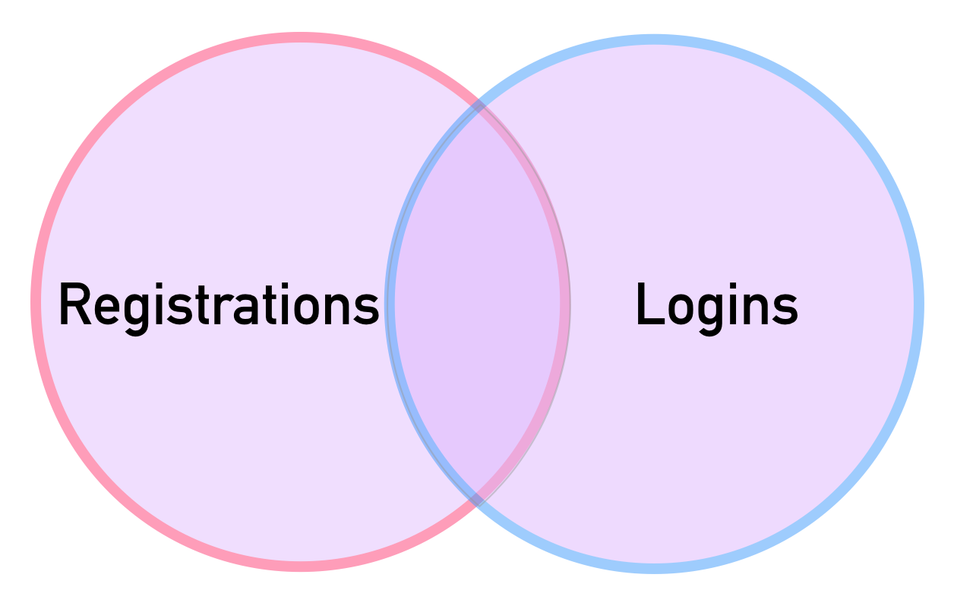
Pandas
pd.merge(registrations,logins,how='outer',on=’name’)
REGISTRATIONS
reg_id | name
1 | Andrew
2 | Bob
3 | Charlie
4 | David
LOGINS
log_id | name
1 | Xavier
2 | Andrew
3 | Yolanda
4 | Bob

Slide 126
Pandas
pd.merge(registrations,logins,how='outer',on=’name’)
RESULTS
reg_id | name | log_id
1 | Andrew | 2
2 | Bob | 4
3 | Charlie | NaN
4 | David | NaN
NaN | Xavier | 1
NaN | Yolanda | 3
REGISTRATIONS
reg_id | name
1 | Andrew
2 | Bob
3 | Charlie
4 | David
LOGINS
log_id | name
1 | Xavier
2 | Andrew
3 | Yolanda
4 | Bob

Slide 127
Pandas
Let’s quickly explore this result in pandas!

Slide 128
Combining DataFrames
Joining on Index and Different Key Names

Slide 129
Text Methods

Slide 130
Pandas
Often text data needs to be cleaned or manipulated for processing.
While we can always use a custom apply() function for these tasks, pandas comes with many built-in string method calls.
Let’s learn how to use them!

Slide 131
Time Methods

Slide 132
Pandas
Basic Python has a datetime object containing date and time information.
Pandas allows us to easily extract information from a datetime object to use feature engineering.

Slide 133
Pandas
For example, we may have recent timestamped sales data.
Pandas will allow us to extract information from the timestamp, such as:
Day of the Week
Weekend vs Weekday
AM vs PM

Slide 134
Data Input and Output
CSV Files

Slide 135
Pandas
Pandas can read in data from a wide variety of sources and has excellent online documentation!
In this series of lectures we will cover some of the most popular ways to read in datasets.

Slide 136
Pandas
Note!
You need to know the exact directory location and correct file name.
You may need passwords or permissions for certain data inputs (e.g. a SQL database password).

Slide 137
Pandas
Final Note:
It’s almost impossible for us to help with datasets outside the course, since they could be incorrectly formatted, in the wrong location, or have a different name.

Slide 138
Pandas
Video Lectures:
CSV Files
HTML Tables
Excel Files
SQL Databases

Slide 139
Data Input and Output
HTML Tables

Slide 140
Pandas
Websites display tabular information through the use of HTML tables tags:
<table>
Pandas has the ability to automatically convert these HTML tables into a DataFrame.

Slide 141
Pandas
Important Notes!
Not every table in a website is available through HTML tables.
Some websites may block your computer from scraping the HTML of the site through pandas.
It may be more efficient to use an API.

Slide 142
Pandas
Let’s work through an example of grabbing all the tables from a Wikipedia Article and then cleaning and organizing the information to get a DataFrame.
Output to an HTML table is also very useful to display tables on a website!

Slide 143
Data Input and Output
Excel Files

Slide 144
Pandas
Pandas can read and write to Excel files.
Important Note!
Pandas can only read and write in raw data, it is not able to read in macros,visualizations, or formulas created inside of spreadsheets.

Slide 145
Pandas
Pandas treats an Excel Workbook as a dictionary, with the key being the sheet name and the value being the DataFrame representing the sheet itself.
Note! Using pandas with Excel requires additional libraries!
Let’s explore how this works!

Slide 146
Data Input and Output
SQL

Slide 147
Pandas
Pandas can read and write to various SQL engines through the use of a driver and the sqlalchemy python library.
So how does this work?

Slide 148
Pandas
Step 1:
Figure out what SQL Engine you are connecting to, for just a few examples:
PostgreSQL
MySQL
MS SQL Server

Slide 149
Pandas
Step 2:
Install the appropriate Python driver library (Most likely requires a Google Search):
PostgreSQL - psycopg2
MySQL - pymysql
MS SQL Server - pyodbc

Slide 150
Pandas
Step 3:
Use the sqlalchemy library to connect to your SQL database with the driver:
docs.sqlalchemy.org/en/13/dialects/index.html

Slide 151
Pandas
Step 4:
Use the sqlalchemy driver connection with pandas read_sql method
Pandas can read in entire tables as a DataFrame or actual parse a SQL query through the connection:
SELECT * FROM table;

Slide 152
Pandas
Important Note!
It’s almost impossible for us to help with your specific work databases outside of the course material, since it requires knowledge of your permissions, database names and locations, and password information!

Slide 153
Pandas
Important Note!
Use your skills in information lookup to easily find many online resources regarding examples for all of the major SQL engines, for example:
Google Search: Oracle SQL + pandas

Slide 154
Pandas
For our example, we’ll use SQLite since it comes with Python and we can easily create a temporary database inside of your RAM.

Slide 155
Pivot Tables

Slide 156
Pandas
Pivot tables allow you to reorganize data, refactoring cells based on columns and a new index.
This is best shown visually...

Slide 157
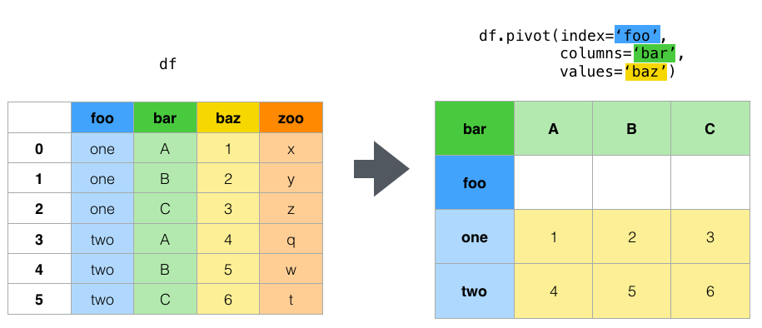
Pandas
A DataFrame with repeated values can be pivoted for a reorganization and clarity

Slide 158
Pandas
We choose columns to define the new index,columns, and values.

Slide 159
Pandas
Notice how the choices for index and column should have repeated values.

Slide 160
Pandas
Also notice how all the information from the zoo column is now discarded.

Slide 161
Pandas
No new information is shown, it is merely reorganized.

Slide 162
Pandas
Note!
It does not make sense to pivot every DataFrame, all of the datasets used in this course will have no need for a pivot table operation to use with machine learning.

Slide 163
Pandas
You should first go through this checklist before running a pivot():
What question are you trying to answer?
What would a dataframe that answers the question look like? Does it need a pivot()
What do you want the resulting pivot to look like?

Slide 164
Pandas
Pandas also comes with a pivot_table method that allows for an additional aggregation function to be called.
This could alternatively be done with a groupby() method call as well.
Let’s explore both .pivot() and pivot_table() methods in pandas!

Slide 165
Pivot Tables

Slide 166
Pandas Section Exercise - Overview

Slide 167
Pandas
Let’s test all your new pandas skills!
Keep in mind:
Most questions can be solved in one or two lines of pandas code.
There could be multiple correct solutions.
Be careful not to run the cell above the expected output.

Slide 168
Pandas Section Exercise - Solutions

