Slide 1

K-Means Clustering

Slide 2
K-Means Clustering
Section Overview
Understanding Clustering
History and Intuition of K-Means
Mathematical Theory of K-Means
Example of K-Means
K-Means Project Exercise
K-Means Project Exercise Solution

Slide 3
K-Means Clustering
Important Note:
Do not confuse K-Means with KNN!
The “K” is completely different in both algorithms, they solve completely different problems and are not related in any way!

Slide 4
Let’s get started!

Slide 5
Clustering
General Concepts

Slide 6
Clustering
Clustering uses unlabeled data and looks for similarities between groups (clusters) in order to attempt to segment the data into separate clusters.
Keep in mind that we don’t actually know the true correct label for this data!

Slide 7
Clustering
Imagine an example data set:
X1 | X2
2 | 4
6 | 3
... | ...
1 | 2

Slide 8
Clustering
Notice again we only have features!
X1 | X2
2 | 4
6 | 3
... | ...
1 | 2

Slide 9
Clustering
How could we cluster this data together?
X1 | X2
2 | 4
6 | 3
... | ...
1 | 2

Slide 10
Clustering
Could simply plot and discover patterns:
X2
X1

Slide 11
Clustering
Here we intuitively see 2 groupings:
X2
X1

Slide 12
Clustering
Note how distance is the intuitive metric:
X2
X1

Slide 13
Clustering
We could then assign clusters:
X2
X1

Slide 14
Clustering
Notice how we don’t actually know for sure if this is a correct way of grouping together these data points, there was no correct label to begin with!
And what about situations that are not so obvious or multi-dimensional?

Slide 15
Clustering
2 or 3 clusters could both be reasonable:
X2
X1

Slide 16
Clustering
2 or 3 clusters could both be reasonable:
X2
X1

Slide 17
Clustering
2 or 3 clusters could both be reasonable:
X2
X1

Slide 18
Clustering
Different methods can be used to decide!
X2
X1

Slide 19
Clustering
Clustering doesn’t “label” these for you!
X2
X1

Slide 20
Clustering
Clustering doesn’t “label” these for you!
CATS
DOGS
X2
BIRDS
X1

Slide 21
Clustering
Clustering doesn’t “label” these for you!
Group: 0
Group: 1
X2
Group: 2
X1

Slide 22
Clustering
Main Clustering Ideas:
Use features to decide which points are most similar to other points.
Realize that there is no final correct y label to compare cluster results to.
We can think of clustering as an unsupervised learning process that “discovers” potential labels.

Slide 23
Clustering
Unsupervised Learning Paradigm Shift:
What about a new unlabeled data point?
How do we assign it to a cluster?
Was it the correct cluster for assignment?

Slide 24
Clustering
Unsupervised Learning Paradigm Shift:
How do we assign a new data point to a cluster?
Different approaches depending on the unsupervised learning algorithm used.
Use features to assign most appropriate cluster.

Slide 25
Clustering
Unsupervised Learning Paradigm Shift:
How do we assign a new data point to a cluster?
Just as before, no way to measure if this was the “correct” assignment.

Slide 26
Clustering
Unsupervised Learning Paradigm Shift:
If we’ve discovered these new cluster labels, could we use that as a y for supervised training?
Yes! We can use unsupervised learning to discover possible labels, then apply supervised learning on new data points.

Slide 27
Clustering
Unsupervised Learning Paradigm Shift:
If we’ve discovered these new cluster labels, could we use that as a y for supervised training?
What’s the trade-off?

Slide 28
Clustering
Unsupervised Learning Paradigm Shift:
If we’ve discovered these new cluster labels, could we use that as a y for supervised training?
Clustering doesn’t tell you what these new cluster labels represent, no real way of knowing if these clusters are truly significant.

Slide 29
Clustering
Clustering ideas still to come:
How do we decide which number of clusters is best?
Do we decide or let the algorithm decide?
How can we measure “goodness of fit” for clustering without a y label for comparison?

Slide 30
Clustering
Machine Learning as an art:
What is ground truth?
What trade-offs are we making by using unsupervised learning as a substitute for ground truth of the y label that was not given?

Slide 31
Clustering
Keep these ideas in mind as we discover the different algorithms behind clustering!
Also keep in mind that it’s much harder to compare unsupervised algorithms against each other due to the lack of ground truth based performance metrics (e.g. can’t use accuracy or RMSE).

Slide 32
K-Means Clustering
History, Intuition and Theory

Slide 33
K-Means Clustering
Let’s briefly go through a tour of the timeline of the development of K-Means clustering.
Afterwards, we’ll dive deeper into the main method and concepts.

Slide 34
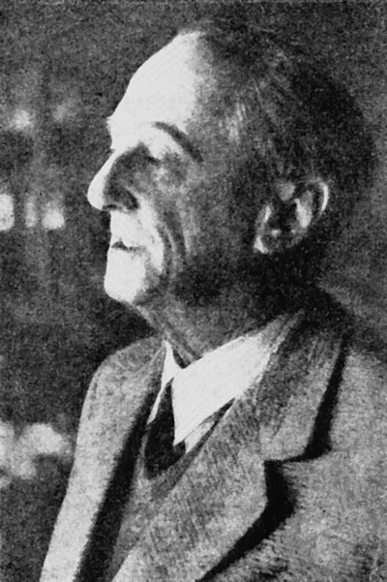
K-Means Clustering
Hugo Steinhaus was the mathematician who began laying out the groundwork for clustering methods.

Slide 35
K-Means Clustering
1940s-1950s: Hugo Steinhaus Polish mathematician and professor.
During WWII he was in hiding from Nazi occupation, yet still taught clandestine math classes from memory, since higher education for Poles was forbidden!

Slide 36
K-Means Clustering
He even established statistical methods for estimating German casualty rates based simply on relative frequencies of obituaries in local newspapers.
After WWII he helped establish the mathematics department at the University of Wrocław.

Slide 37
K-Means Clustering
It was at the University of Wrocław where he began to develop the ideas that would become the foundation of K-Means clustering!
Check out his Wikipedia page for more interesting stories from his incredible life!

Slide 38
Clustering
1957: Stuart Lloyd of Bell Labs developed the standard algorithmic technique for clustering related to K-Means.
However Lloyd did not publish his technique in a journal until 1982.
In 1965 Edward W. Forgy published the clustering technique, thus both Lloyd and Forgy are credited with the development.

Slide 39
Clustering
1967: James MacQueen of UCLA develops and publishes “Some methods for classification and analysis of multivariate observations”.
This is the first publication to introduce the term “K-Means” as a sequential clustering algorithm.

Slide 40
Clustering
So how does K-Means clustering actually work?
The main concept is actually very simple!
Let’s walk through an example of clustering unlabeled data.

Slide 41
Clustering
First a set of properties each point must satisfy:
Each point must belong to a cluster.
Each point can only belong to one cluster (no single point can belong to multiple clusters).

Slide 42
Clustering
So how does K-Means clustering actually work?
X2
X1

Slide 43
Clustering
Note: For visualization purposes, we’ll work with a simple dataset with only 2 features.
X2
X1

Slide 44
Clustering
The process shown here easily extends to N feature dimensions.
X2
X1

Slide 45
Clustering
Step 1: Start with unlabeled data (only features).
X2
X1

Slide 46
Clustering
Step 0: Start with unlabeled data (only features).
X2
X1

Slide 47
Clustering
Note: If we had the group labels, it wouldn’t make sense to cluster!
X2
X1

Slide 48
Clustering
Step 1: Choose the number of clusters to create (this is the K value).
X2
X1

Slide 49
Clustering
Step 1: We’ll choose K=3. Note in most situations you won’t visualize the data!
X2
X1

Slide 50
Clustering
Step 2: Randomly select K distinct data points.
X2
X1

Slide 51
Clustering
Step 2: Randomly select K distinct data points. Our K=3:
X2
X1

Slide 52
Clustering
Step 2: We’ll treat these new K points as our “cluster” points.
X2
X1

Slide 53
Clustering
Step 3: Assign each remaining point to the nearest “cluster” point.
X2
X1

Slide 54
Clustering
Step 3: Assign each remaining point to the nearest “cluster” point.
X2
X1

Slide 55
Clustering
Step 3: Note how this is using a distance metric to judge the nearest point.
X2
X1

Slide 56
Clustering
Step 4: Calculate the center of the cluster points (mean value of each point vector).
X2
X1

Slide 57
Clustering
Step 4: Calculate the center of the cluster points (mean value of point vectors).
X2
X1

Slide 58
Clustering
Step 5: Now assign each point to the nearest cluster center.
X2
X1

Slide 59
Clustering
Step 5: Now assign each point to the nearest cluster center.
X2
X1

Slide 60
Clustering
We repeat steps 4 and 5 until there are no more cluster reassignments.
X2
X1

Slide 61
Clustering
Step 4b: Recalculate new cluster centers:
X2
X1

Slide 62
Clustering
Step 4b: Recalculate new cluster centers:
X2
X1

Slide 63
Clustering
Step 5b: Assign points to nearest cluster center.
X2
X1

Slide 64
Clustering
If there are no more reassignments, we’re done! The clusters have been found.
X2
X1

Slide 65
Clustering
Upcoming considerations:
How do we choose a reasonable value for K number of clusters?
Is there any way we can evaluate how good our current K value is at determining clusters?

Slide 66
Clustering
Let’s continue by coding out an example of K-Means clustering, then we’ll revisit these considerations when they naturally appear after we find the first set of clusters for a given K.

Slide 67
K-Means Clustering
Example
Exploratory Data Analysis

Slide 68
K-Means Clustering
Example
Data Preparation and Model Fitting

Slide 69
K-Means Clustering
Example
Choosing a K Value

Slide 70
Clustering
Recall our previous considerations:
How do we choose a reasonable value for K number of clusters?
Is there any way we can evaluate how good our current K value is at determining clusters?

Slide 71
Clustering
Here we have 3 clusters, how can we measure “goodness of fit”?
X2
X1

Slide 72
Clustering
We could measure the sum of the distances from points to cluster centers.
X2
X1

Slide 73
Clustering
Imagine a simple example starting with K=2.
X2
X1

Slide 74
Clustering
We measure the sum of the squared distances from points to the cluster center:
X2
X1

Slide 75
Clustering
Then we fit an entirely new KMeans model with K+1:
X2
X1

Slide 76
Clustering
Then we fit an entirely new KMeans model with K+1:
X2
X1

Slide 77
Clustering
Then measure again the sum of the squared distance (SSD) to center.
X2
X1

Slide 78
Clustering
In theory this SSD would go to zero once K is equal to the number of points.
X2
X1

Slide 79
Clustering
You would have a cluster for each point! SSD would be perfect at 0!
X2
X1

Slide 80
Clustering
We keep track of this SSD value for a range of different K values.
We then look for a K value where rate of reduction in SSD begins to decline.
This signifies that adding an extra cluster is not obtaining enough clarity of cluster separation to justify increasing K.

Slide 81
Clustering
This is known as the “elbow” method since we will track where decrease in SSD begins to flatten out compared to increasing K values.
Let’s walk through what this chart would look like...

Slide 82
Clustering
Start with K=2:
X2
SSD
X1
K

Slide 83
Clustering
Increase K and measure SSD:
X2
SSD
X1
K

Slide 84
Clustering
Increase K and measure SSD:
X2
SSD
X1
K

Slide 85
Clustering
Repeat this process for some set number of K values:
X2
SSD
X1
K

Slide 86
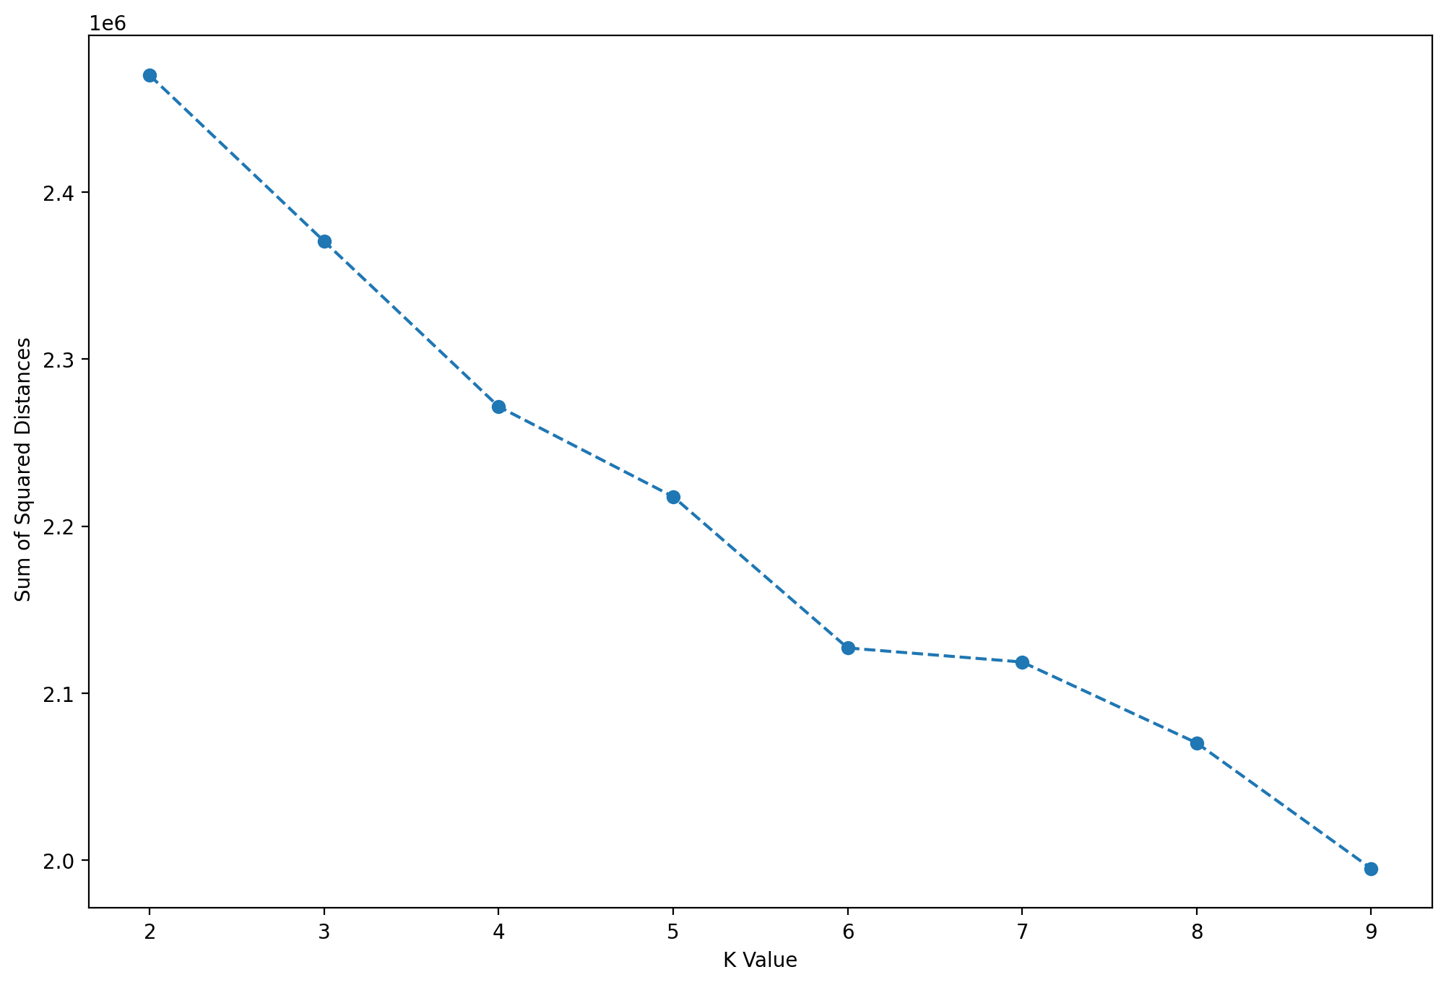
K Means Clustering
You will see a continuous decline.

Slide 87
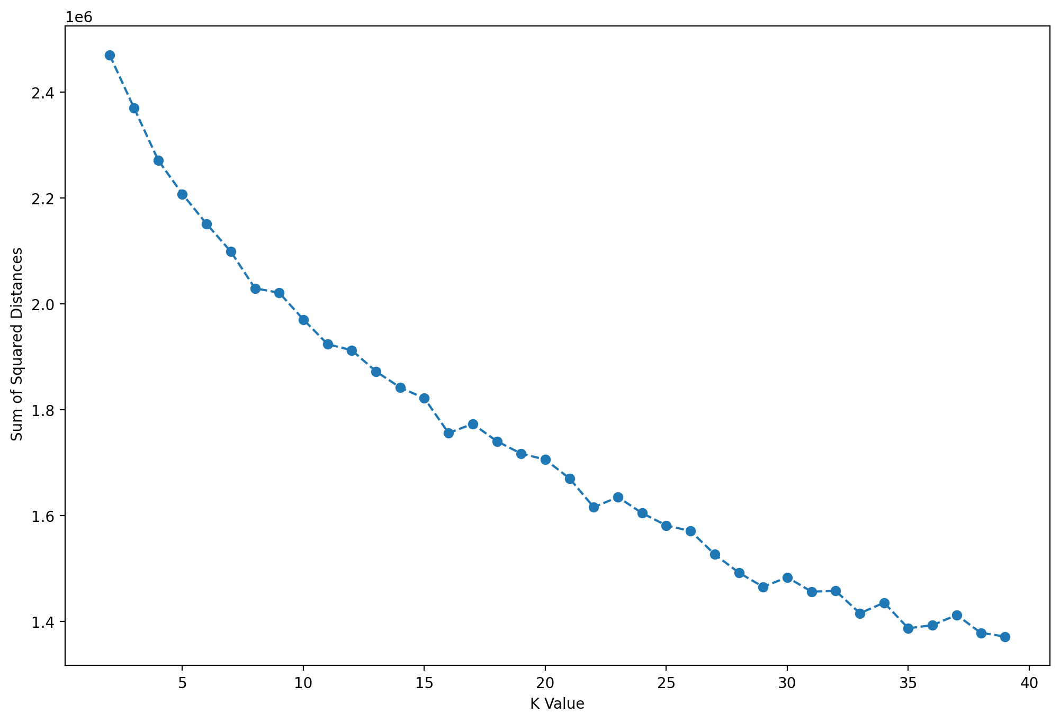
K Means Clustering
Eventually you will see “elbow” points:

Slide 88
K Means Clustering
Eventually you will see “elbow” points:

Slide 89
K Means Clustering
Eventually you will see “elbow” points:

Slide 90
K Means Clustering
Eventually you will see “elbow” points:

Slide 91
Clustering
These points are strong indicators that increasing K further is no longer justified as it is not revealing more “signal”.
You can also measure out this SSD in a barplot.
Let’s explore this further with code!

Slide 92
K-Means Clustering
Color Quantization
Part One: General Concepts

Slide 93
K Means Clustering
Unsupervised Learning provides opportunities for very creative use cases on algorithm applications.
Searching for insights, patterns, and general understanding of our data allows us to apply methods to a variety of tasks.

Slide 94
K Means Clustering
One interesting application of clustering is on image quantization.
Let’s discuss images, computers, colors, and quantization to get an idea of how K Means clustering can be applied to different fields.

Slide 95
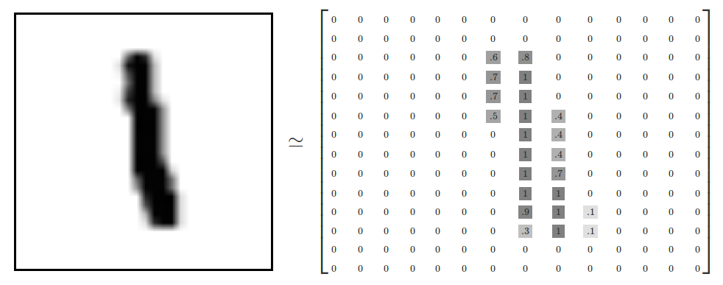
K Means Clustering
Imagine an image of a single pen stroke:

Slide 96
K Means Clustering
This image is in grayscale, meaning the color range goes from black to white.

Slide 97
K Means Clustering
You will notice on the edges there are gray colors between black and white.

Slide 98
K Means Clustering
A computer will store this information as an array with values between a range.

Slide 99
K Means Clustering
A computer will store this information as an array with values between a range.

Slide 100
K Means Clustering
Notice 0 is white and 1 is black, with values in between representing gray.

Slide 101
K Means Clustering
It is also very common for computers to store values from 0-255 for scales.

Slide 102
K Means Clustering
The range 0 to 255 has to do with how computers store 8-bit numbers.

Slide 103
K Means Clustering
But you can always divide all the values by 255 to normalize to between 0 and 1

Slide 104
K Means Clustering
Now that we’ve understood how grayscale images can be represented as arrays, what about color images?
Color images can be represented as a combination of Red, Green, and Blue.

Slide 105
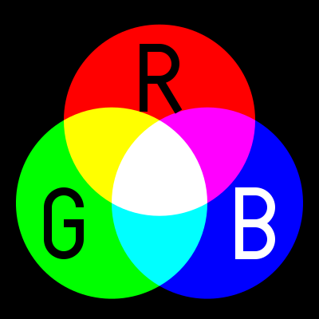
K Means Clustering
Additive color mixing allows a wide variety of colors by simply combining different amounts of Red, Green, and Blue.

Slide 106
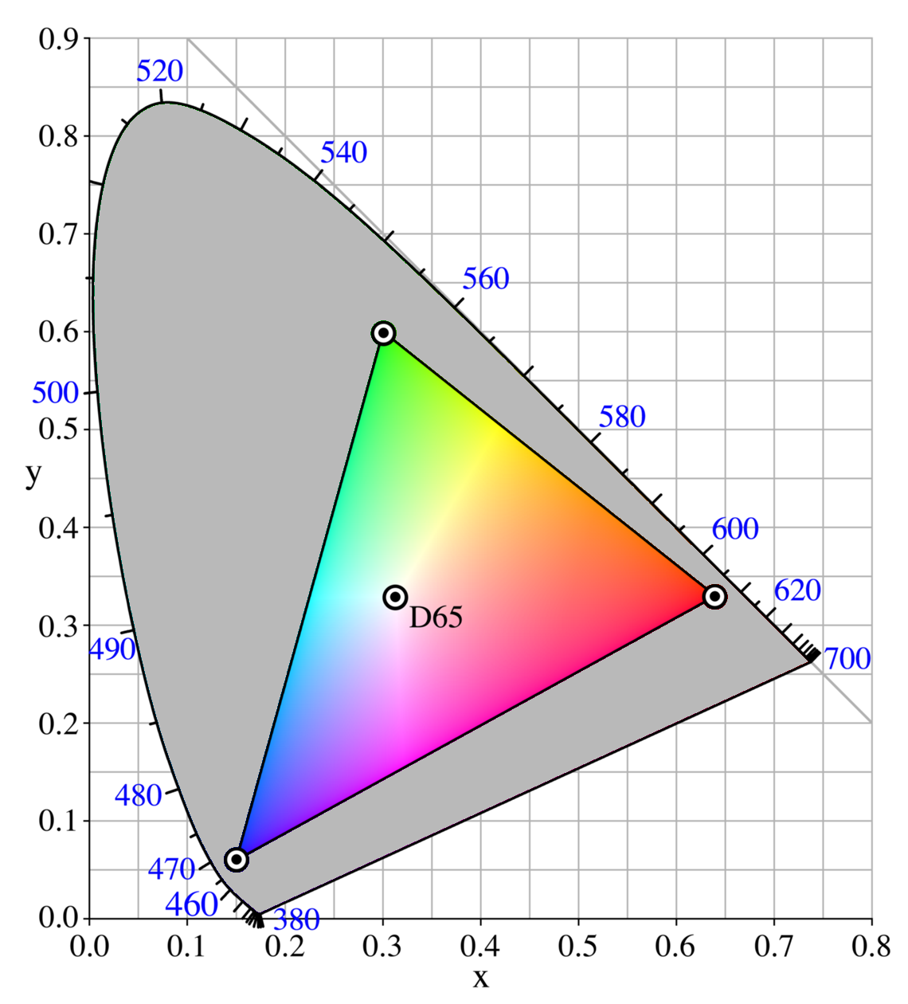
K Means Clustering
RGB can produce a range of colors

Slide 107

K Means Clustering
Each color channel will have intensity values.
You may have already seen this sort of representation in other software with RGB sliders.

Slide 108
K Means Clustering
Notice we now have 3 distinct values to track, with each value in a range (shown here from 0-255).
Combining RGB to produce a distinct color.

Slide 109
K Means Clustering
From a computer perspective, this looks like 3 arrays, each array representing a color channel.
For example, a single pixel (1 by 1 image) here is (213,111,56) for (R,G,B).

Slide 110
K Means Clustering
How is this stored for a larger color image?

Slide 111
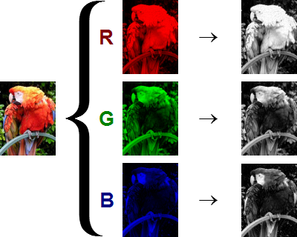
K Means Clustering
The shape of the color array then has 3 dimensions.
Height
Width
Color Channels

Slide 112
K Means Clustering
This means when you read in an image and check its shape, it will look something like:
(1280,720,3)
1280 pixel width
720 pixel height
3 color channels

Slide 113
K Means Clustering
This means when you read in an image and check its shape, it will look something like:
(720,1280,3)
720 pixel height
1280 pixel width
3 color channels
1st
3rd
2nd

Slide 114
K Means Clustering
Keep in mind the computer won’t “know” a channel is Red, it just knows that there are now 3 intensity channels.

Slide 115
K Means Clustering
The user needs to dictate which channel is for which color.
Each channel alone is essentially the same as a grayscale image.

Slide 116
K Means Clustering
From the computer’s perspective you simply have an array with 3 dimensions, where a user or display function can attribute each dimension to a color channel (e.g. red intensity).

Slide 117
K Means Clustering
Swapping these arrays across channels would allow for effects such as color inversion.
Now how can we apply clustering to RGB color channels and images?

Slide 118
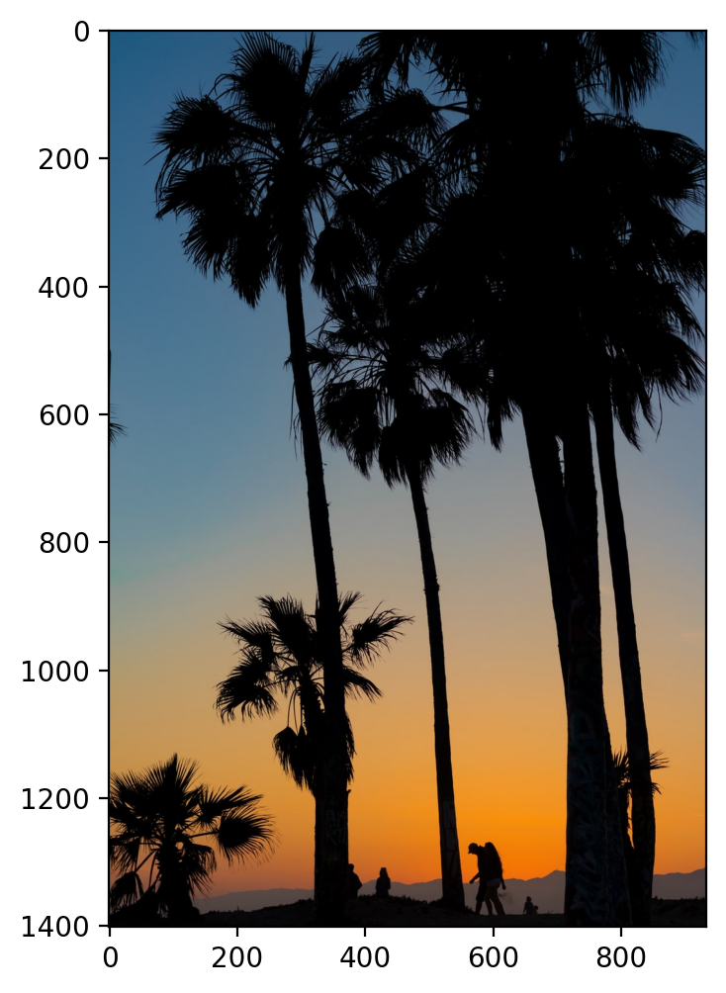
K Means Clustering
Imagine the following image:

Slide 119
K Means Clustering
There are many shades of colors in this image, with many (R,G,B) combinations.

Slide 120
K Means Clustering
What if we wanted to reduce this to 6 colors for simplified display purposes?

Slide 121
K Means Clustering
What if we wanted to compress the image for a smaller screen with less colors?

Slide 122
K Means Clustering
Recall the image is a 3D array (H,W,C):

Slide 123
K Means Clustering
Recall the image is a 3D array (H,W,C):
W
H

Slide 124
K Means Clustering
Recall the image is a 3D array (H,W,C):
W
H

Slide 125
K Means Clustering
Each pixel has an RGB value to create a color:
212 | 132 | 35 | 67
... | ... | ... | ...
 |  |  | ...
 |  |  | ...
45 | 89 | 231 | 14
... | ... | ... | ...
 |  | ... | ...
 |  | ... | ...
100 | 231 | 46 | 34
... | ... | ... | ...
... | ... | ... | ...
... | ... | ... | ...

Slide 126
K Means Clustering
We can reshape the image to an X array feature set, with features R,G,B:
212 | 132 | 35 | 67
... | ... | ... | ...
 |  |  | ...
 |  |  | ...
45 | 89 | 231 | 14
... | ... | ... | ...
 |  | ... | ...
 |  | ... | ...
100 | 231 | 46 | 34
... | ... | ... | ...
... | ... | ... | ...
... | ... | ... | ...

Slide 127
K Means Clustering
We can reshape the image to an X array feature set, with features R,G,B:
R | G | B
100 | 15 | 132
231 | 23 | 78
... | ... | ...
46 | 243 | 164
34 | 145 | 67

Slide 128
K Means Clustering
We can reshape the image to an X array feature set, with features R,G,B:
R | G | B
100 | 15 | 132
231 | 23 | 78
... | ... | ...
46 | 243 | 164
34 | 145 | 67

Slide 129
K Means Clustering
We can reshape the image to an X array feature set, with features R,G,B:
W
R | G | B
100 | 15 | 132
231 | 23 | 78
... | ... | ...
46 | 243 | 164
34 | 145 | 67
H
H x W

Slide 130
K Means Clustering
We then choose a K value of colors and use K Means clustering to create labels:
R | G | B
100 | 15 | 132
231 | 23 | 78
... | ... | ...
46 | 243 | 164
34 | 145 | 67

Slide 131
K Means Clustering
We then choose a K value of colors and use K Means clustering to create labels:
R | G | B | Cluster
100 | 15 | 132 | 0
231 | 23 | 78 | 1
... | ... | ... | ...
46 | 243 | 164 | 2
34 | 145 | 67 | 0

Slide 132
K Means Clustering
Recall each cluster also has a center in the N dimensional feature space:
R | G | B | Cluster
100 | 15 | 132 | 0
231 | 23 | 78 | 1
... | ... | ... | ...
46 | 243 | 164 | 2
34 | 145 | 67 | 0

Slide 133
K Means Clustering
Meaning each cluster center is an average (R,G,B) value we can use for reassignment!
R | G | B | Cluster
100 | 15 | 132 | 0
231 | 23 | 78 | 1
... | ... | ... | ...
46 | 243 | 164 | 2
34 | 145 | 67 | 0

Slide 134
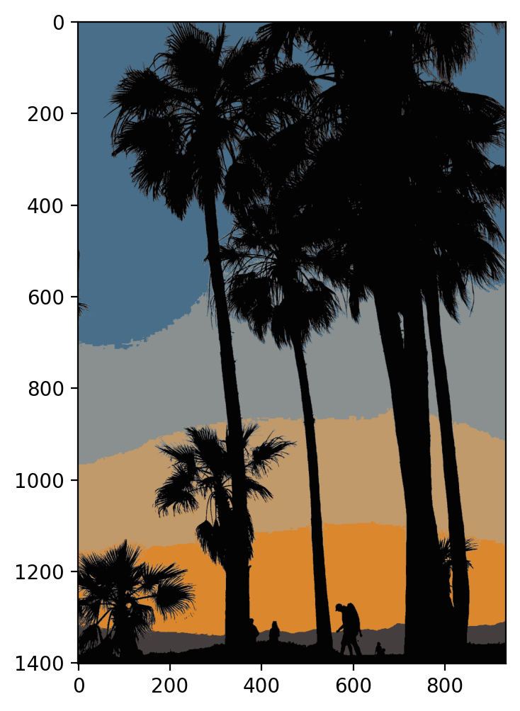
K Means Clustering
We can then grab each data point and convert it to the same value as the center.

Slide 135
K Means Clustering
This directly reduces to K color values (known as quantization).

Slide 136
K Means Clustering
Let’s explore this in practice in the next lecture!

Slide 137
K-Means Clustering
Color Quantization
Part Two: Coding

Slide 138
K-Means Clustering
Exercise Overview

Slide 139
K-Means Clustering
Exercise Solutions
Part Three

