Slide 1
Automated Essay Grading System
CS550 - Introduction to Machine Learning
By : Team Vectors
Mohit Sharma (11840730)
Vivek Singh (11841240)
Notes:
Hello

Slide 2
Index :
Introduction
Objective
Dataset Description
Structure of Dataset
Pre-Processing Steps
Methodology
Results
Future Directions

Slide 3
Introduction
Essays are crucial testing tools for assessing academic achievement, integration of ideas, styles of writing, creativity and ability to recall, but are expensive and time consuming to grade manually.
The subjective nature of essay assessment leads to variation in grades awarded by human assessors, which is perceived by students as a source of unfairness.

Slide 4
Objective
Given an essay, our aim is to evaluate it and give a qualitative score.
The grading system should be consistent in the way it scores essay.
While scoring the essay, the system should consider multiple attributes of the essay to grade it.

Slide 5
Dataset
The dataset we used is made available on the internet by The William and Flora Hewlett Foundation for one competition on Kaggle.com( link)
The dataset consists of 12978 essays on different topics.
The essays were bifurcated into 8 sets to ensure that the automated grader is trained effectively across different types of essays.
Each essay is approximately 150 to 550 words in length. Some essays are more dependent upon source materials than others.

Slide 6
5. Essays in each of the 8 sets have unique characteristics that are used for grading.
6. Each essay has one or more human scores and a final resolved score, which is used to train our model.
7. Each essay set is very different in terms of marking scale used and essay content and essay topic is also different for different sets.

Slide 7
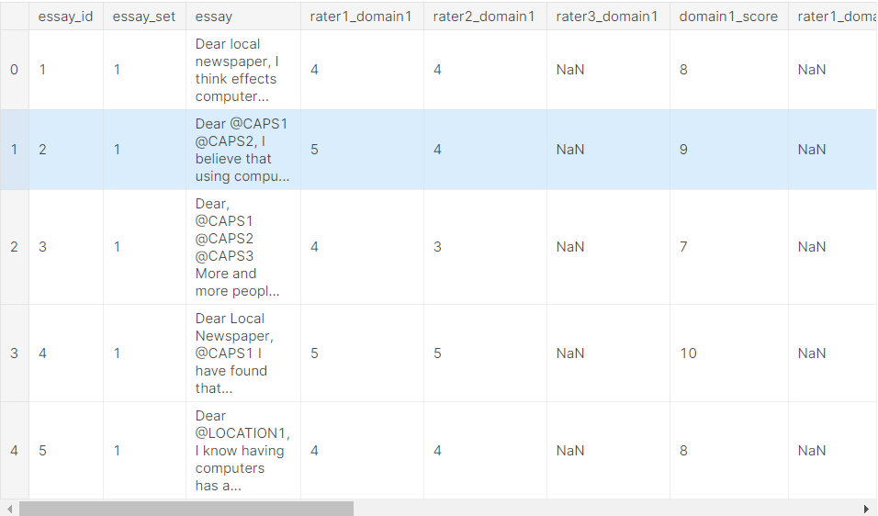
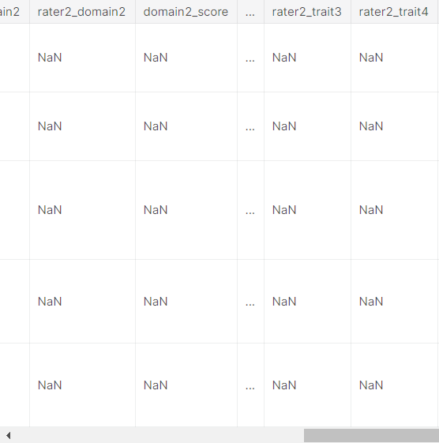
Structure of Dataset

Slide 8
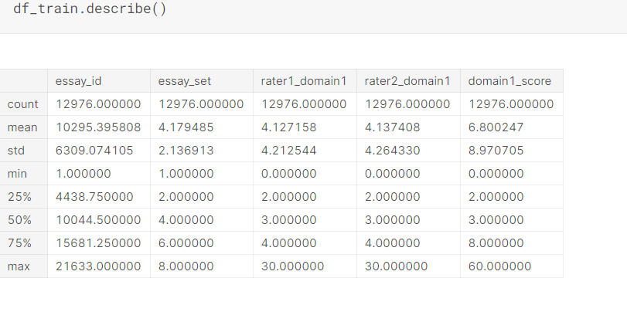

Slide 9
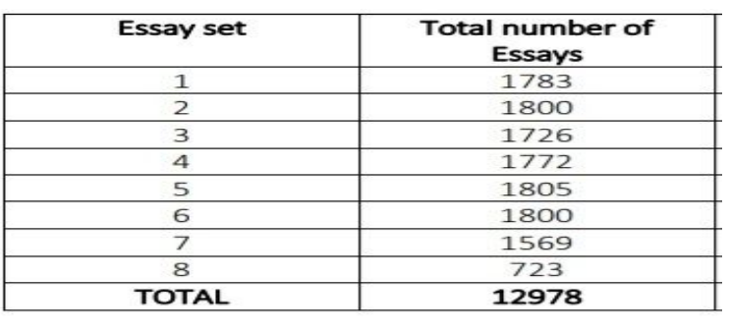

Slide 10

Preprocessing Steps
Since a large number of columns in our raw dataset consists more than 70% null/missing values, so we remove those columns from the dataset.

Slide 11
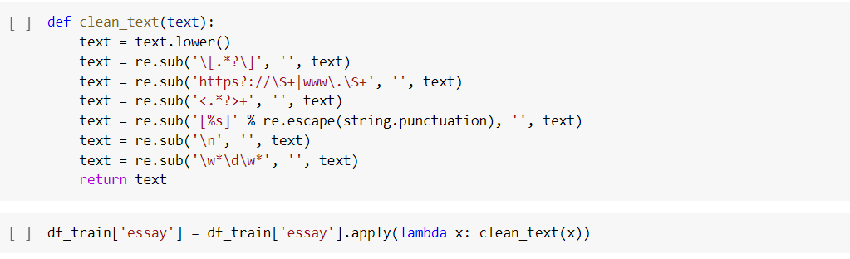
2. Since a lot of garbage characters were there in the essays, so in the next step we clean our text by removing those characters.

Slide 12
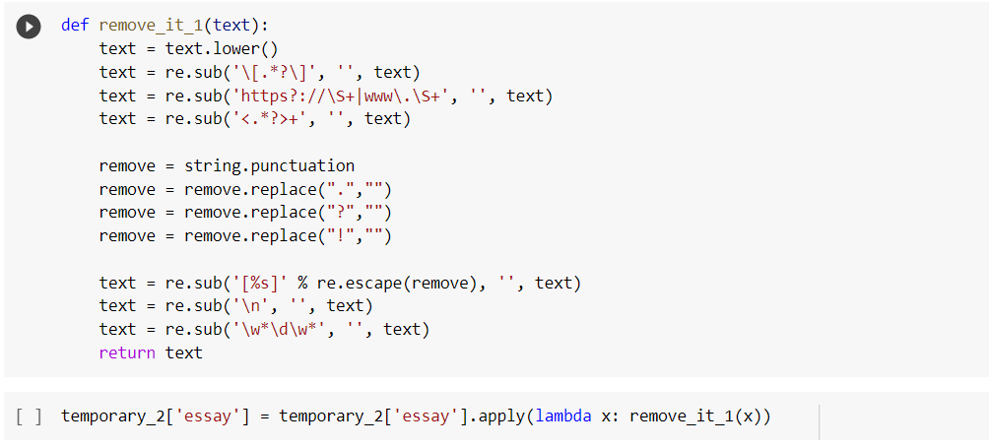
3. In this step, we remove all the punctuation except ?,!,. because
they are used to count the total number of sentences in the essay.

Slide 13
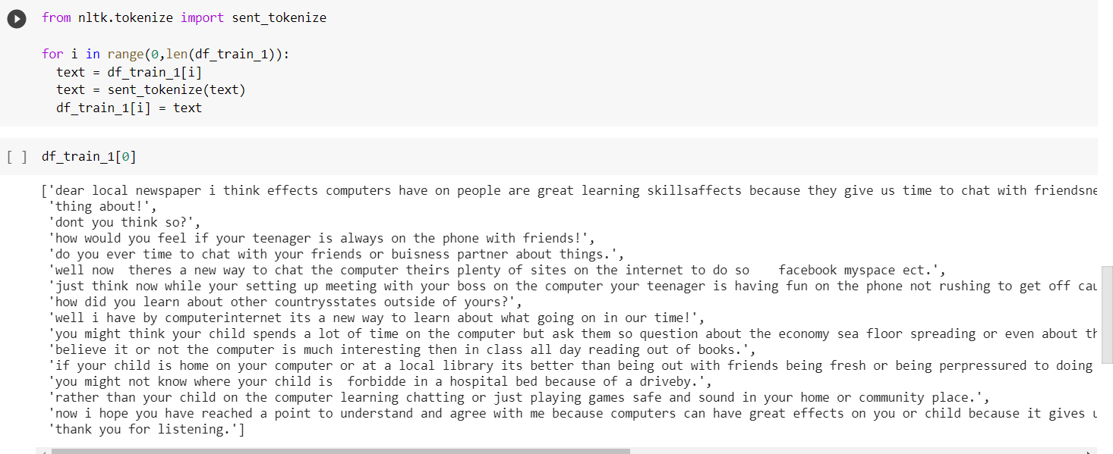
4. In the next step, we tokenize our essay into sentences, and count the number of commas, brackets, punctuation marks, and quotation are there in the essay.

Slide 14
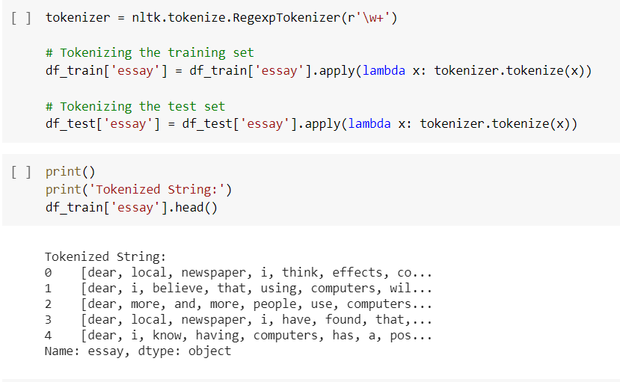
5. In this step, we tokenize the essay into words, for easily extracting our features.

Slide 15
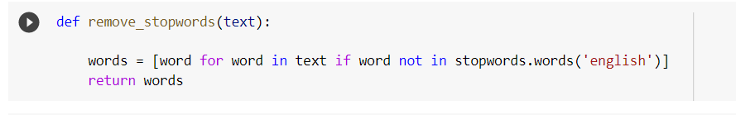
6. In the last step of Pre-processing our data, we remove all the stopwards from the essay, as they don’t add significant meaning to the text.

Slide 16
Feature Extraction
Features of essay are:
Sentence
Word
Long word
Average word length
Comma
Exclamation
Bracket
Punctuation
Quotation
Verb
Adverb
Noun
Pronoun
Adjective
Foreign words
Wrong Spellings

Slide 17
Features 1 to 4 indicate language fluency and dexterity of essay.
Features 5 to 9 are good indicators of a structured and well organised essay.
Features 10 to 14 are part of speech of essay and these are good proxies to test vocabulary.
Features 15 and 16 indicate command over language and facility of use.

Slide 18

Input to feature extraction module:

Slide 19
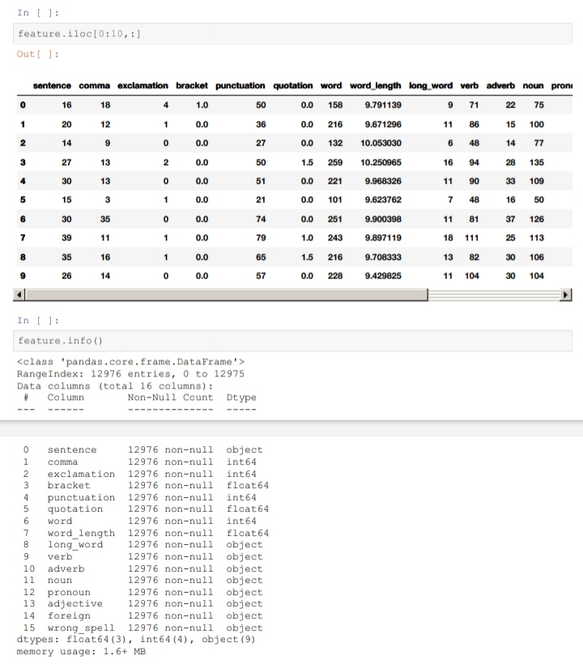
Output of feature extraction module:

Slide 20
Input to model used:

Slide 21
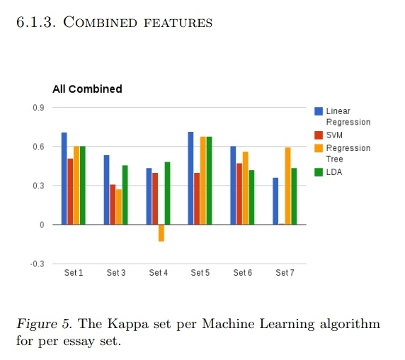
Methodology
Models available:

Slide 22
Why Linear Regression Model?
Accuracy of linear regression model is quite good
as compared to SVM, Decision trees.
Further features chosen are linearly related to
human graded score.

Slide 23
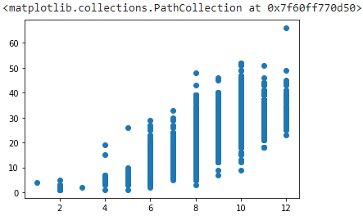
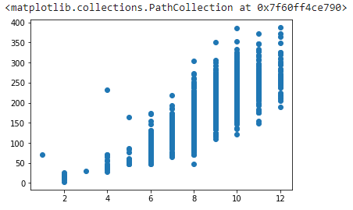
Y-axis: Sentence Count
X-axis: Actual Score
Y-axis: Word Count
X-axis: Actual Score

Slide 24
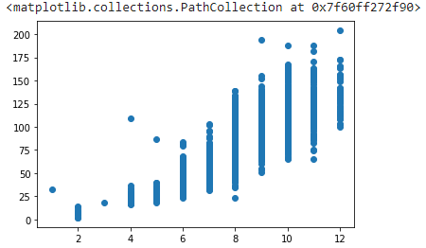
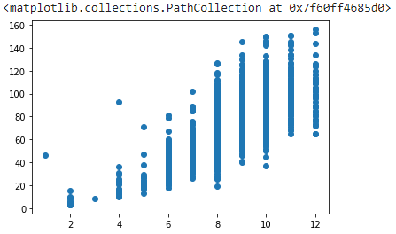
Y-axis: Noun Count
X-axis: Actual Score
Y-axis: Verb Count
X-axis: Actual Score

Slide 25
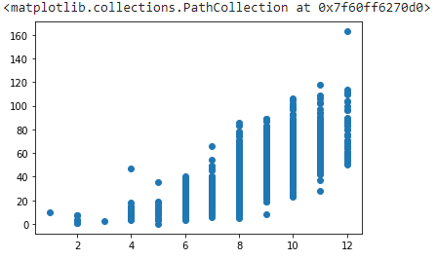
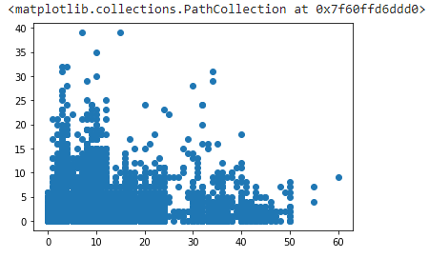
Y-axis: Punctuation count
X-axis: Actual Score
Y-axis: Wrong spelling
X-axis: Actual Score

Slide 26
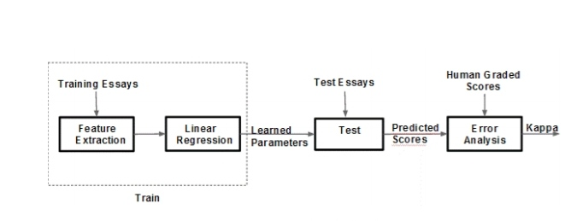
Architecture of Model:

Slide 27
How each Module is working in Model:
Feature extraction module takes cleaned essays(13000) as input and computes all the features like word count, verb count, etc per essay.
Linear regression module takes output from feature extraction module as input and learns model parameters. Model parameters is calculated independently for each essay set. This was done as marking scale of human graded score is different for each essay set(1-8).
Test module uses 10% of original training set as test set and remaining 90% is used to train the model. Then scores for test sets are predicted by model.
Finally Error Analysis module computes error in predicted scores against human graded score. RMSE, Max AE are used as error metric.

Slide 28
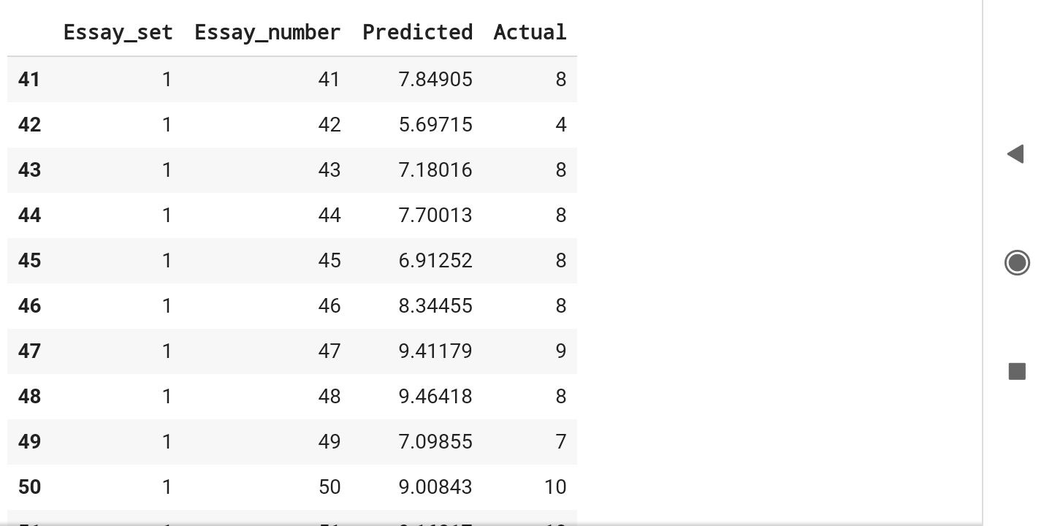
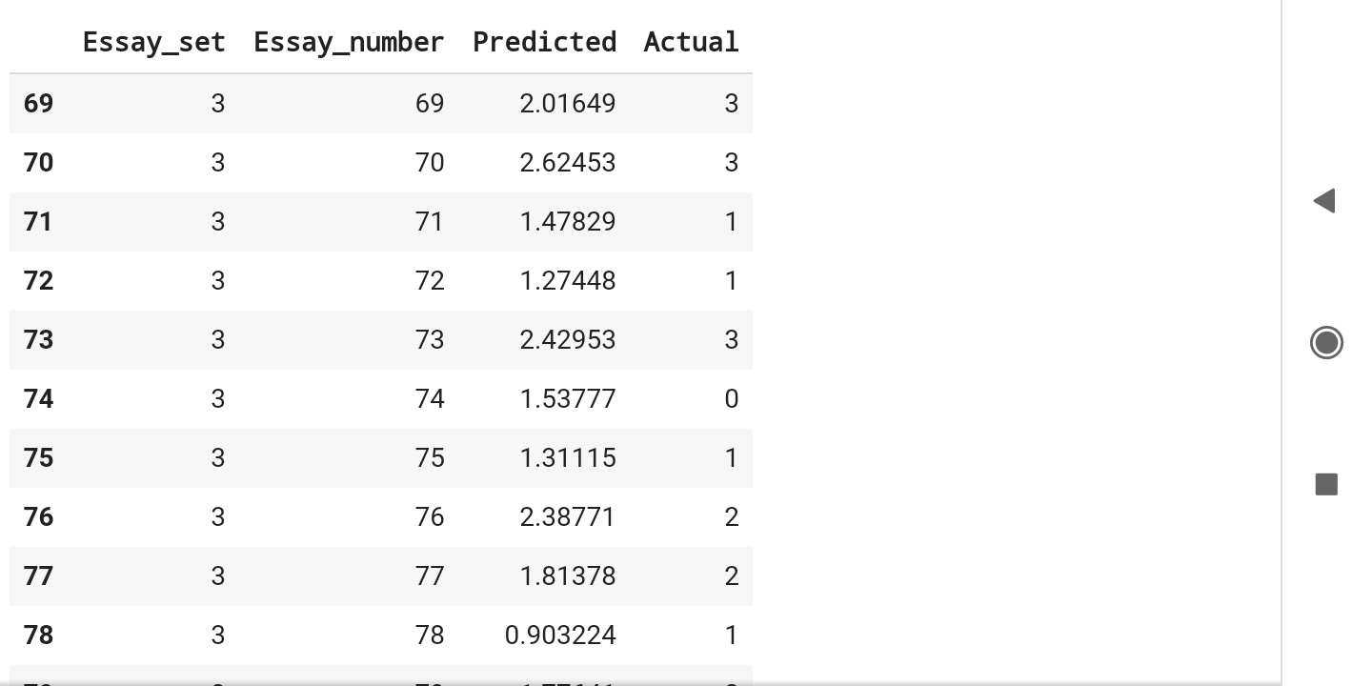
Results:
Predicted Score:
Set 1
Set 3

Slide 29
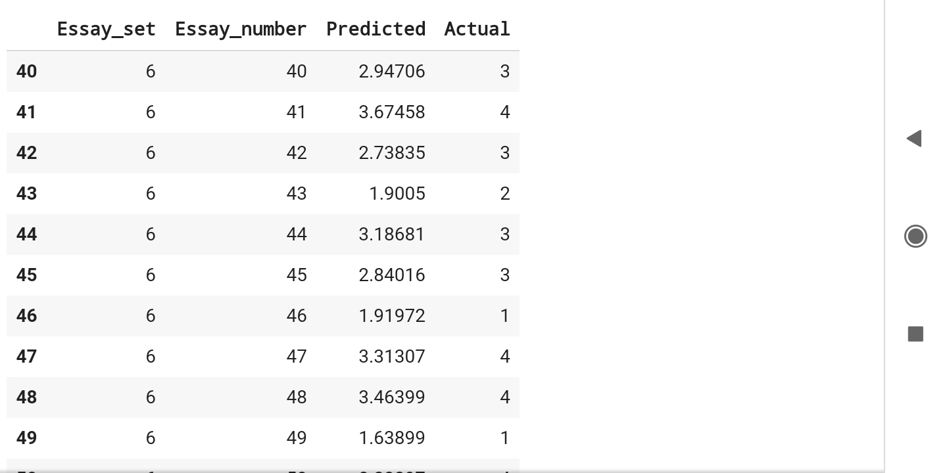
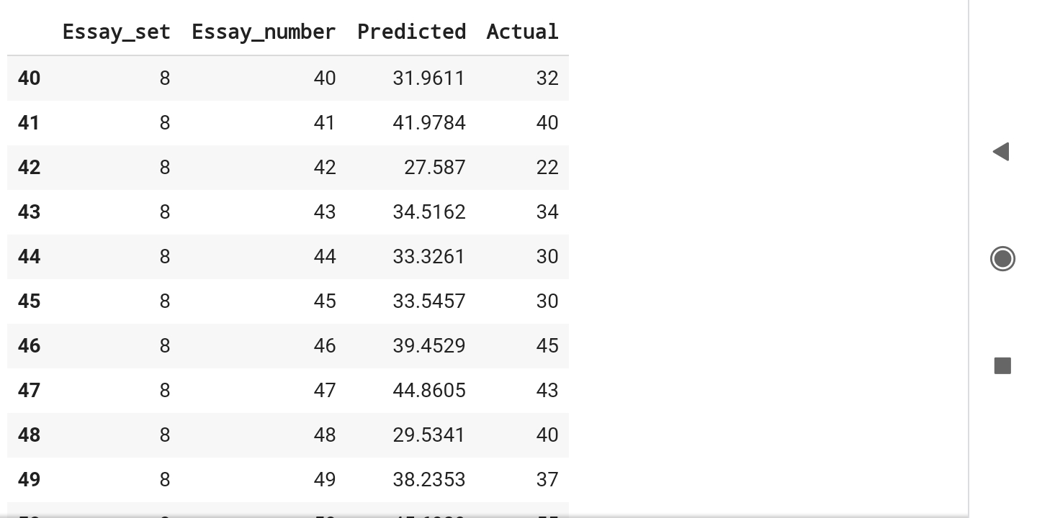
Predicted Score:
Set 6
Set 8

Slide 30
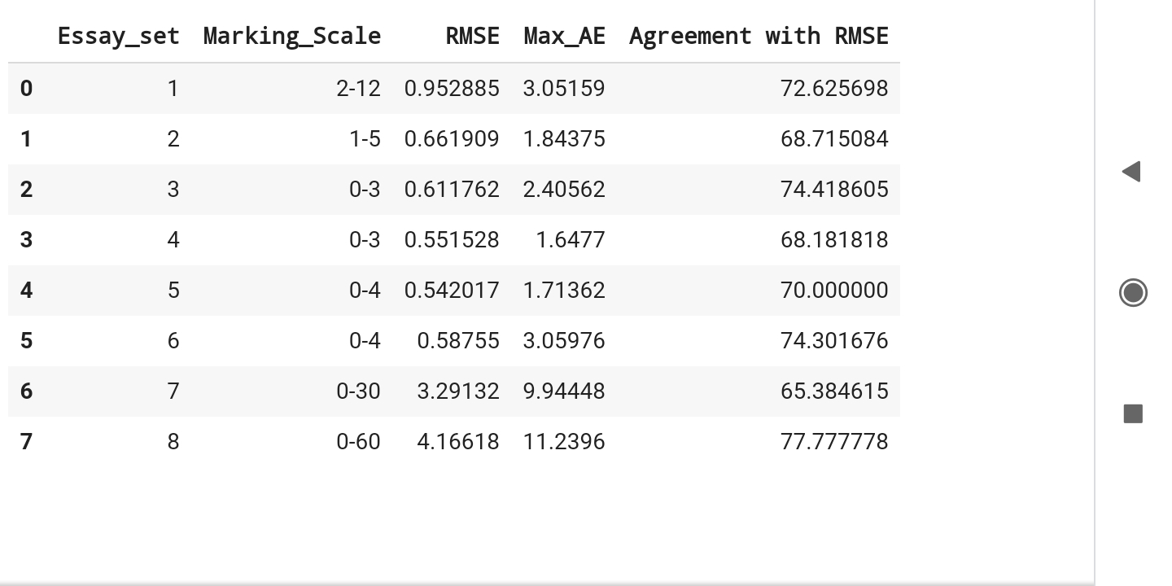
Error Analysis:
Error Set-Wise

Slide 31
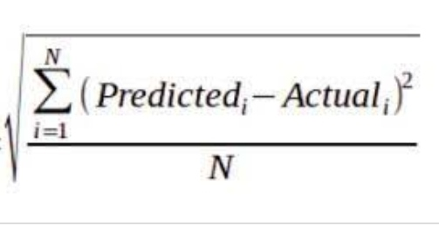
Root Mean Square Error (RMSE)
Maximum Absolute Error (Max_AE) | max( | Predicted_{i} - Actual_{i} | ) 1<=i<=N
Agreement with RMSE | (M/N)x100
N = total number of essays in a particular test essay set(1-8).
M = total number of essays in a essay set whose | Predicted - Actual | <= RMSE
of that essay set.

Slide 32
Future Direction:
Our model works relatively better on non-context specific essays. Performance on content specific and richer essays can be improved by incorporating content and advanced NLP features like Bag of Words(BoW), bi-gram, tri-gram etc. Features that are grammar and usage specific can further enhance the prediction model.
Our future work is on incorporating advanced NLP features in our model to improve prediction score mainly in set 7 and 8 which are content specific and richer essays and have complex sentence structure.

Slide 33
THANK YOU
Any Question ?

