Slide 1
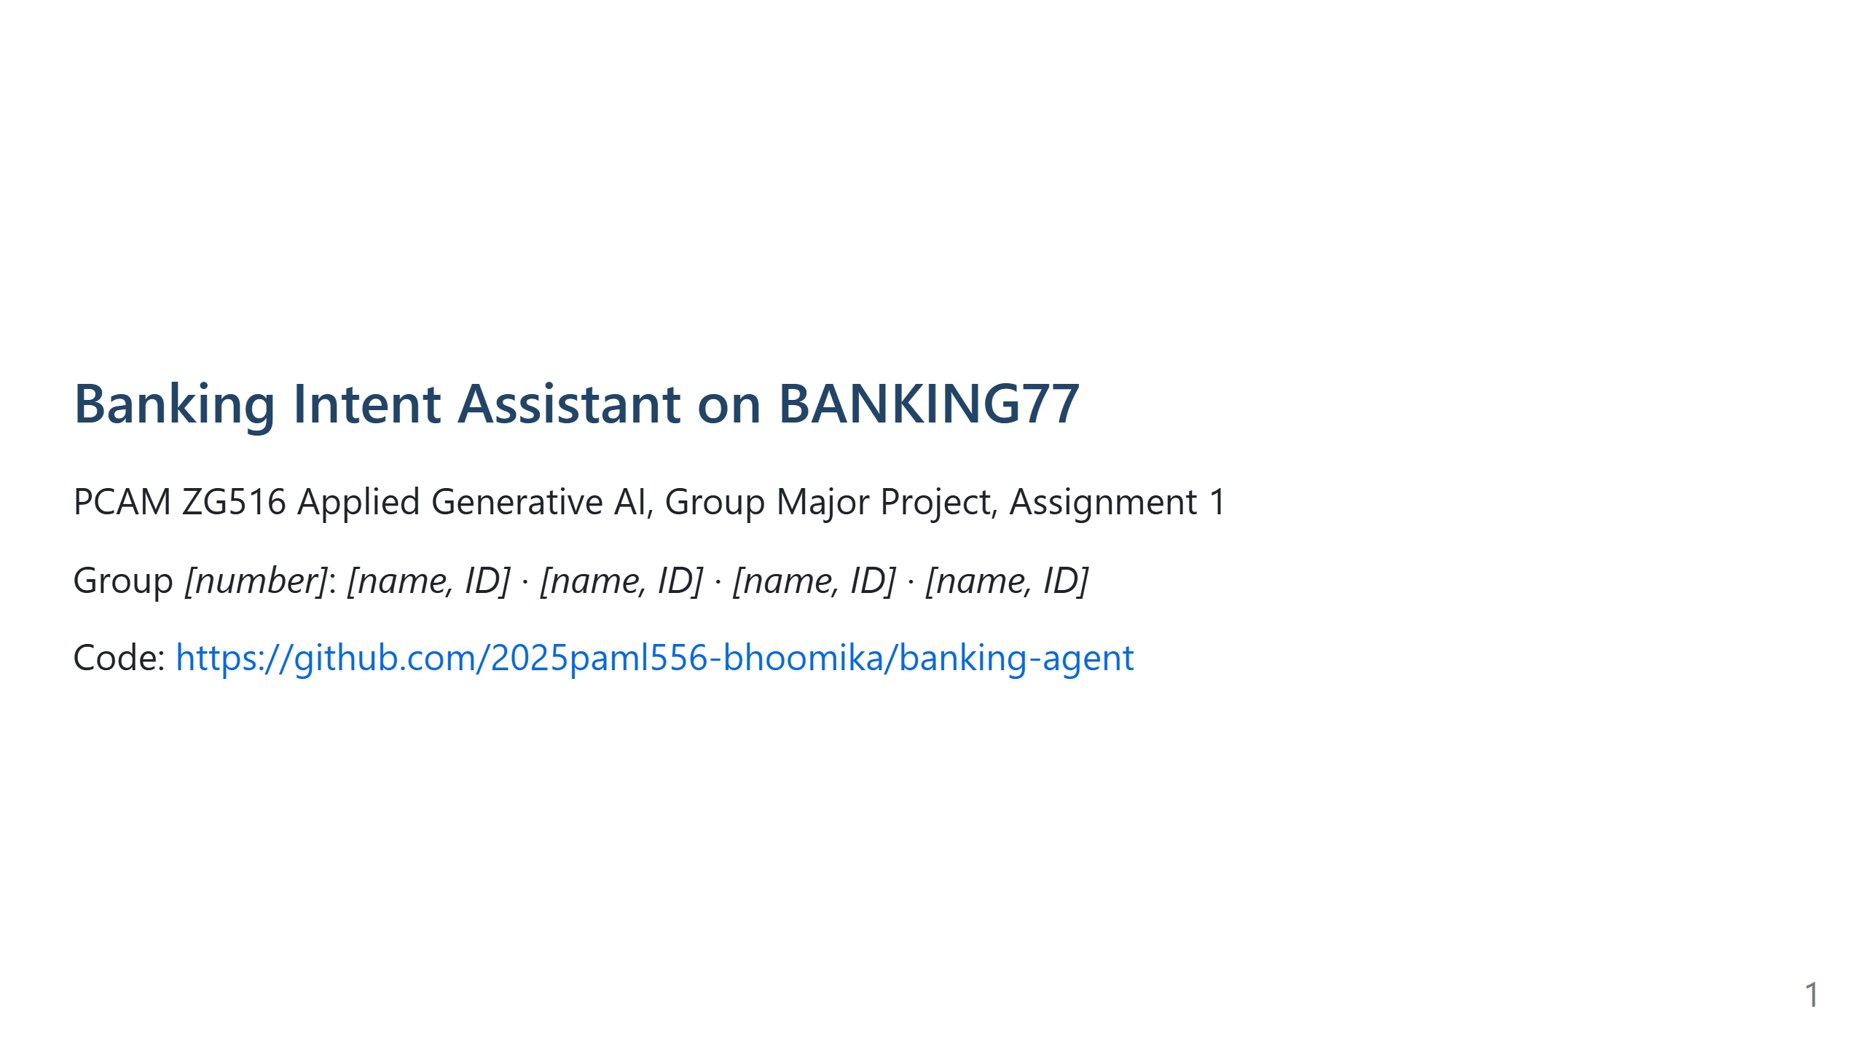
Notes:
0:30. One sentence: a customer writes one free-text message, the assistant finds the intent, calls the right tool, and replies.

Slide 2
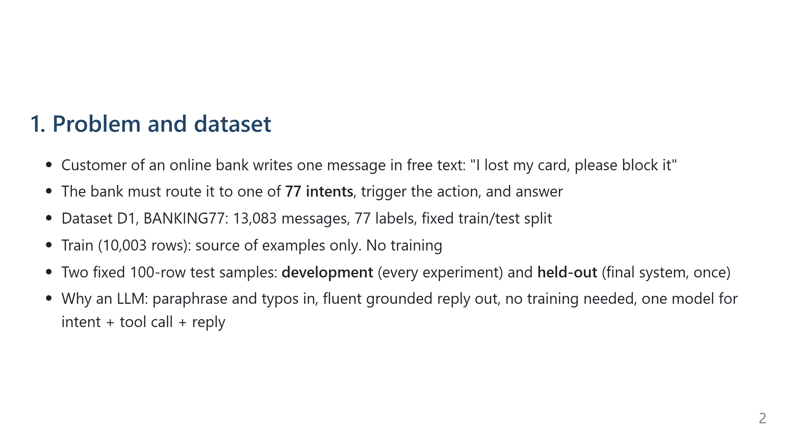
Notes:
1:00. Point out that the held-out set was never touched until the end.

Slide 3
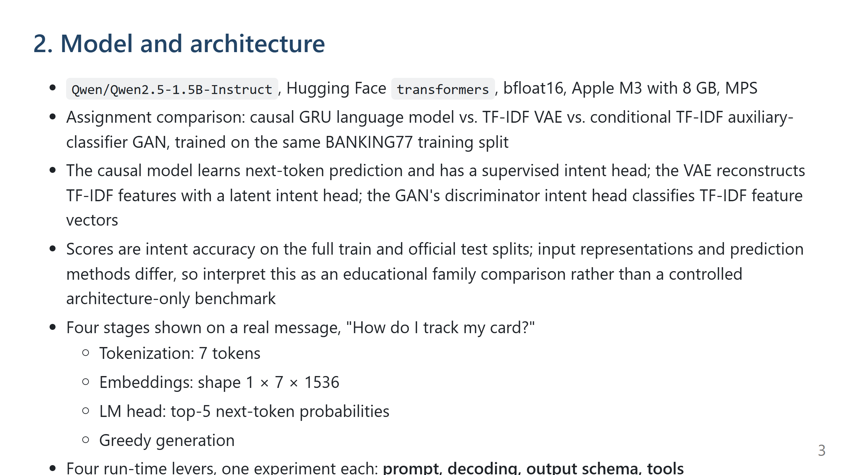
Notes:
1:00. The notebook section 2 prints these four stages live.

Slide 4
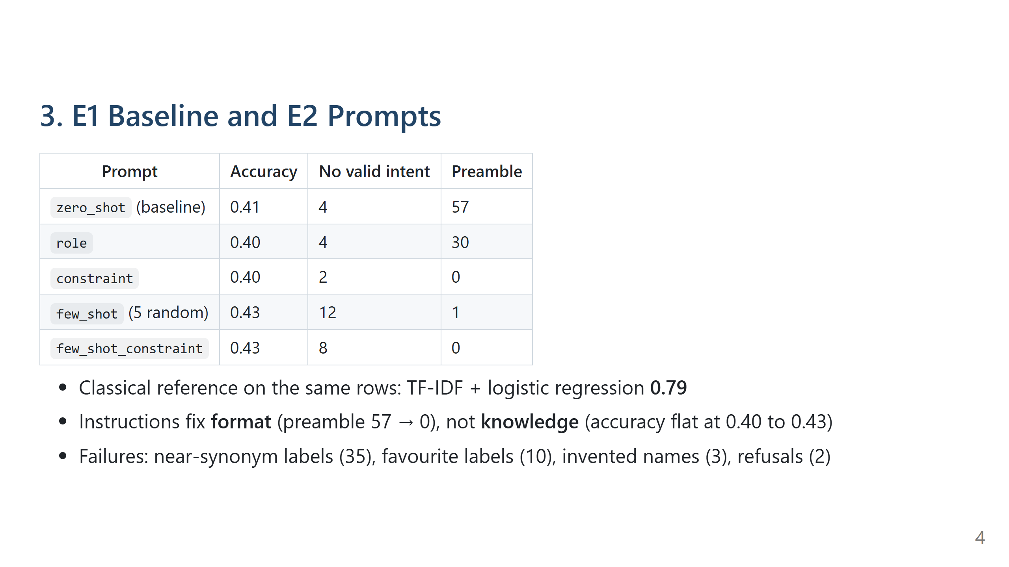
Notes:
1:00. The one message to quote: "track my card" → card_delivery_estimate instead of card_arrival. The names alone do not say where the boundary is.

Slide 5
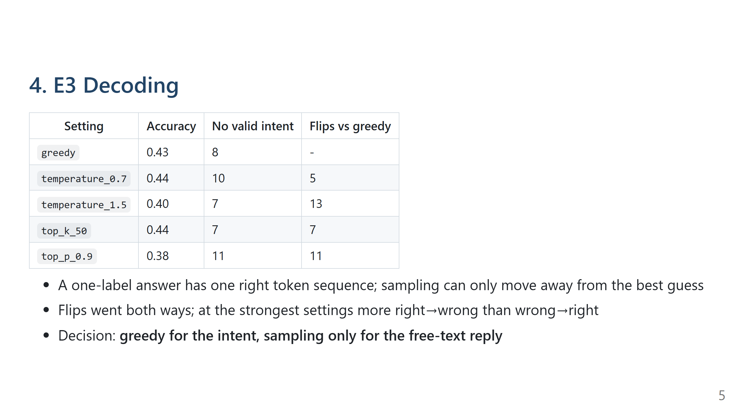
Notes:
0:45.

Slide 6
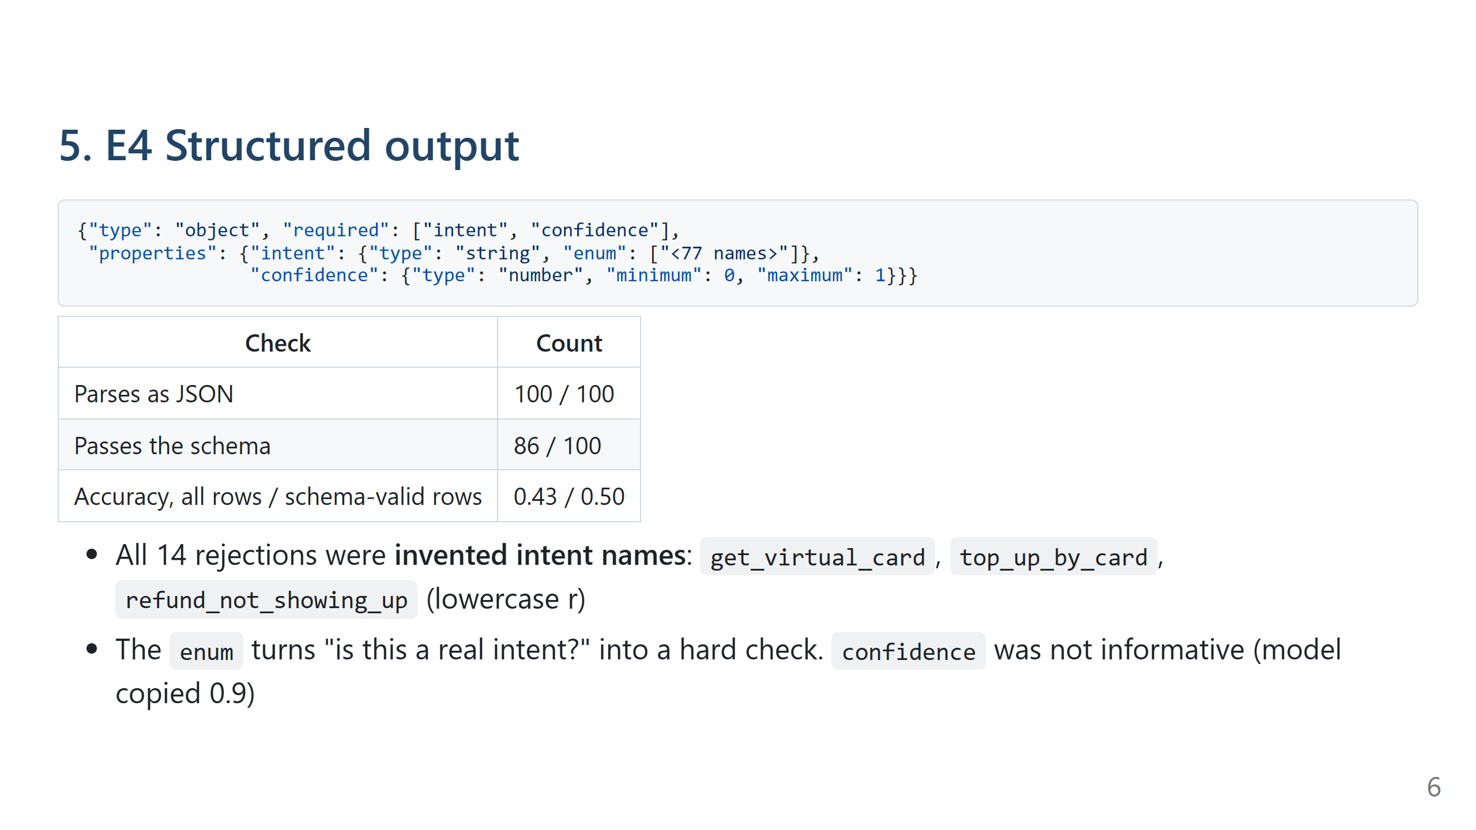
Notes:
0:45. Hallucination in the classification setting: the model generates a value that looks right instead of selecting one.

Slide 7
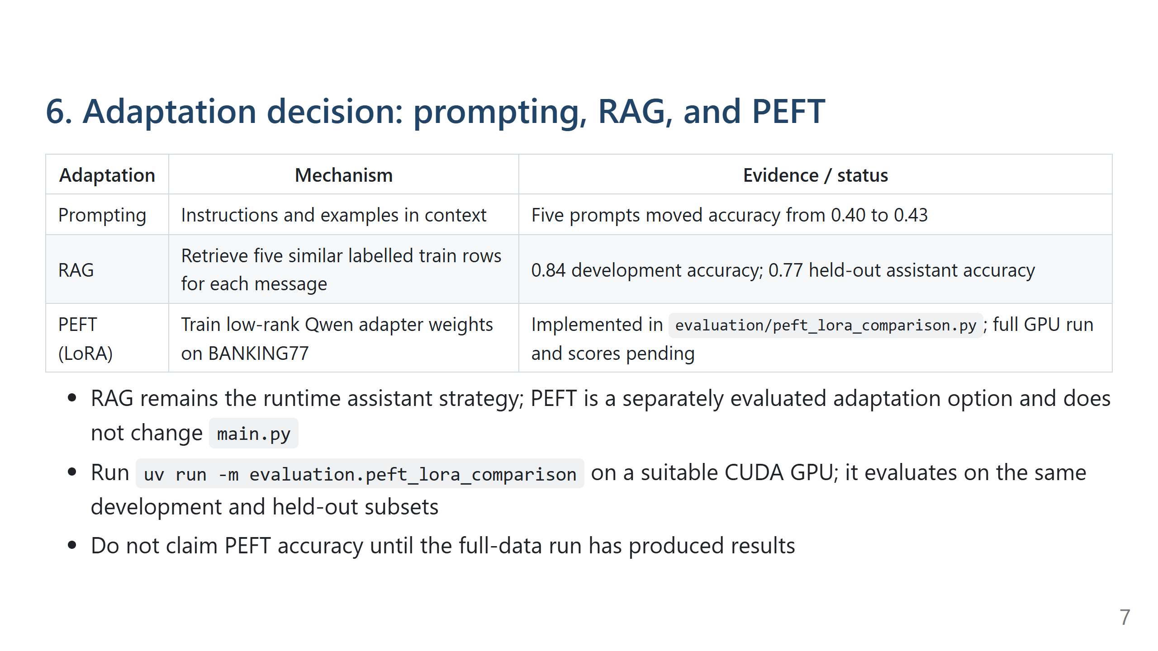
Notes:
1:15. Explain the three approaches; identify PEFT results as pending until run.

Slide 8
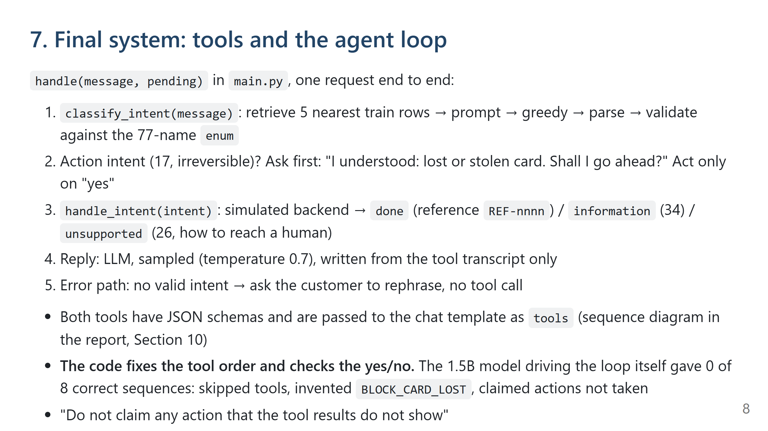
Notes:
1:00. Live demo here if time: `uv run ui.py`, type "I lost my card, please block it", then "yes".

Slide 9
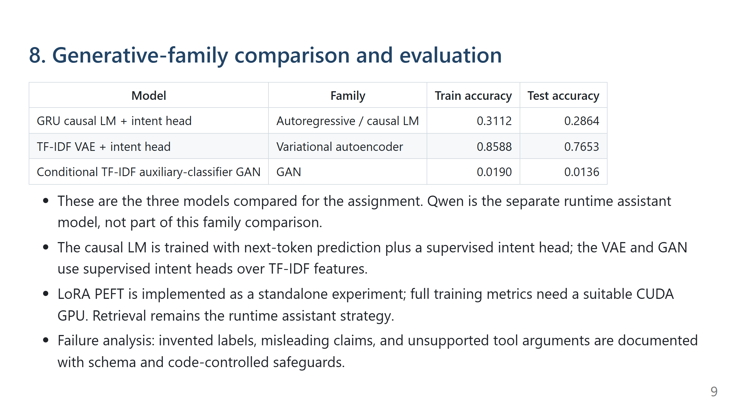
Notes:
The metrics are the verified six-epoch, seed-17 run in the generated CSV.

Slide 10
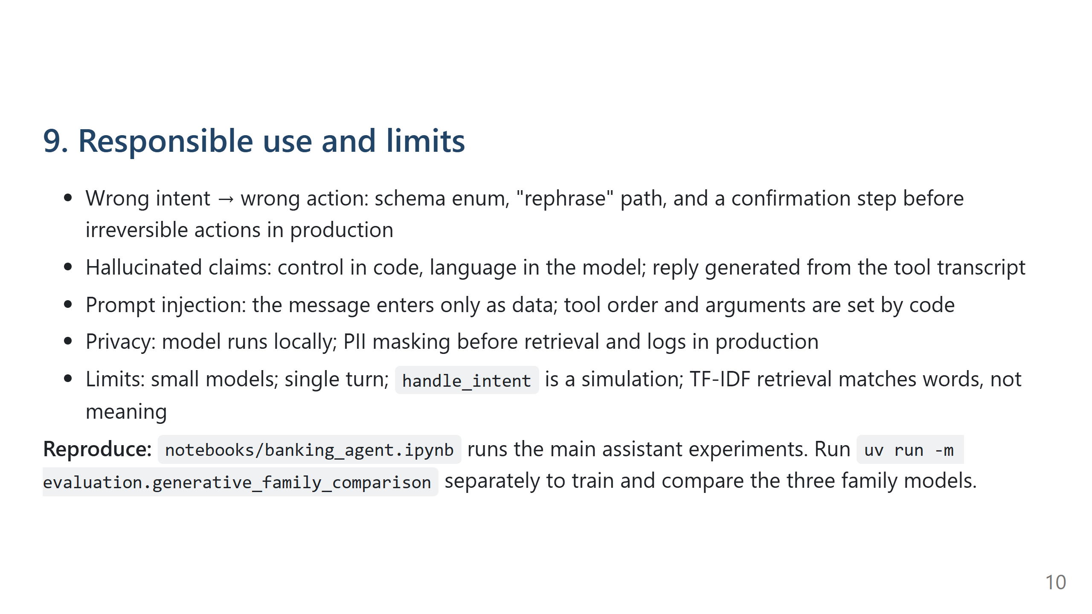
Notes:
0:45. Close with the three principles: control in code, validate at the boundary, fail towards a human.

Slide 11
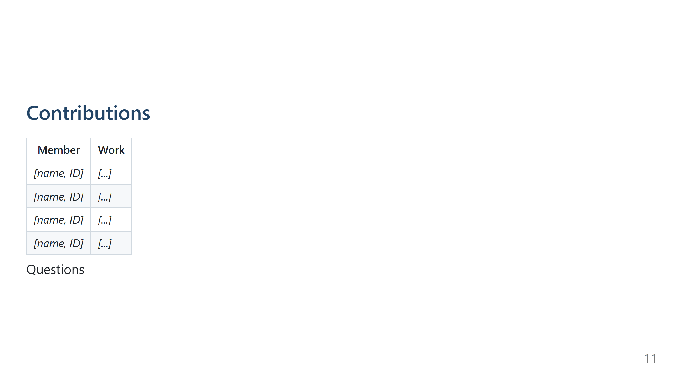
Notes:
Total: about 9 minutes.

