Slide 1

Brewediq Coffee
Coffee Shop Sales Analysis
By- Mohit Vaidya

Slide 2
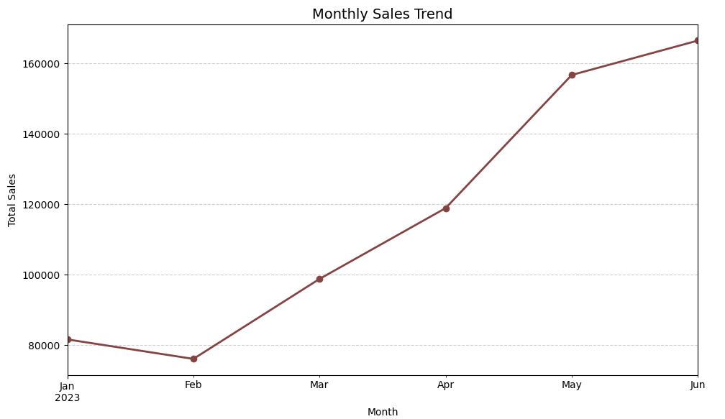
Monthly Sales Trends Over Time
January to February: Sales dropped slightly. This could be due to post-holiday season slowdown.
February to March: Strong recovery , showing increasing customer activity.
March to April: Continued steady growth.
April to May: Sharp rise. This is the biggest jump, possibly due to promotions, seasonal events, or increased demand.
May to June: Growth continued , but at a slower rate compared to April–May.

Slide 3
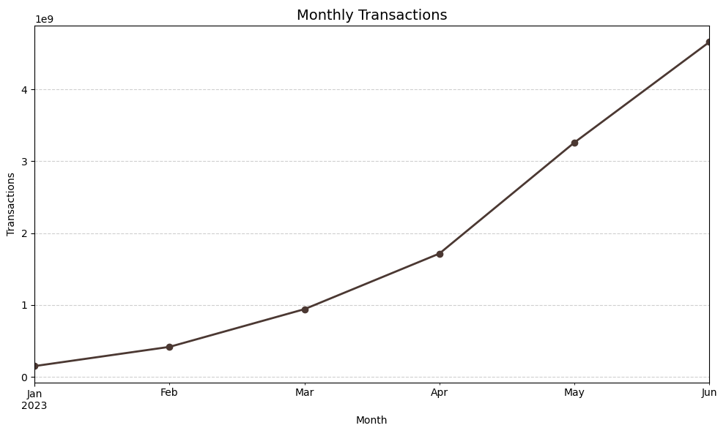
Monthly Transaction Trend
There is a clear upward trend in the number of transactions from January to June.
The transactions start at approximately 140 million in January.
There is steady growth observed each month.
The transaction count significantly rises between April and May
The data indicates rapid growth in monthly transactions over the first half of 2023.

Slide 4
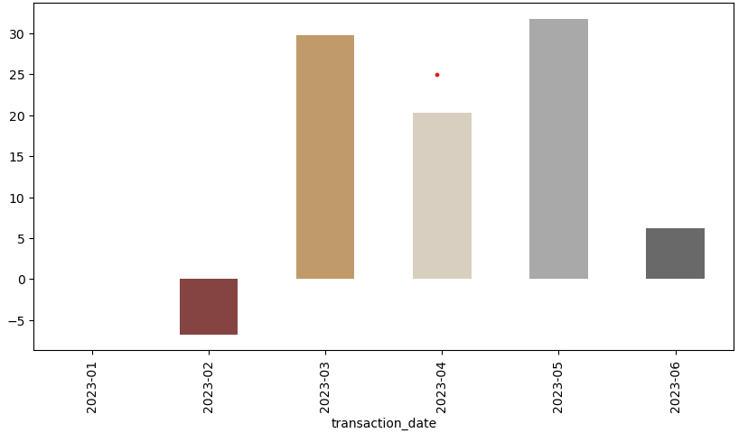
Month-Over-Month Growth Rate
February dip
Sales growth turned negative (~ -6%) compared to January.
Indicates a slowdown right after the initial start — possibly seasonal or post-holiday effects.
Strong rebound in March
Growth jumped to ~30%, showing a sharp recovery.
Likely due to successful campaigns, new demand, or seasonality.
Sustained positive growth (April & May)
May hit the highest growth (~32%), marking a peak performance month.
June slowdown
Growth dropped to only ~6%.
While still positive, the sharp decline suggests cooling demand or early signs of plateauing

Slide 5
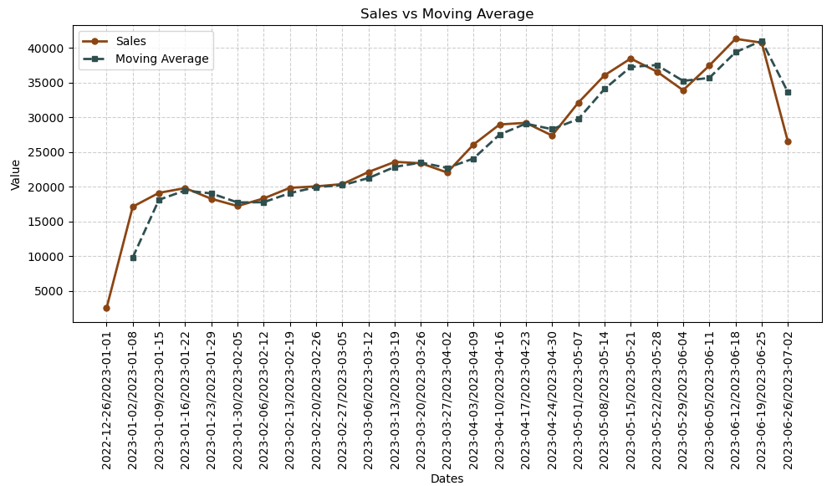
Moving Average
Sales are steadily increasing from the beginning of 2023 until around mid-June 2023.
The curve shows consistent upward momentum, peaking towards June 2023.
The moving average smooths out short-term fluctuations, providing a clearer long-term trend.
Both lines track very closely, which means there is not much extreme volatility in sales.
The sales line (brown) fluctuates more sharply compared to the moving average
The company/product is growing well overall, with sales nearly doubling from February to June.
The moving average indicates strong long-term growth, despite short-term dips.

Slide 6
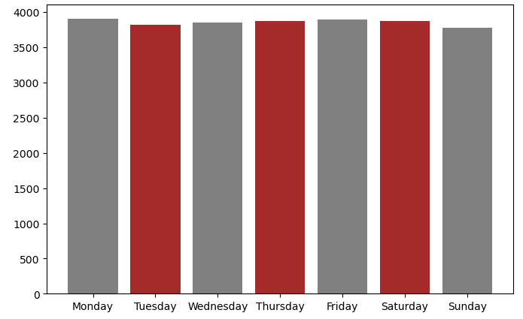
Average Daily Analysis
Sales are fairly uniform across all days of the week.
No extreme highs or lows → demand is steady.
Monday, Friday, and Saturday show slightly higher sales.
These dips may be due to mid-week slowdown and Sunday rest/holiday effects.
Weekdays (Mon–Fri) are slightly stronger overall than weekends.
But Saturday matches weekday highs, showing strong weekend engagement.
Tuesday and Sunday show slightly lower sales.

Slide 7
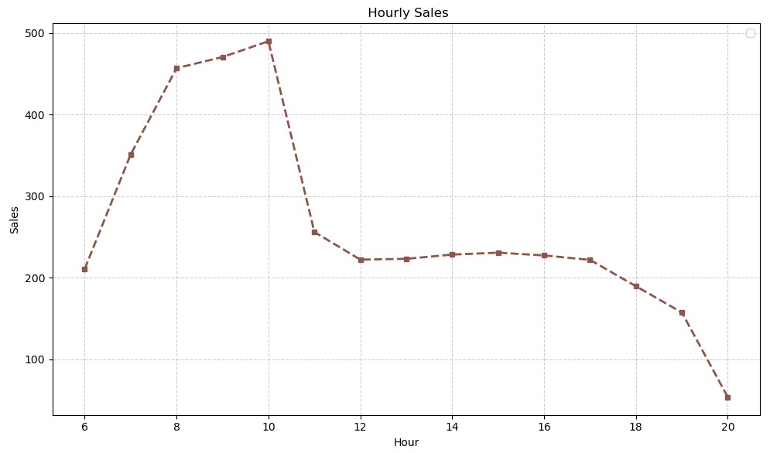
Hourly Analysis
Morning hours (7–10 AM) are the prime sales window, accounting for the largest spike.
Sales drop sharply after 10 AM and never reach that peak again during the day.
The business is highly morning-driven, which may reflect customer habits (breakfast purchases, office commuters, etc.).
Afternoons are steady but not strong, while evenings see continuous decline.

Slide 8
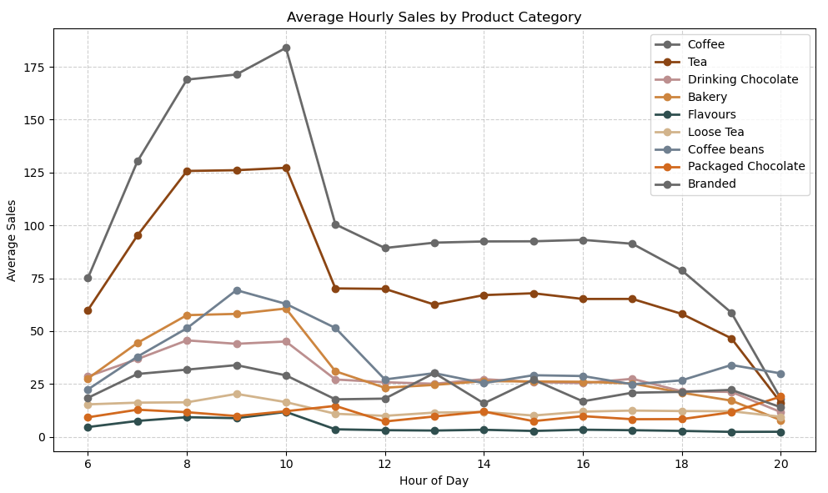
Hourly Sales By Product Category
Morning Peak (7–10 AM)
Coffee, tea, bakery, and drinking chocolate dominate.
This is the highest sales window, driven by breakfast and morning routines.
Mid-day (11 AM – 2 PM)
Sales drop significantly, but coffee and tea maintain moderate demand.
Bakery and chocolate lose importance after the morning rush.
Afternoon & Evening (2 PM – 8 PM)
Coffee and tea continue steady but lower sales.
Packaged chocolate and branded products have small evening bumps, reflecting leisure or impulse buys.

Slide 9
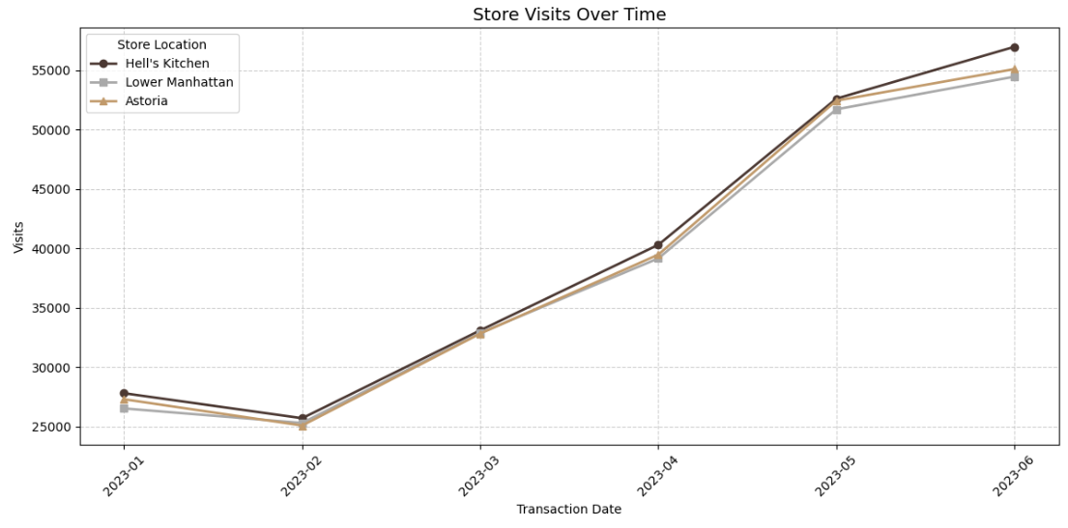
Store Rankings
Hell's Kitchen consistently maintains the highest number of visits throughout the entire period, particularly noticeable from March onwards, ending near 57,000 visits in June.
Lower Manhattan and Astoria show very similar visit patterns and numbers, staying close to each other throughout the period. They both experience strong growth, ending around 54,000-55,000 visits in June.

Slide 10
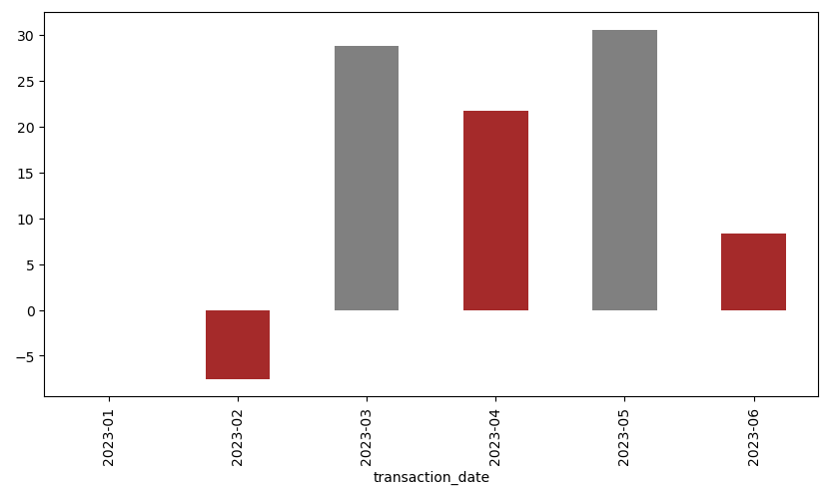
Hell’s Kitchen Month on Month Growth
February : The value is negative. This represents a significant decrease or negative outcome compared to January.
March : There's a substantial increase. This is the highest positive value observed in the period.
April : The value drops significantly from March but remains positive.
May : The value recovers to a level similar to March.
June : The value experiences a sharp decline, ending at a positive but much lower value.

Slide 11
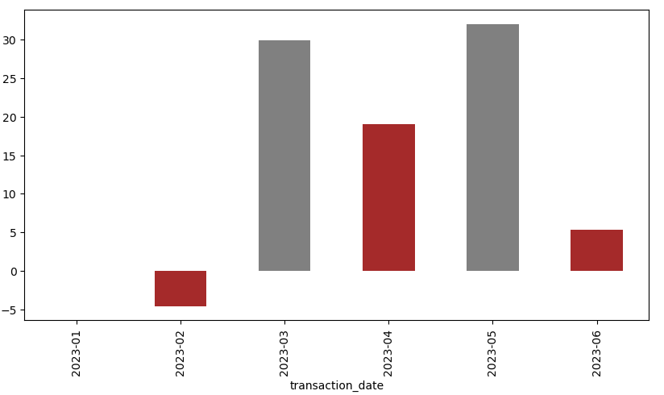
Lower Manhattan Month on Month Growth
February 2023: The value drops below zero, showing a negative value.
March 2023: There's a significant increase, with the value reaching approximately 30, representing the highest positive value in the period.
April 2023: The value decreases substantially from March but remains positive, around 20.
May 2023: The value rebounds to a level similar to March, again close to 30, marking another peak.
June 2023: The value drops sharply again to a positive value around 5, significantly lower than the preceding month.

Slide 12
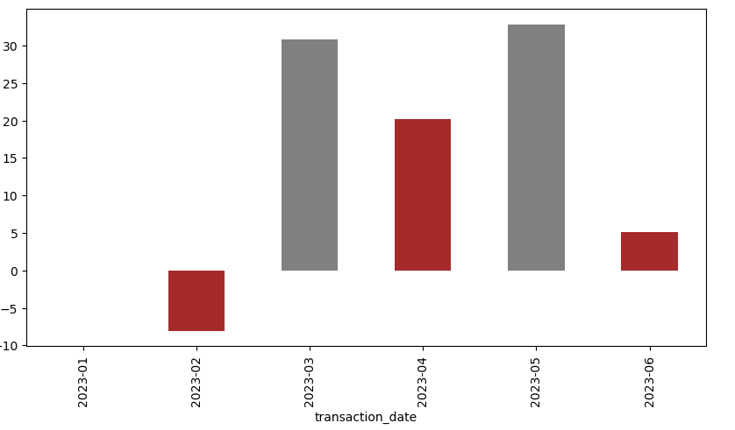
Astoria Month on Month Growth
February: The value is negative, approximately -7.
March : The value is positive and significantly high, around 31.
April: The value is positive, around 20.
May: The value is also positive and high, around 32, representing the highest value in the observed period.
June: The value is positive, around 5.

Slide 13
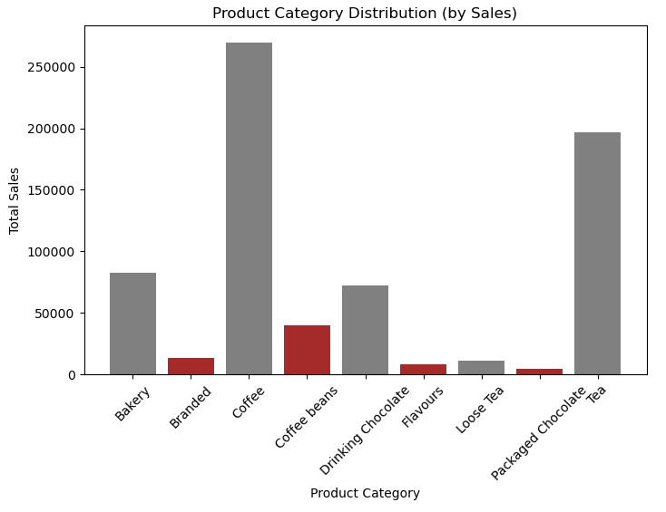
Product Category Distribution by Sales
Highest Selling Category: Coffee clearly stands out as the product category with the highest sales.
Second Highest Selling Category: Tea ranks as the second highest in sales.
Moderately Performing: Bakery and Packaged Chocolate also show substantial sales.
Lower Performing Categories: Coffee and Drinking Chocolate have considerably lower sales compared to the top categories.
Lowest Selling Categories: Branded products, Flavours, and Loose Tea represent the categories with the lowest sales figures.

Slide 14
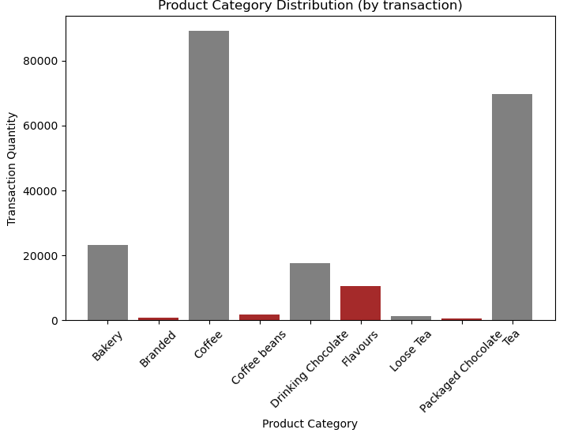
Product Category Distribution by Transaction
Dominant Categories: "Coffee" has the highest transaction quantity, significantly exceeding all other categories, nearing 90,000 units. "Packaged Chocolate" and "Tea" also show high transaction quantities, close to 70,000 units.
Moderate Categories: "Bakery" and "Drinking Chocolate" have moderate transaction quantities, both falling between 20,000 and 40,000 units.
Low Transaction Categories: "Branded," "Coffee beans," "Flavours," and "Loose Tea" have very low transaction quantities, all appearing to be well under 10,000 units.

Slide 15
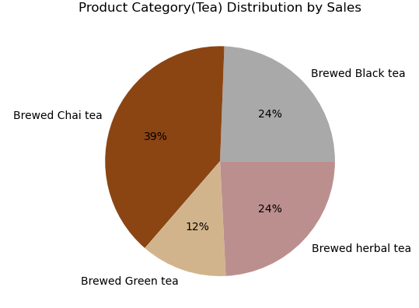
Product Category wise Sales Distribution
Brewed Chai tea accounts for the largest share of sales, representing 39% of the total tea sales shown in the chart.
Brewed Black tea and Brewed herbal tea share the second-largest portion equally, with each contributing 24% to the total sales.
Brewed Green tea holds the smallest share of sales among the categories presented, at 12%.

Slide 16
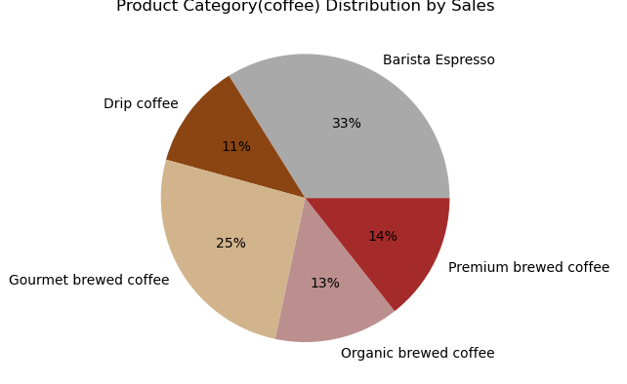
Product Category wise Sales Distribution
Barista Espresso accounts for the largest share of sales, representing 33% of the total, making it the most popular coffee product category by sales in this distribution.
Gourmet brewed coffee holds the second-largest share at 25% of total sales, indicating a significant preference for this category.
Premium brewed coffee and Organic brewed coffee have relatively similar contributions to sales, at 14% and 13% respectively.
Drip coffee constitutes the smallest portion of sales among the listed categories, with 11% of the total, indicating it is the least popular.

Slide 17
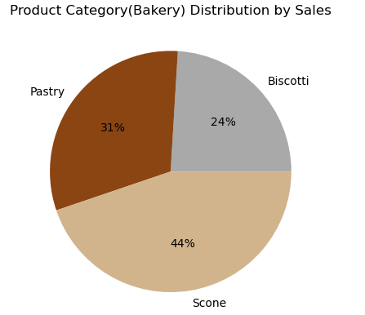
Product Category wise Sales Distribution
Scone is the highest-selling category, accounting for 44% of total bakery sales, indicating it is the most popular or highest revenue-generating product among the three.
Pastry holds the second-largest share with 31% of sales, demonstrating a significant contribution, though less than Scone.
Biscotti represents the smallest portion of sales at 24%, suggesting it is the least popular or lowest revenue-generating product among the three categories shown.

