Slide 1
Process Description and Control
B.Ramamurthy

Slide 2
Introduction
The fundamental task of any operating system is process management.
OS must allocate resources to processes, enable sharing of information, protect resources, and enable synchronization among processes.
In many modern OS the problems of process management is compounded by introduction of threads.

Slide 3
Topics for discussion
Requirement of process
Process states
Creation, termination and suspension
Five State Model
Process Control Block (PCB)
Process control
Unix System V
Summary

Slide 4
What is a process?
A process is simply a program in execution: an instance of a program execution.
Unit of work individually schedulable by an operating system.
OS keeps track of all the active processes and allocates system resources to them according to policies devised to meet design performance objectives.
To meet process requirements OS must maintain many data structures efficiently.
The process abstraction is a fundamental OS means for management of concurrent program execution. Example: instances of process co-existing.

Slide 5
Major requirements
OS must interleave the execution of a number of processes to maximize processor use while providing reasonable response time.
OS must allocate resources to processes in conformance with a specific policy. Example: (i) higher priority, (ii) avoid deadlock.
Support user creation of processes and IPC both of which may aid in the structuring of applications.

Slide 6
Process creation
Four common events that lead to a process creation are:
1) When a new batch-job is presented for execution.
2) When an interactive user logs in.
3) When OS needs to perform an operation (usually IO) on behalf of a user process, concurrently with that process.
4) To exploit parallelism an user process can spawn a number of processes.
==> concept of parent and child processes.

Slide 7
Termination of a process
Normal completion, time limit exceeded, memory unavailable
Bounds violation, protection error, arithmetic error, invalid instruction
IO failure, Operator intervention, parent termination, parent request
A number of other conditions are possible.
Segmentation fault : usually happens when you try write/read into/from a non-existent array/structure/object component. Or access a pointer to a dynamic data before creating it. (new etc.)
Bus error: Related to function call and return. You have messed up the stack where the return address or parameters are stored.

Slide 8
A five-state process model
Five states: New, Ready, Running, Blocked, Exit
New : A process has been created but has not yet been admitted to the pool of executable processes.
Ready : Processes that are prepared to run if given an opportunity. That is, they are not waiting on anything except the CPU availability.
Running: The process that is currently being executed. (Assume single processor for simplicity.)
Blocked : A process that cannot execute until a specified event such as an IO completion occurs.
Exit: A process that has been released by OS either after normal termination or after abnormal termination (error).

Slide 9
State Transition Diagram
Dispatch
Release
Admit
READY
RUNNING
EXIT
NEW
Time-out
Event
Wait
Event
Occurs
BLOCKED
Think of the conditions under which state transitions may take place.

Slide 10
Queuing model
Ready queue
Admit
Dispatch
Release
CPU
Time-out
Event1 Wait
Event1
Occurs
Event2 Wait
Event2
Occurs
Eventn Wait
Event n
occurs

Slide 11
Process suspension
Many OS are built around (Ready, Running, Blocked) states. But there is one more state that may aid in the operation of an OS - suspended state.
When none of the processes occupying the main memory is in a Ready state, OS swaps one of the blocked processes out onto to the Suspend queue.
When a Suspended process is ready to run it moves into “Ready, Suspend” queue. Thus we have two more state: Blocked_Suspend, Ready_Suspend.

Slide 12
Process suspension (contd.)
Blocked_suspend : The process is in the secondary memory and awaiting an event.
Ready_suspend : The process is in the secondary memory but is available for execution as soon as it is loaded into the main memory.
Observe on what condition does a state transition take place? What are the possible state transitions?

Slide 13
State Transition Diagram (take 2)
Dispatch
Release
Admit
READY
RUNNING
EXIT
NEW
Time-out
Activate
Suspend
Ready
Suspend
Event
Wait
Event
Occurs
Event occurs
Blocked
Suspend
Activate
BLOCKED
Suspend
Think of the conditions under which state transitions may take place.

Slide 14
Process description
OS constructs and maintains tables of information about each entity that it is managing : memory tables, IO tables, file tables, process tables.
Process control block: Associated with each process are a number of attributes used by OS for process control. This collection is known as PCB.
Process image: Collection of program, data, stack, and PCB together is known as Process image.

Slide 15
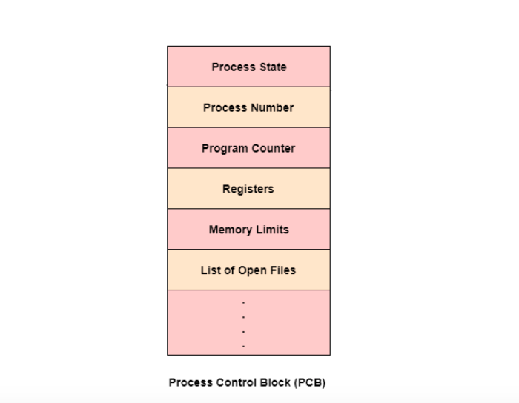


Slide 16
Process control block
Contains three categories of information:
1) Process identification
2) Process state information
3) Process control information
Process identification:
  numeric identifier for the process (pid)
  identifier of the parent (ppid)
  user identifier (uid) - id of the usr responsible for the process.

Slide 17
Process control block (contd.)
Process state information:
  User visible registers
  Control and status registers : PC, IR, PSW, interrupt related bits, execution mode.
  Stack pointers

Slide 18
Process control block (contd.)
Process control information:
  Scheduling and state information : Process state, priority, scheduling-related info., event awaited.
  Data structuring : pointers to other processes (PCBs): belong to the same queue, parent of process, child of process or some other relationship.
  Interprocess comm: Various flags, signals, messages may be maintained in PCBs.

Slide 19
Process control block (contd.)
Process control information (contd.)
  Process privileges: access privileges to certain memory area, critical structures etc.
  Memory management: pointer to the various memory management data structures.
  Resource ownership : Pointer to resources such as opened files. Info may be used by scheduler.
PCBs need to be protected from inadvertent destruction by any routine. So protection of PCBs is a critical issue in the design of an OS.

Slide 20
OS Functions related to Processes
Process management: Process creation, termination, scheduling, dispatching, switching, synchronization, IPC support, management of PCBs
Memory management: Allocation of address space to processes, swapping, page and segment management.
IO management: Buffer management, allocation of IO channels and devices to processes.
Support functions: Interrupt handling, accounting, monitoring.

Slide 21
Modes of execution
Two modes : user mode and a privileged mode called the kernel mode.
Why? It is necessary to protect the OS and key OS tables such as PCBs from interference by user programs.
In the kernel mode, the software has complete control of the processor and all its hardware.
When a user makes a system call or when an interrupt transfers control to a system routine, an instruction to change mode is executed. This mode change will result in an error unless permitted by OS.

Slide 22
Creation of a process
Assign a unique pid to the new process.
Allocate space for all the elements of the process image. How much?
The process control block is initialized. Borrow info from parent.
The appropriate linkages are set: for scheduling, state queues..
Create and initialize other data structures.

Slide 23
Process Interruption
Two kinds of process interruptions: interrupt and trap.
Interrupt: Caused by some event external to and asynchronous to the currently running process, such as completion of IO.
Trap : Error or exception condition generated within the currently running process. Ex: illegal access to a file, arithmetic exception.
(supervisor call) : explicit interruption.

Slide 24
Process and Context Switching
Clock interrupt: The OS determines if the time slice of the currently running process is over, then switches it to Ready state, and dispatches another from Ready queue. “Process switch”
Memory fault: (Page fault) A page fault occurs when the requested program page is not in the main memory. OS (page fault handler) brings in the page requested, resumes faulted process.
IO Interrupt : OS determines what IO action occurred and takes appropriate action.

Slide 25
Process and Context Switching (contd.)
Process switch: A transition between two memory-resident processes in a multiprogramming environment. Study the 7 steps involved in a process switch.
Context switch: Changing context from a executing program to an Interrupt Service Routine (ISR). Part of the context that will be modified by the ISR needs to be saved. This required context is saved and restored by hardware as specified by the ISR.

Slide 26
Process and Context Switching (contd.)
How many context switch occurs per process switch?
Typically 1Process switch : 100 context switches
Process switch of more expensive than context switch.
Read more on this.
This factor is very important for many system design projects.

Slide 27
Unix system V
All user processes in the system have as root ancestor a process called init. When a new interactive user logs onto the system, init creates a user process, subsequently this user process can create child processes and so on. init is created at the boot-time.
Process states : User running , kernel running, Ready in memory, sleeping in memory (blocked), Ready swapped (ready-suspended), sleeping swapped (blocked-suspended), created (new), zombie , preempted (used in real-time scheduling).

Slide 28
Process and kernel context
process context
Application pgms
system calls
Kernel acts on behalf of user
User mode
kernel
mode
kernel tasks
interrupt services
kernel context

Slide 29
Process Context
User address space,
Control information : u area (accessed only by the running process) and process table entry (or proc area, accessed by the kernel)
Credentials : UID, GID etc.
Environment variables : inherited from the parent

Slide 30
U area
Process control block
Pointer to proc structure
Signal handlers related information
Memory management information
Open file descriptor
Vnodes of the current directory
CPU usage stats
Per process kernel stack

Slide 31
Process control
Process creation in unix is by means of the system call fork().
OS in response to a fork() call:
  Allocate slot in the process table for new process.
  Assigns unique pid.
  Makes a copy of the process image, except for the shared memory.
  Move child process to Ready queue.
  it returns pid of the child to the parent, and a zero value to the child.

Slide 32
Process control (contd.)
All the above are done in the kernel mode in the process context. When the kernel completes these it does one of the following as a part of the dispatcher:
  Stay in the parent process. Control returns to the user mode at the point of the fork call of the parent.
  Transfer control to the child process. The child process begins executing at the same point in the code as the parent, at the return from the fork call.
  Transfer control another process leaving both parent and child in the Ready state.

Slide 33
Process creation - Example
main () {
int pid;
cout << “ just one process so far”<<endl;
pid = fork();
if (pid == 0)
cout <<“im the child “<< endl;
else if (pid > 0)
cout <<“im the parent”<< endl;
else
cout << “fork failed”<< endl;}

Slide 34
fork and exec
Child process may choose to execute some other program than the parent by using exec call.
Exec overlays a new program on the existing process.
Child will not return to the old program unless exec fails. This is an important point to remember.
Why do we need to separate fork and exec? Why can’t we have a single call that fork a new program?

Slide 35
Example
if (( result = fork()) == 0 ) {
// child code
if (execv (“new program”,..) < 0)
perror (“execv failed “);
exit(1);
}
else if (result < 0 ) perror (“fork”); …}
/* parent code */

Slide 36
Version of exec
Many versions of exec are offered by C library
exece
execve
execvp
execl, execle, execlp
This will be explained to you with examples in this week’s recitation.

