Slide 1
System Calls in OS

Slide 2
What are system calls?
Provides interface between a process and an operating system.
available as assembly language instructions.
usually made when a process in user mode requires access to a resource.
process requests the kernel to provide the resource via a system call.

Slide 3
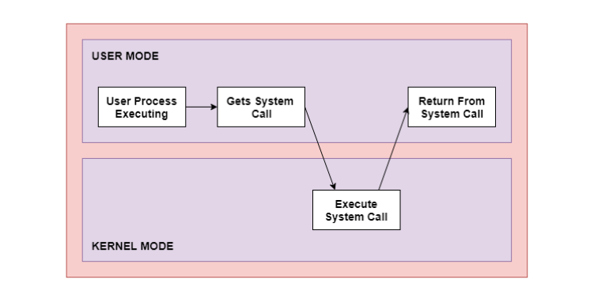

Slide 4
Contd..
processes execute normally in the user mode until a system call interrupts this.
system call is executed on a priority basis in the kernel mode.
After the execution of the system call, the control returns to the user mode and execution of user processes can be resumed.

Slide 5
When required?
If a file system requires the creation or deletion of files.
Reading and writing from files also require a system call.
Creation and management of new processes.
Network connections also require system calls. This includes sending and receiving packets.
Access to a hardware devices such as a printer, scanner etc. requires a system call.

Slide 6
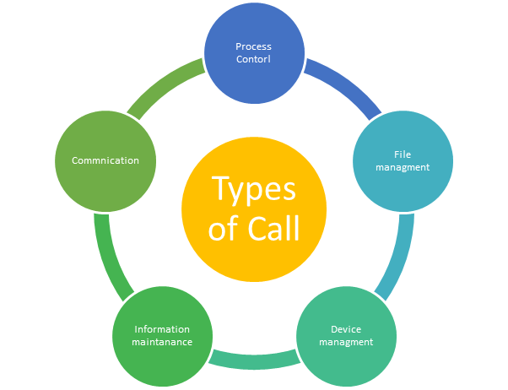

Slide 7
Types of System Calls
Process Control
These system calls deal with processes such as process creation, process termination etc.
Functions:
End and Abort
Load and Execute
Create Process and Terminate Process
Wait and Signed Event
Allocate and free memory

Slide 8
File Management
These system calls are responsible for file manipulation such as creating a file, reading a file, writing into a file etc.
Functions:
Create a file
Delete file
Open and close file
Read, write, and reposition
Get and set file attributes

Slide 9
Device Management
These system calls are responsible for device manipulation such as reading from device buffers, writing into device buffers etc.
Functions
Request and release device
Logically attach/ detach devices
Get and Set device attributes

Slide 10
Information Maintenance
These system calls handle information and its transfer between the operating system and the user program.
Functions:
Get or set time and date
Get process and device attributes

Slide 11
Communication
These system calls are useful for inter-process communication. They also deal with creating and deleting a communication connection.
Functions:
Create, delete communications connections
Send, receive message
Help OS to transfer status information
Attach or detach remote devices

Slide 12
Types of System Calls | Windows | Linux
Process Control | CreateProcess() ExitProcess() WaitForSingleObject() | fork() exit() wait()
File Management | CreateFile() ReadFile() WriteFile() CloseHandle() | open() read() write() close()
Device Management | SetConsoleMode() ReadConsole() WriteConsole() | ioctl() read() write()
Information Maintenance | GetCurrentProcessID() SetTimer() Sleep() | getpid() alarm() sleep()
Communication | CreatePipe() CreateFileMapping() MapViewOfFile() | pipe() shmget() mmap()

Slide 13
fork()
Processes use this system call to create processes that are a copy of themselves. With the help of this system Call parent process creates a child process, and the execution of the parent process will be suspended till the child process executes.

Slide 14
exec()
This system call runs when an executable file in the context of an already running process that replaces the older executable file. However, the original process identifier remains as a new process is not built, but stack, data, head, data, etc. are replaced by the new process.

Slide 15
kill():
The kill() system call is used by OS to send a termination signal to a process that urges the process to exit.

Slide 16
exit():
The exit() system call is used to terminate program execution. Specially in the multi-threaded environment, this call defines that the thread execution is complete. The OS reclaims resources that were used by the process after the use of exit() system call.

Slide 17
open()
used to provide access to a file in a file system.
allocates resources to the file and provides a handle that the process uses to refer to the file.
A file can be opened by multiple processes at the same time or be restricted to one process. It all depends on the file organisation and file system.

Slide 18
read()
used to access data from a file that is stored in the file system.
file to read can be identified by its file descriptor and it should be opened using open() before it can be read.
In general, the read() system calls takes three arguments i.e. the file descriptor, buffer which stores read data and number of bytes to be read from the file.

Slide 19
write()
writes the data from a user buffer into a device such as a file.
This system call is one of the ways to output data from a program.
In general, the write system calls takes three arguments i.e. file descriptor, pointer to the buffer where data is stored and number of bytes to write from the buffer.

Slide 20
close()
used to terminate access to a file system.
Using this system call means that the file is no longer required by the program
When called, the buffers are flushed, the file metadata is updated and the file resources are de-allocated.

